Slide 1

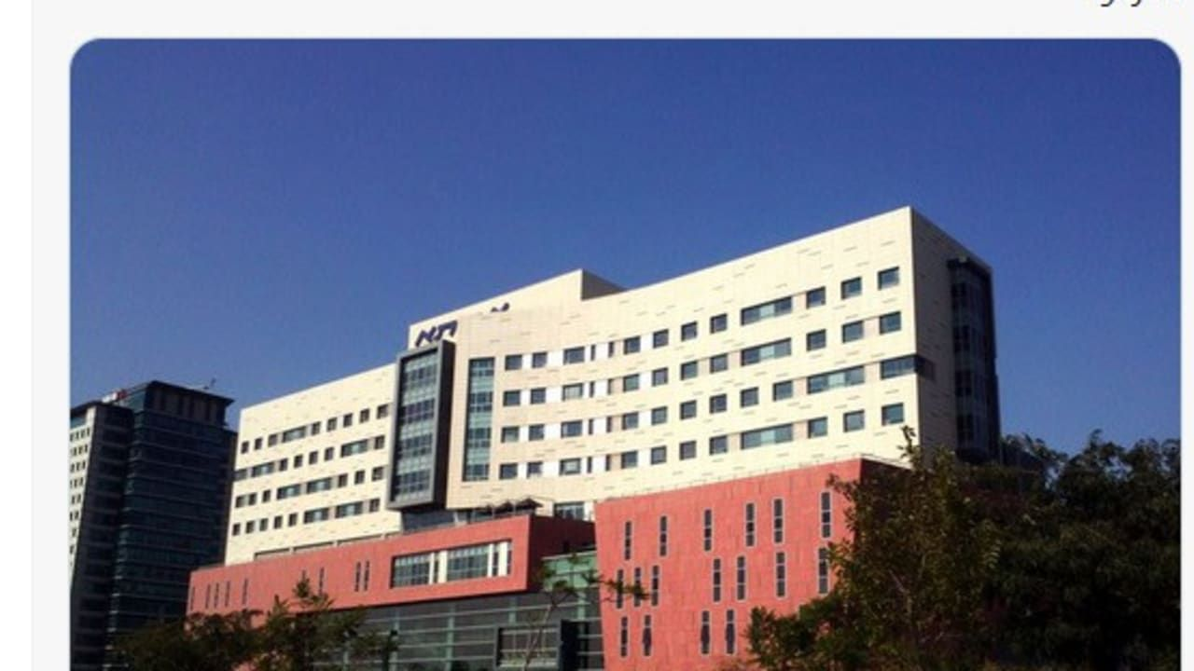


CIN II+ Detection Rates –
Does Colposcopic Biopsy Strategy Matters?
A multi-Center Analysis
Gabi Haran, Zvi Vaknin, Liron Kogan, Gadi Ben Shitrit, Ziv Versano, Avinoam Tzabari, Yoav Baruch

Slide 2

Objective & Methods
Objective:
To evaluate the efficacy of intensive uniform sampling versus selective sampling in detecting high-grade CIN (CIN II+), focusing on definitive CIN III lesions to address concerns of over-diagnosing indolent disease.
Methods:
Retrospective multi-center analysis:
45,079 procedures (2020–2025).
Standardization:
Unified central pathology laboratory and highly experienced colposcopists.
Policy Comparison:
Center 1 (Intensive): Mandatory multiple quadrant biopsies regardless of appearance (92.1% biopsy rate).
Center 2 (Selective): Directed biopsies of suspicious lesions only (35.8% biopsy rate)

Slide 3
Key Results: The hrHPV+ Cohort
Significant Detection Gap in High-Risk Patients:
Efficiency Metric:
The Marginal Number Needed to Biopsy (NNB) to identify one additional occult CIN III
case was 9.
Conclusion: Visual inspection alone is insufficient for high-risk referrals.
 | Center 1 | Center 2 | Statistics
Colposcopy due to abnormal cytology
CIN II+ | 19.1% of 844 | 10.6% of 8,262 | OR=2.01,95% CI 1.67-2.41, p<0.001
Colposcopy due to hrHPV+ patients with normal cytology
CIN II+ | 17.5% of 2,749 | 6.3% of 6,874 | OR=3.16; 95% CI 2.75-3.64, p<0.001
CINIII+ | 16.6% of 2,749 | 5.5% of 6,874 | OR 3.42 95% CI 2.97–3.95; p<0.001

Slide 4
HGSIL, ECC, and Safety in Youth
Capturing Occult Disease:
HGSIL cytology Yield:
Center 1 detected CIN III+ in 41.7% vs. 34.4% at Center 2 (OR 1.36; p = 0.06).
Impact of Systematic ECC:
Identified 40 occult CIN III cases in 2024 alone at Center 1; these lesions were visually imperceptible during ectocervical inspection.
Protecting Younger Populations: Under Age 25:
"No CIN" rates reached 85.9%–93.2%.
Supports a selective approach in this cohort to minimize reproductive/obstetric harm (LEEP-related risks).

Slide 5
Conclusions & The Risk-Based Strategy
Summary:
Intensive sampling significantly increases the detection of CIN III, identifying occult disease missed by selective inspection.
Assuta Network Risk-Based Guidelines:
Selective Protocol (Age <25):
Maintain selectivity to avoid over-treatment and reproductive harm.
Intensive Protocol (hrHPV+ or High-Grade Pap):
Mandatory biopsies of at least 3 quadrants (even if visually normal).
Mandatory ECC:
Required for all hrHPV+ normal Pap, TZ Type 3, and women >55 years.
Goal:
Maximize cancer prevention while minimizing unnecessary intervention.

