Slide 1


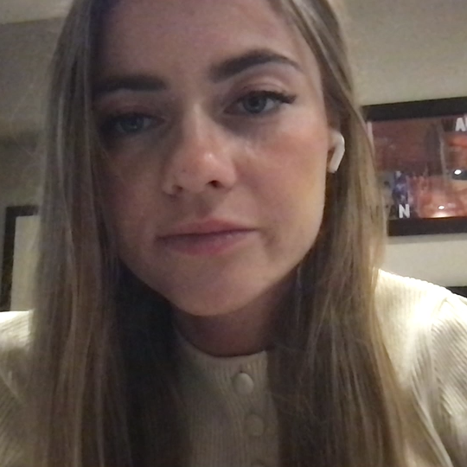
Development of an Expert-Annotated Colposcopic Image Dataset for AI-Assisted Cervical Lesion Interpretation
Barbara Suchońskaª , Bartosz Korzebª , Julita Zembalaª,
Zoulikha Jabiry-Zieniewiczª
ª 1st Department and Clinic of Obstetrics and Gynecology, 1/3 Starynkiewicza Sq, Warsaw, Poland
This research was supported by the National Recovery and Resilience Plan under investment D3.1.1: Comprehensive development of research in the field of medical sciences and health sciences. The project is funded by the Medical Research Agency, Poland, under competition number 2024/ABM/03/KPO, grant agreement no. KPOD.07.07-IW.07-0157/24.

Slide 2
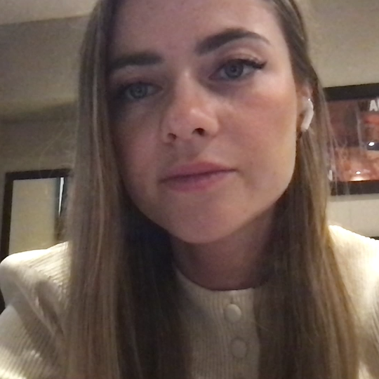
BACKGROUND & PROBLEM
Cervical cancer challenge
650,000 new cases/year globally
350,000 deaths/year
Poland: high mortality (five-year survival rate of 55.1%), low screening uptake
Limitations of colposcopy
Operator-dependent
Interobserver variability
Sensitivity ~68% for HSIL
Risk of missed high-grade lesions
Gap: Lack of large, structured, clinically linked datasets

Slide 3
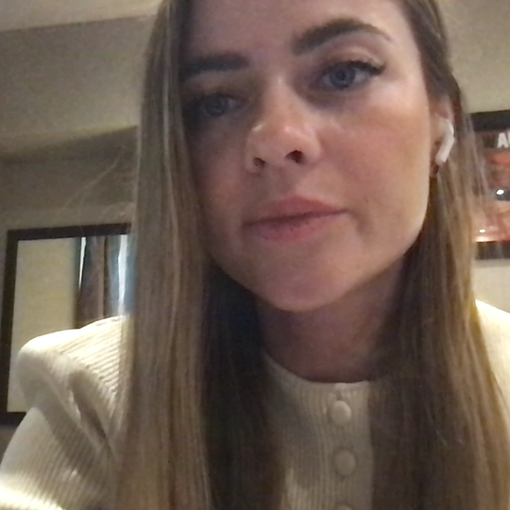
Aim: to Develop a high-quality, AI-ready colposcopic dataset
Designed for:
Detection
Classification
Segmentation
Multimodal AI models

Slide 4
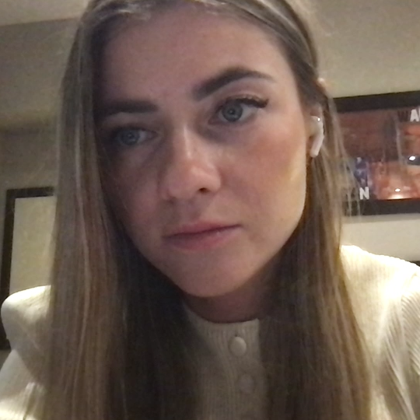
METHODS
Study design
Retrospective cohort
Tertiary referral center
Dataset
737 examinations
6,263 images
14,386 tags
24,959 segmentation masks
Annotation
IFCPC-based
CVAT tool
Pixel-level segmentation
Data integration
Cytology
HPV status
Histopathology

Slide 5
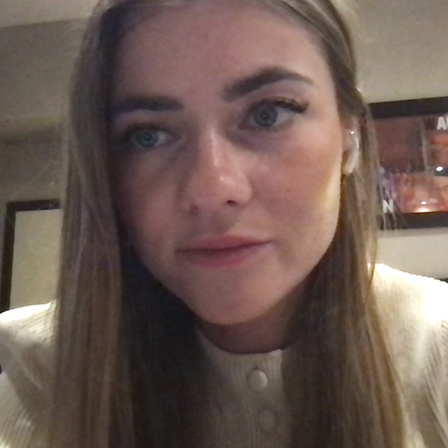
RESULTS & CONCLUSIONS
Future
Deep learning model training
Clinical integration
Earlier detection → reduced mortality
Key strengths
Expert-annotated dataset
Multimodal (image + clinical + histopathology)
Standardized annotation
Impact
Improved diagnostic consistency
Support for less experienced clinicians
Foundation for AI tools

