Slide 1
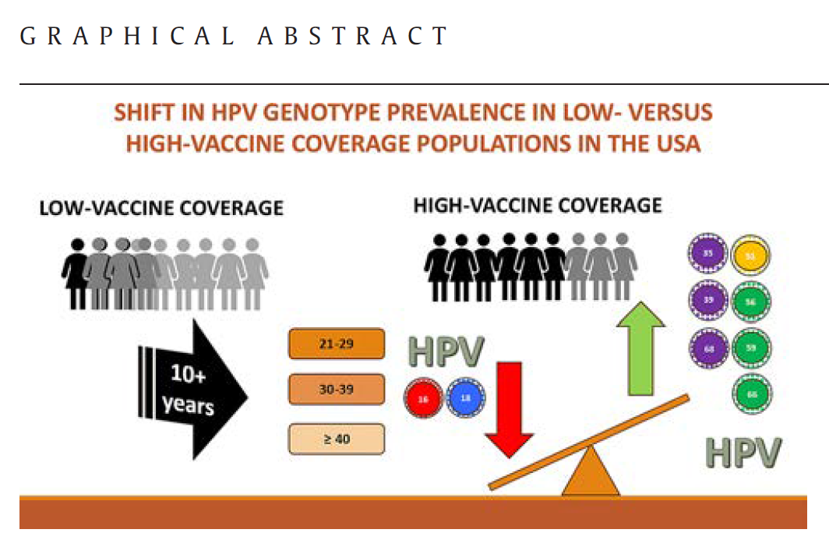

Why Colposcopists Should Embrace Extended Genotyping in a Mixed Vaccination World
Authors: Laurence Vaughan, PhD¹, Jeff Andrews MD, FRCSC¹
1 Medical Affairs, Advanced Diagnostics, Waters Corporation, USA
Objective: Navigating shifting HPV dynamics with precision management
Morel D, Parvu V, Andrews J, Stephenson P, Bull J, Woodward A, Vaughan L. Gynecol Oncol. 2026 Apr;207:40-47

Slide 2

The Shifting HPV Landscape
Impact of HPV vaccination on genotype prevalence in U.S. women
  The quadrivalent vaccine (Gardasil) in 2006 significantly reduced HPV16/18 prevalence
  The 9-valent vaccine (Gardasil-9) covers additional genotypes (31, 33, 45, 52, 58), aiming for broader protection
  Mixed Vaccination Impact: Decline in HPV 16/18 prevalence; rising relative importance of "other" high-risk (HR) types
  Despite vaccine efficacy, evidence suggests vaccination influences the prevalence of non-targeted HPV types, possibly through cross-protection or niche replacement
  The findings suggest that vaccination influences the HPV ecosystem, possibly leading to a dynamic equilibrium where non-targeted types fill ecological niches left by vaccine-targeted types.
Diagnostic Challenge: Morphology (cytology/colposcopy) is less predictive as disease prevalence falls (reduced Positive Predictive Value).
Answer
  Unmasking the group of 12-Other genotypes: Identifying high-grade lesions caused by non-16/18 types, especially in vaccinated cohorts
  Extended genotype reporting
Morel D, et al. Gynecol Oncol. 2026 Apr;207:40-47
Pimenoff VN, et al. HPV World 2024
Notes:
Morel D, Parvu V, Andrews J, Stephenson P, Bull J, Woodward A, Vaughan L. HPV genotype prevalence in low- and high-vaccine coverage, USA populations: Data from real-world cervical cancer screening using the Onclarity HPV assay. Gynecol Oncol. 2026 Apr;207:40-47.
Evidence using the bivalent HPV vaccine up to 12 years post-vaccination shows a sustained replacement of the most common hrHPV types 16, 18, 31, and 45 by other hrHPV types such as 35, 39, 51, 52, 56, 58, 59, and 66, which are considered less oncogenic. Pimenoff VN, et al. "HPV type-replacement in cohorts of vaccinated and unvaccinated individuals." HPV World, 2024

Slide 3
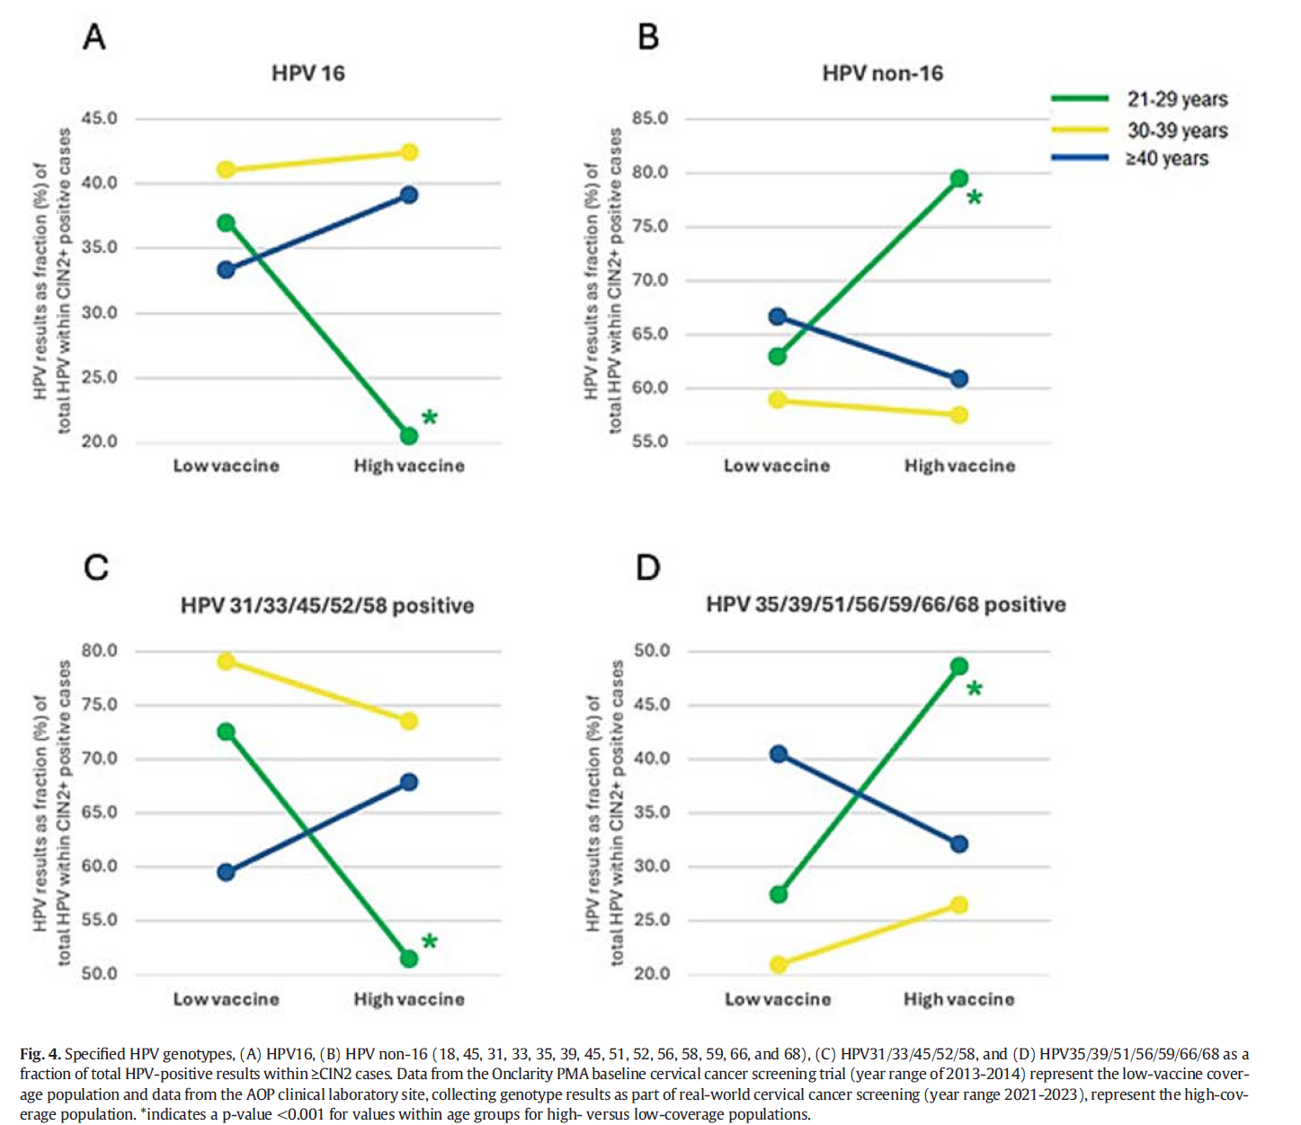
• Both datasets used the FDA-approved Onclarity assay, capable of extended genotyping for 14 high-risk HPV types, allowing detailed comparison over time and populations
  • The low-coverage population data derive from the 2013–2015 Onclarity trial, involving women aged ≥21 across multiple U.S. sites, with limited vaccination history.
  • The high-coverage population data come from routine screening (2021–2023) at three laboratories, with higher estimated vaccination rates based on CDC data, especially among women aged 21–29.
•In women aged 21–29, high vaccine coverage correlates with a significant reduction in HPV16/18 prevalence (from ~5.4% to ~2.3%), confirming vaccine effectiveness.
•Overall HPV prevalence increased in this age group in the high-coverage population, driven by a reciprocal rise in non-vaccine genotypes, notably the "Other 12" types (including HPV31, 33, 35, 39, 45, 51, 52, 56, 58, 59, 66, 68).
•The prevalence of non-vaccine types was significantly higher in the high-coverage group among women aged 21–29, suggesting possible genotype replacement or unmasking effects.
•Within ≥CIN2 cases, HPV16 prevalence was lower in the high-coverage group among young women, while non-16 high-risk types showed increased prevalence, indicating shifts in the HPV virome associated with vaccination.
•Stratification into vaccine-covered genotypes (HPV31/33/45/52/58) and non-covered genotypes revealed that vaccine-targeted types declined similarly across populations, but non-vaccine types, especially HPV35/39/68 and HPV56/59/66, increased in vaccinated cohorts.
•The increase in non-vaccine types is observed predominantly in the youngest, most vaccinated age group, supporting the hypothesis of niche replacement or unmasking rather than assay bias, as the Onclarity assay is not type-restrictive.
Morel D, Parvu V, Andrews J, Stephenson P, Bull J, Woodward A, Vaughan L. Gynecol Oncol. 2026 Apr;207:40-47

Slide 4

for the colposcopist
differential clinical risk profile and progression potential
more difficult visual ‘signature’ of pre-cancer lesions^{1,3,5}
  HPV 16: frequently associated with advanced colposcopic markers like dense acetowhitening, coarse punctation, and mosaicism^{1,3,5}
    Vascular Markers: HPV 16 (and 33) is specifically associated with an increased risk of atypical vessels, coarse punctate, and mosaic features¹
  types like 51 and 56/59 often present with lower risk even when cytology is abnormal, potentially appearing as faint, translucent acetowhitening or no visible lesion at all^{1,5}
  HPV18-positive lesions usually exhibit iodine staining negativity²
  Adenocarcinoma precursor lesions are difficult to identify at colposcopy due to disease originating proximal to the squamocolumnar junction, in glandular epithelium characterized by cervical crypts⁴
  identification of HPV 45 in the HPV test has merit in this context: some colposcopy guidelines recommend endocervical sampling for individuals with HPV 16/18/45 infections and AGC results, but the effectiveness of colposcopy with endocervical sampling to detect AIS remains limited⁴
Vahteristo M, et al. Int J Cancer. 2026 Feb 15;158(4):931-941.
Zhou Q, et al. BMC Womens Health. 2022 Jan 30;22(1):24.
Tjalma W. Facts Views Vis Obgyn. 2018;10:107–13.
Schiffman M, et al. Gynecol Oncol. 2023 Jul;174:253-261.
Zhang Y, et al. Front Oncol. 2023 Apr 5;13:1105482.
Wright TC Jr, et al. Gynecol Oncol. 2019 Aug;154(2):360-367.
J Cuzick, et al. www.HPVWorld.com , 181
Notes:
1 Vahteristo M, Heinävaara S, Dillner J, Kalliala I, Nieminen P, Sarkeala T, Leinonen MK. Long-term human papillomavirus genotype-specific risk of cervical high-grade intraepithelial lesion and cancer-By age group and triage cytology. Int J Cancer. 2026 Feb 15;158(4):931-941.
2 Zhou Q, Gong Y, Qiu X, Sui L, Zhang H, Wang Y, Lin L, Diao W, Li Y. Visual appearance of the uterine cervix differs on the basis of HPV type status in high-grade squamous intraepithelial lesion: the results of a reliable method. BMC Womens Health. 2022 Jan 30;22(1):24.
3 Tjalma W. HPV negative cervical cancers and primary HPV screening. Facts Views Vis Obgyn. 2018;10:107–13.
4 Schiffman M, Mirabello L, Egemen D, Befano B, Xiao Y, Wentzensen N, Raine-Bennett T, Nayar R, Cheung LC, Rositch A, Beaty T, Perkins RB, de Sanjose S, Lorey T, Castle PE, Burk RD. The combined finding of HPV 16, 18, or 45 and cytologic Atypical Glandular Cells (AGC) indicates a greatly elevated risk of in situ and invasive cervical adenocarcinoma. Gynecol Oncol. 2023 Jul;174:253-261.
5 Zhang Y, Li H, Li X, Li Z, You Q, Yi H, Su Y, Zheng X, Chen Y, Chen J. Associations of human papillomavirus genotypes and cervical vascular abnormality in a cohort of women underwent colposcopy, a retrospective study of 6716 patients. Front Oncol. 2023 Apr 5;13:1105482.
6 Wright TC Jr, Stoler MH, Parvu V, Yanson K, Cooper C, Andrews J. Risk detection for high-grade cervical disease using Onclarity HPV extended genotyping in women, ≥21 years of age, with ASC-US or LSIL cytology. Gynecol Oncol. 2019 Aug;154(2):360-367.
7 J Cuzick, R Adcock, CM Wheeler (November 2021). HPV genotype-specific risk for cervical cancer. www.HPVWorld.com , 181

Slide 5
for the colposcopist
general colposcopic performance for detecting CIN2+ typically falls within these ranges^{1,2,3,4}:
  Sensitivity: Roughly 66.7% to 91% (highly dependent on colposcopist experience)
  Specificity: Roughly 50% to 74%
sensitivity for detecting CIN2+ increases to over 90% when colposcopy is combined with HPV genotyping, which is why risk-based management uses the genotype to decide whether a biopsy is mandatory even if a lesion isn't clearly visible^{1,5,6}
mixed vaccination cohort screening now requires extended genotyping to support optimized referral for colposcopy and colposcopic impression, due to shifts in genotype prevalence and differential appearance of CIN2+ lesions
  Clinical Workflow: extended genotyping allows for more conservative management of low-risk types (e.g., 1-year follow-up) while prioritizing colposcopy for higher-risk genotypes
  essential for maintaining colposcopic diagnostic accuracy in a world where vaccine-covered types are disappearing
Perkins RB, et al. J Low Genit Tract Dis 2020;24(2),102-131
Tan JHJ, et al. Aust N Z J Obstet Gynaecol. 2024 Aug;64(4):375-382.
Dorji N, et al. BMC Cancer. 2022 Aug 29;22(1):930.
Dai W, et al. BMC Womens Health. 2024 Jul 24;24(1):419.
GageJC, et al. Obetet Gynecol 2006;108(2), 271–275
Wentzensen N, et al. Am J Obstet Gynecol 2018; 218(6) 604.e1–604.e8.
Thank You
Notes:
Perkins, R. B., et al. (2020). "2019 ASCCP Risk-Based Management Consensus Guidelines for Abnormal Cervical Cancer Screening Tests and Cancer Precursors." Journal of Lower Genital Tract Disease, 24(2), 102–131.
Tan JHJ, Neesham D, Szabo RA, Khomko N, Yap D, Wrede CDH. Colposcopy performance in the new primary HPV screening in Australia: How to determine colposcopy competency? Aust N Z J Obstet Gynaecol. 2024 Aug;64(4):375-382.
Dorji N, Tshering S, Choden S, Chhetri M, Bhujel D, Wangden T, Pradhan B, Bhutia PC, Tshomo U. Evaluation of the diagnostic performance of colposcopy in the diagnosis of histologic cervical intraepithelial neoplasia 2+ (CIN2+). BMC Cancer. 2022 Aug 29;22(1):930.
Dai W, Wang T, Chen L, Qiu Z, Chen P, Chen D. Immediate risk of cervical intraepithelial neoplasia and diagnostic value of colposcopy among cytology-negative women with oncogenic HPV: a retrospective study. BMC Womens Health. 2024 Jul 24;24(1):419.
Gage, J. C., et al. (2006). "Number of Cervical Biopsies and Sensitivity of Colposcopy." Obstetrics & Gynecology, 108(2), 271–275
Wentzensen N, Walker J, Smith K, Gold MA, Zuna R, Massad LS, Liu A, Silver MI, Dunn ST, Schiffman M. A prospective study of risk-based colposcopy demonstrates improved detection of cervical precancers. Am J Obstet Gynecol. 2018

