Slide 1
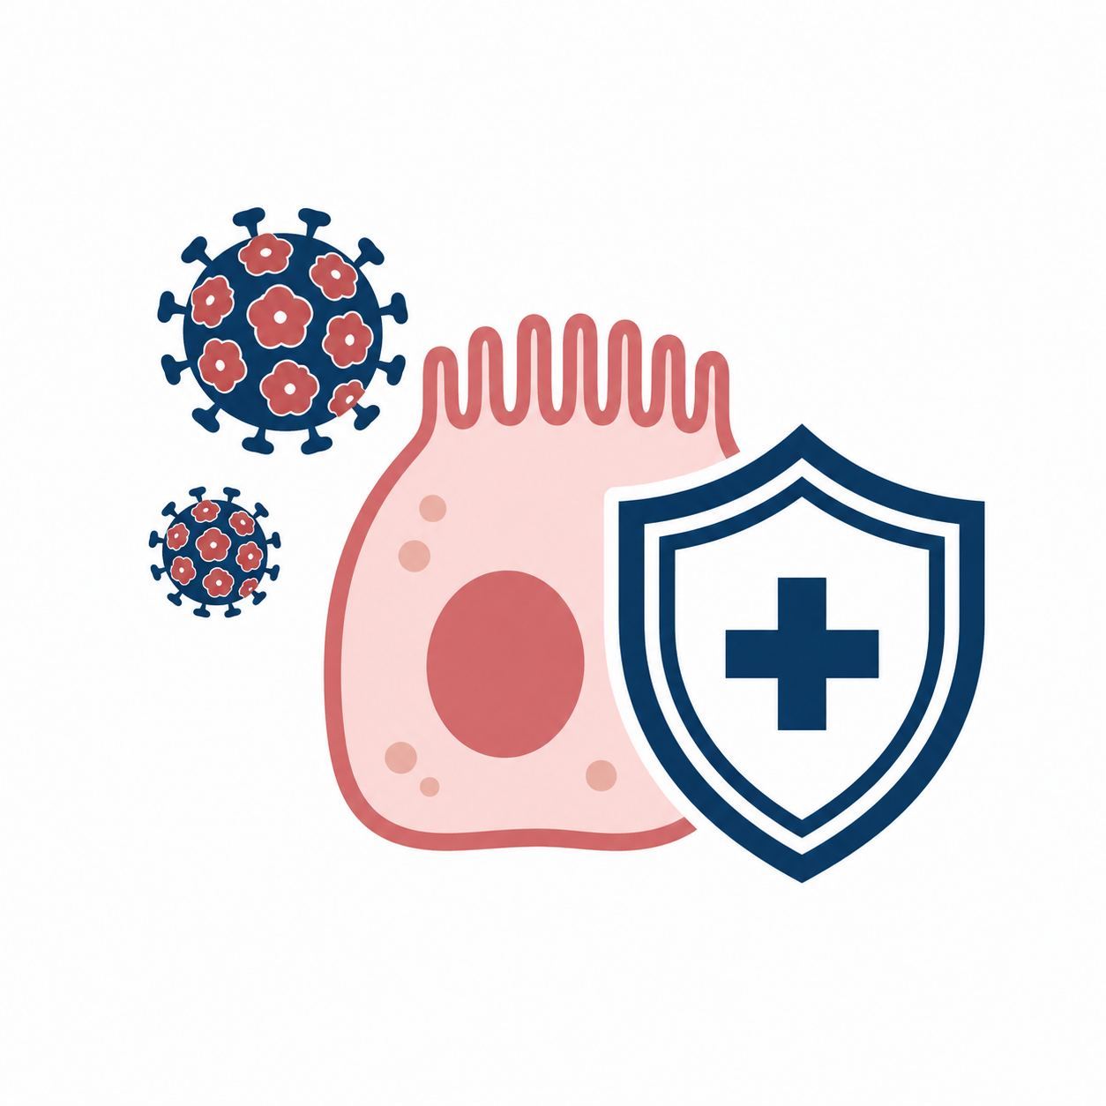



DYNAMICS OF HPV AWARENESS LEVELS AND VACCINATION STATUS AMONG MEDICAL STUDENTS AND OBSTETRICIAN–GYNECOLOGISTS IN UKRAINE
HPV awareness improved, but vaccination coverage remains low
A FIVE-YEAR COMPARATIVE SURVEY AMONG MEDICAL STUDENTS AND GYNECOLOGISTS
CENTRAL FINDING:
KNOWLEDGE ROSE FASTER THAN VACCINATION BEHAVIOR
5 yr
interval between anonymous questionnaire-based surveys
344
17%
total respondents across both surveys
follow-up vaccination coverage among gynecologists
M. Pershyn, A. Tvarkovska, Taran, Broda, Chaika, Lobastova • National Pirogov Memorial Medical University, Vinnytsia, Ukraine
Notes:
Good morning. This e-poster presents a five-year comparison of HPV awareness and vaccination coverage among medical students and gynecologists in Ukraine. The main message is straightforward: knowledge about HPV and vaccination has improved, but the actual uptake of HPV vaccination remains low. This creates a clinically important gap between awareness and preventive action.

Slide 2

BACKGROUND AND AIM
BACKGROUND
AIM
• HPV vaccination is a key preventive tool in cervical cancer prevention.
To assess five-year dynamics of HPV awareness and vaccination coverage among medical students and gynecologists in Ukraine.
• Medical students and gynecologists influence patient counseling and vaccine acceptance.
Core question:
Did improved HPV-related knowledge lead to higher vaccination coverage?
KNOWLEDGE
PREVENTIVE ACTION
• High awareness does not automatically translate into actual vaccination.
STUDY CONCEPT: FROM AWARENESS TO ACTION
KEYWORDS: HPV, CERVICAL CANCER PREVENTION, VACCINATION, MEDICAL EDUCATION, UKRAINE
Notes:
HPV-related disease remains a major target for cervical cancer prevention, and medical professionals play an important role in counseling patients and shaping public attitudes. Our aim was to assess how awareness of HPV, cervical cancer risk factors, and HPV vaccination changed over a five-year period among medical students and gynecologists in Ukraine.

Slide 3

MATERIALS AND METHODS
STUDY DESIGN
INITIAL SURVEY
FOLLOW-UP SURVEY
QUESTIONNAIRE DOMAINS
83
136
Medical students
Medical students
mean age 19.27 yr
• Cervical cancer risk factors
Anonymous questionnaire-based surveys conducted five years apart
5 years
• HPV oncogenic potential
78
47
Gynecologists
mean age 41.51 yr
Gynecologists
• Vaccine effectiveness
• Actual vaccination status
ANALYSIS
Descriptive statistics
Mann–Whitney U test
p < 0.05
PARTICIPANTS WERE GROUPED AS MEDICAL STUDENTS AND GYNECOLOGISTS IN EACH SURVEY WAVE.
KEYWORDS: HPV, CERVICAL CANCER PREVENTION, VACCINATION, MEDICAL EDUCATION, UKRAINE
Notes:
We performed a comparative analysis of two anonymous questionnaire-based surveys conducted five years apart. The initial survey included 83 medical students and 78 gynecologists. The follow-up survey involved 136 medical students, with a mean age of 19.27 years, and 47 gynecologists, with a mean age of 41.51 years. The same standardized questionnaire assessed cervical cancer risk factors, HPV oncogenic potential, vaccine effectiveness, and vaccination status. Descriptive statistics and the Mann-Whitney U test were used, with p below 0.05 considered significant.

Slide 4
RESULTS: HPV-RELATED KNOWLEDGE INCREASED
MEDICAL STUDENTS
GYNECOLOGISTS
Smoking as a risk factor
53%
Smoking as a risk factor
66.8%
57.4%
93.6%
HPV role in cervical cancer
55.6%
HPV role in cervical cancer
93%
87.5%
100%
Vaccination before sexual debut
54.1%
Vaccination before sexual debut
86.2%
82.4%
97.9%
Vaccine effectiveness in males
41.2%
Vaccine effectiveness in males
47.5%
61.8%
95.7%
Initial
Follow-up
Initial
Follow-up
Values are shown as percentages of correct/positive responses.
MOST PRONOUNCED GAINS: HPV ONCOGENICITY AND MALE VACCINATION BENEFITS
KNOWLEDGE INCREASED IN BOTH TARGET GROUPS, PARTICULARLY AMONG GYNECOLOGISTS.
KEYWORDS: HPV, CERVICAL CANCER PREVENTION, VACCINATION, MEDICAL EDUCATION, UKRAINE
Notes:
The follow-up survey showed a clear increase in HPV-related knowledge. Among students, awareness of HPV as a cause of cervical cancer increased from 55.6% to 87.5%, and awareness of vaccination before sexual debut rose from 54.1% to 82.4%. Among gynecologists, the same indicators reached 100% and 97.9%, respectively. The most pronounced improvement among physicians concerned knowledge of vaccine effectiveness in males, which increased from 47.5% to 95.7%.

Slide 5

RESULTS: HPV-RELATED KNOWLEDGE INCREASED
ACTUAL HPV VACCINATION COVERAGE
CONCLUSIONS
STUDENTS: 3.4% → 11.0%
GYNECOLOGISTS: 6.3% → 17.0%
• Awareness of HPV and vaccination improved over five years.
• Actual vaccination coverage remained insufficient in both groups.
• A persistent knowledge–practice gap requires targeted prevention strategies.
KNOWLEDGE INCREASED
BUT VACCINATION REMAINED LOW
STUDENTS
GYNECOLOGISTS
PRACTICAL IMPLICATION:
EDUCATION SHOULD BE COMBINED WITH COUNSELING, ACCESS, AND REMINDERS FOR VACCINATION.
Initial
Follow-up
MAIN MESSAGE: AWARENESS IS NECESSARY, BUT NOT SUFFICIENT FOR PREVENTIVE ACTION.
KEYWORDS: HPV, CERVICAL CANCER PREVENTION, VACCINATION, MEDICAL EDUCATION, UKRAINE
IFCPC Paris 2026 • E-poster with oral commentary • English version
Notes:
Despite this positive trend in awareness, vaccination coverage remained low. The proportion of vaccinated students increased only from 3.4% to 11.0%, and among gynecologists from 6.3% to 17.0%. Therefore, education alone appears to be insufficient. These results support the need for targeted strategies combining medical education, counseling, access to vaccination, and clear prevention-focused messages for both future physicians and practicing specialists.

