Slide 1






“HPV epidemiology in Mexican
vaccinated and unvaccinated
patients undergoing colposcopy
consultation: an ambispective
study of the last 10 years.”
F. Alcorta-Nuñez, I.E. Tovar-Salas, D.D.J. Gauna-Leal, A. Villarreal-Garza, M. Hernandez-Saldaña, D.C. Pérez-Ibave, C.H. Burciaga-Flores, R. Ibarra-Patiño, O. Vidal-Gutiérrez, M.D.L. Garza-Rodríguez.

Slide 2



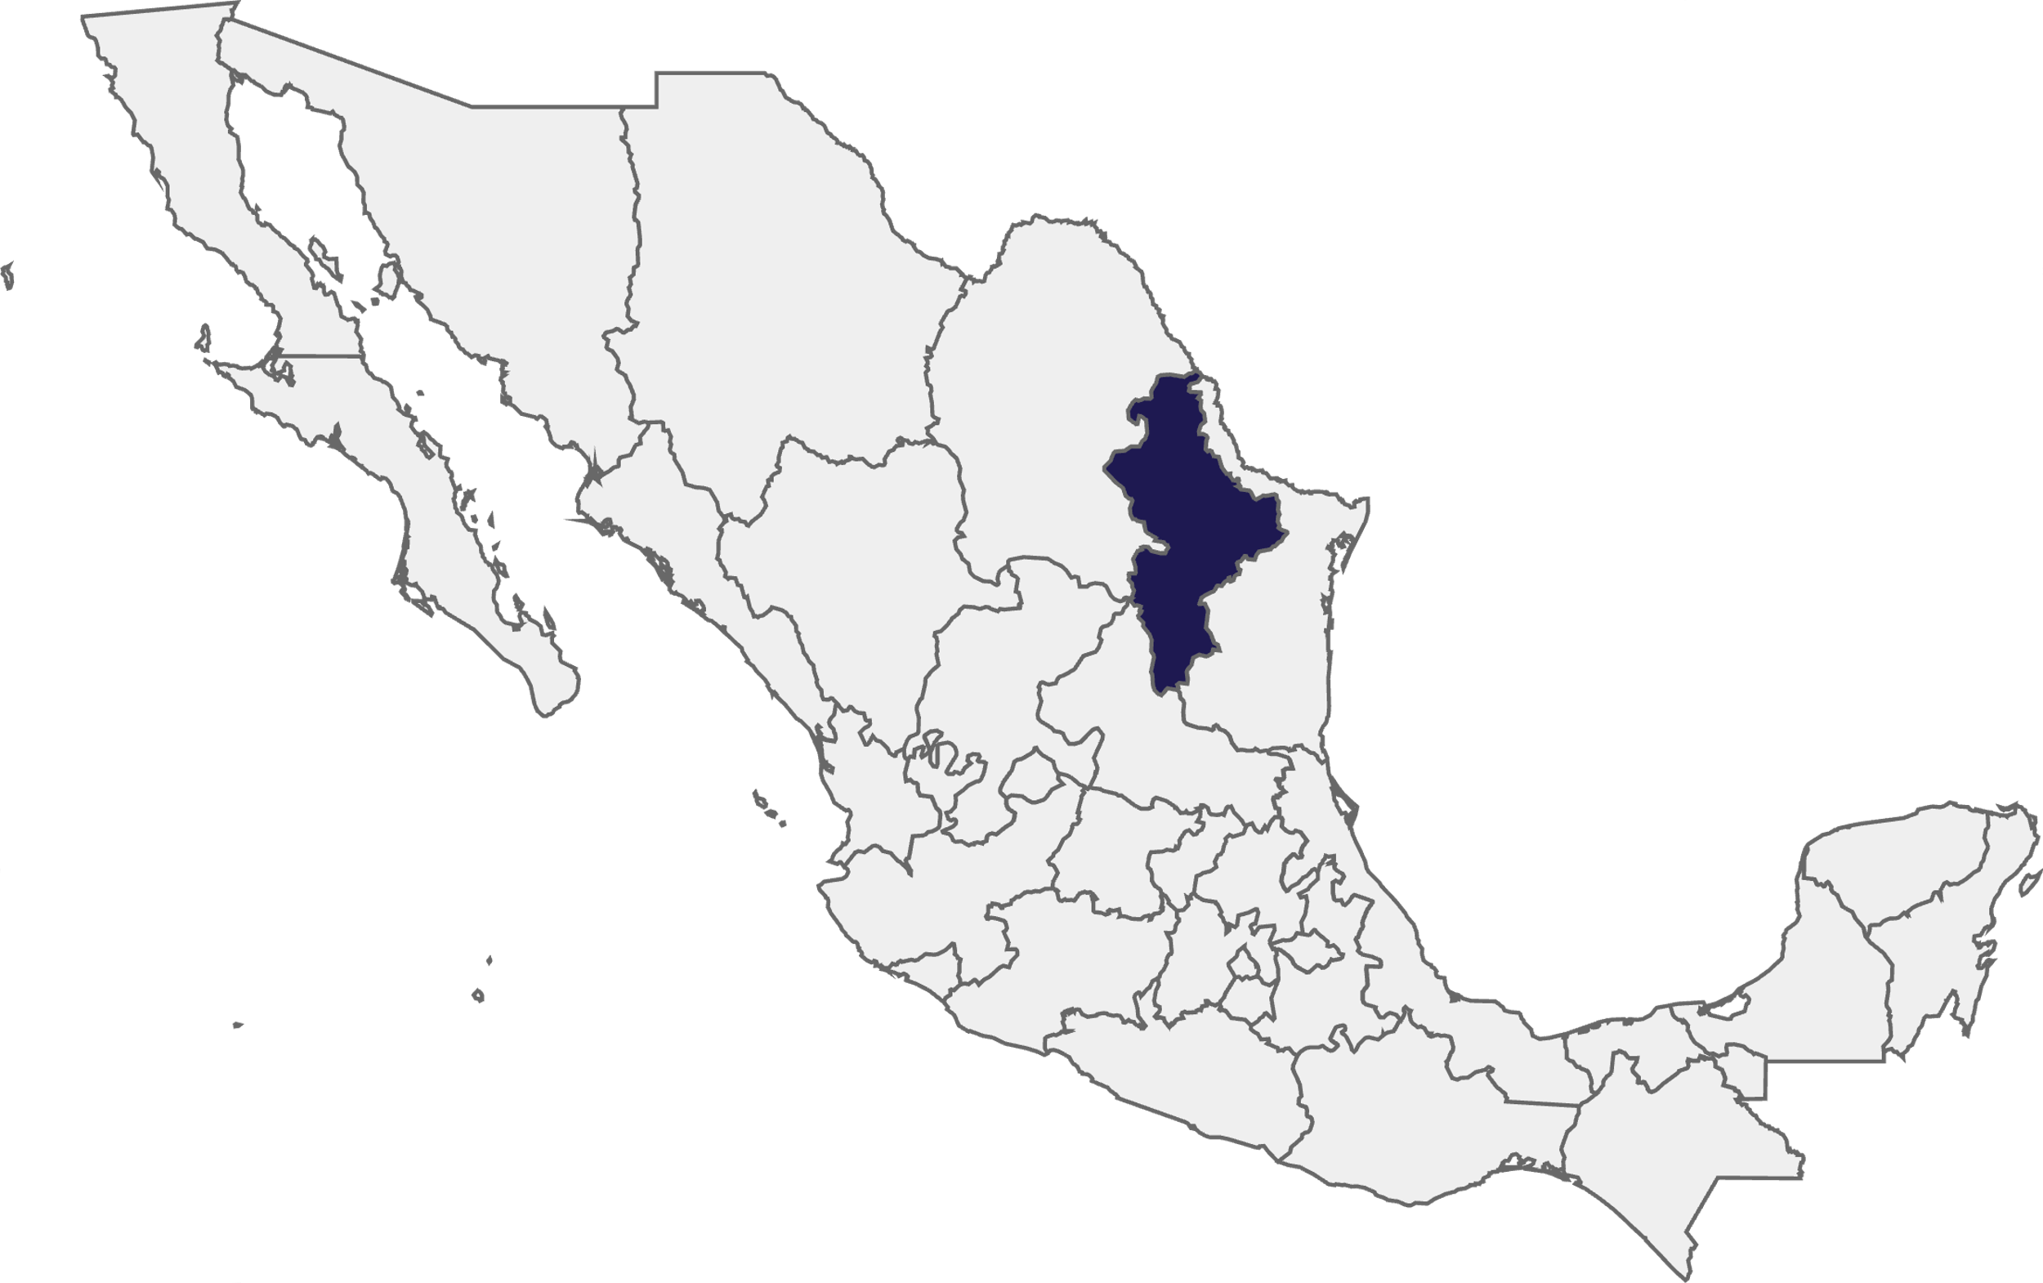


Objectives
To describe and compare the epidemiological
distribution of HPV genotypes over a 10-year
period using cross-sectional data from
colposcopy consultations in northern Mexico.

Slide 3







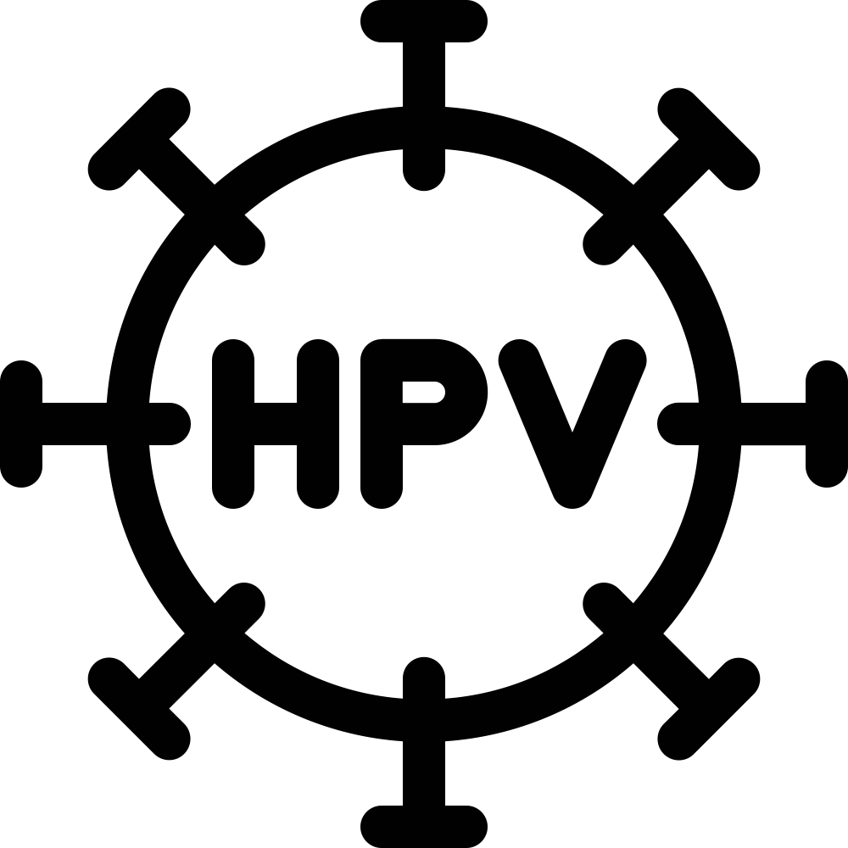





An observational, cross-sectional, ambispective study was conducted among 356 women aged 18 years or older attending in a university hospital in northern Mexico. Cervical samples were analyzed for 32 high-risk and low-risk HPV genotypes using reverse hybridization. Data on sociodemographics, HPV vaccination, and prior HPV/STI history were collected. For comparison, 356 participants were grouped into two periods: 2015–2017 (n=248) and 2023– 2025 (n=108).
METHODOLOGY
POPULATION
SAMPLE COLLECTION
2015-2017
2023-2025
16
31
56
LABORATORY GENOTYPE ANALYSIS
18
CHRONOLOGICAL DATA COMPARISON

Slide 4

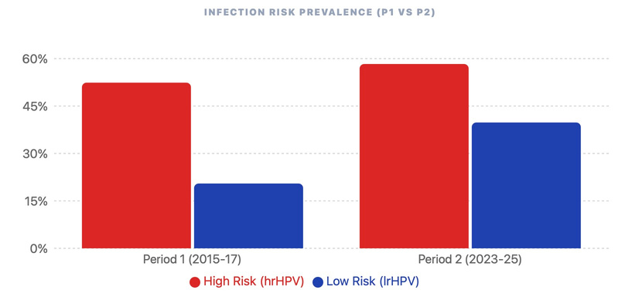


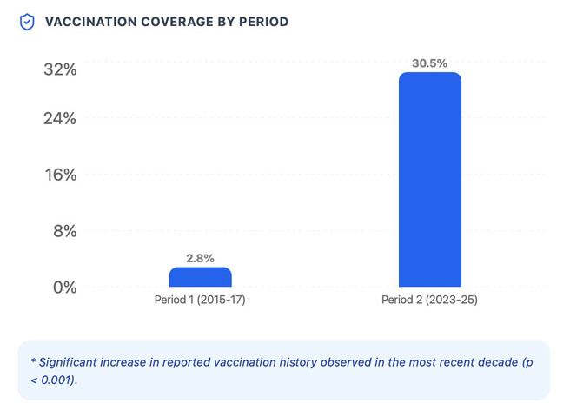
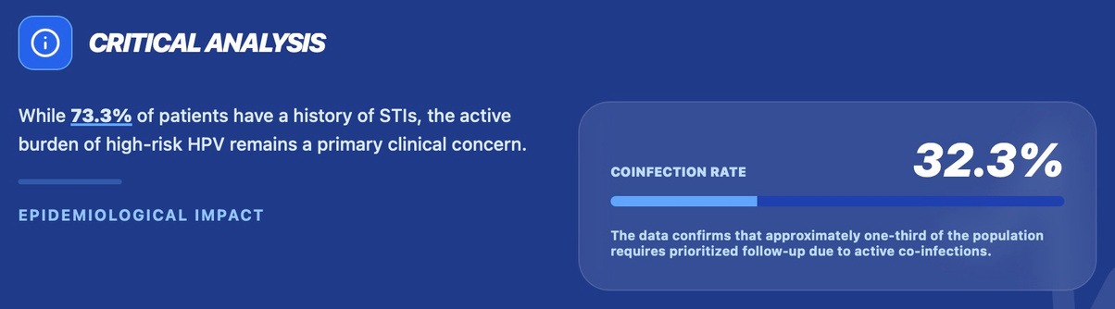
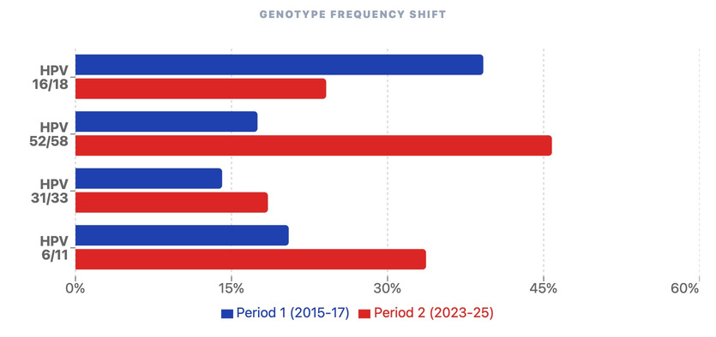

Low vs High risk prevalence
Among the 356 patients analyzed to date, 58.3% tested positive for high-risk HPV, and 39.8% were positive for low-risk HPV genotypes (n=108 from second period).
RESULTS
A substantial increase in HPV vaccination coverage was observed between periods
During the second period, patients reported a history of sexually transmitted infections, and some presented coinfection with high-risk HPV.
Genotype distribution shifted over time.

Slide 5


A marked shift in the distribution of high-risk HPV genotypes has been observed over the past decade in this population. The reduced predominance of HPV 16 and 18 and the emergence of other high-risk genotypes may be associated with increasing vaccination coverage. These findings highlight the importance of continued vaccination efforts, ongoing epidemiological surveillance, and adaptation of screening and prevention strategies to evolving genotype patterns.
Conclusion

