Slide 1

Link between Oral lichen planus and rapid cervical HPV infection progression to CIN2+
Muryzina I., Gargin V., Bilodid O., Alekseeva V., Lazurenko V.

Slide 2
Background & Hypothesis
OLP
(autoimmune disease)
Keratinocyte damage
(HPV16 target)
New HPV16 infection
Rapid CIN progression
⚠ Accelerated HPV persistence
The aim of the study was to investigate the link between oral lichen planus and rapid HPV16-related CIN2+ development

Slide 3
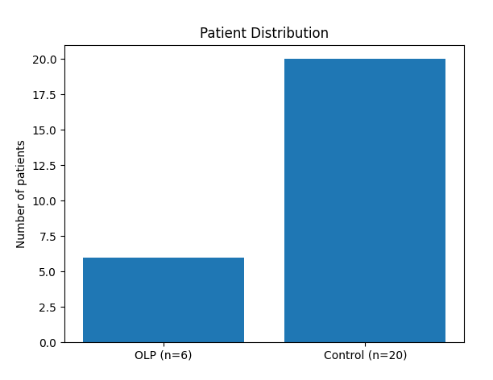
Material and Methods
Methods
• OLP (n=6) vs Control (n=20)
• LEEP samples + IHC (CK7, CK19, p63, Ki67)
Analysis
• Marker expression at margins
• Association with CIN2+

Slide 4
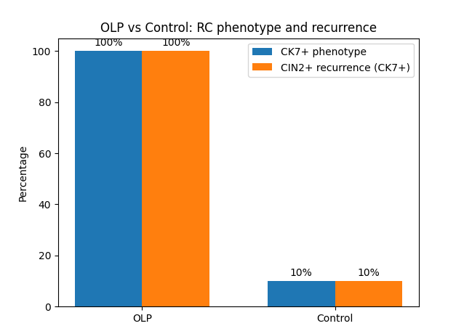
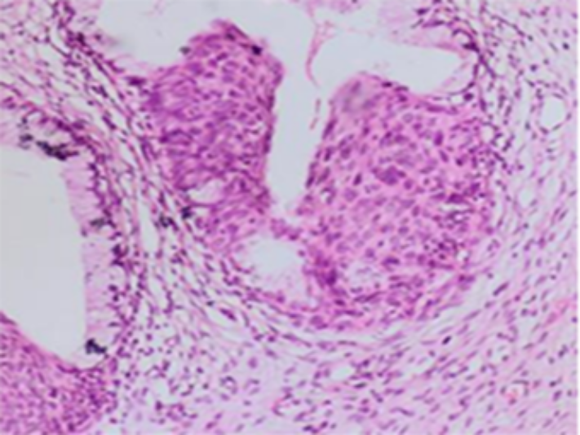
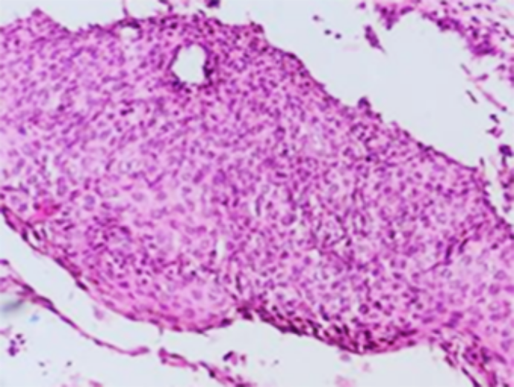
Results
1. OLP is associated with a consistent CK7-positive proliferative phenotype and rapid progression to CIN2+.
2. OLP may promote HPV persistence
CIN2, H&E, ×200

Slide 5


