Slide 1



Development of a chatbot as a public health strategy to promote health literacy on cervical cancer prevention
B. Belém Luna Sampaio¹, T. Nascimento Moura², E. Carla Figueirêdo Vidal², H. Maria Furtado Jorge³,
J. Picanço Magalhães⁴, A. Fabiane De Andrade Larre⁵, A. Reeves De Castro⁶, F. Da Mota Almeida Peroni⁶, S. Ann Costa Clemens⁷, S. De Jesus Silva Bezerra Dos Anjos⁷.
¹Uece - Fortaleza (Brazil), ²Urca - Crato (Brazil), ³Ufpi - Teresina (Brazil), ⁴Tactium - Fortaleza (Brazil), ⁵Instituto Brasileiro De Controle Do Câncer - São Paulo (Brazil), ⁶Grupo Mulheres Do Brasil - Fortaleza (Brazil), ⁷Johns Hopkins University - Baltimore (United States)

Slide 2
Objectives
To develop a chatbot integrated with WhatsApp as a public health strategy to promote health literacy about cervical cancer prevention.
Methods
Methodological study - April and December 2025.
National social impact project developed by the Women of Brazil Group aimed at eliminating cervical cancer by promoting knowledge about HPV vaccination and preventive screening.

Slide 3
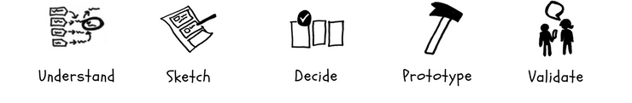
Methods
Developed based on Google Ventures' Design Sprint methodology
By a multidisciplinary health team from the project, based on official national and international health guidelines.
Prototyped by a team that develops health technology.

Slide 4
Results
Construction of a structured database on HPV, vaccination, screening tests, and primary, secondary, and tertiary prevention actions for cervical cancer within the scope of Brazil's Unified Health System (SUS).
A chatbot was developed with a defined flow, language appropriate for health literacy, and security and monitoring mechanisms.
The prototype was implemented on a platform hosted on a private cloud and integrated with Artificial Intelligence models. It is available for free access to more than 24,000 people trained by the project.

Slide 5

Conclusion
Culturally contextualized and evidence-based, strengthens health literacy, expands access to reliable information, and promotes informed decisions about vaccination and preventive screening.
It is a scalable, low-cost, and high-reach digital intervention aimed at expanding access to quality information and contributing to adherence to vaccination and screening actions.

