Slide 1





Knowledge, attitudes, and practices regarding HPV vaccination among students in Cotonou, 2026.
Edited :
Arlette Constantine WOROU, PhD candidate
Prof. Véronique Blanquet: Professor of Genetic at U1094 Inserm U270 IRD – Epidemiology of Chronic Diseases in Tropical Areas, University of Limoges
Dr. Moussiliou Paraiso: Associate Professor in Epidemiology and Public Health, Director of the Research Unit on Population Surveillance, Health and Safety at IRSP, University of Abomey-Calavi
Dr. Freddy Gnangnon: Associate Professor of Surgical Oncology, Head of the Surgical Oncology Unit, Department of Surgery, Faculty of Health Sciences, University of Abomey-Calavi

Slide 2
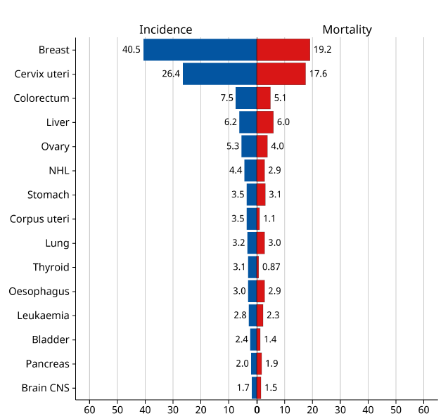
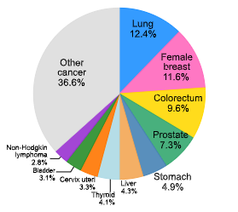
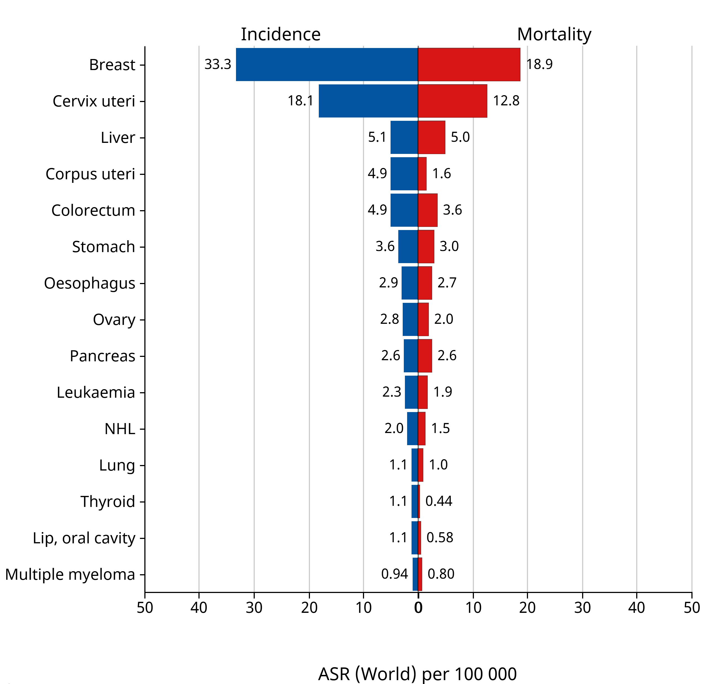
BACKGROUND
GLOBOCAN 2022,CIRC
World : 8th
Africa : 2nd
Bénin : 2nd
ASR (World) per 100 000
Figure 1: Absolute number and incidence of cervical cancer worldwide in 2022.
Figure 2: Age-Standardized Rate (World) per 100 000, Incidence and Mortality, Females, in 2022
Africa (Top 15 cancer sites)
Figure 3: Age-standardized rate (world) per 100,000 women – Cancer incidence and mortality in Benin, 2022 (top 15 cancer sites)
AIM: Assessment of knowledge, attitudes, and practices regarding HPV vaccination among students in Cotonou, 2026

Slide 3
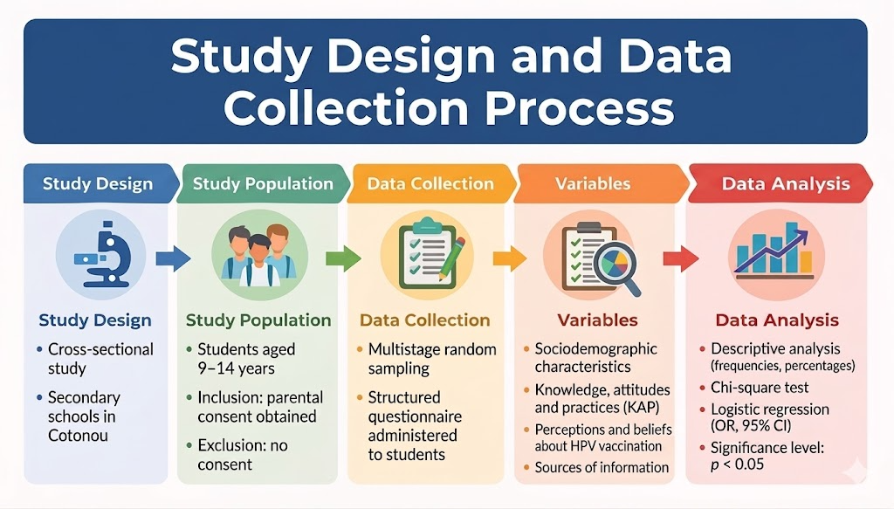

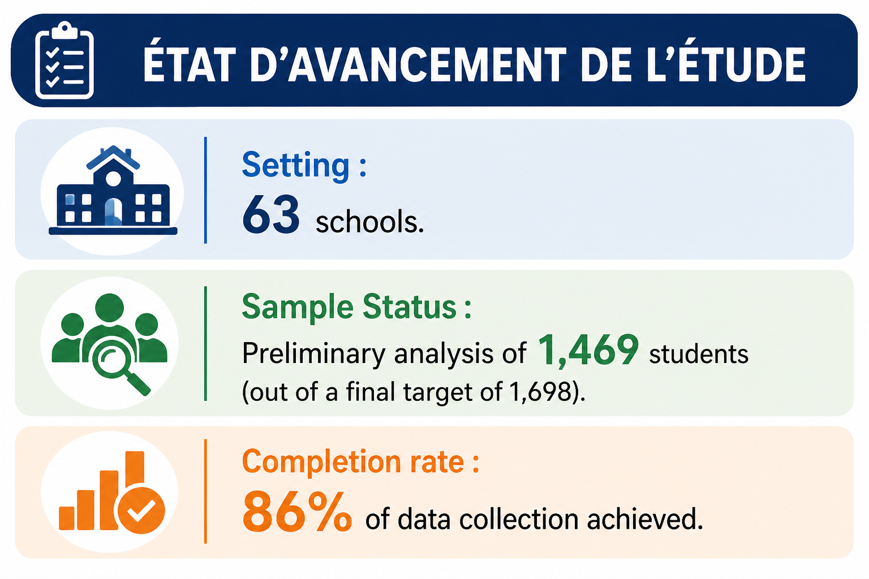
METHODS

Slide 4

RESULTS
Knowledge & Awareness
54.0%
Factors associated with KAP
67.2%
Have heard of HPV
Do not know transmission routes
Reasons for Refusal / Hesitancy
Low knowledge
59.0%
Reduces vaccine acceptance · p<0.05 (OR 0.21)
57.9%
Lack of information
61.5%
Know HPV causes cervical cancer
Know the HPV vaccine exists
Fear of side effects
59.1%
Neutral attitude
Attitudes
Family/friends recommendation
44.7%
95% CI [0.07–0.65] · p<0.05 (OR 0.25)
80.5% are not opposed to the vaccine and 62.8% believe benefits outweigh risks a favorable starting point.
Discouraging messages
27.9%
Positive attitude
95% CI [0.03–0.24] · p<0.05 (OR 0.09)
Lack of trust
33.5%
Practice
78.3%
Not vaccinated
Overall KAP Scores
8.6%
39%
18.7%
Knowledge
Attitudes
Practice

Slide 5
CONCLUSION & RECOMMENDATIONS
Recommendations
Strengthen school-based programs
02
Leverage social media
01
Integrate structured HPV education into the national curriculum, targeting children aged 9–14 years. Prioritize transmission routes and vaccine safety content.
Deploy targeted digital campaigns countering misinformation. Collaborate with trusted influencers to normalize HPV vaccination among adolescents.
Focus on risk perception
03
Activate peer-to-peer education
04
Harness the 61.2% who are willing to inform peers. Student ambassador programs can amplify reach and trust within school communities.
Shift messaging from biological facts to personal risk and cancer prevention, addressing the emotional barriers identified in multivariate analysis.
Needs to Improve Acceptance
Cancer prevention communication 56.6 % Healthcare provider endorsement 37.6 %
Conclusion: Low knowledge and fear of side effects are preventing optimal vaccine uptake. A multi-pronged strategy combining school-based education, healthcare provider engagement, digital outreach, and peer empowerment is essential to achieve equitable HPV vaccine coverage.

