Slide 1
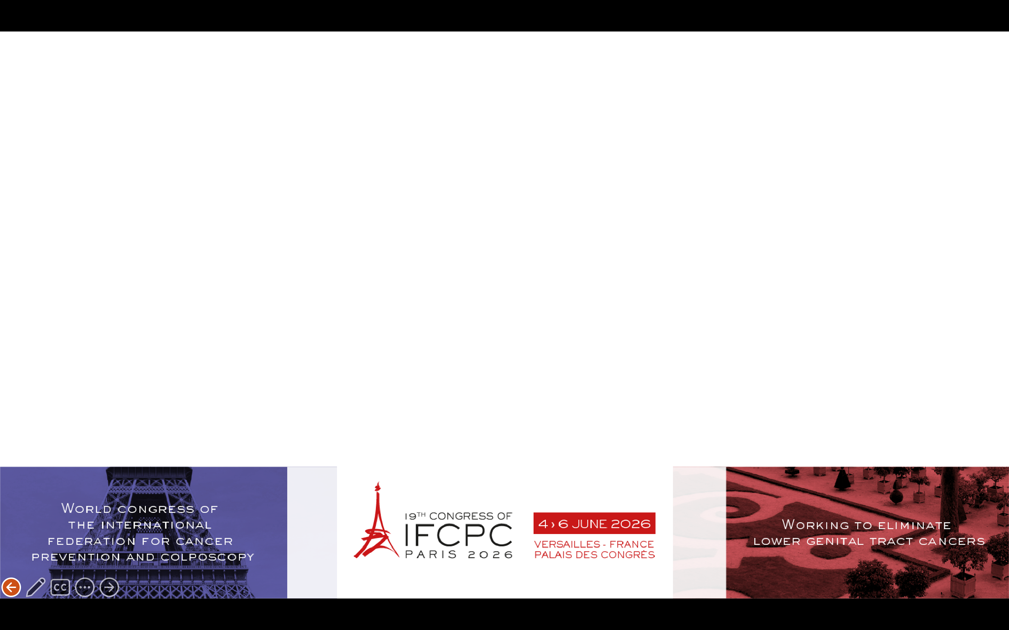

Cervical ulcer with complete resolution after coriolus versicolor-based vaginal gel: a clinical case.
Nadia Nassar, Jennifer Castellanos, María Pérez, Luis Alós, Marta Padín
Hospital Clínico Universitario Lozano Blesa - Zaragoza (Spain)

Slide 2
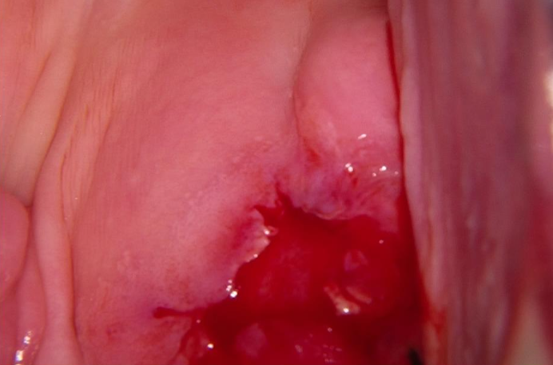
Methods
Case presentation and initial evaluation
A 35-year-old nulligravid woman was referred for HPV 58 positivity with negative cytology and a treated history of CIN1 abroad.
Initial colposcopy showed ectropion and mild acetowhite areas, with biopsies confirming cervicitis.
Three months later, she returned with postcoital bleeding.
Colposcopy:
  Cicatricial cervix with extensive ulceration.
Repeat HPV, cytology, and STI tests were negative.
Biopsies showed a large ulcerated area with intense inflammation but no dysplasia or malignancy.

Slide 3
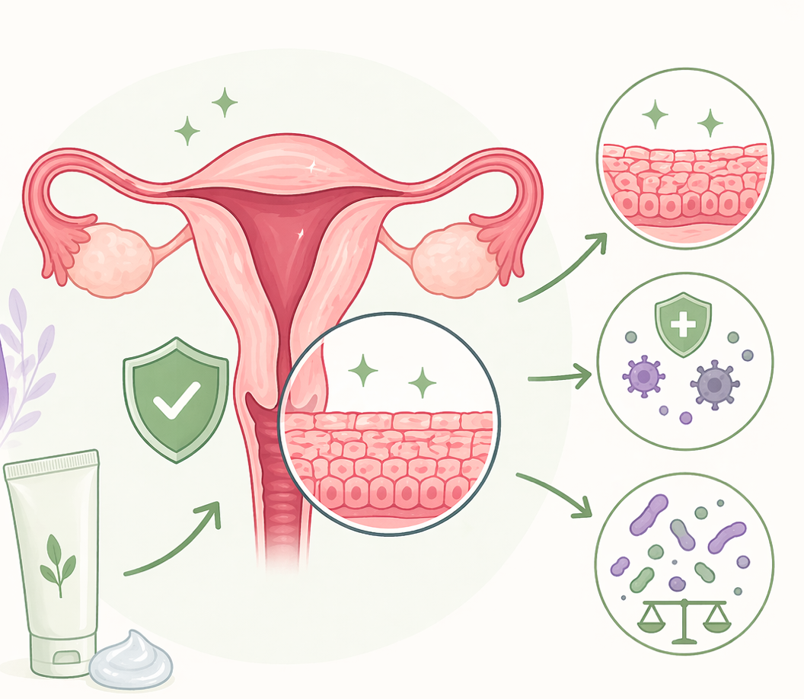
Results
Treatment Approach →Daily Coriolus Versicolor Gel
The patient was prescribed a daily vaginal gel containing Coriolus Versicolor to support cervical mucosal repair.
Menstrual cup use was discontinued to remove mechanical irritation and aid healing in the context of inflammation and epithelial fragility.

Slide 4
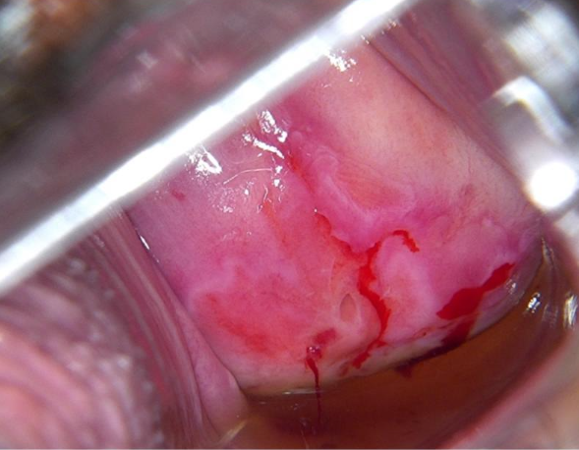
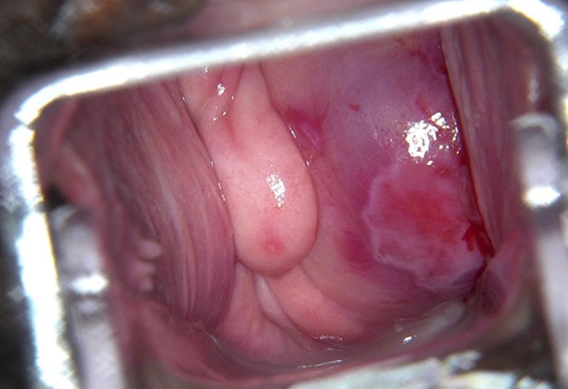
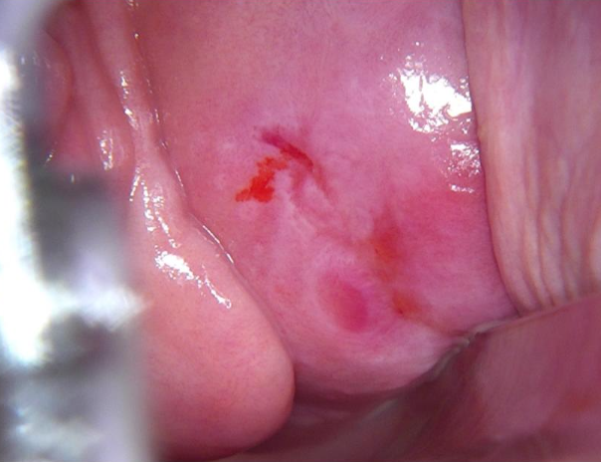
Two months
Symptoms had resolved and colposcopy showed marked improvement.
Three months
Near-complete re-epithelialization was observed
Six months
Fully re-epithelialized, HPV testing remained negative,and postcoital bleeding had resolved.
Results

Slide 5
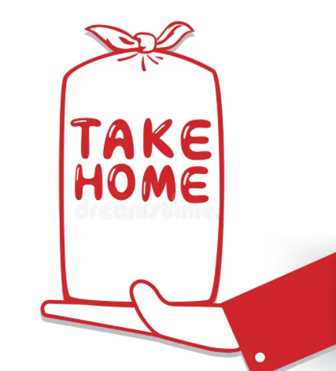
Conclusions
The case shows a benign but extensive cervical ulcer responding rapidly to Coriolus Versicolor-based vaginal gel.
Cervical lesions can affect women´s wellbeing whether caused by HPV or others factors.
This suggests non-surgical mucosal repair therapies may be effective for inflammatory or HPV-related cervical conditions offering a safe, noninvasive option for cervical mucosal repair.

