Slide 1
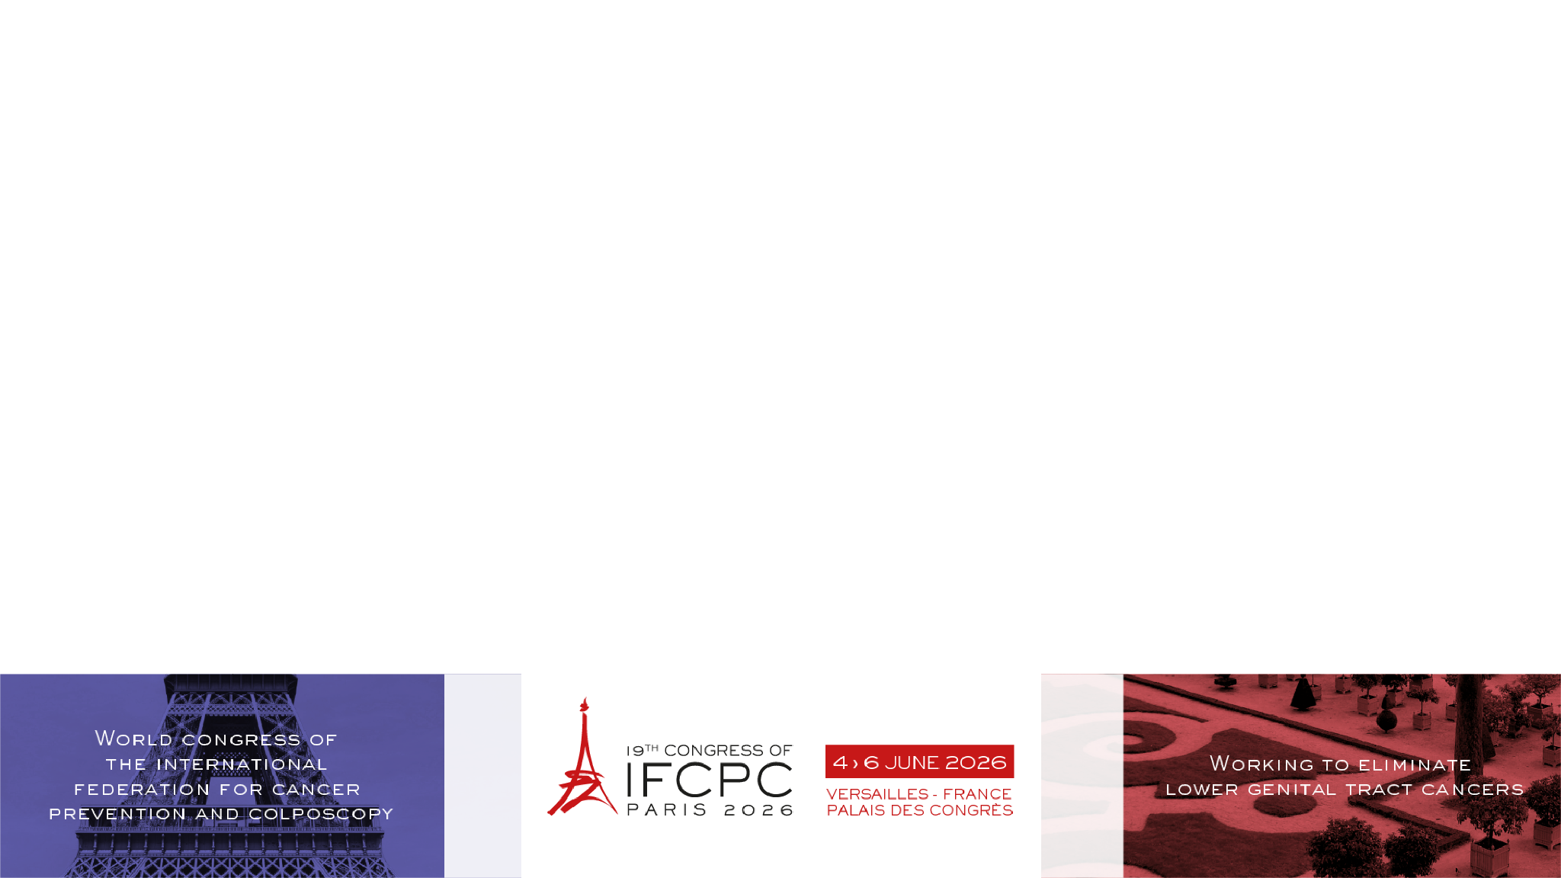

S
HOME
OBJECTIVES
METHODS
RESULTS
CONCLUSIONS
HSIL VULVAR DIAGNOSED IN THE FIRST TRIMESTER OF PREGNANCY:
A CASE REPORT.
Nadia Nassar ¹, Marta Padín ¹, Elisa Lozano ¹, María Martínez ¹, Cristina Centeno ².
¹ Hospital Clínico Universitario Lozano Blesa – Zaragoza (Spain),
² Hospital Universitario Vall D’Ebron – Barcelona (Spain).

Slide 2
OBJECTIVES
HOME
OBJECTIVES
METHODS
RESULTS
CONCLUSIONS
1
High - grade squamous intrahepithelial lesion of the vulva (HSIL/VIN2-3) associated with high - risk HPV is uncommon during pregnancy and presents diagnostic and therapeutic challenges due to limited treatment options and the immunological changes of gestation.
Management should be individualized, prioritizing maternal - fetal safety while maintining lesion control.

Slide 3

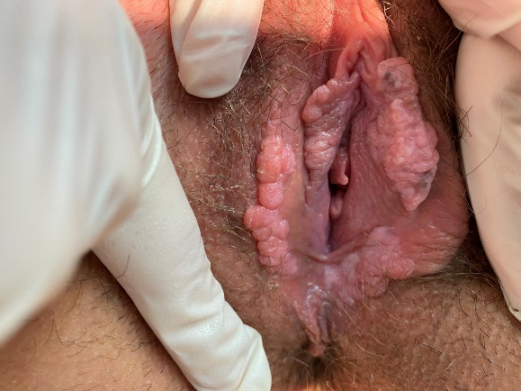
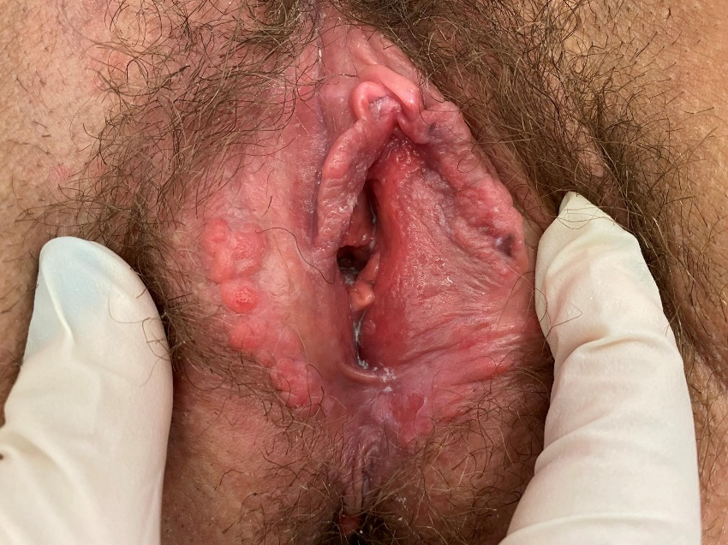
METHODS
HOME
OBJECTIVES
METHODS
RESULTS
CONCLUSIONS
2
A 36-year-old pregnant woman with a history of cervical HSIL treated with two conizations and with no evidence of cervical disease at the time of pregnancy, presented at 9 weeks gestation pruritic vulvar lesions.
Biopsy confirmed vulvar HSIL/VIN2.
Conservative management was chosen, consisting of a topical Coriolus versicolor - based external gel, which was well tolerated and achieved partial clinical improvement with lesion flattening.

Slide 4
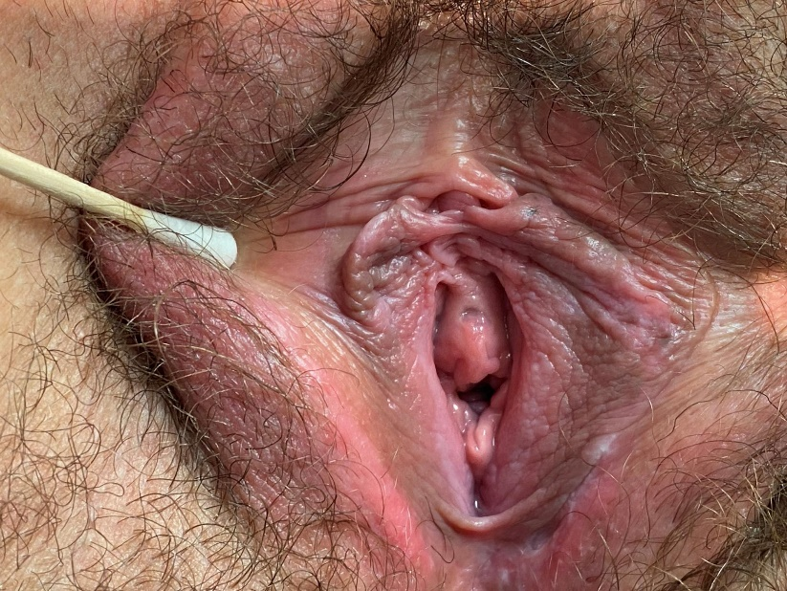
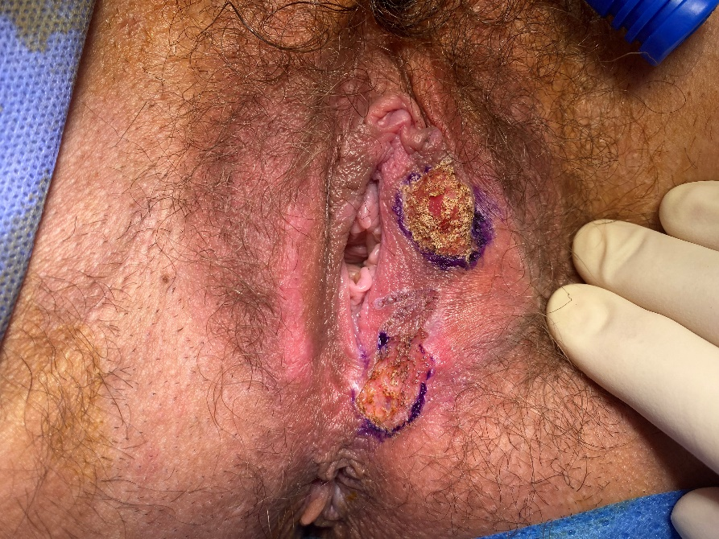
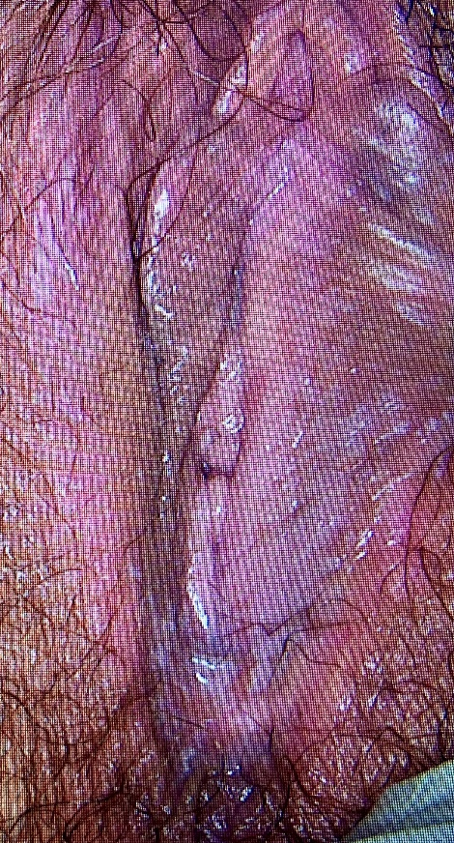
RESULTS
HOME
OBJECTIVES
METHODS
RESULTS
CONCLUSIONS
3
Pregnancy
The pregnancy evolved with progressive cervical shortening and failed cerclage, leading to preterm delivery 26 + 2 weeks due to premature rupture of membranes and uterine activity.
Neonate
The neonate evolved without sequelae.
Postpartum
Postpartum, topical immunomodulatory therapy with imiquimod was administerd, followed by fractional CO₂ laser therapy, which achieved complete lesion resolution confirmed by negative co-testing and biopsy.

Slide 5
HOME
OBJECTIVES
METHODS
RESULTS
CONCLUSIONS
CONCLUSIONS
4
This case illustrates the feasibility of conservative management of vulvar HSIL during pregnancy and the variable behaviour of these lesions under gestational immune modulation.
Prior cervical pathology may increase obstetric risk and requires close follow-up.
Non-surgical approaches, such as Coriolus versicolor - based therapy, may represent safer options during pregnancy by supporting the local immune response and promoting partial lesion regression within a conservative management strategy.
Fractional CO₂ laser therapy is effective for persistent postpartum disease and may be considered a first-line definitive treatment after delivery.

