Slide 1




The clinical features, management, and outcomes of cervical cancer in pregnancy: a single-center cohort
Sofia Lizarzaburu, Francisco dos Reis, Silvana Quintana
Ribeirão Preto Medical School, University of São Paulo, Brazil
Primary Objective: To analyze Overall Survival (OS) of pregnancy-associated cervical cancer (PACC) in a high-burden setting across three clinical cohorts:
Postnatal Diagnosis (n=8)
Antenatal Pregnancy Interruption (n=6)
Antenatal Pregnancy Preservation (n=12)

Slide 2
Study Design and Patient Triage
Brazilian Tertiary Referral Center
Historical Cohort: 2000-2025
1,627 Screened
Patients with uterine cervical diseases
N = 26 Analyzed
Histopathologically confirmed invasive PACC
Postnatal Diagnosis
(n = 8)
Antenatal Pregnancy Interruption
(n = 6)
Antenatal Pregnancy Preservation
(n = 12)

Slide 3
Divergent Clinical Severities at Presentation
Postnatal Diagnosis (n=8)
Pregnancy Interruption (n=6)
Pregnancy Preservation (n=12)
37.5%
Locally Advanced
(IB3 – IIIB)
66.7%
Locally Advanced
(IIIB – IIIC1)
50%
Locally Advanced
(IB3 – IIIC1)
Histology:
Predominantly Squamous Cell Carcinoma (75%)
Management:
Primary Surgery (Stage I) or Multimodal CRT (Bulky/Advanced)
Histology:
Predominantly Squamous Cell Carcinoma (66.7%)
Management:
Termination followed by Stage-Adapted Therapy (RH or CRT)
Histology:
Predominantly Adenocarcinoma (58.3%)
Management:
Observation (Early) or Neoadjuvant Chemotherapy (Advanced) → Postpartum RH/CRT
100% Live Birth Rate
(75% Prematurity)
Note: Locally advanced disease is defined as FIGO Stages IB3–IIIC2. CRT: chemoradiotherapy; RH: radical hysterectomy;

Slide 4
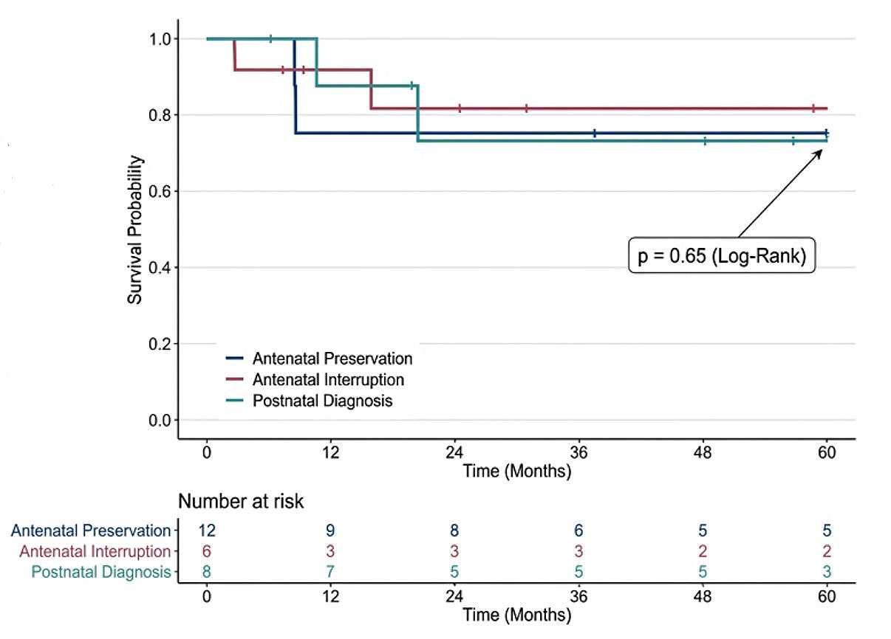
Oncologic Outcomes and Overall Survival
Outcomes Snapshot
Postnatal Diagnosis (Surgical): 100% NED (5 of 5)
Antenatal Interruption: 66.7% NED (4 of 6)
Antenatal Preservation: 58.3% NED (7 of 12)
Despite significant variance in initial tumor burden and necessary treatment delays for fetal maturation, survival probabilities stabilize at comparable 5-year levels.

Slide 5
Conclusions for High-Burden Settings
High Clinical Severity
50% presented with locally advanced disease, reflecting systemic barriers to early detection in a developing country setting, despite the window of opportunity provided by prenatal care
Equivalent Survival
Despite divergent clinical presentations and necessary treatment delays for fetal maturation, 5-year overall survival stabilized at comparable levels across all cohorts (p=0.65)
Centralized Care
Integrated multidisciplinary management at an expert tertiary referral center is essential to mitigate these extreme oncologic risks and optimize outcomes

