Slide 1



Burden of CIN2+ in patients with hrHPV and
low-grade cervical cytology
Treatment and follow up
Navneetha Naveendra, Zeynep Tugce Tugcu, Keya Madani, Mary McDonald, Shailaja Anipindi, Gwen Makosana, Yulia Gurtovaya, Selina Chiu, Diana Marcus, Helen Staley
Chelsea And Westminster Hospital NHS Foundation Trust - London (United Kingdom)

Slide 2
Burden of CIN2+ in patients with hrHPV and
low-grade cervical cytology
Treatment and follow up
Navneetha Naveendra, Zeynep Tugce Tugcu, Keya Madani, Mary McDonald, Shailaja Anipindi, Gwen Makosana, Yulia Gurtovaya, Selina Chiu, Diana Marcus, Helen Staley
Chelsea And Westminster Hospital NHS Foundation Trust - London (United Kingdom)
Introduction
Persistent infection with hrHPV is a key driver of cervical dyskaryosis and carcinogenesis, which has been shown to cause 95% of cervical cancers if left untreated¹.
Management of persistent hrHPV infection with low-grade cytological abnormalities remains challenging.
While excisional treatment may be offered, its benefits must be balanced against the risks of persistent hrHPV and potential complications, including preterm birth.
Some patients prefer conservative management unless high-grade disease is confirmed.
We aimed to evaluate the prevalence of CIN2+ among patients undergoing large loop excision of the transformation zone (LLETZ) for low-grade cytological abnormalities.
Methods
A retrospective analysis of 419 patients who underwent a LLETZ procedure between December 1st 2022 and November 30th 2024 in London’s Chelsea and Westminster Hospital and West Middlesex Hospital.
Low grade cytological abnormalities include: low grade dyskaryosis and borderline changes in squamous cells.
The primary outcome was the prevalence of CIN2+ (CIN2 or CIN3), CGIN or invasive carcinoma.

Slide 3
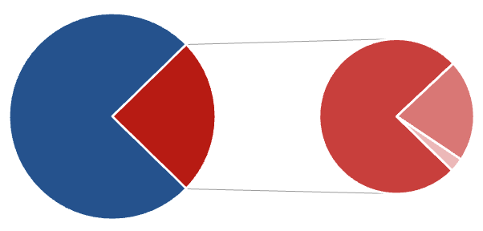
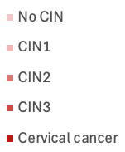


Burden of CIN2+ in patients with hrHPV and
low-grade cervical cytology
Treatment and follow up
Navneetha Naveendra, Zeynep Tugce Tugcu, Keya Madani, Mary McDonald, Shailaja Anipindi, Gwen Makosana, Yulia Gurtovaya, Selina Chiu, Diana Marcus, Helen Staley
Chelsea And Westminster Hospital NHS Foundation Trust - London (United Kingdom)
Results
419 patients underwent a LLETZ procedure, of whom 25% (n=103) had low-grade cytological abnormalities on preceding smear. All smears were hrHPV positive.
Figure 2: Smear preceding LLETZ
Figure 3: Final Histology of Low-Grade Cytological Abnormalities
Figure 1: Age of Referral to LLETZ
25
43
68
75%
21%
20%
19%
25%
54% = CIN2+
(n=56)
76%
24%
35%
CIN2+ was identified alongside low-grade dyskaryosis in 58% (n=45) and borderline change in squamous cells in 55% (n=12), with no CIN2+ detected in patients with normal cytology.
56% (n=32) of patients diagnosed with CIN2+ had a history of prior abnormal smears

Slide 4
Burden of CIN2+ in patients with hrHPV and
low-grade cervical cytology
Treatment and follow up
Navneetha Naveendra, Zeynep Tugce Tugcu, Keya Madani, Mary McDonald, Shailaja Anipindi, Gwen Makosana, Yulia Gurtovaya, Selina Chiu, Diana Marcus, Helen Staley
Chelsea And Westminster Hospital NHS Foundation Trust - London (United Kingdom)
Discussion
This study demonstrates a notably high burden of clinically significant disease amongst patients undergoing LLETZ for persistent low-grade cytological abnormalities, with CIN2+ identified in 55%.
The comparable rates of CIN2+ in patients with low-grade dyskaryosis (58%) and borderline change in squamous cells (55%) may suggest that subclassification of low-grade cytological abnormalities has limited discriminatory value.
The absence of CIN2+ in patients with normal cytology aligns with national screening data, which demonstrates lower immediate risk of high-grade disease in this subgroup².
The progression risk associated with persistent hrHPV infection underpins the recommendation for repeat testing and subsequent referral if persistence is confirmed².
More than half of our patients with CIN2+ had a history of prior abnormal smears (56%), highlighting the importance of longitudinal screening history for risk prediction.
Incorporating prior cytology and HPV persistence into clinical decision-making may improve identification of patients with underlying high-grade disease.

Slide 5
Burden of CIN2+ in patients with hrHPV and
low-grade cervical cytology
Treatment and follow up
Navneetha Naveendra, Zeynep Tugce Tugcu, Keya Madani, Mary McDonald, Shailaja Anipindi, Gwen Makosana, Yulia Gurtovaya, Selina Chiu, Diana Marcus, Helen Staley
Chelsea And Westminster Hospital NHS Foundation Trust - London (United Kingdom)
Conclusion
CIN2+ occurs in a substantial proportion of patients with low-grade cytological abnormalities.
These findings should inform shared decision-making and counselling, in particular in the management of persistent abnormal smears.
References
1. Cervical cancer, World Health Organization. Available at: https://www.who.int/news-room/fact-sheets/detail/cervical-cancer (Accessed: 18 April 2026).
2. Section 2: Cervical Sample Testing - NHS England Digital. Available at: https://digital.nhs.uk/data-and-information/publications/statistical/cervical-screening-annual/england-2023-24/section-2-cervical-cytology (Accessed: 18 April 2026).

