Slide 1



Test of cure positivity after LLETZ in an era of primary hrHPV screening
Zeynep Tugce Tugcu¹, Keya Madani¹, Navneetha Naveendra¹, Mary McDonald¹, Shailaja Anipindi¹, Gwen Makosana¹, Yulia Gurtovaya¹, Selina Chiu S², Diana Marcus¹, Helen Staley¹
¹Chelsea and Westminster Hospital NHS Foundation Trust, London (United Kingdom) | ²Imperial College London, London (United Kingdom)

Slide 2
Test of cure positivity after LLETZ in an era of primary hrHPV screening
Zeynep Tugce Tugcu¹, Keya Madani¹, Navneetha Naveendra¹, Mary McDonald¹, Shailaja Anipindi¹, Gwen Makosana¹, Yulia Gurtovaya¹, Selina Chiu S², Diana Marcus¹, Helen Staley¹
¹Chelsea and Westminster Hospital NHS Foundation Trust, London (United Kingdom) | ²Imperial College London, London (United Kingdom)
INTRODUCTION
BACKGROUND
LLETZ is the standard treatment for CIN, with success rates historically exceeding 90% (1). The UK transitioned to primary hrHPV screening in 2019–2020, replacing cytology as the first-line test (2). This shift means that hrHPV clearance — rather than cytological normalisation — is now the benchmark for treatment success at six-month test of cure (TOC) (3).
hrHPV persistence post-LLETZ poses a significant clinical challenge, requiring ongoing surveillance and potentially repeat procedures, with associated patient burden and resource implications (4,5).
AIM
To determine the rate of hrHPV-positive test-of-cure (TOC) results at six months following LLETZ, and to identify clinicopathological and procedural risk factors associated with hrHPV persistence in a real-world NHS colposcopy service.
Primary outcome: Rate of positive TOC at 6 months post-LLETZ
Secondary outcomes: Risk factors for hrHPV persistence including margin status, LLETZ depth, grade of disease, smoking status, and vaccination history

Slide 3
Test of cure positivity after LLETZ in an era of primary hrHPV screening
Zeynep Tugce Tugcu¹, Keya Madani¹, Navneetha Naveendra¹, Mary McDonald¹, Shailaja Anipindi¹, Gwen Makosana¹, Yulia Gurtovaya¹, Selina Chiu S², Diana Marcus¹, Helen Staley¹
¹Chelsea and Westminster Hospital NHS Foundation Trust, London (United Kingdom) | ²Imperial College London, London (United Kingdom)
METHODS
STUDY DESIGN
DATA COLLECTED
Retrospective audit of outpatient LLETZ procedures across two sites within a London NHS Trust.
Period: 1 December 2022 – 30 November 2024
Age, index cytology grade, histological diagnosis, resection margin status, LLETZ depth, vaccination status, smoking status, and 6-month TOC hrHPV result.
INCLUSION CRITERIA
TOC CLASSIFICATION
All patients undergoing at least one LLETZ for hrHPV-positive cervical abnormality. All index smears were hrHPV positive.
hrHPV negative (clear), hrHPV positive only, hrHPV positive + low-grade cytology, hrHPV positive + high-grade cytology.

Slide 4
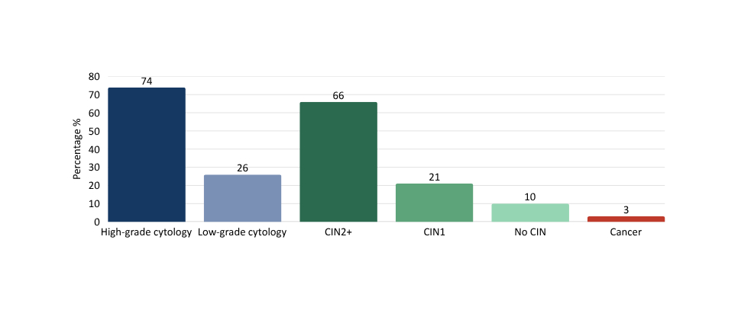
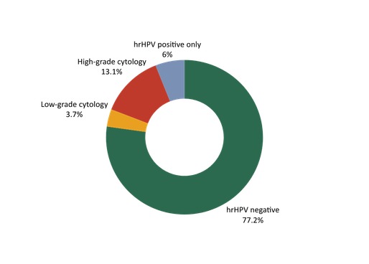
Test of cure positivity after LLETZ in an era of primary hrHPV screening
Zeynep Tugce Tugcu¹, Keya Madani¹, Navneetha Naveendra¹, Mary McDonald¹, Shailaja Anipindi¹, Gwen Makosana¹, Yulia Gurtovaya¹, Selina Chiu S², Diana Marcus¹, Helen Staley¹
¹Chelsea and Westminster Hospital NHS Foundation Trust, London (United Kingdom) | ²Imperial College London, London (United Kingdom)
RESULTS
419
77%
23%
Total patients
(median age 38, range 25-68)
hrHPV negative TOC
n=295 / 382
Positive TOC
n=87 / 382
Fig 1. Index cytology & histology (n=419)
Fig 2. TOC result breakdown (n=382)
Table 1. Risk factors in positive TOC group (n=87)
Risk factor | n | Percentage
High-grade index smear | 58
CIN2+ histological diagnosis | 50
Suboptimal LLETZ depth | 25
Positive resection margins | 18
Current smoker | 22
HPV un-vaccinated | 85
67%
57%
29%
21%
25%
98%

Slide 5
Test of cure positivity after LLETZ in an era of primary hrHPV screening
Zeynep Tugce Tugcu¹, Keya Madani¹, Navneetha Naveendra¹, Mary McDonald¹, Shailaja Anipindi¹, Gwen Makosana¹, Yulia Gurtovaya¹, Selina Chiu S², Diana Marcus¹, Helen Staley¹
¹Chelsea and Westminster Hospital NHS Foundation Trust, London (United Kingdom) | ²Imperial College London, London (United Kingdom)
DISCUSSION & CONCLUSION
DISCUSSION
A positive TOC rate of 23% is notably higher than rates reported in pre-hrHPV screening era studies, which typically cited treatment failure rates of 5–10% (1,4). This likely reflects the greater sensitivity of hrHPV testing compared with cytology, detecting low-level viral persistence that would previously have been missed (5).
The predominance of high-grade disease (CIN2+) among those with positive TOC is consistent with published literature, where higher viral loads and deeper transformation zone involvement are associated with reduced clearance rates (1,4).
Suboptimal LLETZ depth in 29% of positive TOC cases is a potentially modifiable procedural factor. Adequate excision depth is critical to encompass the full transformation zone, particularly in type 3 transformation zones. This supports the need for quality assurance of LLETZ technique and standardised depth targets.
The low vaccination rate (2%) reflects the age profile of the cohort (median 38), predating widespread HPV vaccination (2). Smoking (25%) as a cofactor aligns with known immunosuppressive effects on local cervical immunity and HPV clearance (4).
CONCLUSION
REFERENCES
Positive TOC rates post-LLETZ are higher than historically expected in the era of primary hrHPV screening, with 23% of patients hrHPV positive at six months (2,3). High-grade disease and suboptimal LLETZ depth are key associated factors (4).
  Procedural technique should be audited and standardised
  Patients with high-grade CIN should receive enhanced counselling regarding TOC outcomes
  Larger prospective studies are needed to validate risk stratification models in the hrHPV screening era
  Soutter WP, Sasieni P, Panoskaltsis T. Long-term risk of invasive cervical cancer after treatment of squamous cervical intraepithelial neoplasia. International Journal of Cancer. 2005 Nov 11;118(8):2048–55.
  Public Health England. Cervical screening: programme overview [Internet]. GOV.UK. 2024. Available from: https://www.gov.uk/guidance/cervical-screening-programme-overview
  England N. Cervical screening standards data report 2023 to 2024 [Internet]. GOV.UK. 2025. Available from: https://www.gov.uk/government/publications/cervical-screening-standards-data-report-2023-to-2024/cervical-screening-standards-data-report-2023-to-2024
  Kocken M, Helmerhorst TJ, Berkhof J, Louwers JA, Nobbenhuis MA, Bais AG, et al. Risk of recurrent high-grade cervical intraepithelial neoplasia after successful treatment: a long-term multi-cohort study. The Lancet Oncology. 2011 May;12(5):441–50.
  Arbyn M, Ronco G, Anttila A, Meijer CJLM, Poljak M, Ogilvie G, et al. Evidence Regarding Human Papillomavirus Testing in Secondary Prevention of Cervical Cancer. Vaccine. 2012 Nov;30:F88–99.

