Slide 1

Preliminary results on a Coriolus versicolor-based vaginal gel for cervical healing and HR-HPV clearance post-conization
Carmen Álvarez¹, Sara Jasmal-Ismail², María Bejarano³
¹Hospital Universitario De Jerez De La Frontera, Jerez De La Frontera (Spain); ²Hospital Universitario De Ceuta - Ceuta (Spain); ³Hospital Universitario De Jerez De La Frontera – Jerez De La Frontera (Spain)
Notes:
My name is Carmen Álvarez Gil and I work in the Lower Genital Tract Pathology Unit at the University Hospital of Jerez de la Frontera, Spain. My presentation focuses on the preliminary results of a Coriolus versicolor-based vaginal gel for cervical healing and the elimination of high-risk HPV after conization.

Slide 2
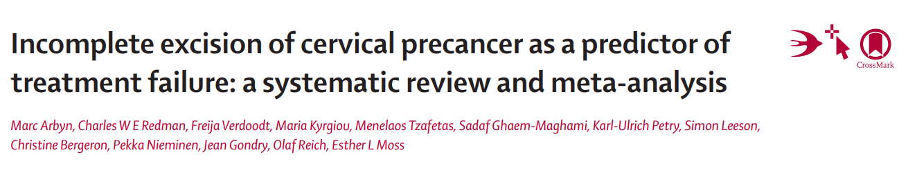
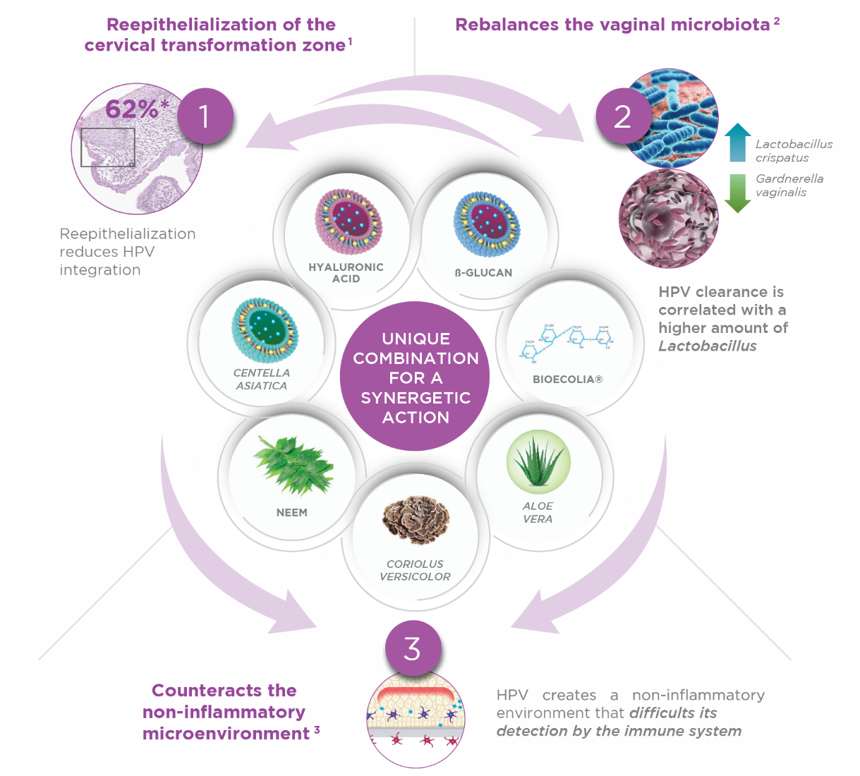
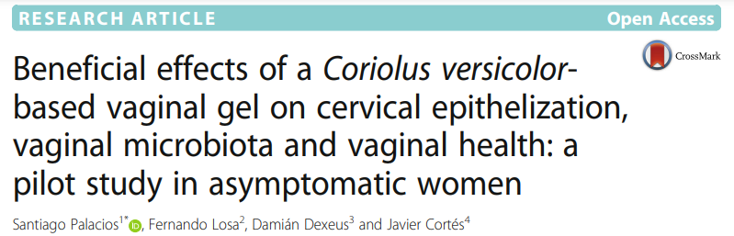
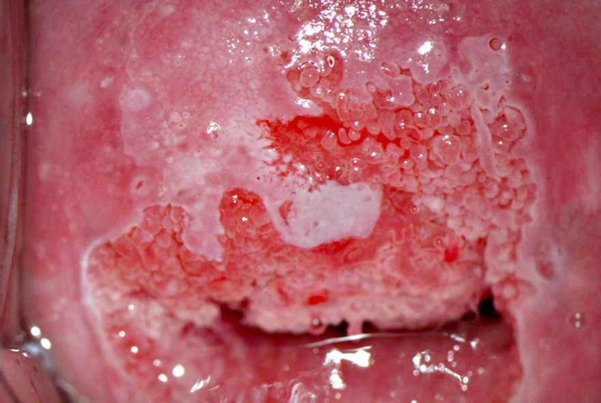
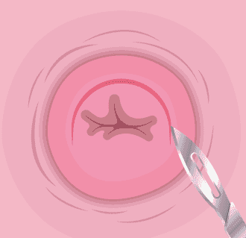

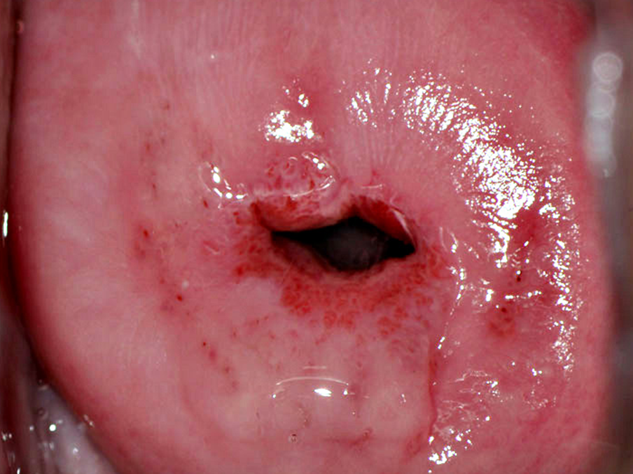


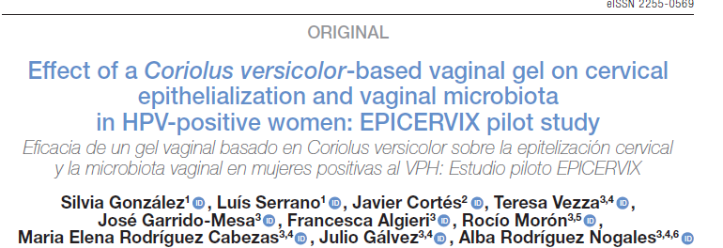
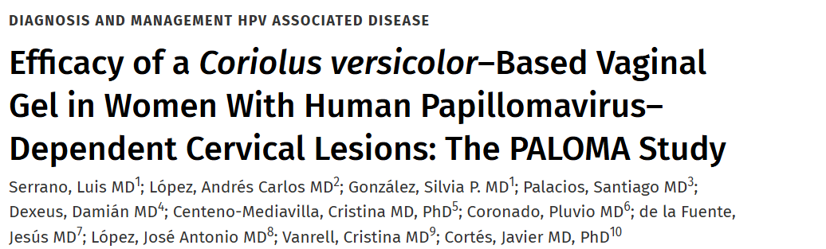
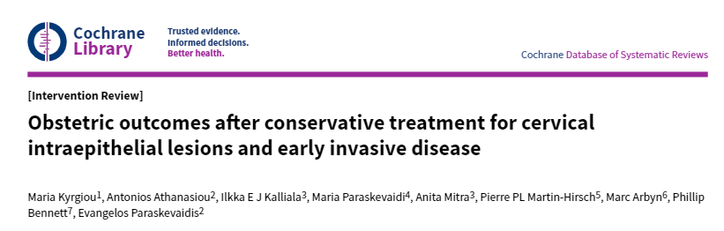
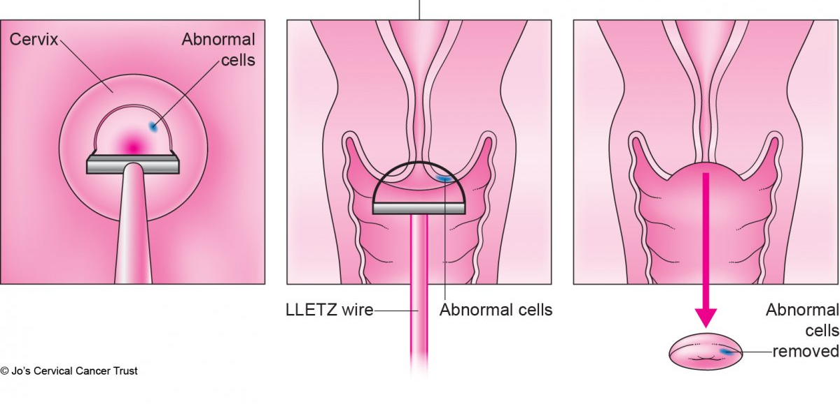

Patients that undergo excisional treatment are at increased risk of CIN2+
Factors associated with recurrence: Margins and HPV test
The Coriolus versicolor-based vaginal gel has demonstrated efficacy in HPV+ patients with low-grade cervical lesions
Risk of residual or recurrent CIN2+ post-treatment
 | Positive | Negative
Margins | 17.1% | 3.7%
HPV Test | 28.4% | 0.8%
Excisional treatment can lead to medical complications
Efficacy in HPV+ with low-grade cervical lesions
Efficacy after excisional treatment
Cervical re-epithelization
Post-operative bleeding
HR-HPV clearance
HR-HPV clearance
Low-grade lesion regression
  Cervical stenosis
  Post-operative bleeding
  Persistent lesions due to incomplete excision
  Persistent HR-HPV
Postmenopausal women:
  Atrophy: reduced accessibility, colposcopy difficulty
  Lower cytology accuracy
  Type 3 transformation zone
  Higher rate of insufficient samples
Notes:
Women treated with excisional procedures for high-grade squamous intraepithelial lesions (CIN2/3) remain at an increased risk of developing CIN2+ and cervical cancer compared to the general population for at least a decade after treatment.
Positive margin and HPV positivity post-treatment have been associated with risk of recurrence, with current evidence showing that the combination of both markers improves risk stratification.
Excisional treatment may also lead to complications such as cervical stenosis, post-operative bleeding, and lesion persistence or recurrence.
This is particularly relevant in postmenopausal women, who represent a more complex population due to cervical atrophy, reduced diagnostic accuracy, and difficulties in colposcopy.
Therefore, strategies that improve cervical re-epithelialization and HPV clearance after treatment may have a significant clinical impact.
In this context, a Coriolus versicolor–based vaginal gel has shown efficacy in low-grade lesions and HPV clearance.
We therefore hypothesized that it could improve re-epithelialization after excision, reduce post-operative bleeding, and enhance HPV clearance.

Slide 3





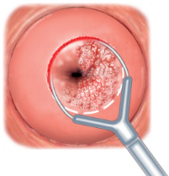


Preliminary results on a Coriolus versicolor-based vaginal gel for cervical healing and HR-HPV clearance post-conization
Observational, prospective, single-center, controlled with clinical practice study
Population
A
Control group – Without treatment
Arms
B
>18 years
Undergoing excisional treatment for CIN
Treatment group - Perioperative application and once daily for 3 months
Pathological anathomy results
Visits
POSITIVE MARGINS
NEGATIVE MARGINS
Randomized patients: N=66
Arm A: 35, Arm B: 31
Follow up period
(3 months, no treatment)
21 days
Visit 0
Visit 1
Visit 2 (at 21 days)
Visit 3 (at 3 months)
Visit 3 (at 6 months)
Inclusion
Medical records
Inclusion
Conization
Start treatment
Reepithelization degree
Bleeding degree
Cytology normalization
HR-HPV clearance
Adherence and Tolerability
GENERAL POPULATION AT 21 DAYS
POSITIVE-MARGINS POPULATION AT 3 MONTHS
Cervical re-epithelization
Post-operative bleeding
HR-HPV viral clearance
4-point Likert scale - percentage of epithelization:
4-point Likert scale - percentage of post-operative bleeding:
COBAS HPV test
Viral clearance was defined as a negative test or loss of ≥1 baseline genotypes
4 75 – 100%
3 50 – 75%
Satisfactory epithelization
4 No bleeding
3 < menstruation
Minimal bleeding
2 25 – 50%
1 0 – 25 %
Deficient epithelization
2 = menstruation
1 > menstruation
Heavy bleeding
Notes:
To test this hypothesis, we conducted a prospective, single-center, controlled pilot study including women over 18 undergoing excisional treatment for cervical lesions.
Patients were assigned to either a treatment group, receiving a Coriolus versicolor–based vaginal gel for three months, or a control group with no adjuvant treatment.
Early outcomes were assessed at 21 days, while follow-up depended on margin status: 3 months for positive margins and 6 months for negative margins.
The main endpoints were cervical re-epithelialization, post-operative bleeding, both assessed using a 4-point Likert scale and high-risk HPV clearance assessed using COBAS HPV test.

Slide 4

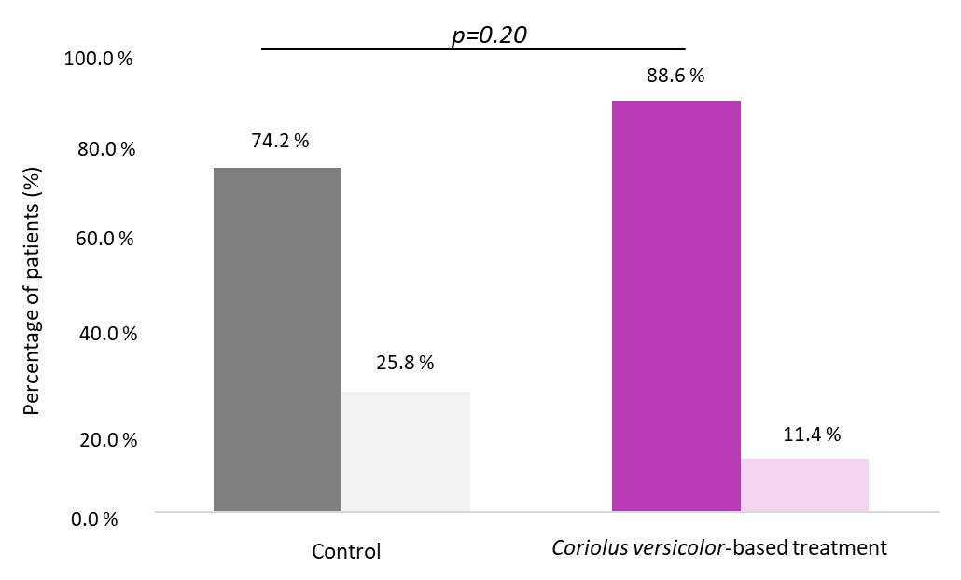
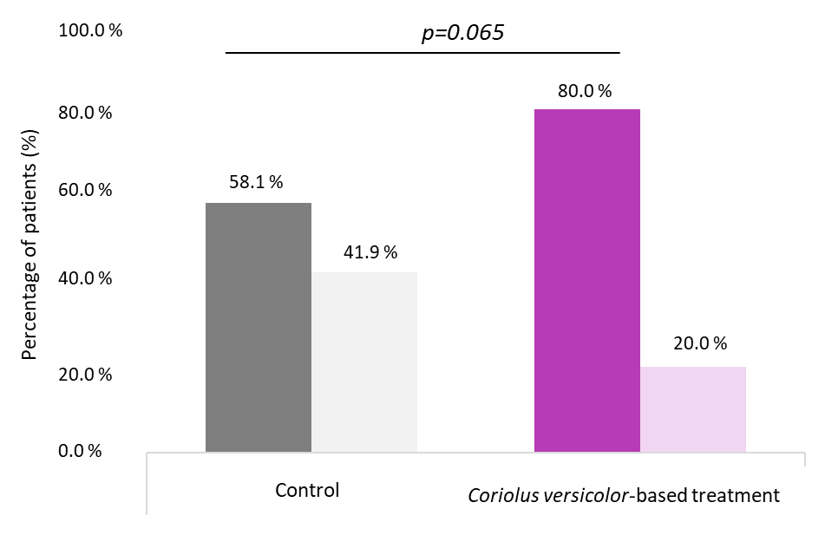
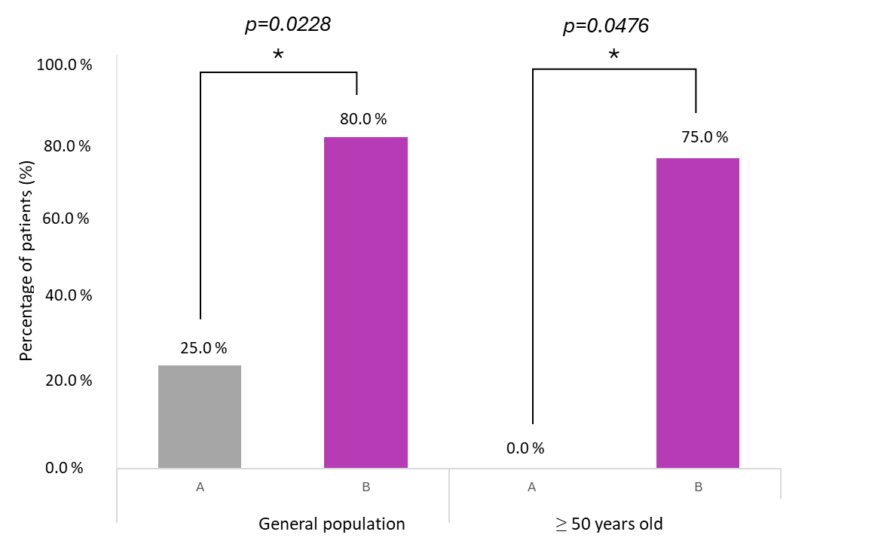


Results
Population
Baseline characteristics: There were no statistical significant differences between groups in terms of baseline characteristics or risk factors
N= 66
Mean age= 42.4 years
Smokers= 48.5%
Average nº of partners= 1.2
Positive margins= 34.8%
Vaccinated= 90.9%
  Before lesion: 25%
  Post lesion: 75%
 | CONTROL group | Coriolus-versicolor group
Sample size | 31 | 35
Mean age (years) | 41.3 | 43.3
% smokers | 58.1% | 40%
Parity | 1.3 | 1.1
Use of a barrier method. | 22.6% | 28.6%
Positive margins | 25.8% | 42.8%
VISIT 21 DAYS: General Population
VISIT 3 MONTHS : Patients with positive margins
Re-epithelization at 21 days in general population
Post-operative bleeding at 21 days in general population
HR-HPV clearance at 3 months in positive margins population
A: Control (N=8)
B: Coriolus versicolor-based vaginal gel (N=15)
Notes:
66 women were included in the study. We analyzed potential risk factors for HPV persistence, including age, smoking status, parity, and margin involvement, with no significant differences between groups at baseline.
At 21 days post-excision, we observed a positive trend toward improved cervical re-epithelialization and reduced post-operative bleeding in the treated group, although these differences were not statistically significant.
At 3 months, high-risk HPV clearance was significantly higher in treated patients compared to controls, reaching 80% versus 25%. Notably, in women aged 50 years or older, clearance was also significantly higher, with 75% in the treated group compared to 0% in controls.

Slide 5
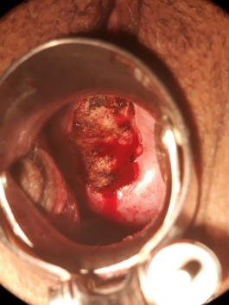
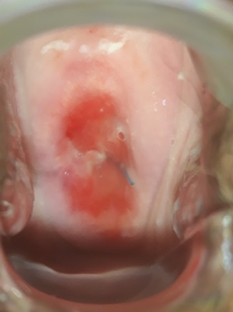


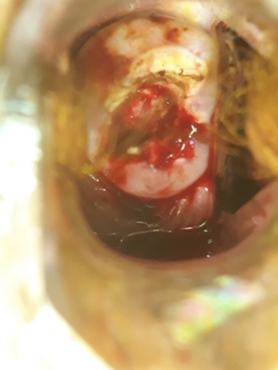
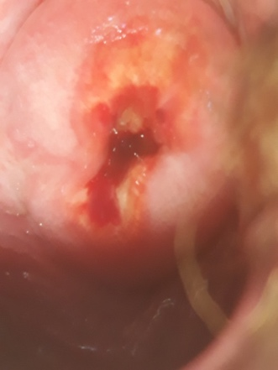

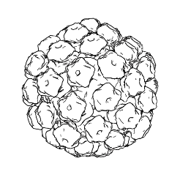
Conclusion
Coriolus versicolor-based vaginal gel significantly improves the elimination of high-risk HPV compared to no treatment
Right after surgery
21 days after surgery
Limitations
Opportunity
Coriolus versicolor-based vaginal gel
Excisional treatment is tailored to the characteristics of the lesion and the patient. There is intrinsic variability in the surgical technique
Pilot study: small sample size
Uneven distribution of positive margins
Further studies with larger population and multicenter collaboration and longer follow-ups
New research lines or designs
Patients with cervical stenosis
Post-menopausal women
Stratification by specific margin involvement (endo/ectocervical)
Control
Without treatment
The Coriolus versicolor-based vaginal gel showed a positive trend in cervical re-epithelialization and minimal bleeding 21 days after excisional surgery
The Coriolus versicolor-based vaginal gel significantly enhanced HR-HPV clearance in margin-positive patients. This improvement is maintained in patients ≥ 50 years of age
The Coriolus versicolor-based vaginal gel is a complementary therapeutic tool after excisional treatment for CIN
Notes:
This study has some limitations, including its small sample size and variability in excisional techniques, as well as an uneven distribution of positive margins.
However, it also opens the door to further research, particularly in larger populations, with longer follow-up, and in specific groups such as postmenopausal women.
In conclusion, the Coriolus versicolor–based vaginal gel showed a positive trend toward improved cervical re-epithelialization and reduced bleeding at 21 days after excision.
Importantly, in patients with positive margins, the gel significantly improved high-risk HPV clearance at 3 months, with this benefit also observed in women aged 50 years and older.
These findings suggest that this vaginal gel may represent a valuable complementary therapeutic option following excisional treatment for cervical intraepithelial neoplasia.

Slide 6
Thank you for your attention
Notes:
Thank you very much for your attention.

