Slide 1
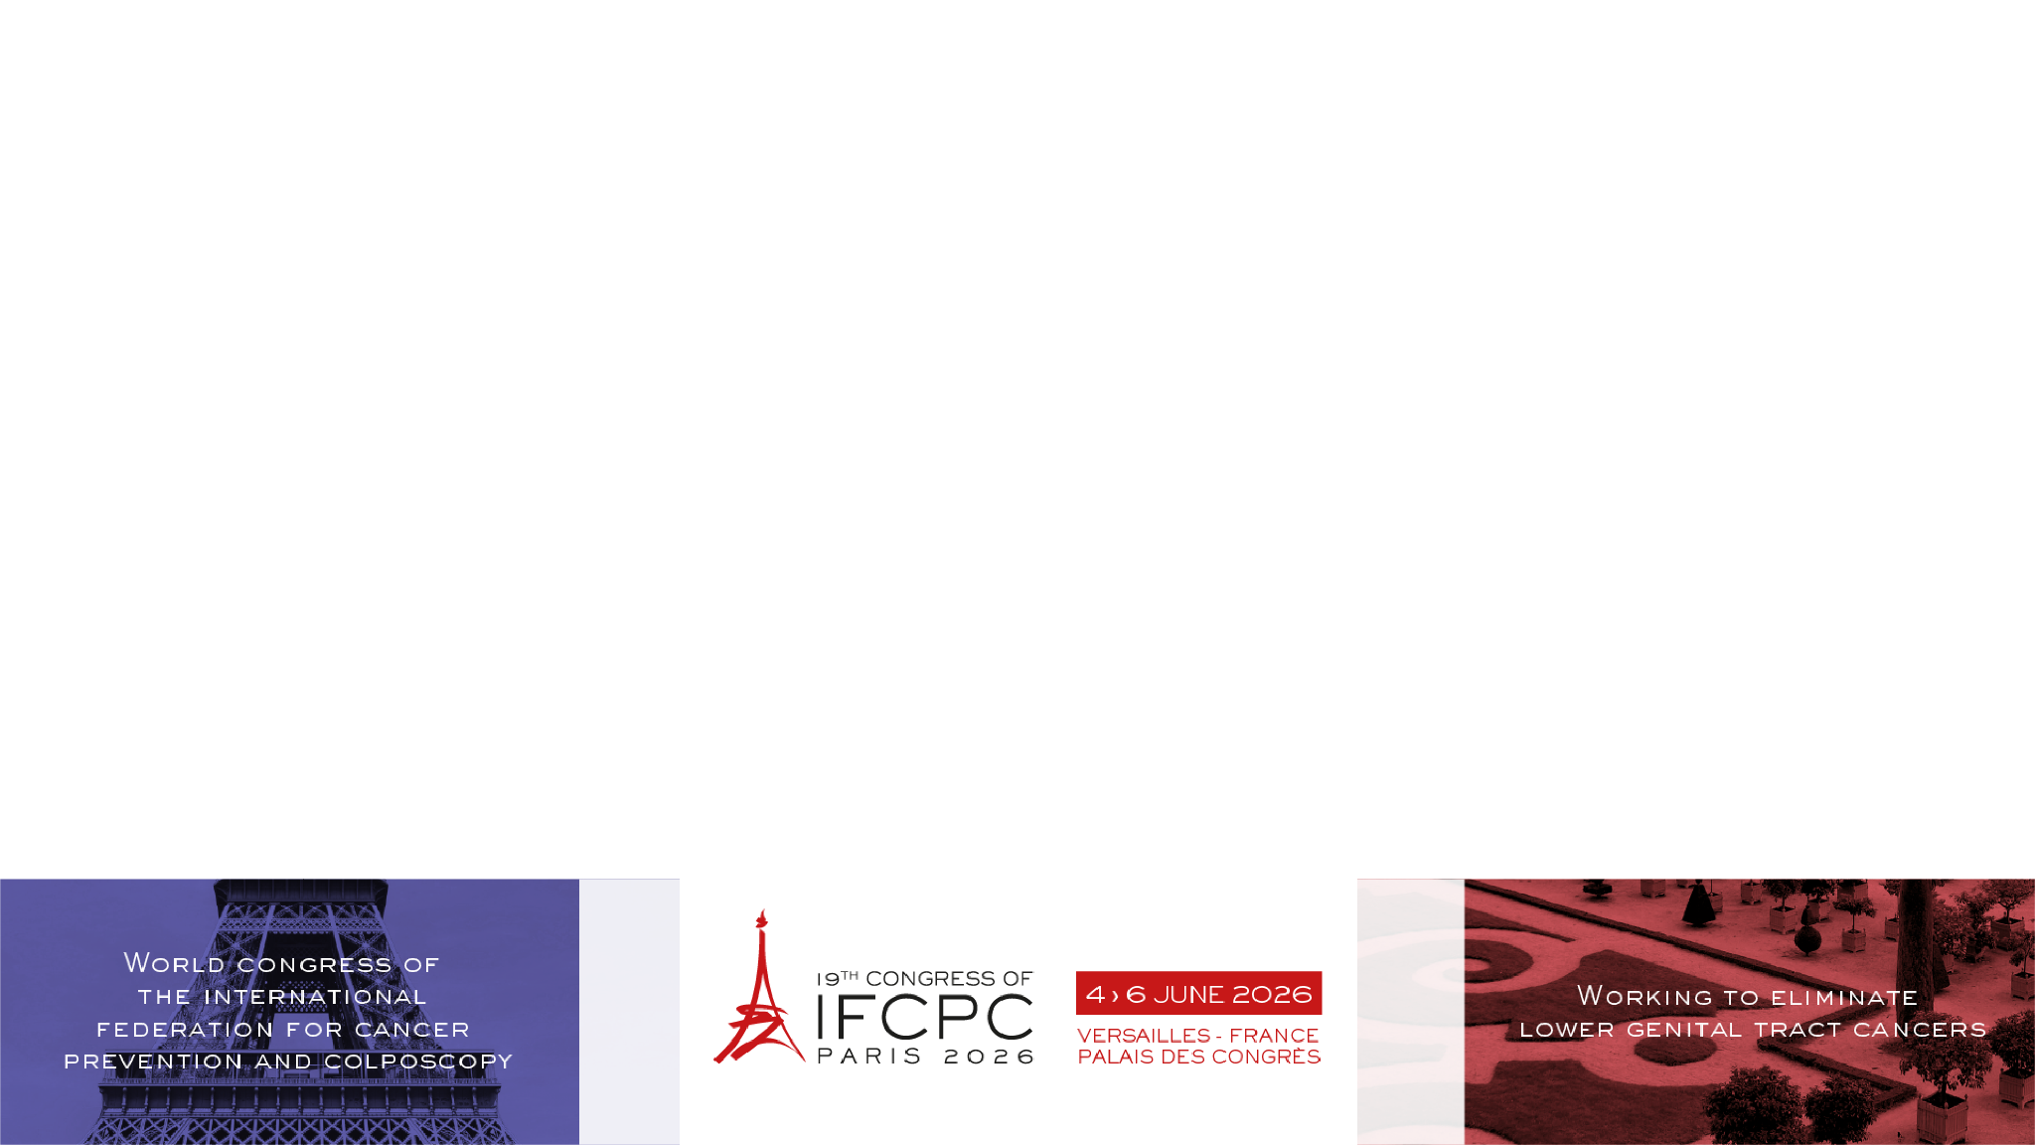

Effectiveness of a multi-ingredient
Coriolus versicolor-based vaginal gel in patients coinfected with HPV and
HIV: a pilot observational study.
Jesús Joaquín Hijona¹, Teresa Rodríguez², María Soledad Sánchez¹, Rosa María Alcalá³
¹Hospital Universitario De Jaén, Jaén (Spain); ²Universidad De Granada, Granada (Spain); ³Hospital Materno Infantil De Jaén, Jaén (Spain)

Slide 2

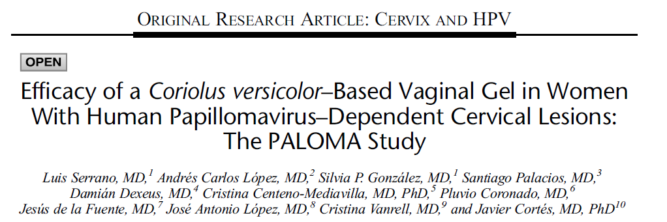
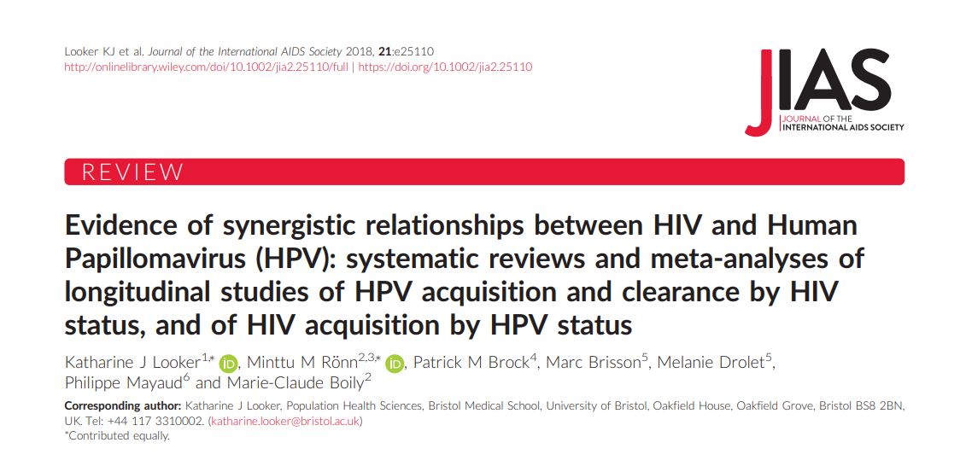
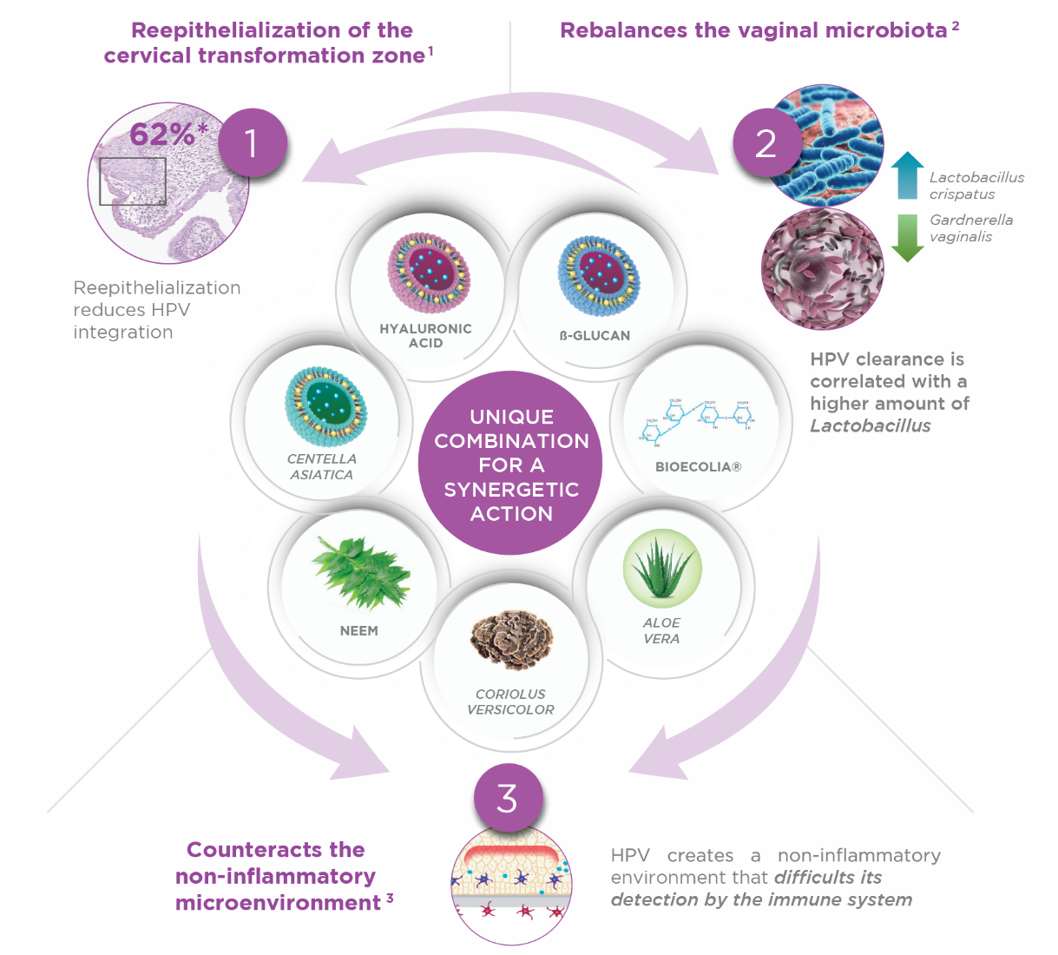
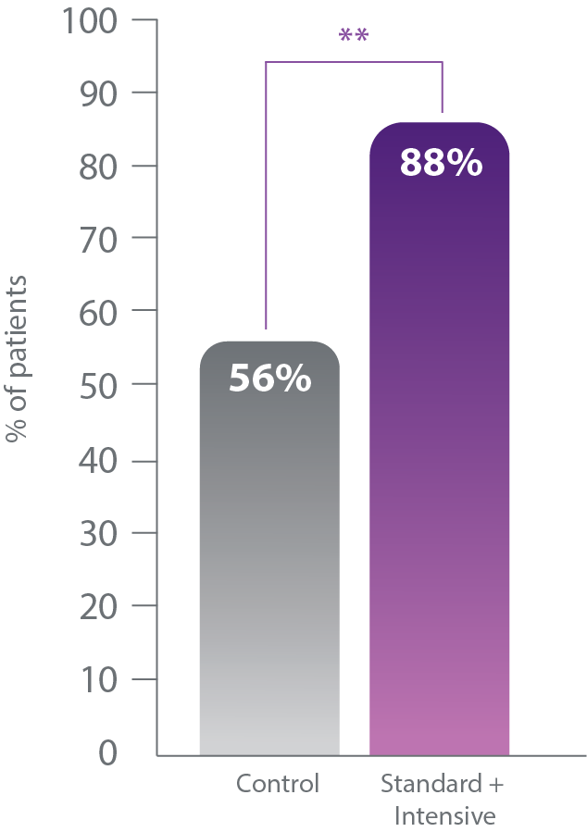


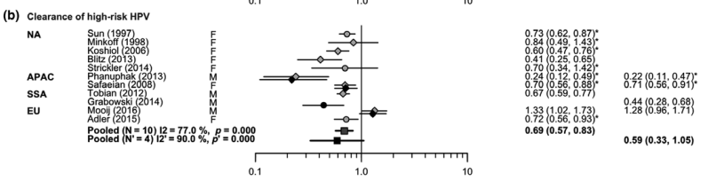

Background
Aim
HIV alters the pathogenesis of HPV, increasing the risk of HPV infection, persistence, and reactivation.
Repair* of low-grade cervical lesions in HR-HPV patients at 6 months²
HIV
HPV
Risk of HPV acquisition is approximately doubled in the presence of HIV infection, while the rate of HPV clearance is approximately halved.
*Normal cytology and concordant colposcopy
To provide evidence on the effectiveness of a Coriolus versicolor-based vaginal gel in repairing HPV-related cervical lesions and enhancing HR-HPV clearance in HIV-positive patients.
1. Looker, K. et al. J Int AIDS Soc.. 2018; 21(6):e25110 doi:10.1002/jia2.25110; 2.Serrano, L. et al. JLGTD 2021; 25(2):130-136. doi:10.1097/LGT.0000000000000596

Slide 3






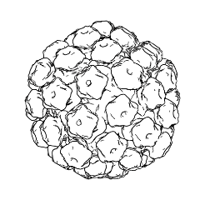
Methods
Descriptive, prospective, observational, pilot study.
Visit 1
Once daily for 1 month and every other day for 5 months
Visit 2
Population
6 months
Age: 25 – 60 years
Coinfected with HR-HPV and HIV
Abnormal cervical cytology (ASCUS/LSIL)
Informed consent
Inclusion
HPV Test (hybrid capture test)
Cytology
Colposcopy (IFCPC 2011)
Biopsy if required
Epithelization degree
HPV Test (hybrid capture test)
Cytology
Colposcopy (IFCPC 2011)
Biopsy if required
Epithelization degree
IRC approval was obtained
Outcomes
Baseline characteristics
Sample size (n) | 28
Average age (years, [SD]) | 45.4 (9.0)
AIDS (%) | 35.7
Smokers (%) | 53.6
ASC-US (%) | 60.7
LSIL (%) | 39.3
ART (%) | 71.4
CIN-1 (%) | 67.9
HPV 16 (%) | 57.1
Lesion repair
Cytological normalization with concordant colposcopy
HR-HPV clearance
Hybrid capture test.
Clearance was categorized as:
complete (negative HR-HPV test)
Partial (loss of at least baseline genotype).

Slide 4
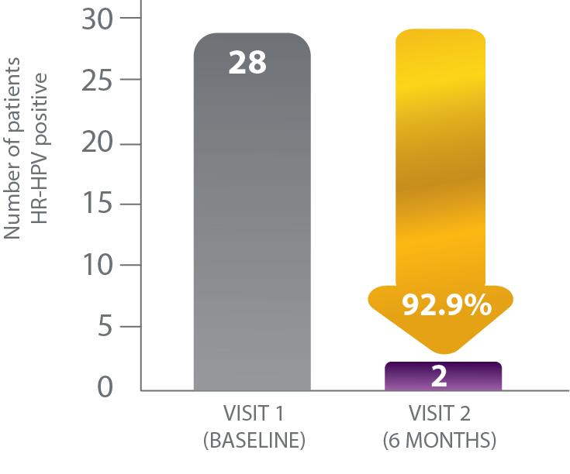
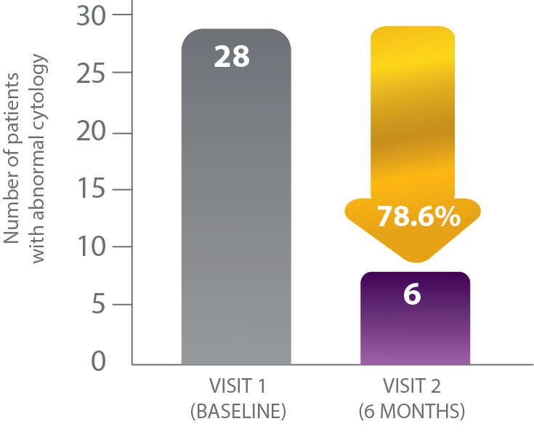
Results
HR-HPV clearance
Cytological Normalization
Normalization of colposcopic abnormalities
57.9 %
of patients with abnormal colposcopic findings showed normalization after treatment.
The effect of a Coriolus versicolor-based vaginal gel in immunocompromised patients appears to be comparable to that observed in immunocompetent patients:
- Cytological normalization: 78,6% vs 88% (PALOMA 1)¹
- Viral clearance: 92,9% vs 63^{%1.}
A Coriolus versicolor-based vaginal gel may represent a useful therapeutic option even in difficult-to-treat populations, such as patients living with HIV, as it enhances viral clearance and repair of HPV-related cervical lesions.
1. Serrano, L. et al. JLGTD 2021; 25(2):130-136. doi:10.1097/LGT.0000000000000596

Slide 5
Thank you for your attention

