Slide 1
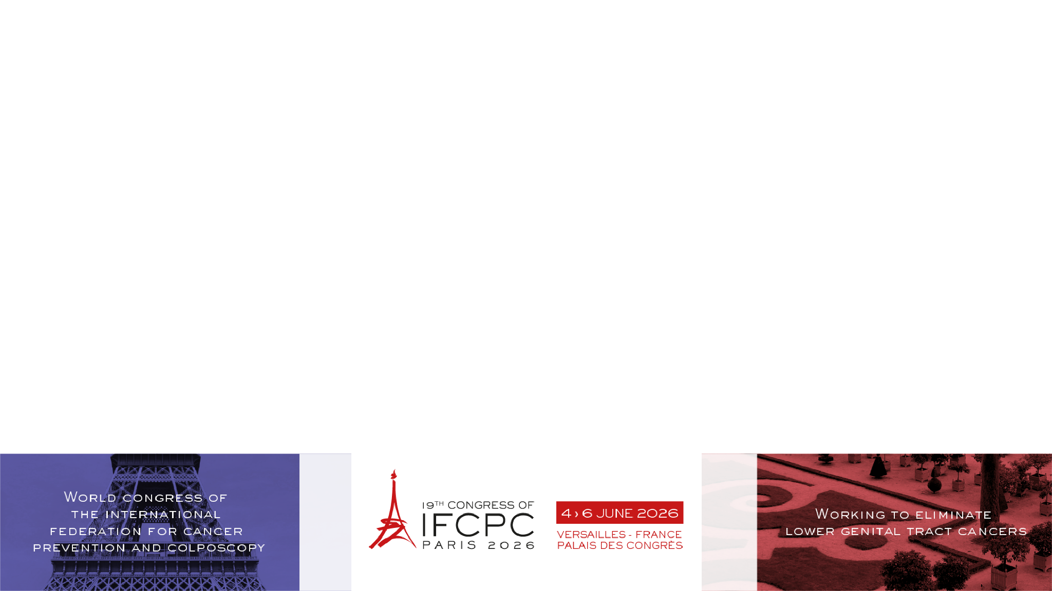
Anal Microbiome and Inflammation
Alterations After Curcumin Treatment from a Pilot Safety and Feasibility
Clinical Trial
¹Lisa Flowers, MD, MPH, ¹Timothy Read, PhD, ¹Raju Subbiah, M.Sc., ¹Sakthivel Govindaraj, PhD, ¹Nadi Kaonga, MD, ¹Nichole Ciers-Davis, ¹Kadera Lymon, MPH, ¹Vijayakumar Velu, PhD, ¹Canhua Xiao, PhD
¹Emory University - Atlanta (United States)

Slide 2

Objectives and Background
Curcumin possesses potent anti-inflammatory with anti-tumor properties and ability to reverse the effects of HPV.
However, curcumin’s application for anal high-grade squamous intraepithelial lesions (aHSIL) has not been tested.
Thus, we conducted a 3+3 dose escalation clinical trial to evaluate safety and feasibility for curcumin’s anal application.
To detect alterations in the anal microbiome of individuals with aHSIL pre-and-post 14 days of curcumin treatment.
To examine inflammatory markers pre-and-post 14 days of curcumin treatment

Slide 3
Methods
We recruited participants with aHSIL/ to receive anal curcumin capsules
Pre- and post-intervention anal swabs were collected for microbiome (shotgun sequencing) and inflammation (MSD) testing.
Linear decomposition models (LDM) and non-parametric tests were performed for microbiome and inflammation, respectively.
At increasing dosages starting with 500 mg daily up to a maximum tolerated dose of 3,000 mg for 14 consecutive days.

Slide 4

Results
No significant side effects were reported (N=12)
aHSIL shrinkages were observed.
No significant difference was found for alpha and beta diversities for the anal microbiome pre- and post-intervention.
At the species level, Mediterraneibacter faecis showed a lowest p value and had a trend of a significant increase after curcumin (p=0.052).
  Mediterraneibacter faecis has been identified as enriched in women without high-risk HPV infection. The increase in our data suggests curcumin’s potential protective role on promoting beneficial microbiome like Mediterraneibacter faecis against HPV infection and anal disease progress.
Inflammatory marker results showed that interleukin-1 receptor antagonist (IL1ra) was statistically significantly reduced after treatment (p=0.027), suggesting a potential anti-inflammatory effect of curcumin at anal canal.

Slide 5

Conclusion
Our findings also provide preliminary evidence indicating curcumin’s protective effects on promoting beneficial microbiome like Mediterraneibacter faecis against HPV infection and reducing inflammation for aHSIL.
Curcumin application was well tolerated, with no significant adverse effects reported, supporting its safety for anal use in aHSIL patients.
Together, these findings suggest that curcumin may exert dual benefits through microbiome modulation and inflammation reduction.
Acknowledgments
Georgia Center for Oncology Research and Education: Award ID: 0000067974

