Slide 1


Changes in the awareness of cervical cancer and the characteristics of the vaccination population after HPV vaccine introduction in China
Miao Zou
Maternal and Child Health Hospital of Hubei Province, Wuhan, China

Slide 2



Background & Challenges
Disease Burden & Etiology
Aim:To Evaluate
Knowledge Changes & Vaccinee Characteristics
Cervical cancer is a life-threatening malignant tumor that poses a severe global health threat to women In 2022, China reported an estimated 150,700 new cases and 55,700 deaths from cervical cancer, with both incidence and mortality rates continuing to rise.
HPV Vaccine Access & Uptake
This study analyzed the dynamic changes in women’s cervical cancer awareness amid extensive media promotion and active medical education, and characterized 10,985 HPV-vaccinated women at our center (age, demographics, sexual history, screening history).
The findings aim to provide a theoretical basis for local governments to improve HPV vaccination rates and guide targeted public education.
The first HPV vaccine was FDA-approved in 2006, with 6 vaccines now marketed in China since 2016. As voluntary, self-funded Category II vaccines, vaccination willingness is highly dependent on women’s knowledge of cervical cancer prevention.
Knowledge Gap & Intervention Context
Prior to vaccine introduction, Chinese women showed poor awareness of cervical cancer and HPV vaccines. Post-approval, media coverage and institutional health education have increased significantly, creating a critical opportunity to assess knowledge changes.

Slide 3
Table 1. Knowledge of cervical cancer, HPV, and HPV vaccines among women from 2016 to 2020
Results
Table 1. Knowledge of cervical cancer, HPV, and HPV vaccines among women from 2016 to 2020
Item | 2016（N=9670） |  |  | 2017(N=4653) |  |  | 2018（N=7485） |  |  | 2019（N=7569） |  |  | 2020(N=8207)
 | Yes(N) | Yes(%) |  | Yes(N) | Yes(%) |  | Yes(N) | Yes(%) |  | Yes(N) | Yes(%) |  | Yes(N) |  | Yes(%)
Have you heard of cervical cancer? | 4098 | 42.38% |  | 2002 | 43.03% |  | 5478 | 73.19% |  | 6283 | 83.01% |  | 7476 |  | 91.09%
Cervical cancer can be diagnosed early | 3553 | 36.74% |  | 1767 | 37.98% |  | 4494 | 60.04% |  | 5321 | 70.30% |  | 6620 |  | 80.66%
Early cervical cancer is curable | 3204 | 33.13% |  | 1526 | 32.80% |  | 3749 | 50.09% |  | 4490 | 59.32% |  | 5323 |  | 64.86%
Have you heard of HPV? | 2388 | 24.69% |  | 1235 | 26.54% |  | 2756 | 36.82% |  | 4350 | 57.47% |  | 5568 |  | 67.84%
High-risk HPV infection is the cause of cervical cancer | 1709 | 17.67% |  | 821 | 17.64% |  | 2029 | 27.11% |  | 3414 | 45.11% |  | 4243 |  | 51.70%
HPV spreads primarily through sexual contact | 1866 | 19.30% |  | 1032 | 22.18% |  | 2259 | 30.18% |  | 3824 | 50.52% |  | 4955 |  | 60.38%
HPV can be cleared | 1202 | 12.43% |  | 567 | 12.19% |  | 1338 | 17.88% |  | 1995 | 26.36% |  | 2175 |  | 26.50%
HPV infection does not necessarily develop into cervical cancer | 882 | 9.12% |  | 475 | 10.21% |  | 1042 | 13.92% |  | 2110 | 27.88% |  | 2471 |  | 30.11%
Cytology + HPV test can prevent cervical cancer | 1793 | 18.54% |  | 1008 | 21.66% |  | 2100 | 28.06% |  | 3449 | 45.57% |  | 4395 |  | 53.55%
Have you heard of HPV vaccines | 1839 | 19.02% |  | 1282 | 27.55% |  | 3896 | 52.05% |  | 5175 | 68.37% |  | 7074 |  | 86.19%
HPV vaccines can prevent cervical cancer, CIN, penile cancer,etc. | 1470 | 15.20% |  | 1105 | 23.75% |  | 3360 | 44.89% |  | 4737 | 62.58% |  | 6620 |  | 80.66%
After HPV vaccination, regular cervical cancer screening is still required | 1394 | 14.42% |  | 1001 | 21.51% |  | 3026 | 40.43% |  | 4542 | 60.01% |  | 6417 |  | 78.19%
The optimal age for HPV vaccination is before the start of sexual activity | 749 | 7.75% |  | 562 | 12.08% |  | 1853 | 24.76% |  | 3591 | 47.44% |  |  | 5791 | 70.56%
From 2016 to 2020, women’s knowledge about cervical cancer, HPV, and HPV vaccines showed a gradually increasing trend, especially after 2018. However, compared to the knowledge about cervical cancer and HPV vaccines, women’s knowledge of HPV was relatively low.

Slide 4
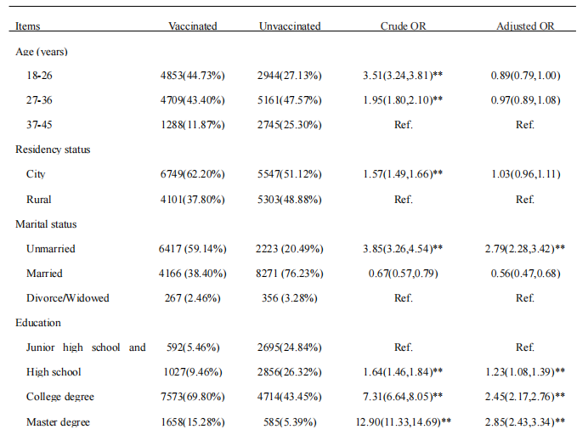
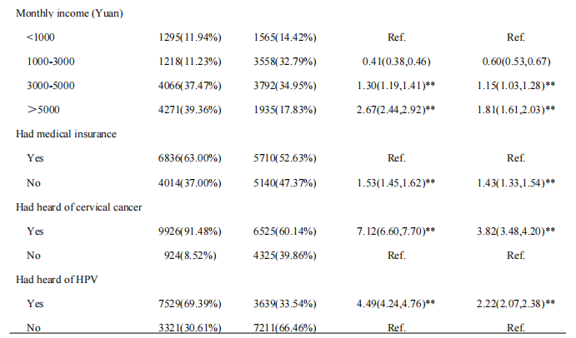
Results
Table 2 Logistic regression analysis (OR and 95% CI) for vaccination predictors
Women who were unmarried, had higher education levels, higher income, possessed health insurance, and had heard of cervical cancer and HPV were significantly more likely to be vaccinated.
** P<0.01, *P<0.05

Slide 5
Results and Conclusions
Figure 2 Age distribution of 10985 women who received HPV vaccine
Figure 3. Sexual history and screening history of 10985 women who received the HPV vaccine
Among 10,985 vaccinated women, only 135 (1%) were under 18, 7389 (67%) had pre-vaccination sexual history,
while merely 3204 (43%) had undergone cervical cancer screening.
This study found that the approval of HPV vaccines in China, coupled with widespread media coverage and scientific education provided by medical institutions, has continuously increased women's awareness of cervical cancer and HPV vaccines. However, awareness of HPV still needs improvement. Most of the vaccinated women had a college education or above and had a higher awareness of cervical cancer and HPV. The current problem is that the vast majority of vaccinated women are adults, whereas the vaccination rate for young girls is less than 1%, despite continuous promotion. Building on the effective expanded pilot programs, China formally incorporated bivalent HPV vaccines into the National Immunization Program in November 2025, providing free vaccination for 13-year-old girls. On the other hand, the cervical cancer screening rate still remains relatively low, indicating a need for increased emphasis on the importance of screening while promoting the HPV vaccine.
Conclusions

