Slide 1


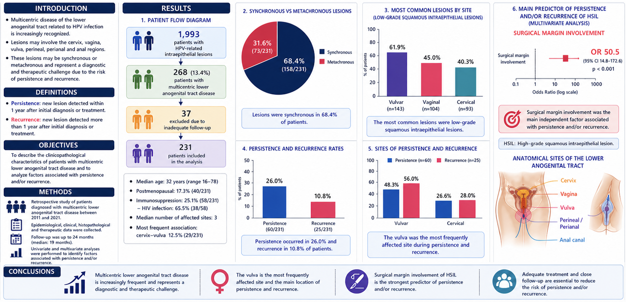

MULTICENTRIC DISEASE OF THE LOWER ANOGENITAL TRACT: MANAGMENT AND OUTCOMES
La Valle S., Salamanca C., Puñal A., Spinosa, M. Fleider L.,
Gynecology Division, Hospital de Clínicas “José de San Martín”, University of Buenos Aires, Argentina.

