Slide 1





A cross-sectional study on the seroprevalence of type-specific HPV antibodies among women with current HPV infection who are negative, positive, or at different stages of cervical lesions
2026.05 Versailles·FRANCE
Li Tingyuan^{1,2}, Liu Yiwei³, Tuohetiguli Mutailpu¹, Li Mengting¹, Chang Yining²,
Wang Dengfeng², Peng Tao¹, Zhang Zhihui¹, Xie Liangzhi³, Chen Wen¹
^{1.} National Cancer Center/Cancer Hospital, Chinese Academy of Medical Sciences and Peking Union Medical College, Beijing 100021, China.
^{2.}Sichuan Cancer Hospital & Institute, Sichuan Cancer Center, School of Medicine, University of Electronic Science and Technology of China, Chengdu 610041, China
^{3.} Sinocelltech Ltd., Beijing 100176, China.

Slide 2
Introduction and Objective
Introduction
Serology has been pivotal for understanding the natural history of high-risk human papillomavirus (hrHPV) infection, pathogenesis, and vaccination efficacy.
Studying the age-specific titers of different types of hrHPV helps establish the epidemiological basis of immune response to natural infection or cervical lesions, which might contribute to threshold research on type-specific titers induced by HPV prophylactic vaccines.
Due to limitations of detection technology for antibodies against different types of hrHPV, epidemiological data on immune response to hrHPV infection and different grades of histopathologically confirmed cervical lesions remain insufficient, especially in older women who have a higher risk of cervical cancer.
Objective
To investigate the serum distribution of antibodies against hrHPV in normal women who are currently HPV-negative or HPV-positive, as well as in women at different stages of cervical lesions.

Slide 3
Methods
Study population and sample collection
Including criteria: Females who were 18–75 years old; not in the lactation period and not pregnant; have never been diagnosed acquired immune deficiency syndrome; have the ability to act independently and be able to provide informed consent.
Excluding criteria: Invalid test results for HPV antibody.
Sample collection: the plasma samples of eligible participants were collected for the detection of type-specific antibodies against HPV L1 capsid protein.
Type-specific HPV antibody detection
Luminex immunological assay (LIA) was used for the HPV antibody detection.
The direct binding IgG assay for HPV VLP types 6, 11, 16, 18, 31, 33, 35, 39, 45, 51, 52, 56, 58, and 59 has been proven to be sensitive, accurate, robust, linear (parallel) and durable, and can be used to measure type-specific antibodies after natural infection or vaccination with VLP-based vaccines.
Statistical analysis
Antibody titers for the 12 hrHPV types were log‑transformed and summarized for inter‑group comparisons.
The geometric mean of type-specific hrHPV antibodies were calculated using data of participants with detectable antibodies.

Slide 4
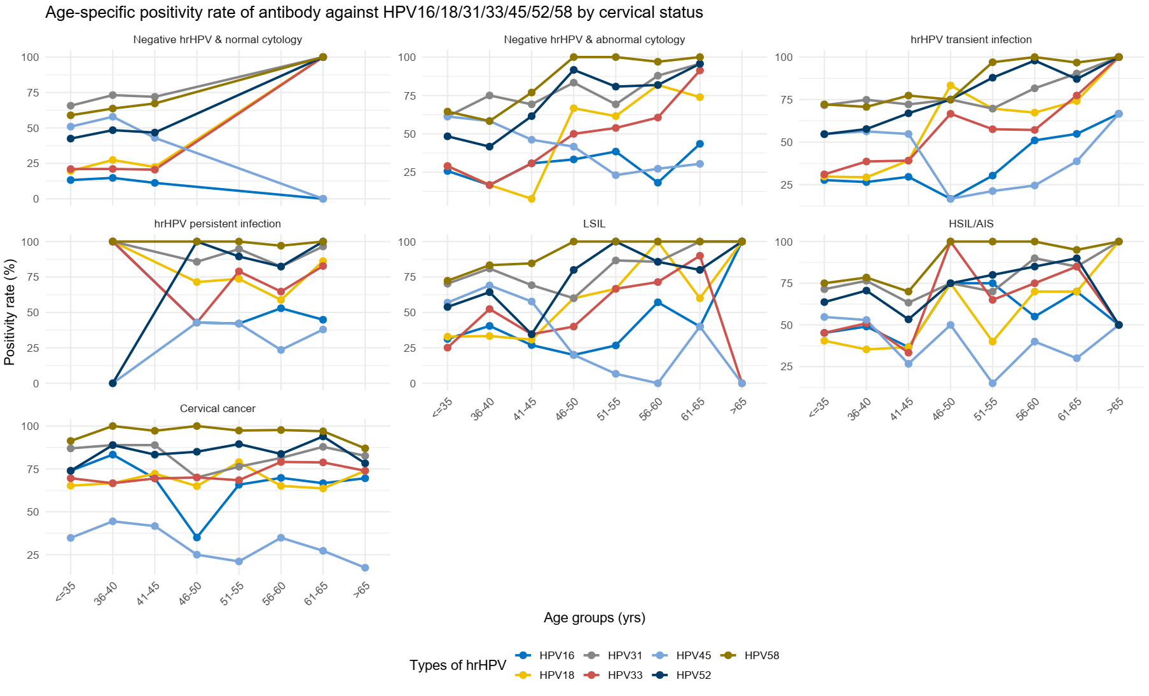
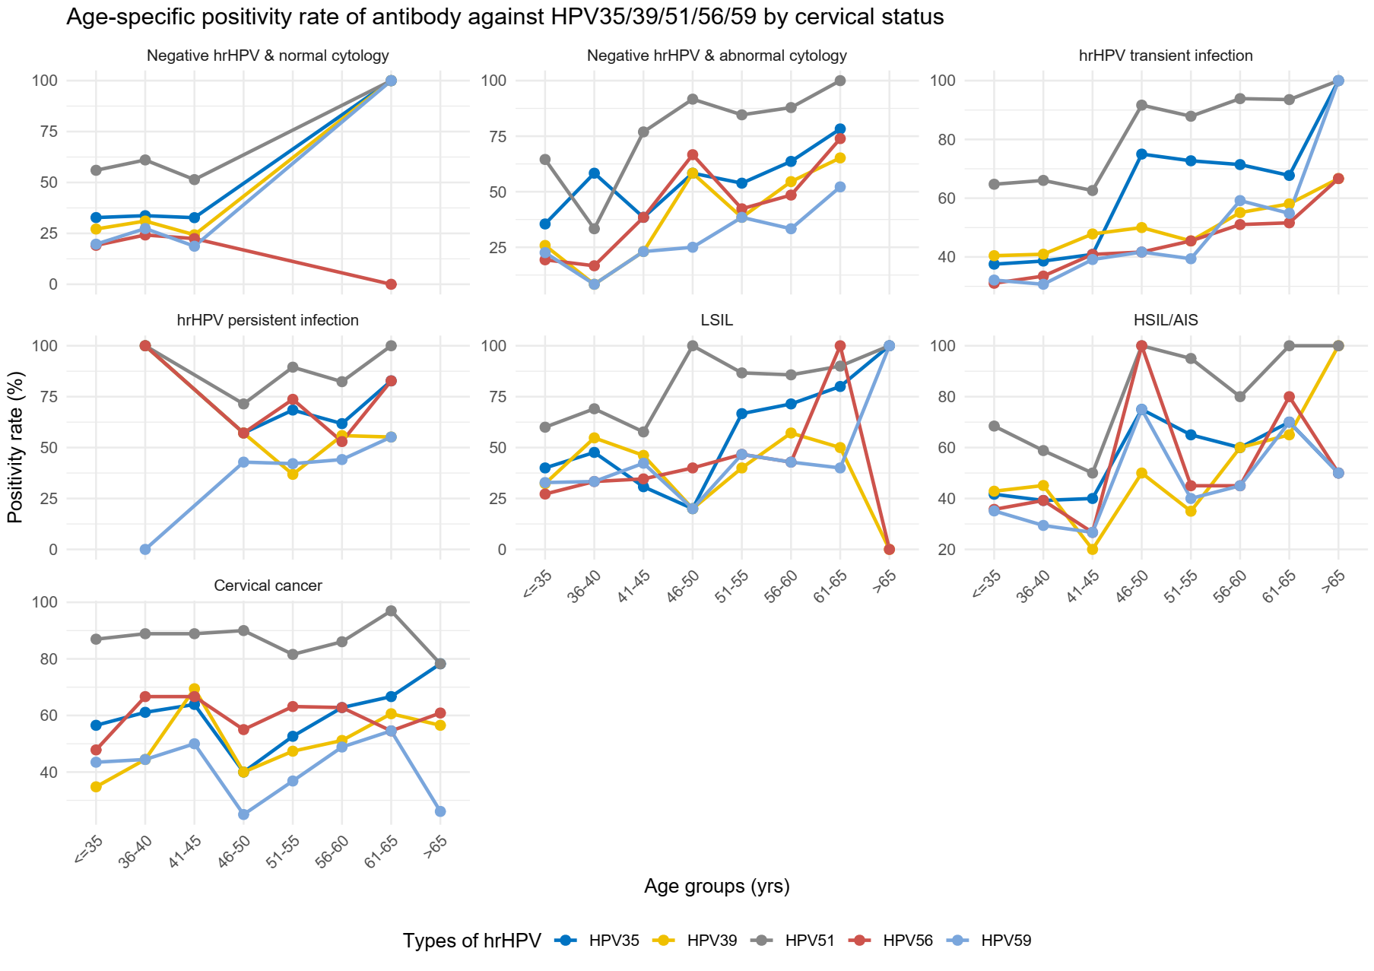
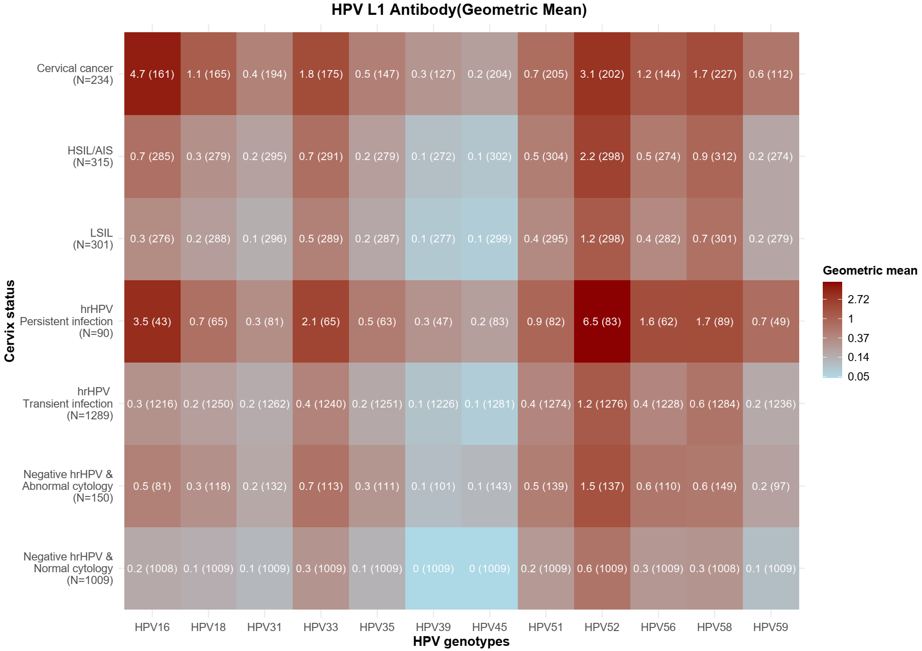
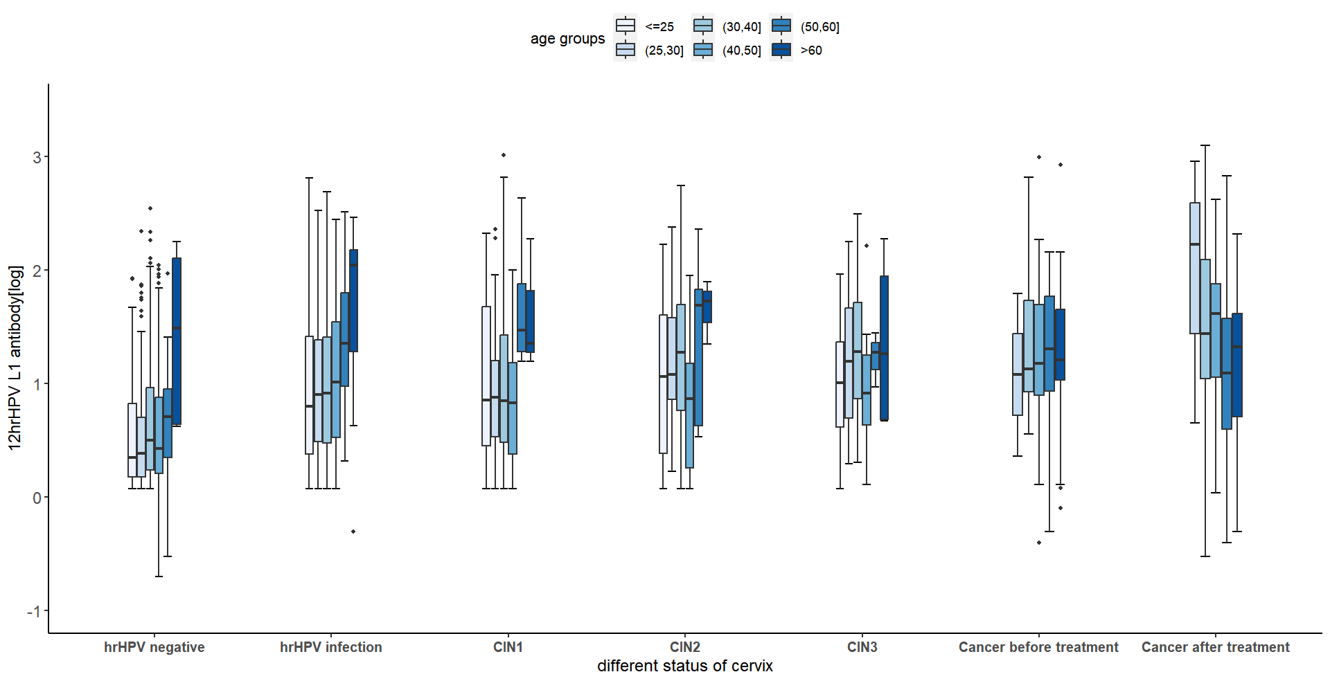
Results
A total of 3,388 participants (enrolled Feb 2023–Feb 2026) were included: 1,009 hrHPV‑negative & NILM, 150 hrHPV-negative & abnormal cytology, 1,289 hrHPV transient infection, 90 hrHPV persistence without histologically confirmed cervical lesion, 301 LSIL, 315 HSIL/AIS, and 234 cancer.
In non-cancer participants, the positivity rate of the 12 hrHPV types increased with age. In contrast, among cancer patients, both the positivity rate and antibody titers remained similar across all age groups.
Participants with hrHPV persistence or histologically confirmed cervical cancer had higher antibody titers against the 12 hrHPV types compared to the other participant groups.
In treated cancer patients, titers decreased significantly with age (P<0.05).

Slide 5
Conclusions and Acknowledgement
hrHPV antibody titer might be a potential biomarker for cervical lesion progression, with its age association showing a disease stage‑specific pattern.
Monitoring hrHPV antibody dynamics may aid in risk assessment and prognosis, particularly during post treatment follow-up.
Funding: Beijing Natural Science Foundation, Grant Number: No.7252123;
Corresponding to Prof. Wen Chen; e-mail: chenwen@cicams.ac.cn

