Slide 1
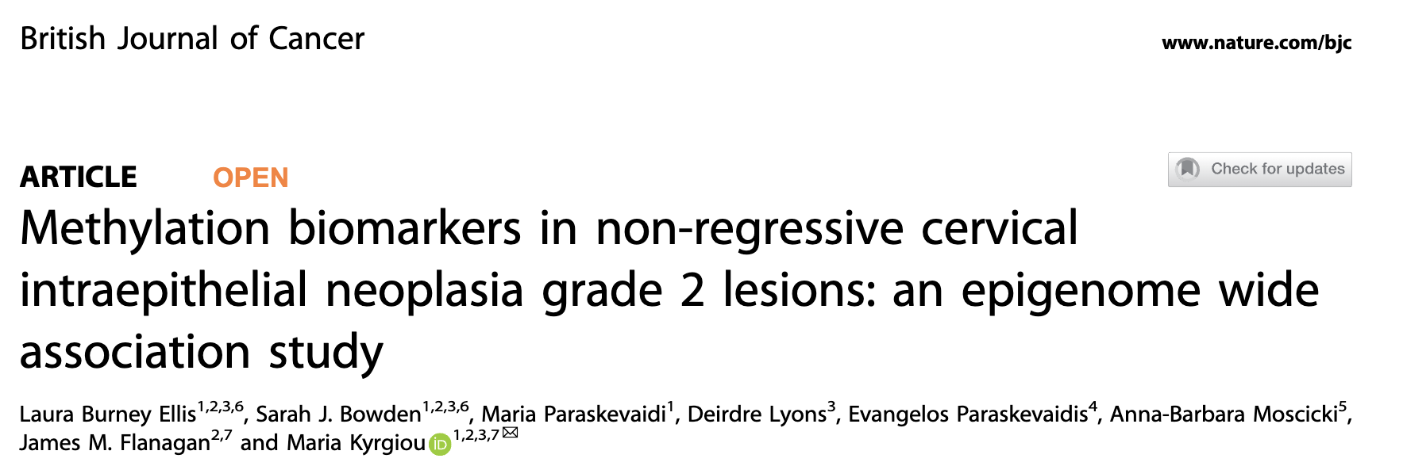
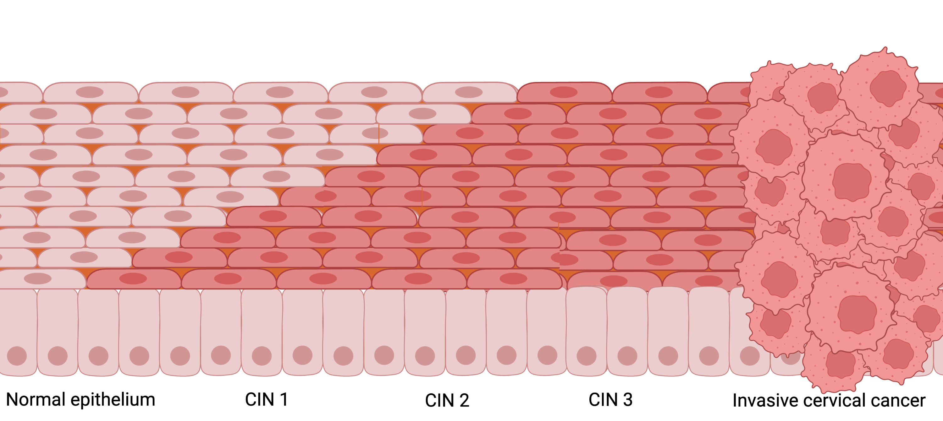

CIN2: To treat or not to treat?
What if we had a predictive biomarker?
! No accurate way to predict which lesions will regress
Regresses
spontaneously
Treat
surgically
???

Slide 2

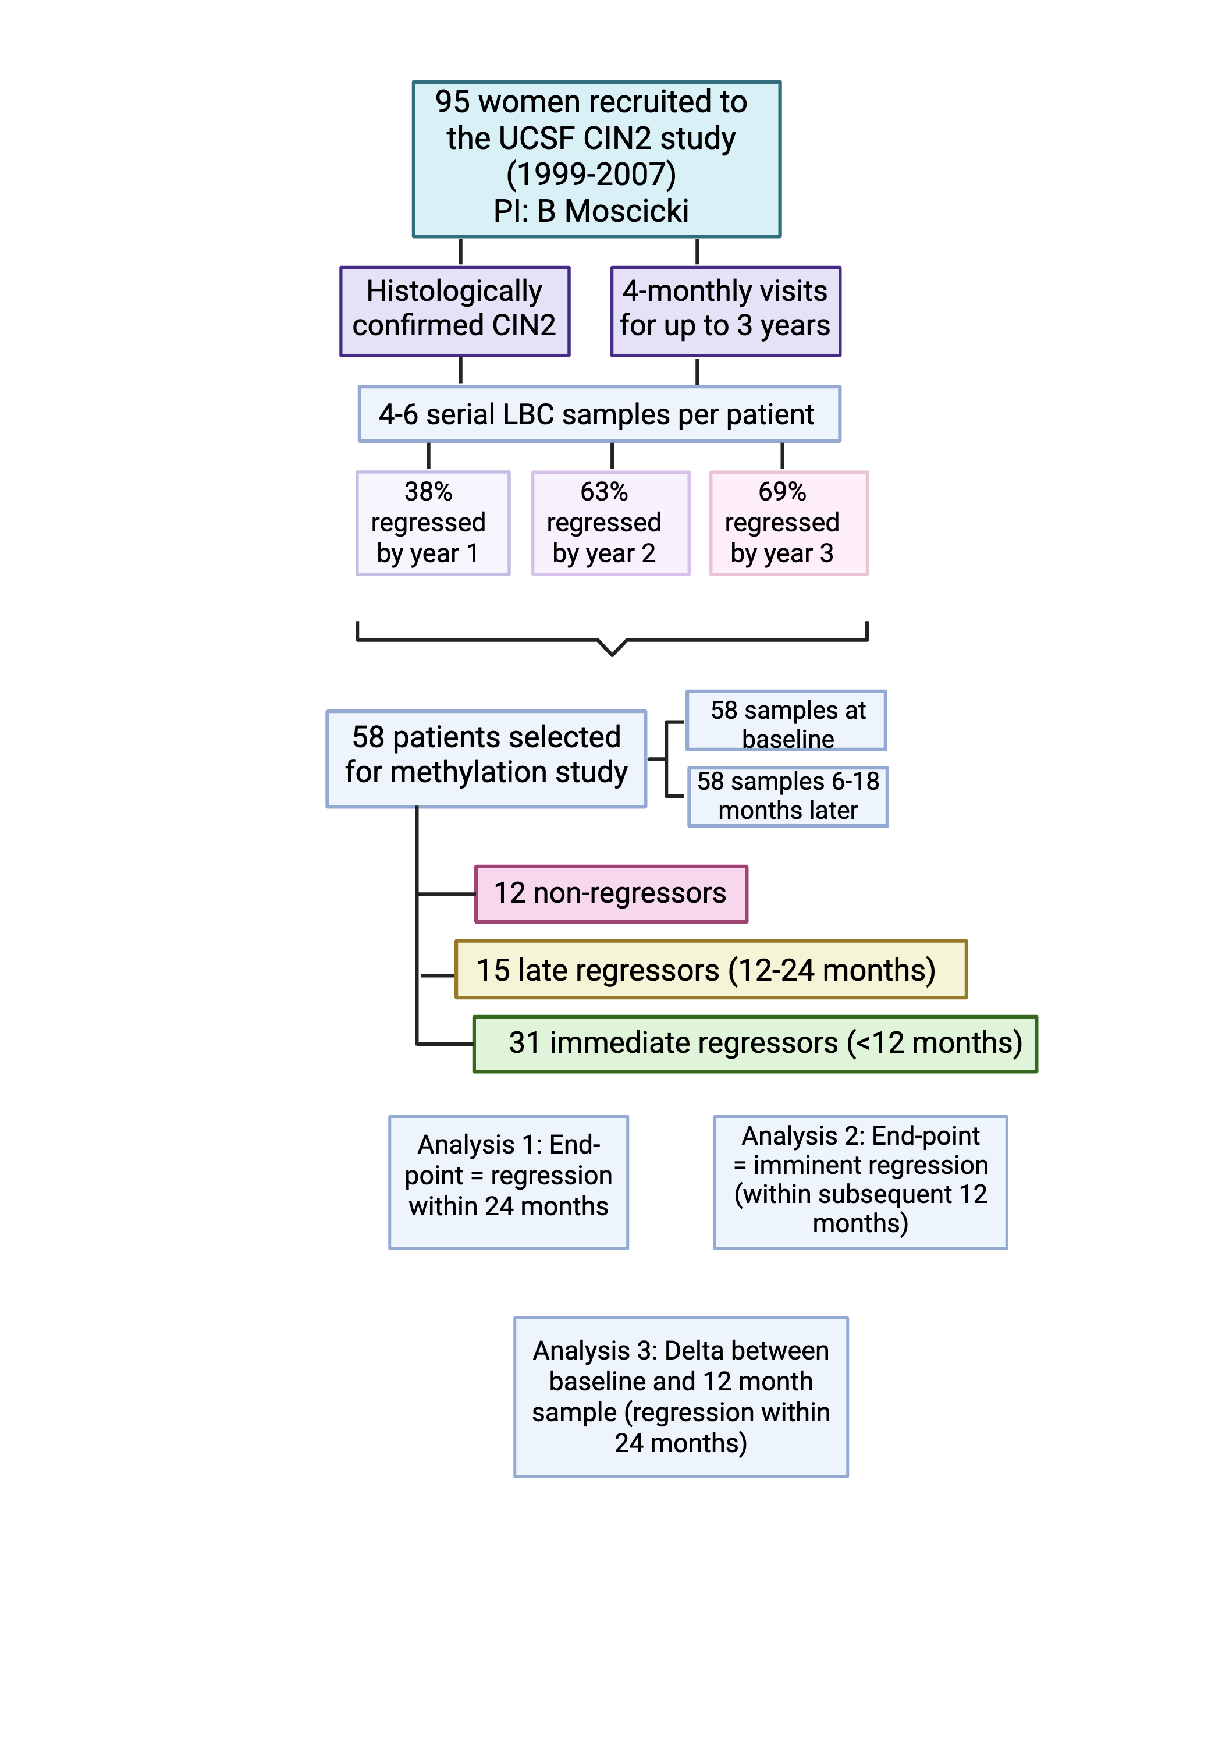

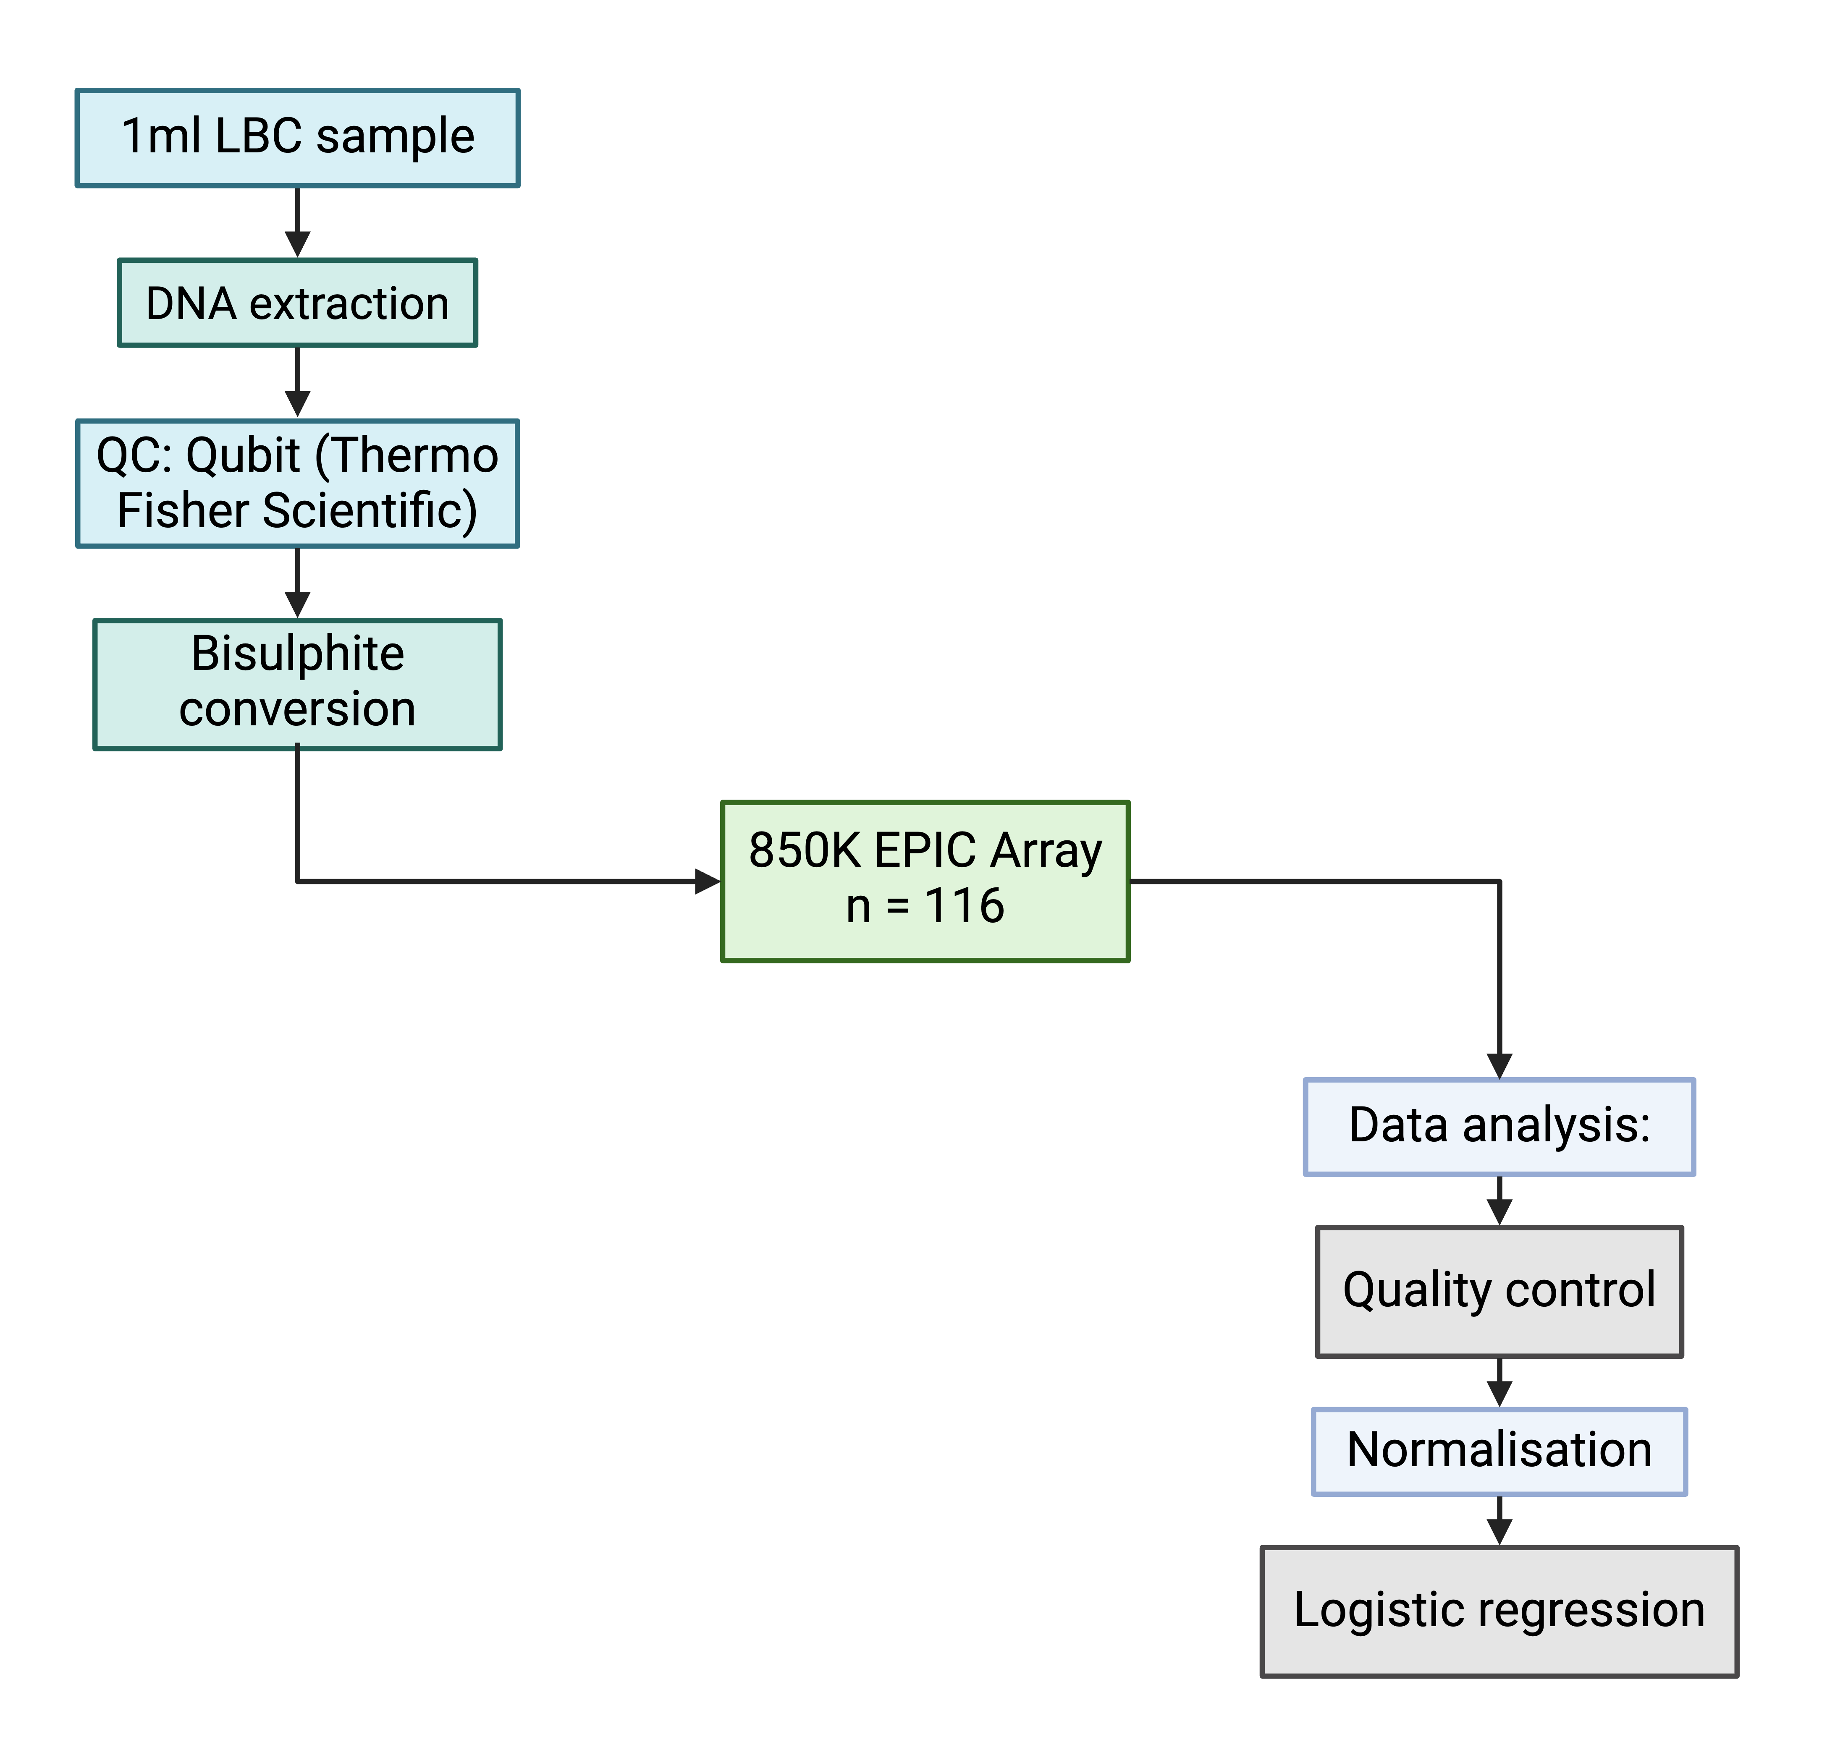
DNA methylation as a predictive biomarker to identify which CIN2 lesions will progress and which will regress?
Study design: An 850k methylation array on cervical DNA from a cohort of 58 women with conservatively managed CIN2, who were monitored with serial samples up for 3 years and have a known outcome (progression or regression)
Eligibility criteria:
  sufficient DNA in paired samples
  hrHPV positive
  clear outcome
Analyses:
Regression (n=46) vs non-regression at 24 months (n=12)
Imminent regression (n=46) vs non-regression (n=27)
Delta 0-12 months: regression (n=46) vs non-regression at 24 months (n=12)
Notes:
Our analyses were firstly for overall regression vs non-regression, secondly, for imminent regression or in other words regression in the subsequent 12 months, and finally a delta analysis comparing methylation over time, to look for significant differences associated with histological change

Slide 3
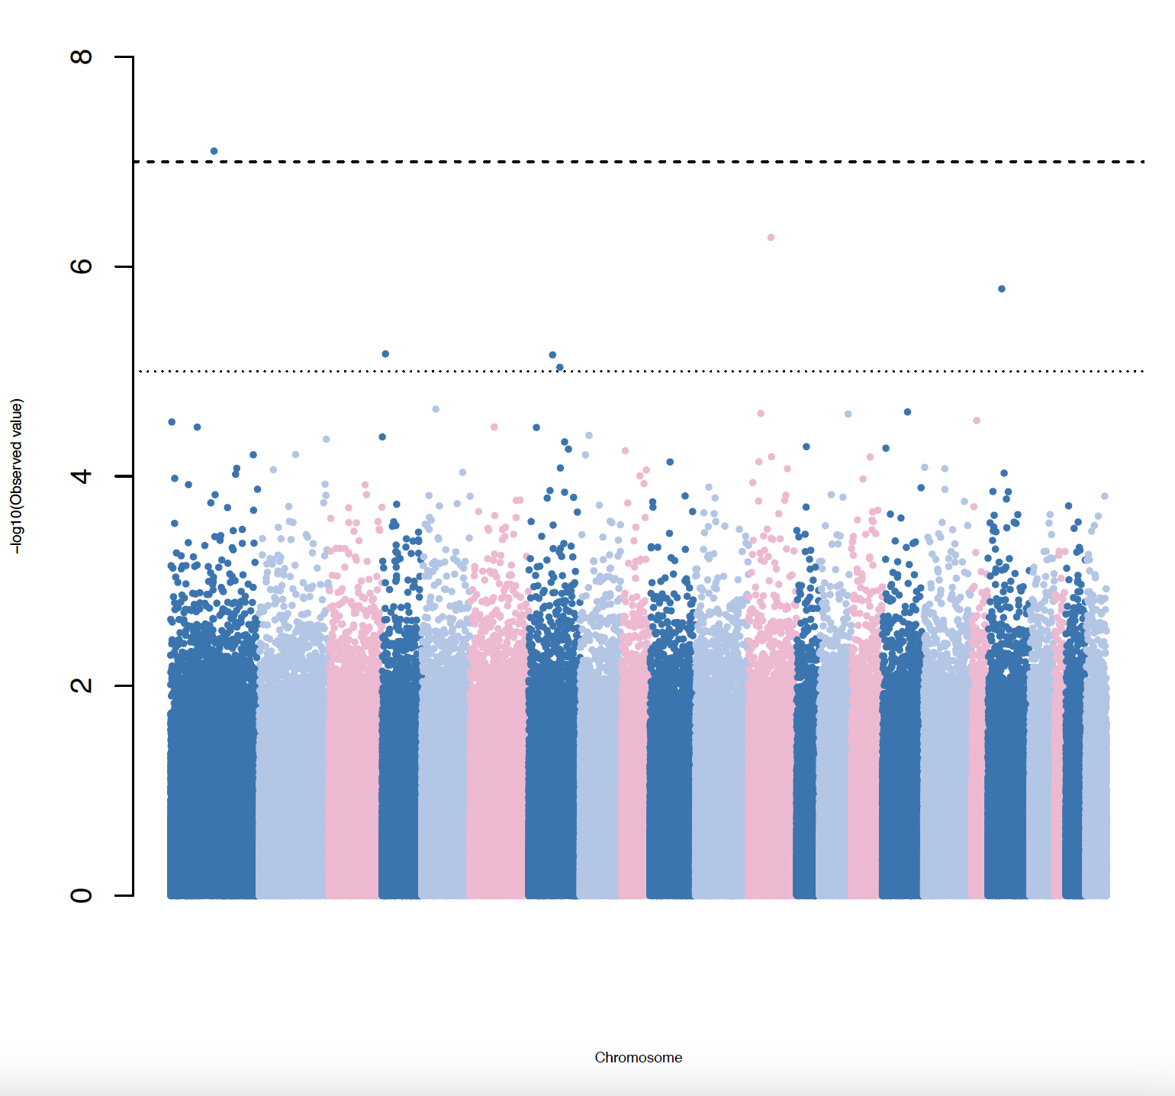
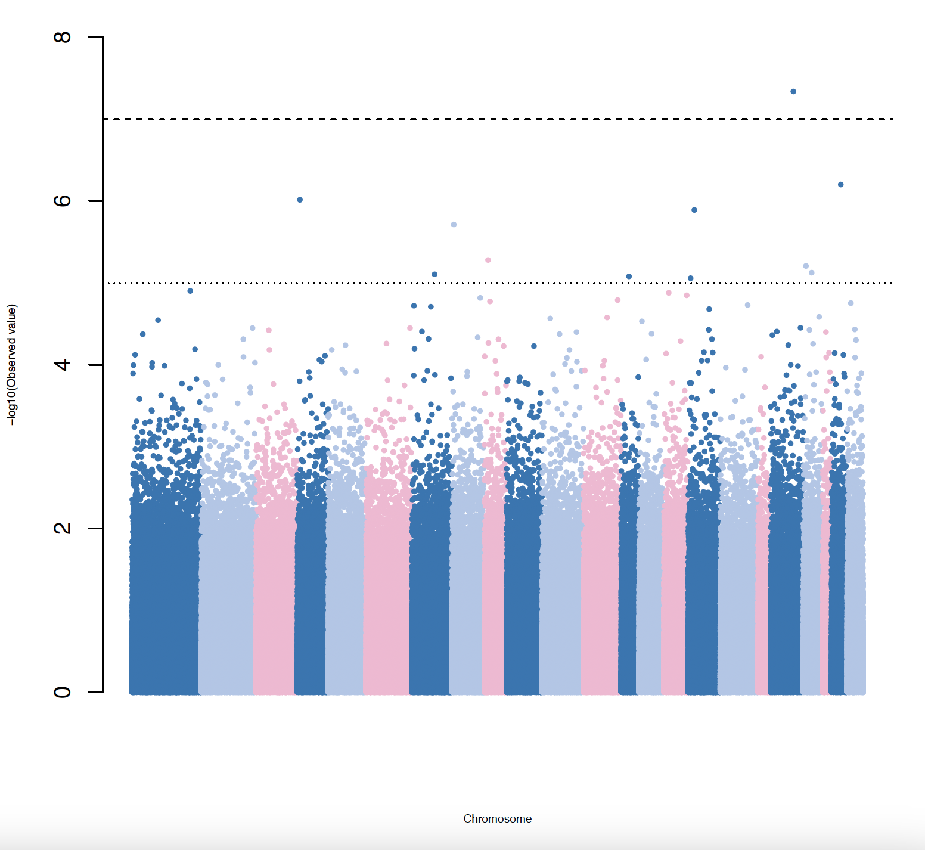
Results
CpG | Chromosome, position | Relation | Gene | P Value | FDR
cg12754953 | 1, 165656459 | Open Sea | ALDH9A1 | 7.90e-08 | 0.068
cg18887759 | 19, 50324282 | S shelf | MED25 | 4.59e-08 | 0.040
cg12754953
cg18887759
Regressors vs Non-regressors
(24 months)
Imminent Regressors (<12 months)
vs Non-regressors
p =10⁻⁷
p =10⁻⁷
p =10⁻⁵
p =10⁻⁵
Ellis et al, BJC 2026
Notes:
In our analyses looking at regression vs non-regression and regression within 12 months, there was one significant site in each after correcting for multiple testing. These are the Manhattan plots of those two analysis, and the genes that the methylated site corresponds to

Slide 4
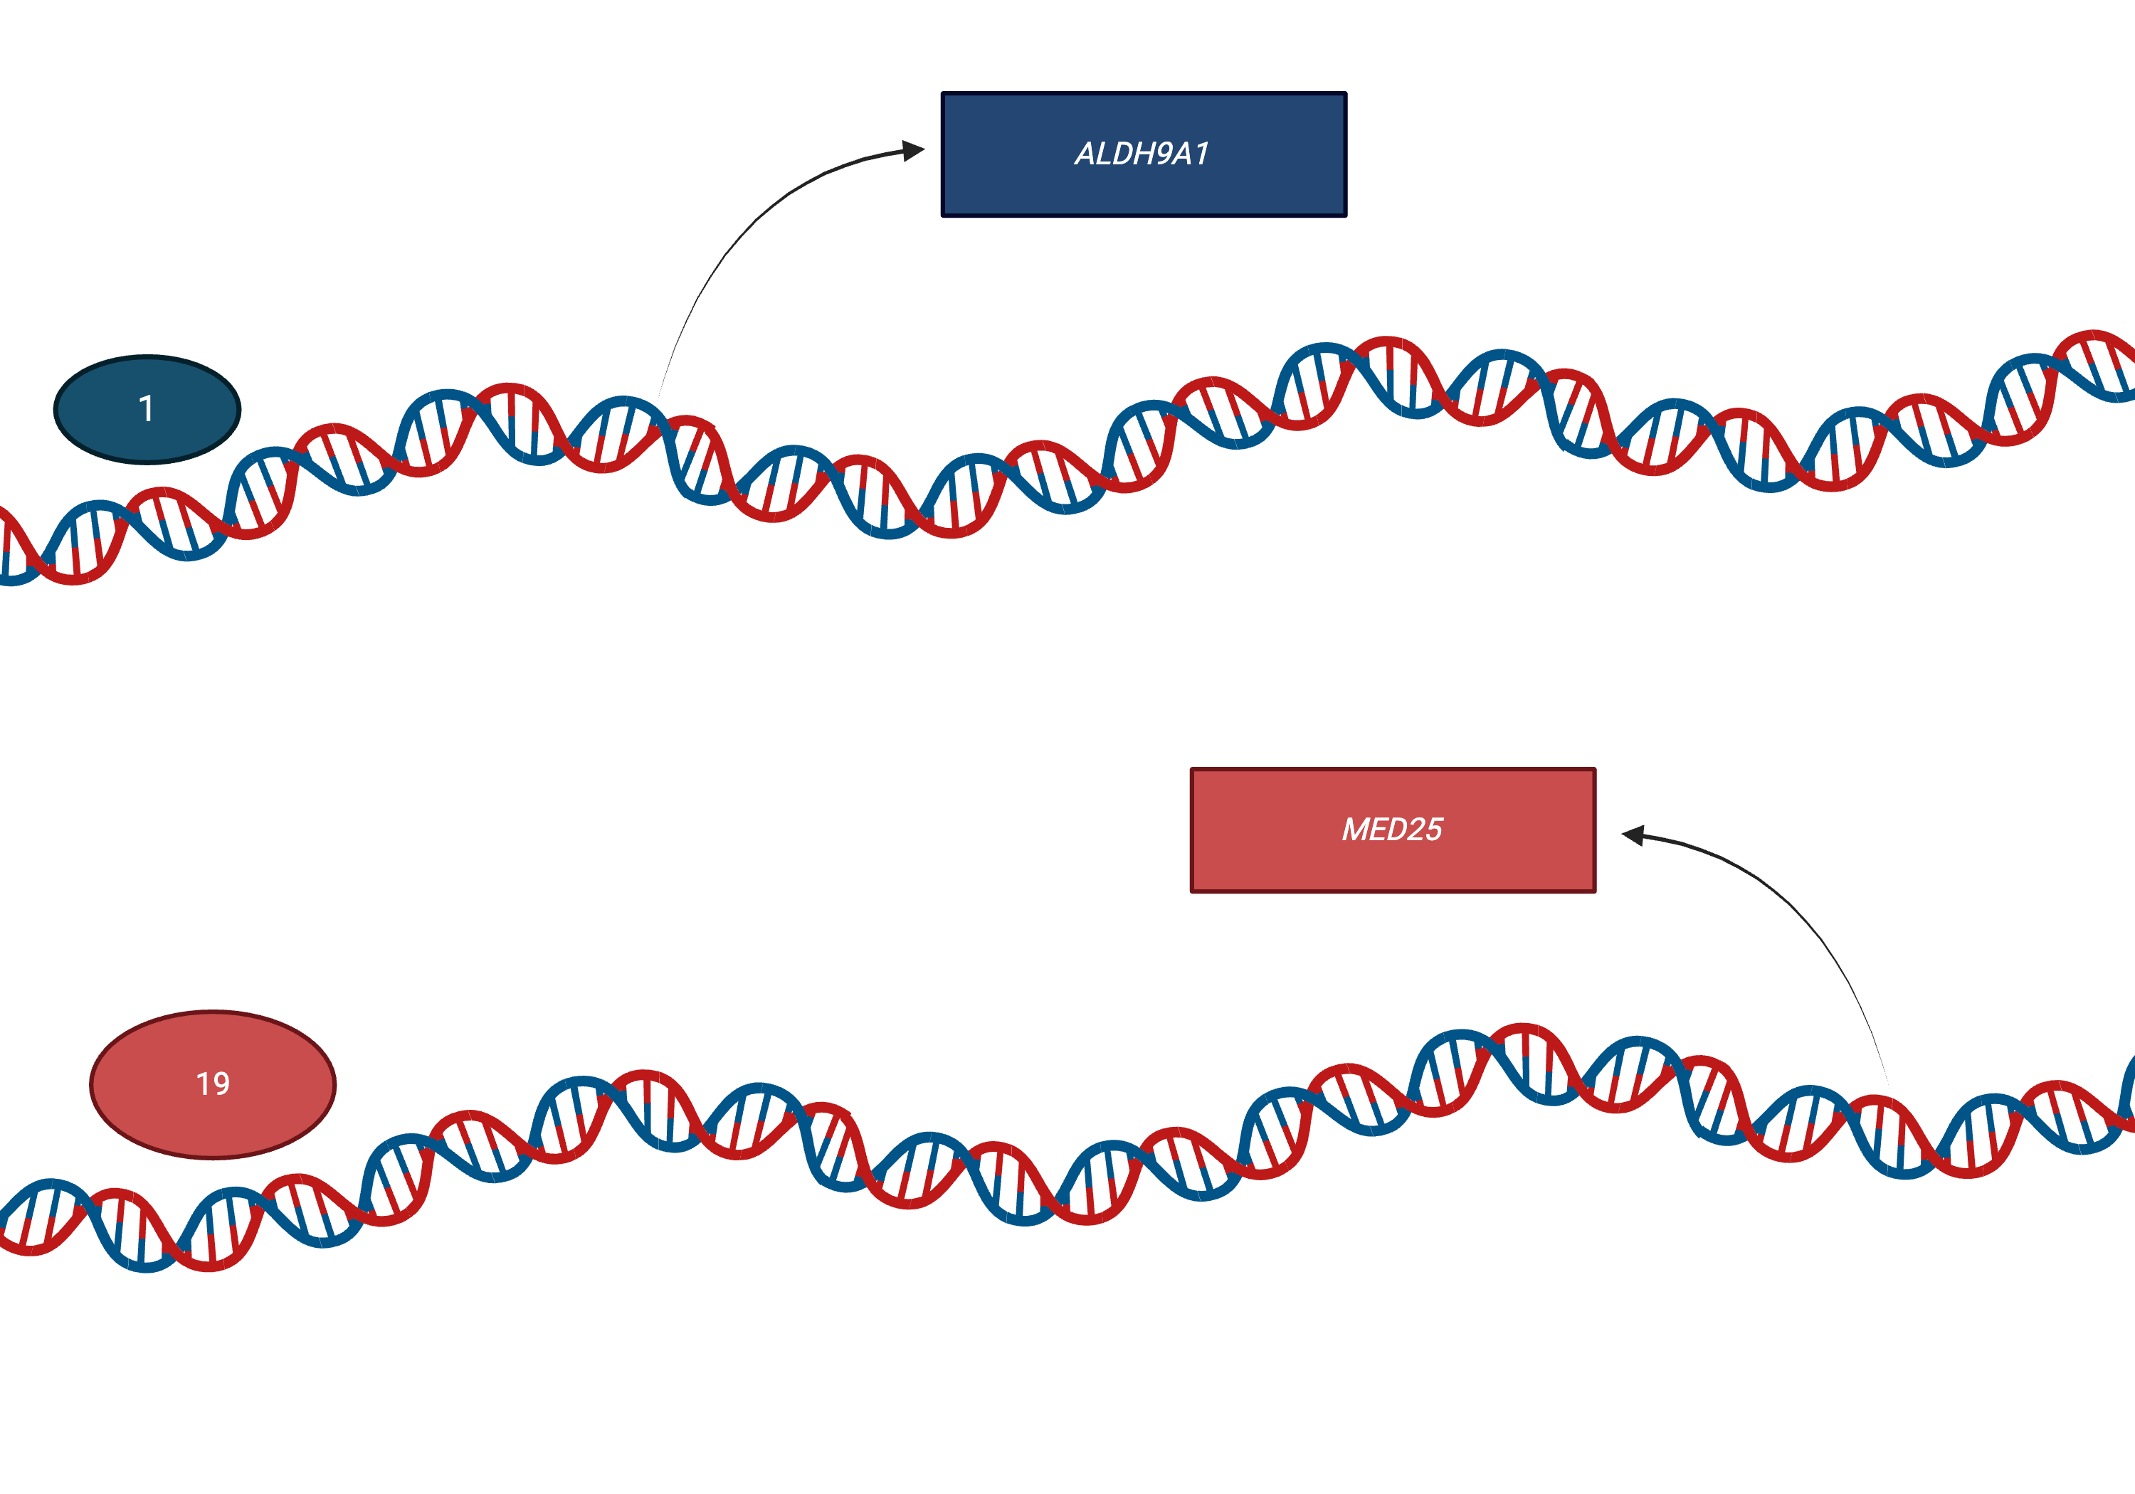
Implicated genes and their proteins
ALDH9A1
= aldehyde dehydrogenase
Involved in regulation of cell proliferation and survival
Examining ALDH9A1 on the Human Protein Atlas reveals a worse 5-year survival in 291 cervical cancers with a low expression (60% vs 71%, p=0.032)
MED25
= viral-protein complex
Human Protein Atlas cohort 5-year survival rate is 75% with high expression of MED25, compared to 58% with a low expression (p=0.0052)
Ellis et al, BJC 2026
Notes:
The genes associated with these differently methylated sites are not well explored. Interestingly, ALDH9A1 is involved in cell proliferation and survival, and MED25 forms a viral protein complex. So biological plausibility of the role of these genes in cervical carcinogenesis may exist.

Slide 5
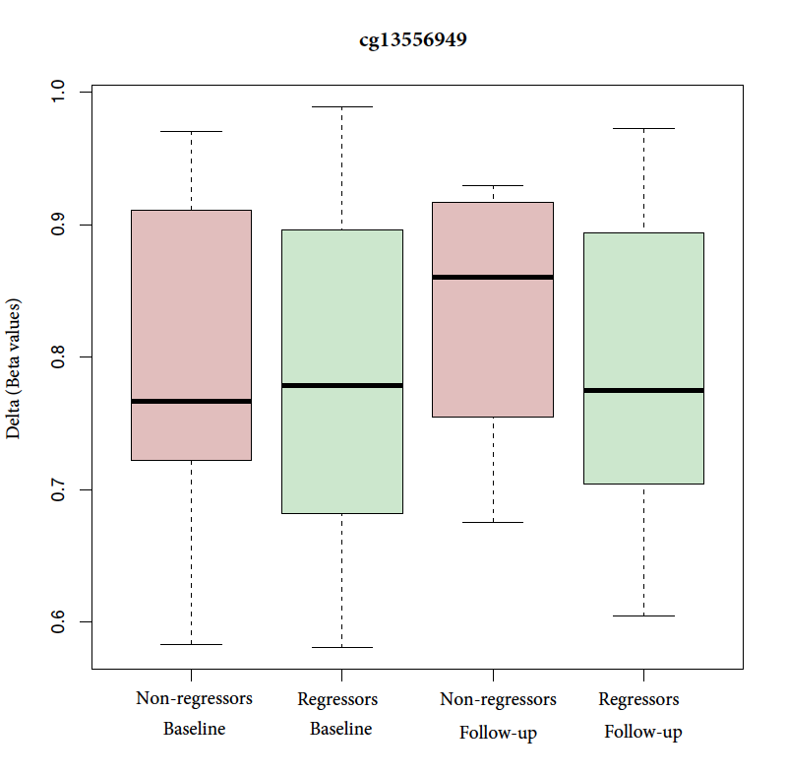
Results: Delta analysis
p 3.48e-08
CpG | Chromosome, position | Relation | Gene | P Value | FDR
cg13556949 | 19, 49395260 | Open Sea | TULP2 | 3.48e-08 | 0.030
TULP2
Expression increased in dendritic cells → play a role in immune response to HPV
Increase in methylation in non-regressors could represent a decreasing relative percentage of immune cells
Status and timepoint | Non-regressors (baseline) | Regressors (baseline) | Non-regressors (follow-up) | Regressors (follow-up)
Median beta value | 0.767 | 0.779 | 0.861 | 0.775
Delta |  |  | +0.094 | -0.004
Ellis et al, BJC 2026
Notes:
The delta analysis found one differently methylated site in non-regressors: methylation at TULP2 increased as cells failed to regress histologically. TULP2 expression is increased in dendritic immune cells, so an increase in methylation may correspond to a decreasing relative percentage of immune cells

