Slide 1


Clinical Utility of an Optoelectronic Imaging Tracing System for Diagnosis of High-Grade Cervical Lesions
Department Of Gynecology And Obstetrics
The First Affiliated Hospital Of Zhengzhou University
Zhengzhou, China
Presenter: Prof. Liping Han

Slide 2

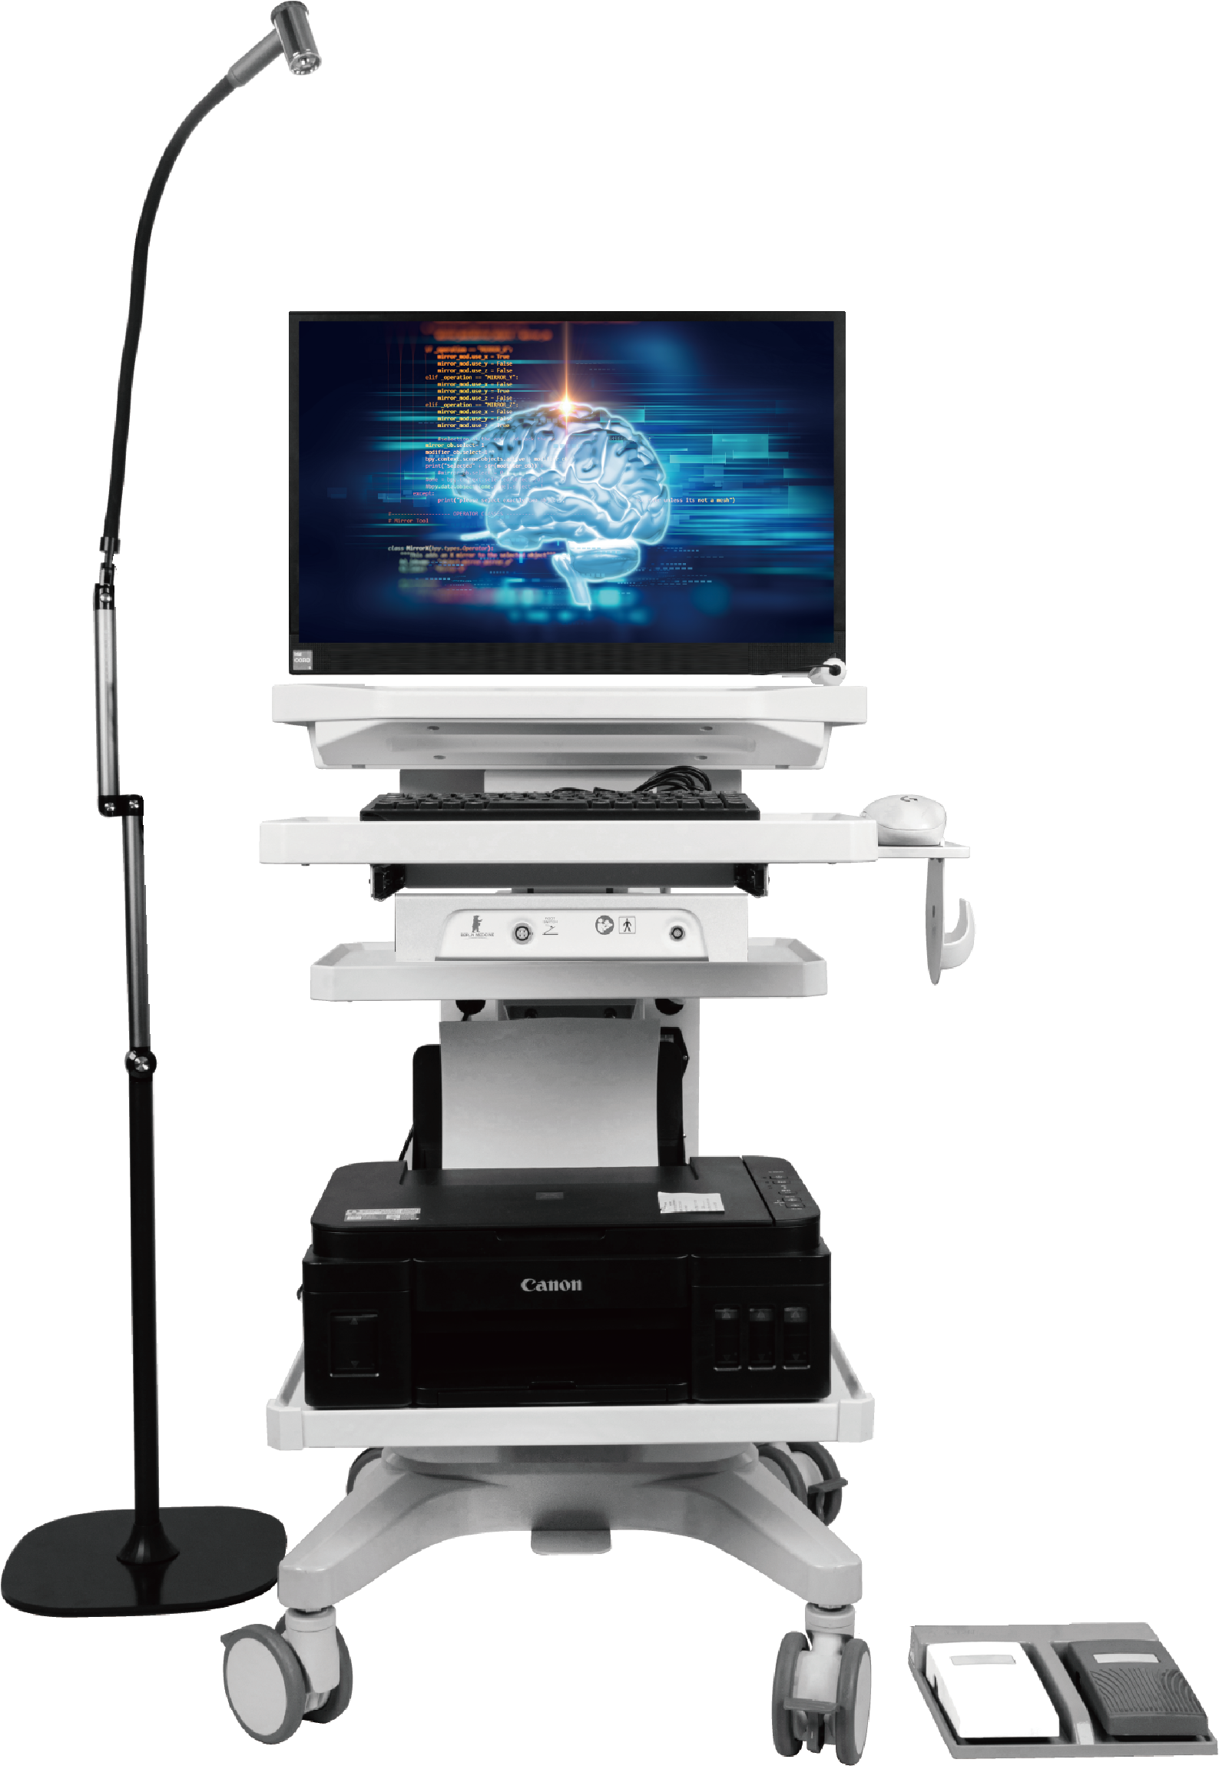
Abstract
Background: To evaluate the performance of a novel Optoelectronic Imaging Tracing System (OITS) in diagnosing high-grade cervical intraepithelial neoplasia and to compare its effectiveness with existing methods, including HPV genotyping, liquid-based cytology (LBC), and colposcopy in cervical lesion screening.
Methods: This prospective observational study enrolled 303 women referred for colposcopy between September and December 2024. All participants underwent OITS examination prior to colposcopy, followed by directed cervical biopsy with histopathology as the reference standard. The diagnostic performance of OITS for detecting CIN2+ and CIN3+ lesions was compared with LBC, high-risk HPV (hrHPV) testing, HPV16/18 genotyping, and colposcopic impression. Sensitivity, specificity, predictive values, receiver operating characteristic (ROC) curves, and area under the curve (AUC) were calculated.

Slide 3
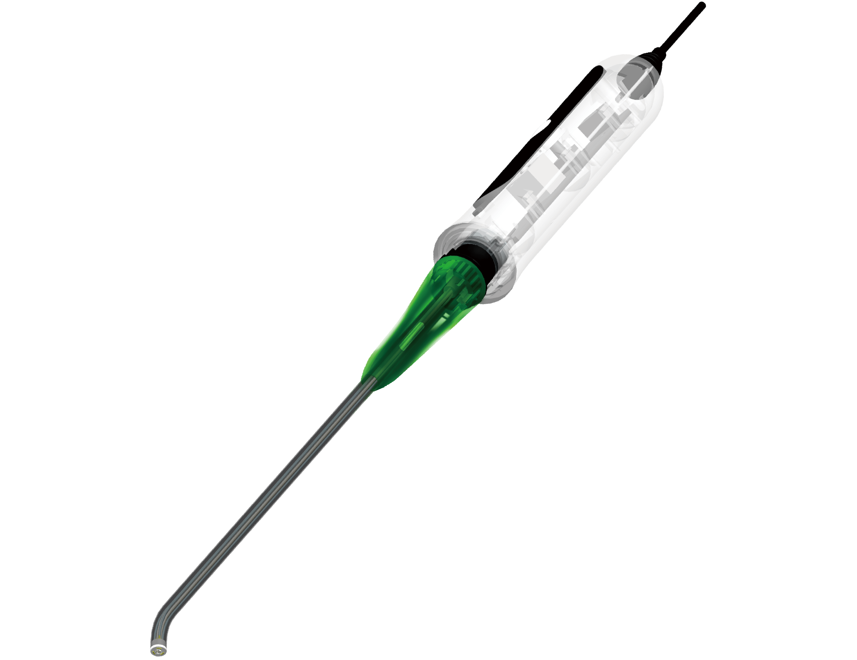
Results: Histopathology identified 82 cases of CIN2+ and 34 cases of CIN3+. OITS demonstrated the highest diagnostic accuracy for CIN2+ detection, with an AUC of 0.798 (95% CI: 0.762–0.834), sensitivity of 97.6% (95% CI: 94.2-100), specificity of 62.0% (95% CI: 55.6-68.4), and a negative predictive value of 98.6% (95% CI: 96.6-100.5). OITS positivity increased with lesion severity and reached 100% in CIN3 and invasive cancer. Across stratified subgroups defined by HPV status, cytology, and colposcopic impression, OITS consistently maintained sensitivity above 93%, outperforming all comparator methods.
Conclusions: OITS shows excellent and stable performance in identifying high-grade cervical lesions among women referred for colposcopy. Its high sensitivity, strong rule-out capability, and objective assessment suggest that OITS may serve as an effective adjunct or alternative triage tool to optimize cervical cancer screening and referral strategies.

