Slide 1


Predictors of CIN2+ in Conization Specimens From Women With Endocervical ASC-H Cytology
Josep M Sole-Sedeno¹, José Andrés Puertas¹, Clara Muñoz¹, Nadwa Kanjou¹, Berta Fabregó¹, Ester Miralpeix¹, Jordi Massó², Laura Franco², Ivonne Vázquez², Gemma Mancebo¹
¹Obstetrics And Gynecology Department, Hospital Del Mar - Barcelona (Spain),
²Pathology Department, Hospital Del Mar - Barcelona (Spain)
Notes:
Introduction "Good afternoon, everyone. I am pleased to present our research conducted at Hospital del Mar in Barcelona, titled: Predictors of CIN2+ lesions in conization specimens among women with ASCH endocervical cytology."

Slide 2

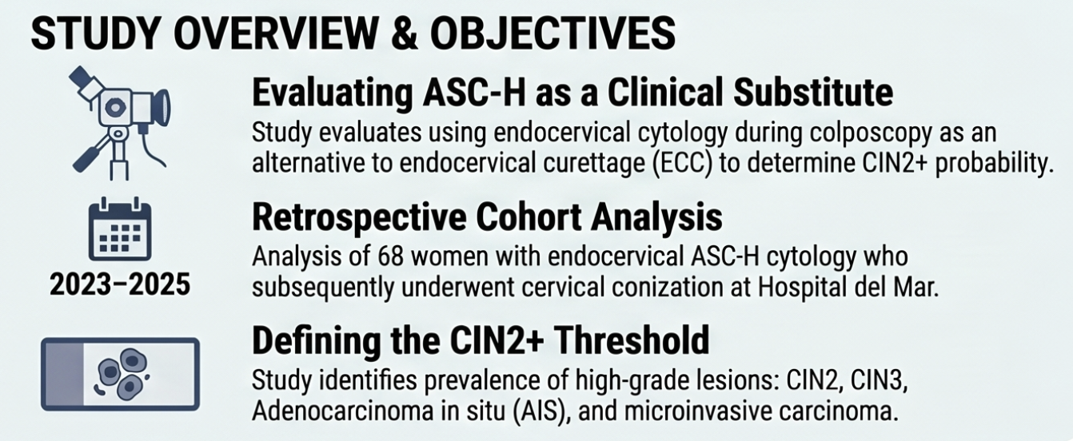
Notes:
"In recent years, clinical guidelines have evolved, proposing endocervical cytology as a valid alternative to traditional endocervical curettage (ECC). This is particularly relevant during colposcopy for patients with a Type 3 transformation zone or when no clear lesion is visible. However, the predictive value of ASCH (Atypical Squamous Cells, cannot exclude HSIL) in the endocervix remains a subject of debate."

Slide 3
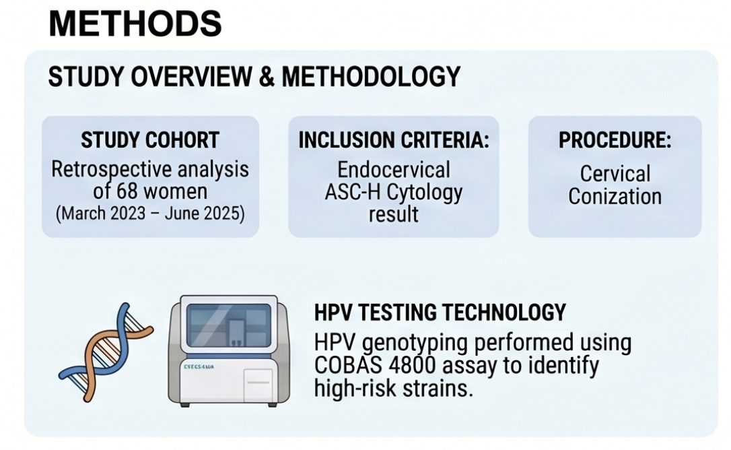
Notes:
"To address this, we conducted a retrospective cohort study of 68 women treated at our center between March 2023 and June 2025. All participants had an ASCH result in their endocervical cytology. We analyzed the subsequent conization pieces to determine the prevalence of high-grade lesions and evaluated whether factors like HPV 16/18 genotyping could help us predict the severity of the disease."

Slide 4
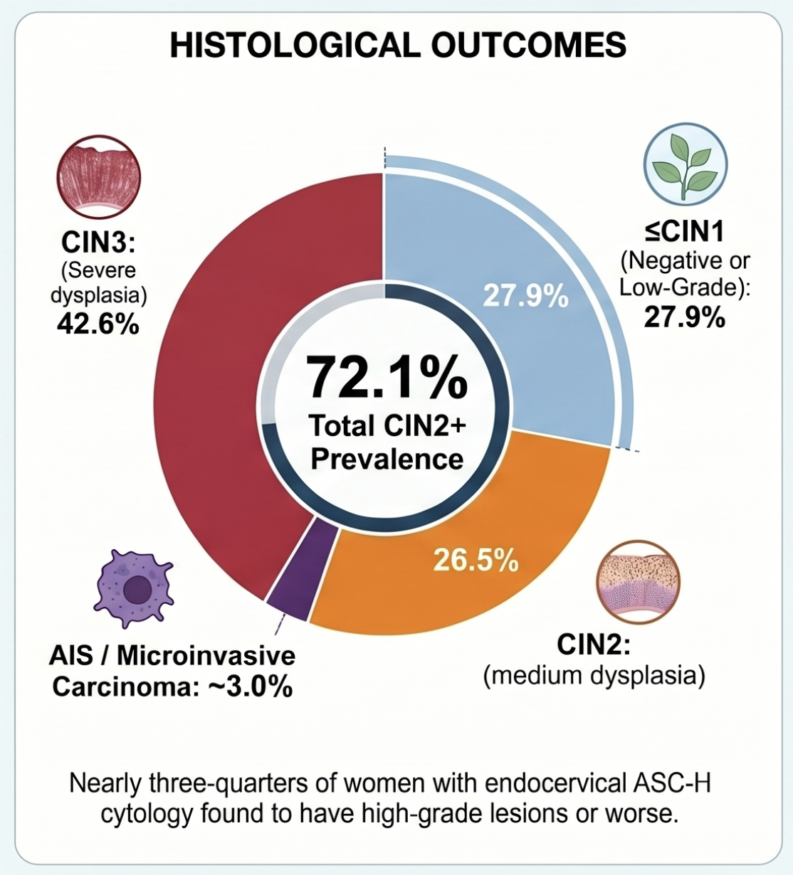
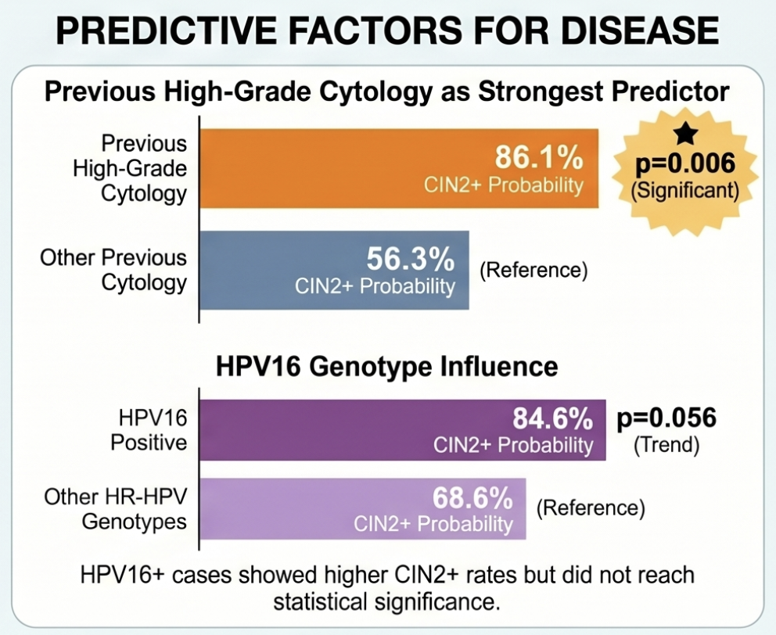
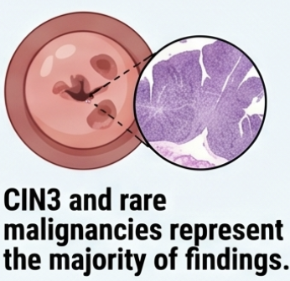
There was 1 case of invasive carcinoma (HPV16, previous citology HSIL/CIN2, colposcopy ZT type 3 with no lesions), and 1 case AIS (HPV16 and 18, biopsy CIN2, previous citology LSIL).
Notes:
Our results confirm that ASCH endocervical cytology is a powerful red flag. Specifically:
72.1% of the women in our study actually had a high-grade lesion (CIN2+).
Notably, 42% presented CIN3, and we even identified two cases of invasive carcinoma (3% of the sample).
When looking for predictors, the most significant factor was having a previous high-grade cytology result.
Interestingly, partial HPV 16/18 genotyping did not show statistical significance as a predictor in this specific cohort."

Slide 5

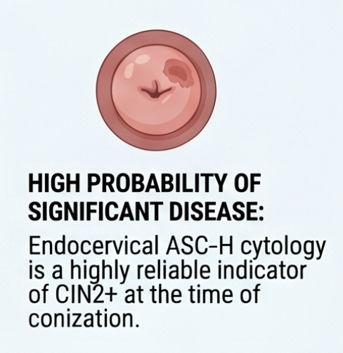
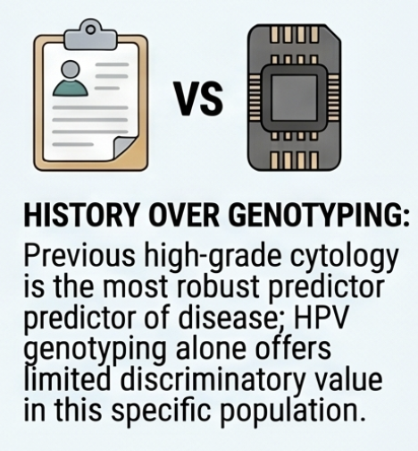
Notes:
In conclusion, our data from Hospital del Mar suggest that when ASCH is detected in the endocervix, there is a very high probability—over 72%—of an underlying high-grade lesion. This reinforces the use of cytology as a robust diagnostic tool, often more clinically relevant than molecular genotyping for immediate surgical decision-making. Thank you for your attention."

