Slide 1


Genital involvement in chronic graft-versus-host disease after allogeneic hematopoietic stem cell transplantation: a case report
Vulvar and vaginal lesions
Nadia Nassar¹, Marta Padín¹, Javier Medrano¹, Elisa Lozano¹, María Martínez¹
¹Hospital Clínico Universitario Lozano Blesa - Zaragoza (Spain)

Slide 2

Objective
To emphasize the importance of routine gynecological surveillance after allogeneic hematopoietic stem cell transplantation (HSCT) for the early detection and treatment of chronic genital graft-versus-host disease (cGVHD) and lesions associated with the human papillomavirus (HPV).

Slide 3
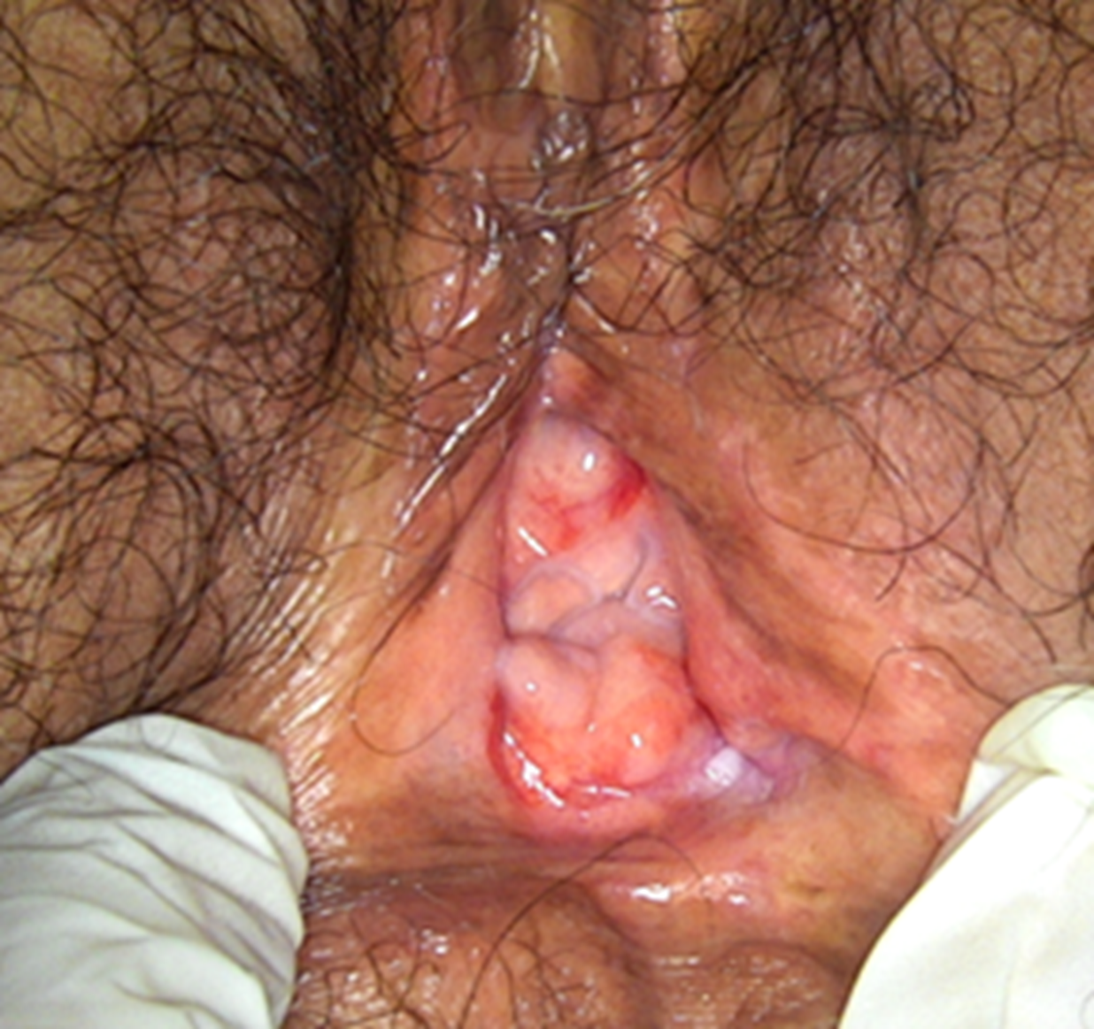
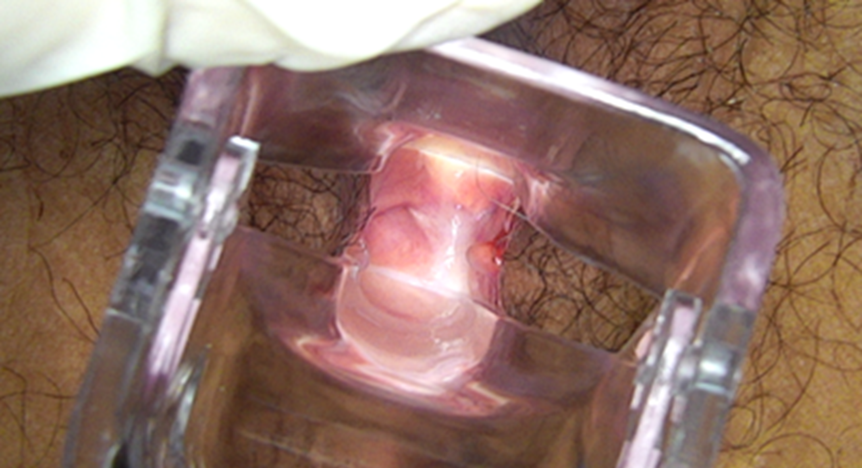
Materials and methods
This is a 58 years old woman who developed vulvar burning and dyspareunia seven months after allogeneic hematopoietic stem cell transplantation (HSCT). Examination showed recurrent lichen like vulvar lesions that responded to topical corticosteroids (Figure 1).
At 12 months post transplant, she was diagnosed with complete vaginal stenosis. Treatment with local estrogen therapy and progressive vaginal dilators was started, resulting in partial anatomical and symptomatic improvement (Figure 2).
Figure 1. Vulvar improvement after topical corticosteroids.
Figure 2. Partial improvement of vaginal stenosis after local estrogens and dilators.

Slide 4
Results
25–52%
of transplanted patients
7–10 months
after HSCT
Chronic graft-versus-host disease (cGVHD) is the most common late complication after allogeneic hematopoietic stem cell transplantation (HSCT) and a leading cause of non relapse morbidity and mortality.
Genital involvement is frequent:
                Vulvar 70%
                Vaginal 6-16%
                Mixed 25-28%
Frequently it coexists with cGVHD in other organs, particularly skin and oral mucosa.
HPV Risk factor
Immune dysregulation and prolonged immunosuppressive therapy increases susceptibility to human papillomavirus (HPV) infection and cervical lesions.
Clinic
Symptoms → dyspareunia, dryness, pain and burning
Clinical findings → resemble lichen planus
Severe disease → labial fusion, sclerosis, adhesions and vaginal stenosis
Diagnosis: primarily clinical. Biopsy reserved for uncertain cases.
Treatment: topical immunosuppressants, local estrogen therapy and vaginal dilators.
Surgery indicated for advanced adhesions or stenosis.

Slide 5
Conclusions
Chronic genital graft-versus-host disease (cGVHD) is a common complication of hematopoietic stem cell transplantation (HSCT) that is often underdiagnosed.
Gynecological follow up is essential for its detection and appropriate treatment, reducing the development of human papillomavirus (HPV) related complications and improving patients quality of life.

