Slide 1
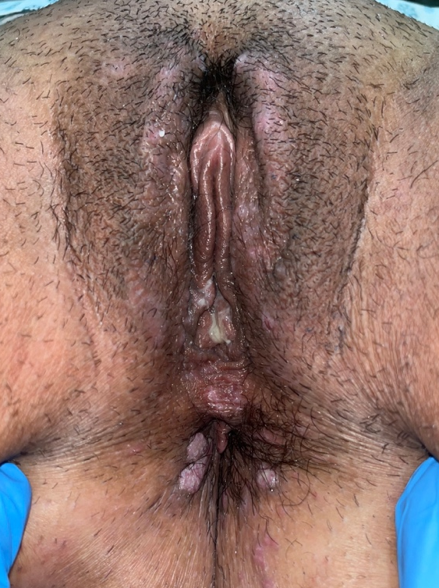

PC 038
CONDYLOMA LATA: AN IMPORTANT GYNECOLOGICAL FINDING FOR THE DIAGNOSIS OF SECONDARY SYPHILIS
GIULIA MARCHETTI¹, ADRIANA BITTENCOURT CAMPANER¹, DANIEL PEREIRA AYRES NETTO¹
Department of Obstetrics and Gynecology, Santa Casa de Misericórdia de São Paulo, São Paulo, Brazil.
Background/Objective: Syphilis is a sexually transmitted infection with a variable clinical presentation, particularly in its secondary stage, and may mimic other genital and systemic dermatoses, which can hinder early diagnosis. This report aims to describe a case of secondary syphilis with prominent vulvar manifestations that was initially misdiagnosed, highlighting the importance of a thorough physical examination and the consideration of differential diagnoses in atypical vulvar lesions.
Methods: This is a case report based on data extracted from the patient’s medical records. The patient provided written informed consent for publication, and the study was approved by the Research Ethics Committee of Irmandade da Santa Casa de Misericórdia de São Paulo.

Slide 2
Case Report
A 31-year-old woman presented to a specialized lower genital tract pathology clinic with complaints of painful, raised vulvar and perianal lesions that had begun two weeks earlier, without progression or associated systemic symptoms. She was nulliparous, using combined oral contraceptives, with regular menstrual cycles and an active sexual life with multiple partners, without condom use. She denied comorbidities, regular medication use, allergies, risk behaviors, or immunosuppressive conditions. She reported previous emergency department visits, where she had been diagnosed with genital herpes and treated with oral acyclovir, without clinical improvement, prompting further evaluation.
On general physical examination, whitish plaques with raised borders were observed on the hard palate and lower lip mucosa (Figure 1), in addition to multiple erythematous macules on the palms and soles (Figure 2). Vulvar examination revealed multiple moist, raised, well-defined plaques measuring 1 to 2 cm, involving the labia majora, labia minora, and perianal region (Figure 3).
Secondary syphilis was considered the main diagnostic hypothesis, supported by the comprehensive physical examination. A single dose of 2.4 million IU of intramuscular benzathine penicillin was administered. Non-treponemal (VDRL) and treponemal (FTA-ABS) tests, as well as serologic screening for HIV and hepatitis B and C, were requested. After one week, the patient returned with significant clinical improvement of both oral and genital lesions (Figure 4). The FTA-ABS test was positive, and the VDRL titer was 1:256. At three-month follow-up, complete clinical resolution was observed, along with a decline in the VDRL titer to 1:2.

Slide 3
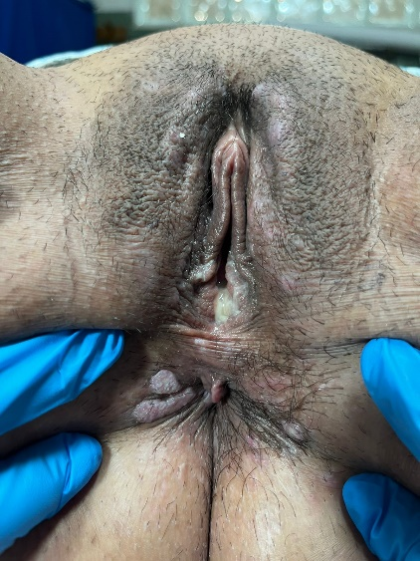
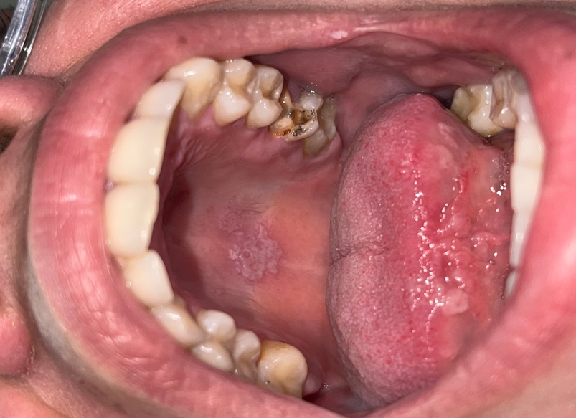
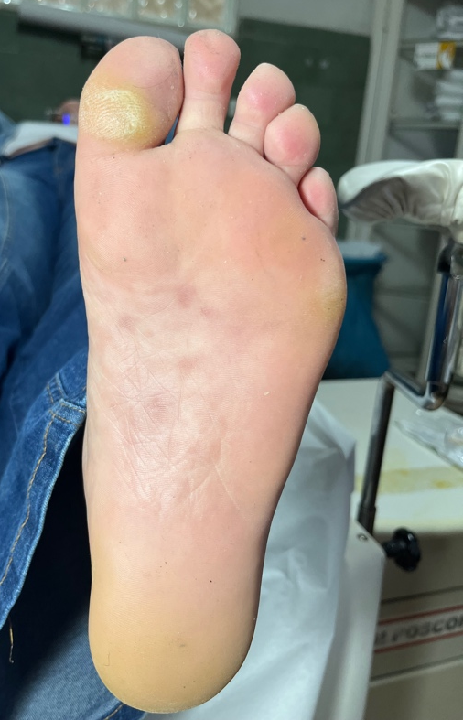
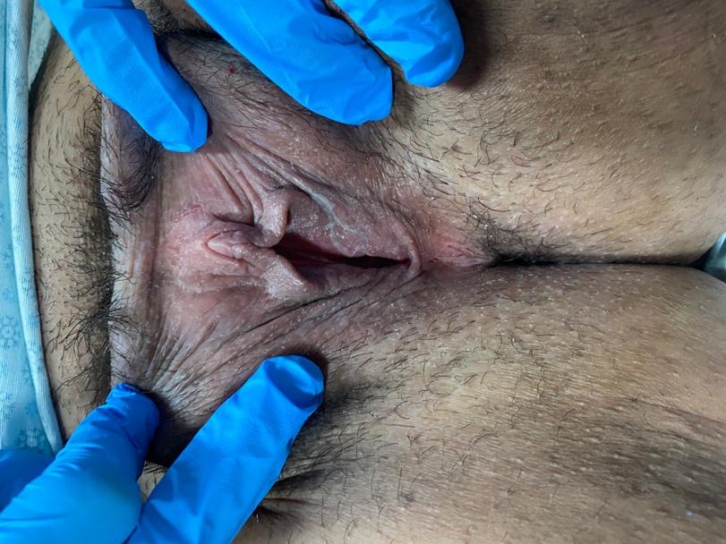
Images
Figure 1. Whitish plaques with raised borders on the hard palate mucosa.
Figure 2. Reddish soles macules.
Figure 3. Elevated plates with well-defined borders, approximately 1 to 2 cm from the pubis to the perianal region.
Figure 4. Normal vulva after treatment with 2,400,000 IU of Benzathine Penicillin.

Slide 4
Conclusions
Secondary syphilis presents with varied and often nonspecific clinical manifestations, which is why it is classically called "the great pretender." Cutaneous-mucosal lesions, such as palmoplantar macules, oral plaques, and condyloma latum, may go unnoticed or be misinterpreted, delaying diagnosis and treatment [1].
In women, vulvar lesions of secondary syphilis are usually moist, raised, and painless, leading many patients to seek care exclusively for genital changes [2]. However, such lesions can be confused with other vulvar dermatoses, such as herpes simplex or condyloma acuminatum, especially when there are atypical symptoms, such as pain, as observed in this case [2,3].
In 2024, 256,000 cases of acquired syphilis were reported in Brazil [4]. This number symbolizes the great impact of the disease on the population and reinforces the importance of proper diagnosis to obtain early treatment. Therefore, it is essential that gynecologists and specialized healthcare professionals include secondary syphilis in the differential diagnosis of vulvar lesions, emphasizing the importance of a complete physical examination and proper investigation for early diagnosis and interruption of the transmission chain.

Slide 5
References
Forrestel AK, Kovarik CL, Katz KA. Sexually acquired syphilis: historical aspects, microbiology, epidemiology, and clinical manifestations. J Am Acad Dermatol. 2020;82(1):1–14. doi:10.1016/j.jaad.2019.02.073.
Barei F, Murgia G, Ramoni S, Cusini M, Marzano AV. Secondary syphilis with extra-genital condyloma lata: a case report and review of the literature. Int J STD AIDS. 2022;33(12):1022–1028. doi:10.1177/09564624221124710.
Lynch PJ, Moyal-Barracco M, Scurry J, Stockdale C. 2011 ISSVD terminology and classification of vulvar dermatological disorders: an approach to clinical diagnosis. J Low Genit Tract Dis. 2012;16(4):339–344.
Brasil. Ministério da Saúde. Secretaria de Vigilância em Saúde e Ambiente. Boletim Epidemiológico Sífilis 2025. Brasília (DF): Ministério da Saúde; 2025. Available from: https://www.gov.br/saude/pt-br/centrais-de-conteudo/publicacoes/boletins/epidemiologicos/especiais/2025/boletim-epidemiologico-da-sifilis.pdf

