Slide 1






Awareness and Knowledge about Cervical Cancer Prevention and HPV Vaccination
-Survey among students at the University of Lahore, Pakistan-
Marie Wieneke, Mathias Bonk, Meike Schild-Suhren and Sumbal Shabaz
Correspondence: marie.wieneke@uni-oldenburg.de
Objective: a) knowledge and awareness of cervical cancer, its prevention, and HPV vaccination
b) sources of health information about cervical cancer and HPV vaccination

Slide 2
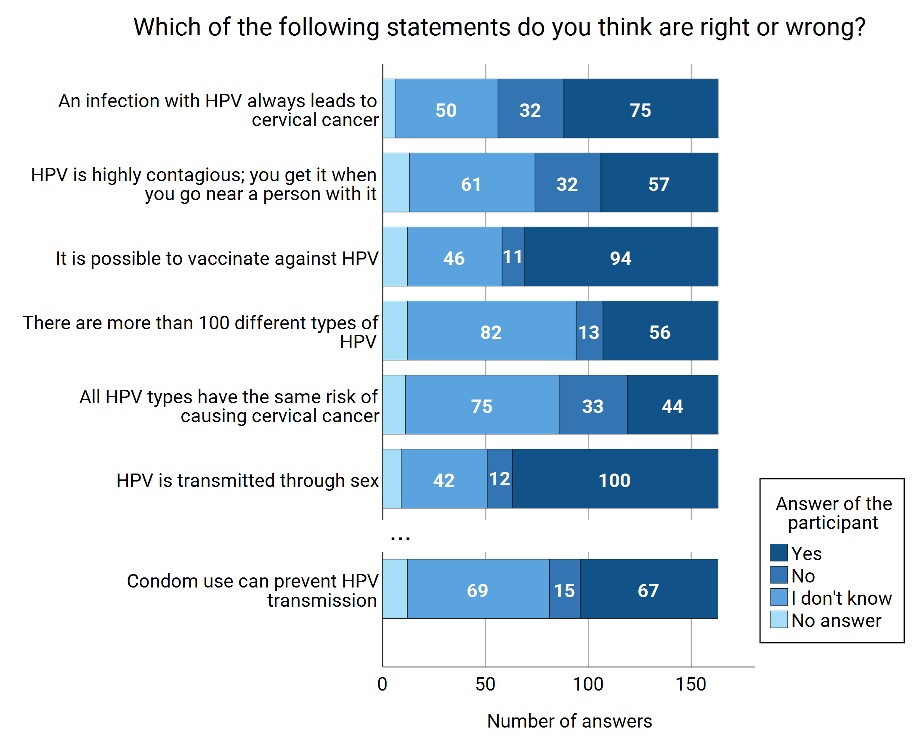
Method: Online survey in English conducted May-June 2025 at the University of Lahore, Pakistan
163 students from medical-related fields
52% females, 44% males, median age 20 years
Perceived risk factors for cervical cancer by [...] of participants:
Sexually transmittable diseases (73%)
Having multiple sexual partners (63%)
Infection with HIV (53%)
…
Infection with HPV (42%)
...
Condom use (16%)
Not believing in God (11%)
…
→ limited knowledge and misconceptions about cervical cancer prevention and HPV vaccination

Slide 3
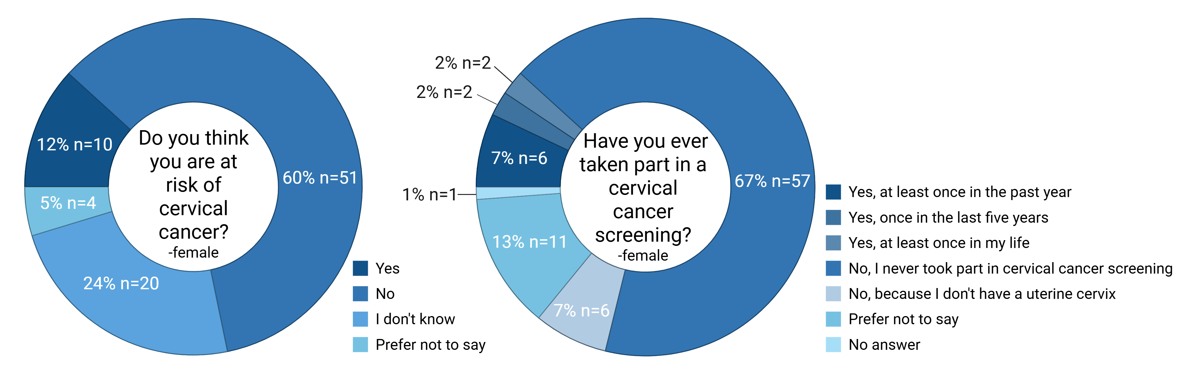
Risk awareness and prevention participation
→ risk awareness for cervical cancer/HPV infection associated with participation in cervical cancer screening (p < 0.001)/being vaccinated against HPV (p<0.001)

Slide 4
Health literacy
Number and share of participants’ answers to the questions: | Where do you get your information about cervical cancer and HPV? | What do you think is the most reliable source of information on health, cervical cancer, and HPV?
Parents or other relatives | 23 (14,1%) | 10 (6,1%)
Friends | 21 (12,9%) | 5 (3,1%)
Social media platforms like TikTok, Facebook, X | 62 (38,0%) | 25 (15,3%)
Information page on the Internet | 46 (28,2%) | 15 (9,2%)
Educational institutions (school, university) | 73 (44,8%) | 29 (23,9%)
Health professionals | 47 (28,8%) | 49 (39,1%)
Radio | 1 (0,6%) | 2 (1,2%)
Television | 4 (2,5%) | 0 (0%)
Print media | 4 (2,5%) | 3 (1,8%)
Other | 25 (15,3%) | 14 (8,6%)

Slide 5
Conclusion
Low to moderate awareness and knowledge of cervical cancer, HPV, and preventive measures among university students from medical fields in Pakistan
Higher level of risk awareness significantly associated with participation in cervical cancer screening and HPV vaccination
Targeted health education is needed to address knowledge gaps, overcome misconceptions, and reduce stigma
Educational institutions, healthcare professionals, and social media platforms as key channels
Manuscript submitted 15.04.2026: Wieneke M., Bonk M, Schild-Suhren M. and Shabaz S. (2026): Awareness and Knowledge of Cervical Cancer Prevention and HPV Vaccination among University Students in Pakistan: A Cross-Sectional Study. Discov Public Health
Correspondence: marie.wieneke@uni-oldenburg.de

