Slide 1



Improving Patient Understanding and Reducing Anxiety in Colposcopy Reporting via Large Language Models:
A Randomized Controlled Trial
Ms. Yuting WANG
wangyuting_0112@163.com
School of Population Medicine and Public Health, Chinese Academy of Medical Sciences and Peking Union Medical College, Beijing, China

Slide 2


Study Background
【Challenges in Medical Information Communication】
【The Pivotal Role of Colposcopy】
Acetowhite epithelium, transformation zone,…
What does this mean? Is it serious? Can it be treated?
Screening Abnormality
Colposcopy
Pathological Diagnosis
Problem: Highly specialized medical terminology creates a major barrier to patient understanding.
Impact: Patients may struggle to access and interpret information accurately, leading to misunderstanding, anxiety, and reduced confidence in clinical decision-making.
Colposcopy is not only a “bridge” in the clinical care pathway; colposcopy reports are also a key vehicle for doctor–patient communication.
The understandability of reports directly affects patients’ perception of their condition, emotional response, and adherence to follow-up.
【Terminology Barriers and Clinical Pain Points】
【Urgent Clinical Need】
Approximately 9,100 online consultation records
Real-world evidence: Data were extracted and analyzed from three major medical consultation platforms.
Observed demand: Patient inquiries about how to understand colposcopy reports have increased markedly.
Unmet need: There is an urgent clinical need for intelligent, patient-friendly interpretation of colposcopy reports to bridge the gap between professional medical language and patient understanding.
Problem: According to IFCPC standards, colposcopy reports require standardized and highly professional terminology, such as acetowhite epithelium and transformation zone.
Impact: Most patients lack specialized gynecological knowledge, making it difficult for them to understand the clinical meaning of these terms.
This may lead to overestimation or underestimation of disease severity, increased anxiety, and a greater explanatory burden for clinicians.
Notes:
Colposcopy is a key step in the cervical cancer prevention pathway, linking abnormal screening results with pathological diagnosis. Its report is an important tool for doctor–patient communication.
Meanwhile, these reports often contain specialized terminology. Although necessary for standardized reporting, these terms are difficult for most patients to understand, which may cause misunderstanding, anxiety, and explanatory burden for clinicians.
Across three major online medical consultation platforms, we identified around 9,100 inquiries related to colposcopy reports, reflecting a substantial real-world demand for patient-friendly report interpretation.

Slide 3
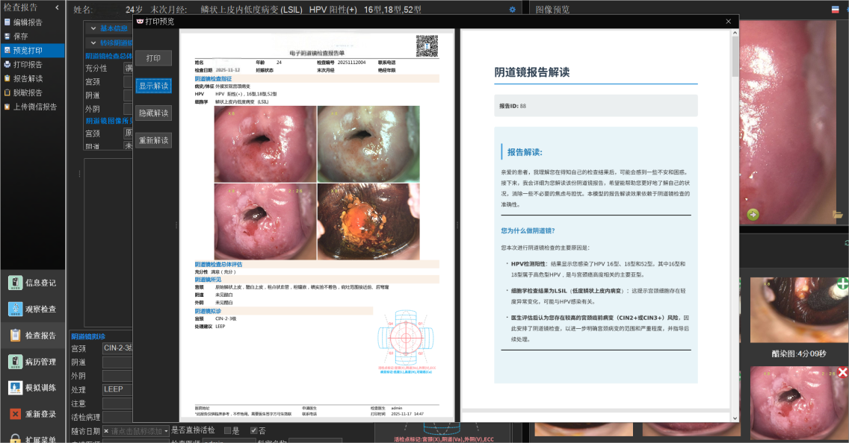
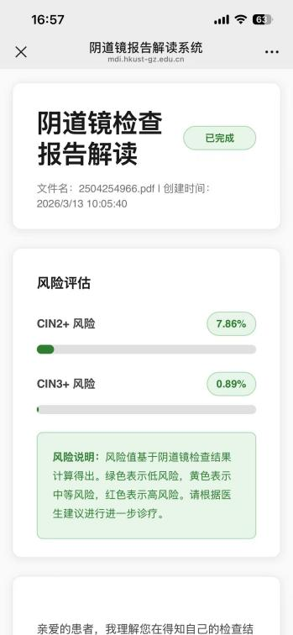
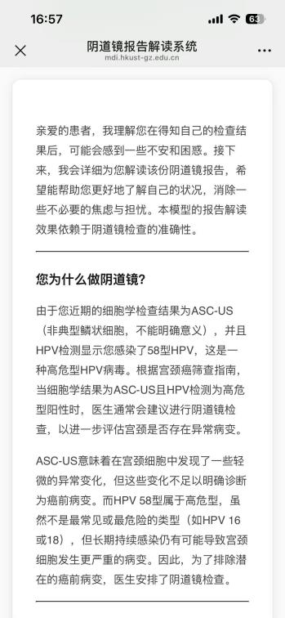
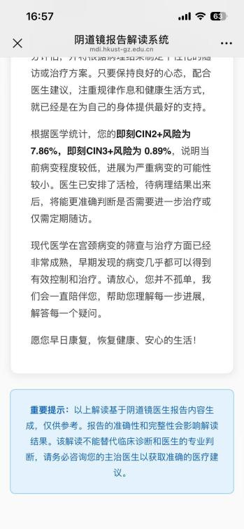
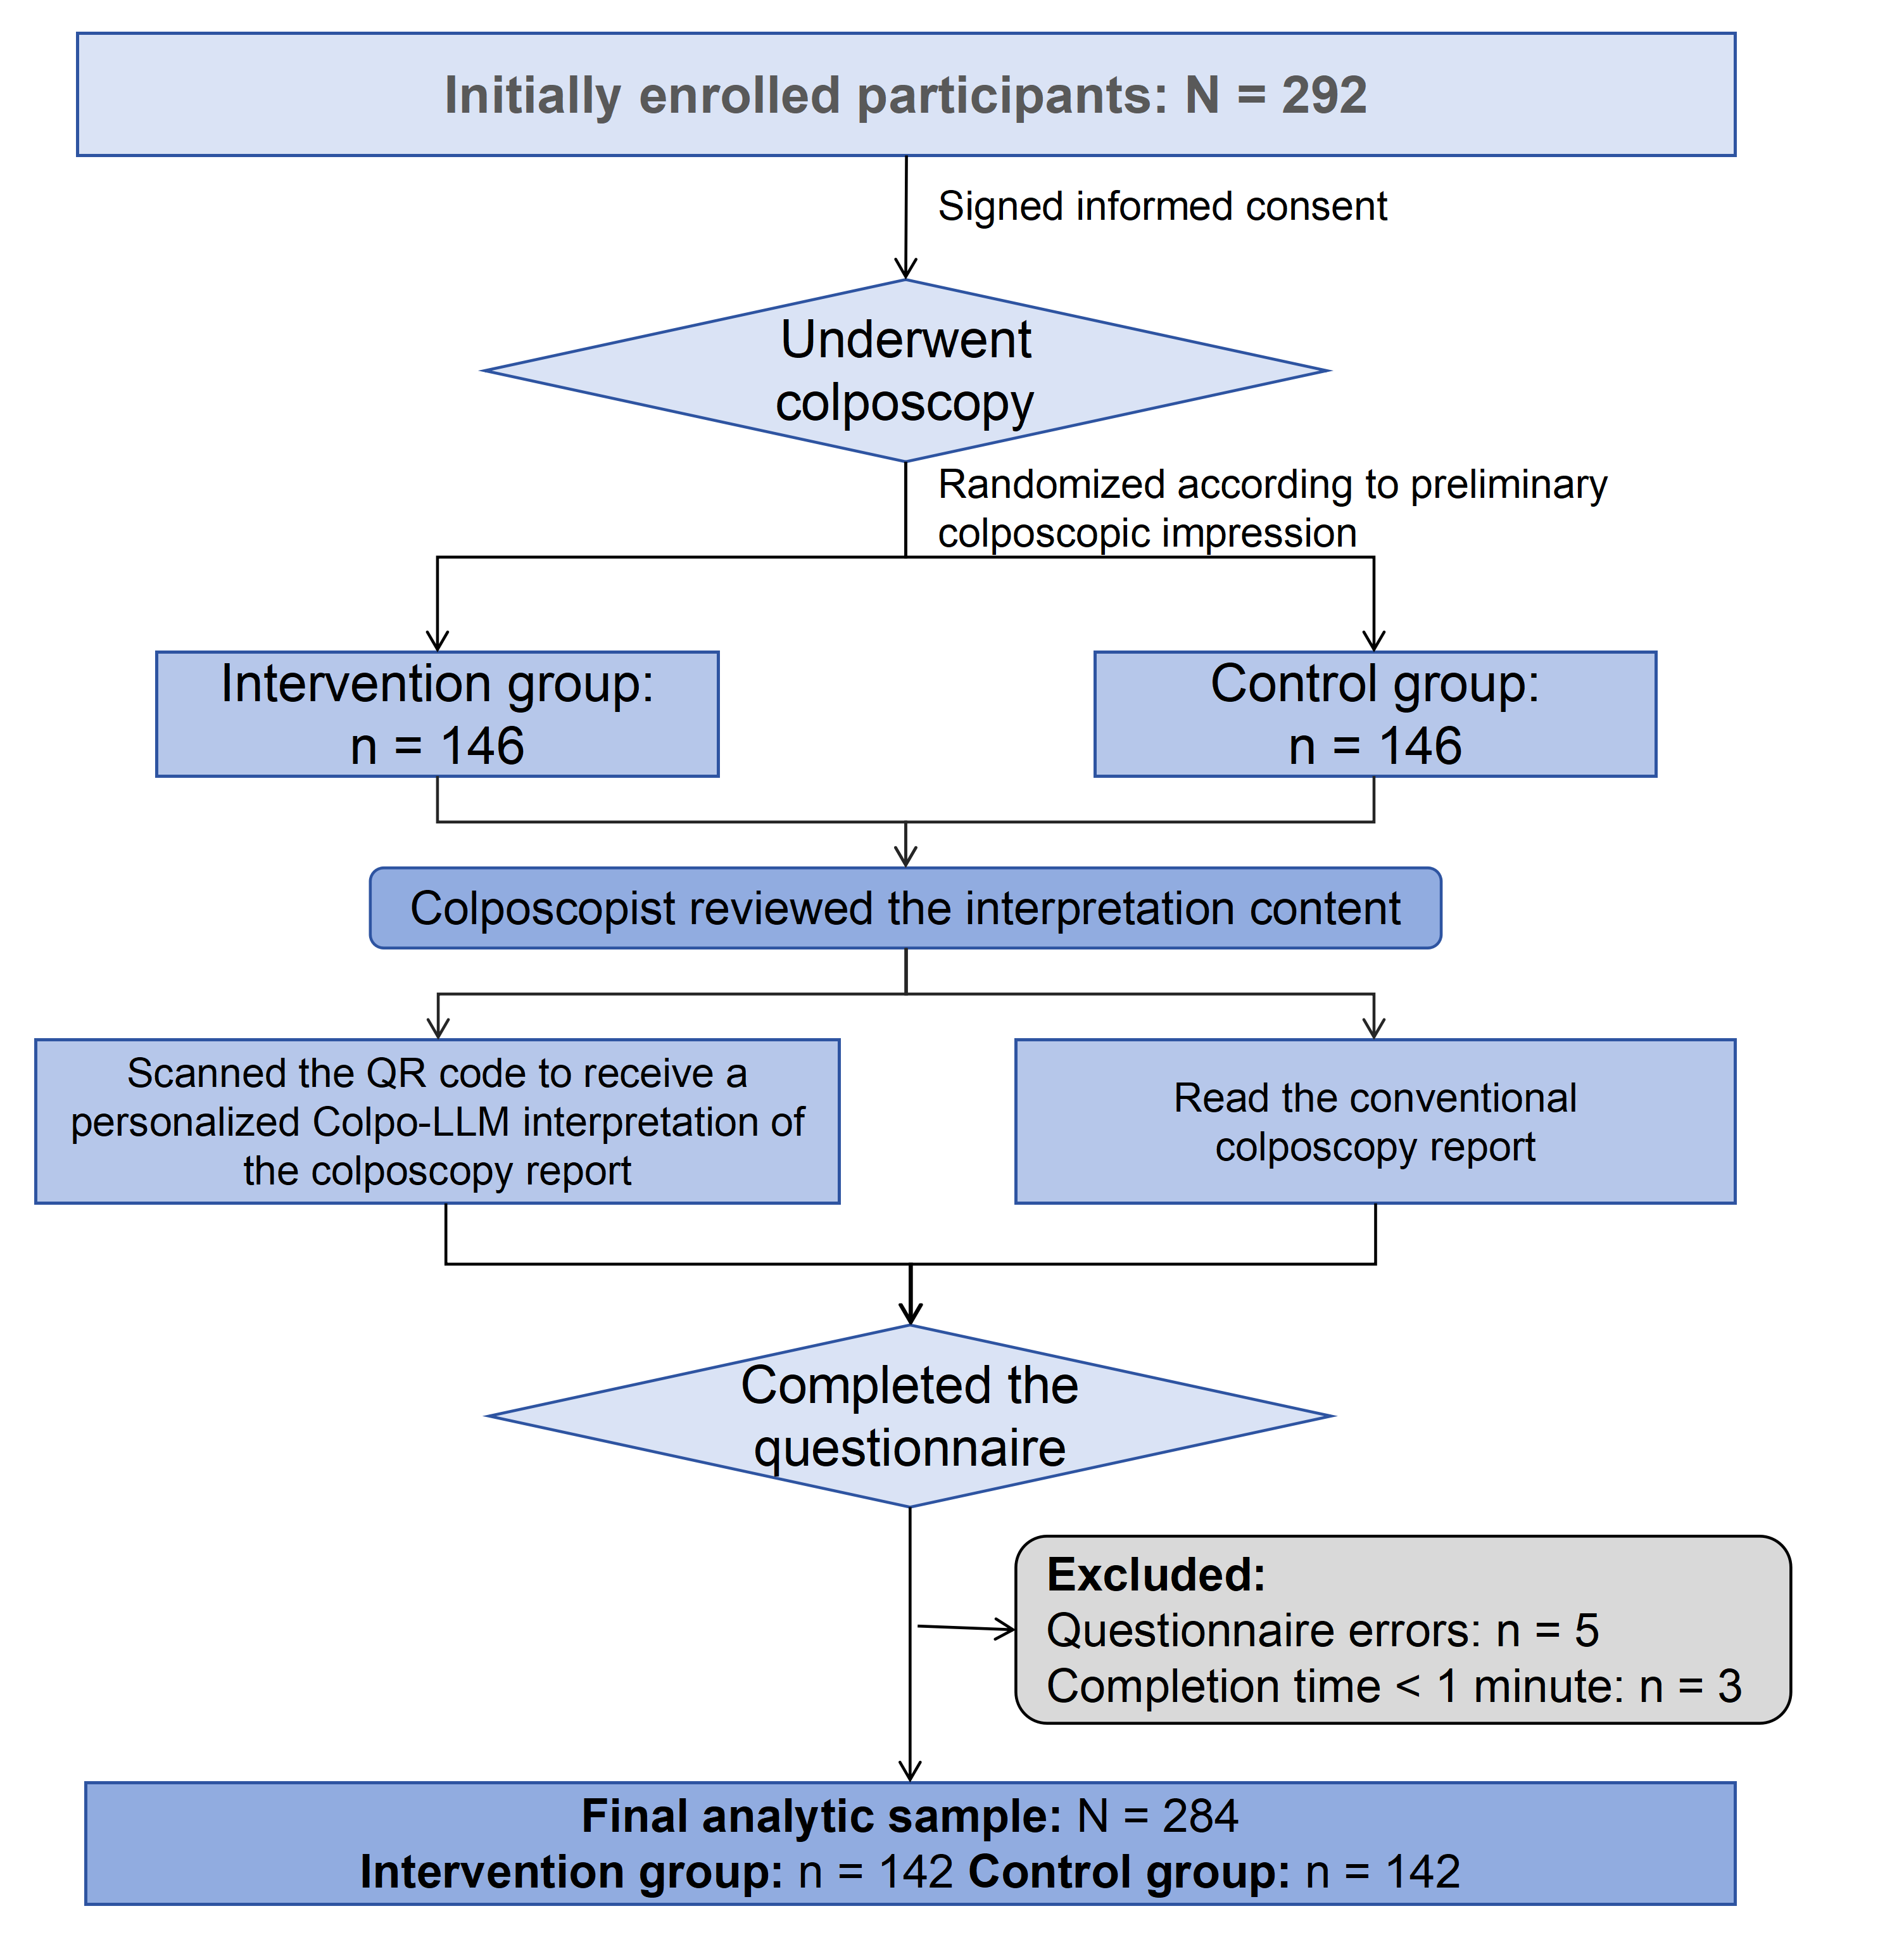
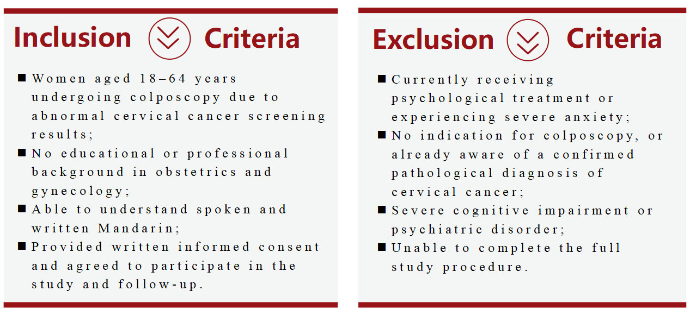
Study Design
We developed Colpo-LLM, a Qwen-based specialized system for interpreting colposcopy reports, and conducted a randomized controlled trial to evaluate its effects on cervical cancer-specific health literacy, anxiety-related emotional experience, and report perception.
Single-center, open-label randomized controlled trial
Eligible participants were consecutively recruited from the gynecology outpatient clinic of Chengdu Women’s and Children’s Central Hospital between January 1 and March 6, 2026
Trial registration: ChiCTR2500114886
Clinician Workstation
Patient Mobile Interface
Patient-friendly interpretation output
Instant access via QR code
A dedicated QR code is generated on the report, allowing patients to scan and immediately access the personalized interpretation.
Notes:
To address this problem, we developed Colpo-LLM. The system converts professional medical language into personalized, patient-friendly explanations.
We conducted a single-center, open-label randomized controlled trial at Chengdu Women’s and Children’s Central Hospital. Participants were recruited between January and March in 2026. They were randomly assigned to the intervention or control group in a 1-to-1 ratio. In the intervention group, participants received the Colpo-LLM-generated interpretation after their report was issued. Instead, participants In the control group only read the conventional colposcopy report. Both groups completed the questionnaire afterwards. All generated content is reviewed by colposcopists before being provided to patients.

Slide 4
Results — Baseline Characteristics of Participants
Total sample N=284
Intervention group : Control group = 1 : 1
Between-group comparisons showed no statistically significant differences in age, educational attainment, marital status, gravidity, parity, contraceptive method, total general health literacy score and health literacy level, prior receipt of cervical cancer screening education, awareness of large language models, or use of relevant health assistant tools (all P > 0.05).
Overall, the two groups were well balanced across most baseline characteristics and showed good comparability.
HPV infection
Predominantly OHR-HPV infection
Median age
35 years (IQR: 30–40)
Education level
≥ College/university education: 70%
Cytology results
Mainly NILM
Cervical cancer screening education
Previously received: 77.82%
HPV vaccination
129 participants (45.42%)
Preliminary colposcopic impression
The proportion of NILM and LSIL was nearly 1 : 1
Awareness and use of AI tools:
Had heard of LLMs: 267 participants (94.01%)
Had used health assistant tools: 125 participants (44.01%)
Notes:
A total of 284 participants were included. The median age was 35, most had college level education, more than three quarters had received cervical cancer screening education, and nearly half had received HPV vaccination.
Regarding clinical characteristics, infection with the other 12 high-risk HPV types accounted for the largest proportion. Most participants had normal cytology or mild cytological abnormalities, and preliminary colposcopic impressions were mainly normal findings or LSIL. Baseline characteristics were well balanced between the two groups.

Slide 5
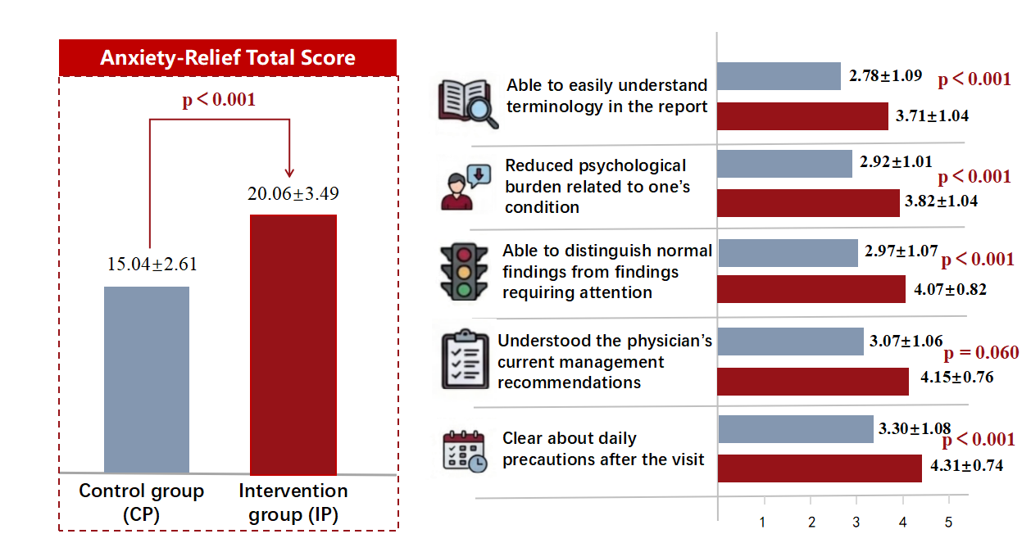
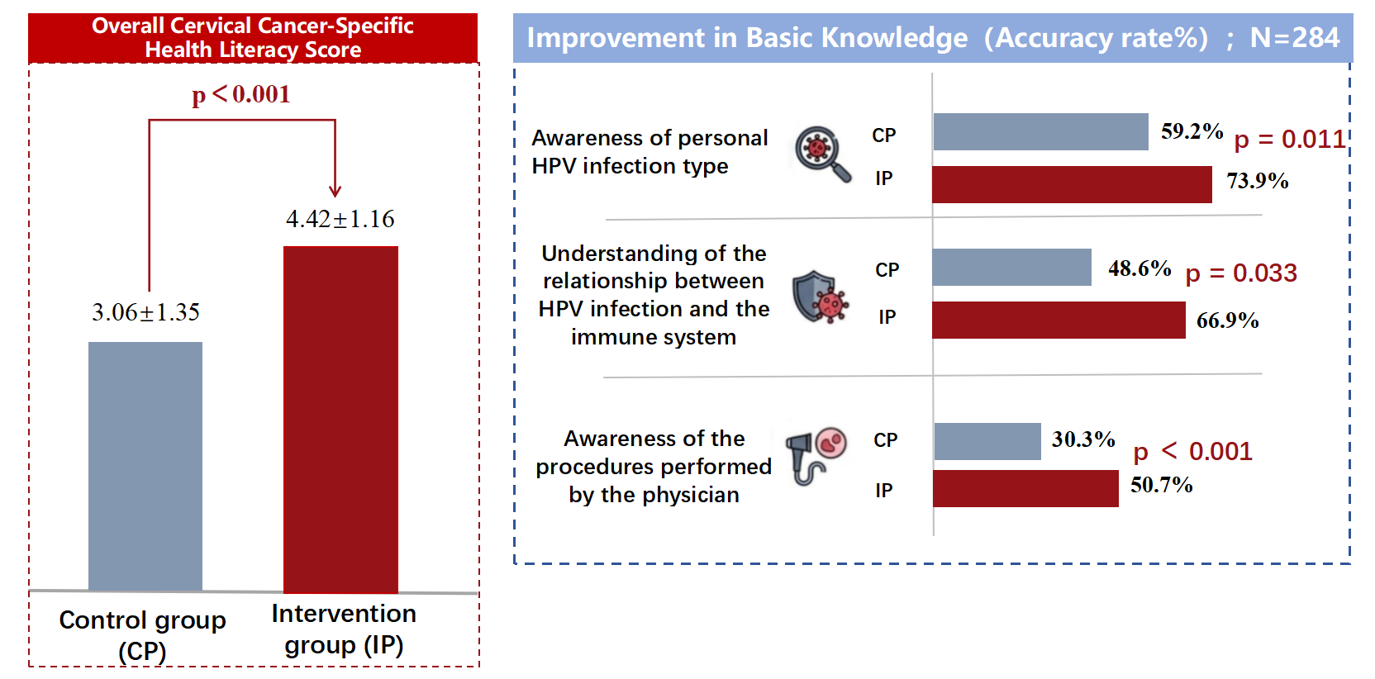
Results
Primary Outcome: Improved Cervical Cancer-Specific Health Literacy
Secondary Outcome: Reduced
Patient Anxiety
Cervical cancer-specific health literacy was assessed using six objective questions, with a total score ranging from 0 to 6. A higher score indicates better patient understanding of cervical cancer-related knowledge, examination findings, and their own condition.
Anxiety-related emotional perception was measured using five items, with a total score ranging from 5 to 25. A higher score indicates lower anxiety and a more positive emotional experience.
Colpo-LLM, when enhanced with disease-specific knowledge and integrated with physician review, significantly improved patients’ understanding of cervical cancer and enhanced their emotional experience during report reading. The system may serve as a useful clinical tool for patient-oriented colposcopy report explanation and doctor-patient communication under clinical supervision.
Notes:
As for results, both cervical cancer-specific health literacy the anxiety-related scores were significantly higher in the intervention than in the control with p < 0.001. It implicates Colpo-LLM improved both patient understanding and emotional experience.
Overall, Colpo-LLM translated specialized colposcopy report information into patient-friendly explanations. With disease-specific knowledge and physician review, it may support patient-oriented report explanation and doctor–patient communication under clinical supervision.

Slide 6





Thank you for your attention!
Ms. Yuting WANG, wangyuting_0112@163.com
Dr. Peng XUE, xuepeng_pumc@foxmail.com
Prof. Youlin QIAO, qiaoy@cicams.ac.cn
Notes:
Thank You!

