Slide 1


Cervical adenocarcinoma in situ - from primary screening, diagnosis, and treatment to follow-up: A retrospective study
Yulin Guo
Maternal and Child Health Hospital of Hubei Province, Wuhan, China

Slide 2



Background & Challenges
Definition of AIS
Adenocarcinoma In Situ (AIS) is a critical precursor lesion to invasive cervical adenocarcinoma (ADC). Timely and accurate early detection is paramount for effective clinical intervention.
Our Aim: To Address Critical Gaps in AIS Management
This single-center retrospective study aims to evaluate key issues in AIS screening and management in a developing country context, providing evidence-based insights to guide and optimize clinical practice protocols.
Rising Incidence (SEER Data)
SCC incidence reduced by 41.9%, while ADC rose by 29.1%. ADC now accounts for ~25% of all cervical cancers in developed nations.
01. Screening Sensitivity
02. Diagnostic Value
03. Therapeutic Efficacy
Global Research Disparity
04. Recurrence Rates
Burden grows in developing countries due to limited screening/vaccination, yet systematic research on AIS in these regions remains scarce.

Slide 3
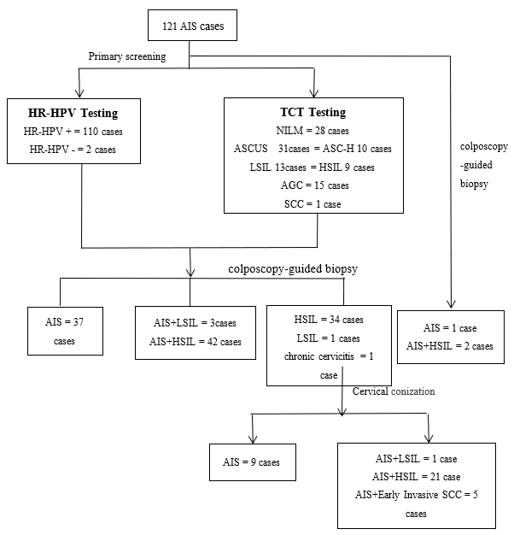
Study Design & Population
A Retrospective Analysis
Type:Single-center, retrospective study design.
Setting:Hubei Clinical Medical Research Center for Gynecologic Malignancy.
Period:Jan 2008 to Sep 2024 (16-year data collection).
Inclusion and Exclusion
Inclusion:Initial screening based on cytology and/or HPV testing; a pathological diagnosis of AIS by colposcopic biopsy or cone biopsy.
Exclusion:Pregnancy, prior cervical treatment, or other malignancies.
In total, 121 eligible patients with AIS were included .
85 cases (70.2%) were diagnosed using colposcopy-guided biopsy, whereas the remaining 36 cases (29.8%) required a definitive diagnosis via cone biopsy pathology.
Figure 1. Diagnostic flowchart of 121 AIS cases

Slide 4
Results
Sensitivity of Different Screening Methods for AIS Diagnosis
Table 1. Comparison of Sensitivity of Different Screening Methods for Diagnosing AIS
The sensitivity of cytological testing was 73.83% (79/107), but it exhibited low detection rates for glandular epithelial abnormalities (14.02%) and a high false-negative rate (26.17%). HPV testing demonstrated a sensitivity of 98.21% (110/112), whereas combined cytological and HPV testing did not outperform HPV testing alone.
Histological Category | No. of tests (Sensitivity, %)
 | HPV | TCT | HPV/TCT
AIS alone | 26/27 (96.30%) | 13/24 (54.17%) | 30/30 (100.00%)
AIS+SIL/early invasive SCC | 84/85 (98.82%) | 66/83 (79.52%) | 86/88 (97.72%)
Table 2. Comparison of Sensitivity between Colposcopy-Guided Biopsy and Conization in Diagnosing AIS
In terms of pathological diagnosis, mixed lesions accounted for 74.38% of AIS cases. The sensitivity of biopsy alone for diagnosing AIS was 69.49%, with 30.51% of the cases ultimately diagnosed through cone biopsy pathology.
Sensitivity of Colposcopy Biopsy and Conization in Diagnosing AIS
Histological Category | No. of tests (Sensitivity, %)
 | Colposcopy-Guided Biopsy | Conization
AIS alone | 29/30 (96.67%) | 22/30 (73.33%)
AIS+SIL/early invasive SCC | 53/88 (60.23%) | 74/89 (83.15%)

Slide 5
Results and Conclusions
Table 5. Analysis of Factors Influencing Postoperative HPV Infection
Items | Postoperative HPV Infection |  | χ² | P
 | Positive (N, %) | Negative (N, %)
Surgical margin status
Positive margin | 3(15.00%) | 17(85.00%) | 0.007 | 0.934
Negative margin group | 13(14.61%) | 76(85.39)
Hysterectomy status
Hysterectomy | 4(9.52%) | 38(90.48%) | 1.310 | 0.252
Non-hysterectomy | 12(17.39%) | 57(82.61%)
HPV vaccination status
Vaccinated | 7(15.91%) | 37(84.09%) | 0.132 | 0.716
Unvaccinated | 9(13.43%) | 58(86.57%)
Neither margin status, hysterectomy status, nor HPV vaccination status were significant factors influencing postoperative HPV infection.
This study retrospectively analyzed the clinical characteristics of 121 AIS patients and found that HPV testing is preferred for initial AIS screening because of its high sensitivity. As 74.38% of AIS co-exists with high-grade squamous intraepithelial lesions, pathologists may focus on squamous epithelial abnormalities and overlook glandular lesions, necessitating a collaborative diagnosis between biopsy and conization specimens.
In terms of treatment, no significant difference in efficacy was observed between conization and total hysterectomy, with strict adherence to indications (negative margins and compliant young patients) and the establishment of a standardized follow-up system, cervical conization can serve as a safe alternative for fertility preservation.
Conclusions

