Slide 1




Acceptability of HPV Self-Sampling Among Women Referred for Colposcopy in Singapore
PC_028
Presented By: Dr Marie Min Tse Tan
On Behalf of: Brigitte Zhiyu Tok, Hiu Gwan Chan, Lim Kun Lee, Wai Yen Lee, Lin Ean Lynette Oon, Sun Kuie Tay, Joella Xiaohong Ang

Slide 2






Cervical Cancer - Major Global Health Burden
~ 600k cases/year globally
HPV is the primary cause, screening is effective in prevention
Singapore screening uptake is suboptimal & below target (~45%)
Barriers: Embarrassment, Discomfort, Perceived ease of use
HPV self-sampling may improve screening acceptability and access
Study Aim: Evaluate the acceptability of HPV self-sampling among women referred for colposcopy.

Slide 3
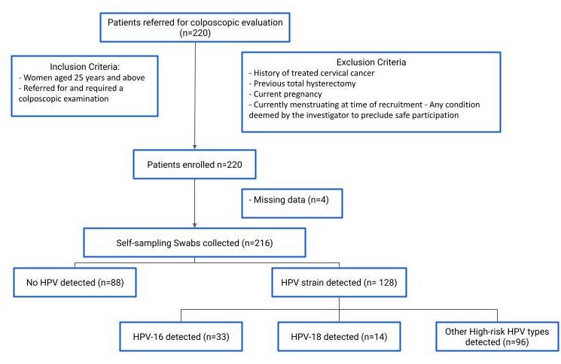
Methods (n=216)
Single-centre prospective cohort study from Feb 2024 - June 2025
216 women ≥ 25 years requiring a colposcopy were included
Quantitative feedback questionnaire with 10-point Likert scales was administered
Figure 1. Flowchart of participants in the self-sampling study.

Slide 4
Results – High acceptability of HPV Self Sampling
Table 1. Feedback questionnaire summarizing the quantitative responses on the human papillomavirus self-sampling swab by women. Data shows median and inter-quartile ranges.
Question | Women responses (n= 215), Median (IQR)
How much did you like performing the self-sampling | 8 (6-9)
How easy was the self-sampling procedure | 9 (8-10)
How comfortable was the self-sampling procedure | 8 (7-10)
How embarrassing was the self-sampling procedure | 2 (1-5)
How unpleasant was the self-sampling procedure | 3 (1-6)
How clear were the self-sampling instructions | 9 (8-10)
How anxious were you when you were performing the self-sampling | 5 (2-8)
How scared were you when you were performing the self-sampling | 5 (1-7)
How confident are you that the self-sampling was performed correctly | 7 (5-9)
How willing are you to go for cervical cancer screening if there was an option for HPV self-sampling | 9 (7-10)
I prefer self-sampling to a doctor/nurse performing the test | 7 (5-9)
How likely are you to recommend your friend/family to go for self-sampling | 8 (6-10)
If your results required you to return for a Pap smear, how likely are you to return to the clinic | 10 (8-10)
I would prefer doing the self-sampling at home compared to in the clinic | 7 (5-9.25)
Overall acceptability was high across usability, comfort, and willingness

Slide 5






Discussion
HPV self-sampling was highly acceptable across usability, comfort, and willingness domains
High ease of use and low embarrassment were key drivers of acceptability
Supports potential role of self-sampling as a patient-centred screening strategy even in higher-risk populations
High intention to return for follow-up Pap smear suggests good acceptability within care pathways
Moderate anxiety likely reflects underlying colposcopy-related context rather than procedure burden
Strong willingness for future use and high likelihood of recommending to others
Thank you.

