Slide 1



The Diagnostic Value of Hypermethylated PCDHGB7 MSRE-qPCR in Endocervical Gastric-type Adenocarcinoma
Fangfang Zhong, MD¹, Wei Li, MD, PhD², Xiang Tao, MD, PhD¹, Chengquan Zhao, MD³
1. Department of Pathology, Obstetrics & Gynecology Hospital of Fudan University, Shanghai, 200011, China
2. Laboratory of RNA Epigenetics, Institutes of Biomedical Sciences, Shanghai Medical College of Fudan University
3. Department of Pathology, Magee-Womens Hospital of University of Pittsburgh Medical Center, Pittsburgh, USA
06-06-2026

Slide 2
Objective & Methods
Accurate diagnosis of endocervical gastric type adenocarcinoma (GAS) remains a major challenge especially in biopsy.
The objective of this study is to evaluate whether hypermethylation of PCDHGB7 may serve as a useful diagnostic marker for GAS.
83 cases of usual type endocervical adenocarcinoma (UEC)
The final methylation value (Conversion ΔCT value) of PCDHGB7 in each sample was calculated by normalization to reference gene GAPDH.
A novel enzymatic quantitative PCR (MSRE-qPCR) assay was developed for quantitative DNA methylation detection
DNA extraction from formalin-fixed paraffin- embedded (FFPE) sections
A total of 261 cases were selected
90 cases of GAS
49 cases of lobular endocervical glandular hyperplasia (LEGH) or atypical LEGH
39 normal/benign cases
Notes:
A novel ME‑qPCR assay was developed for quantitative DNA methylation detection.

Slide 3
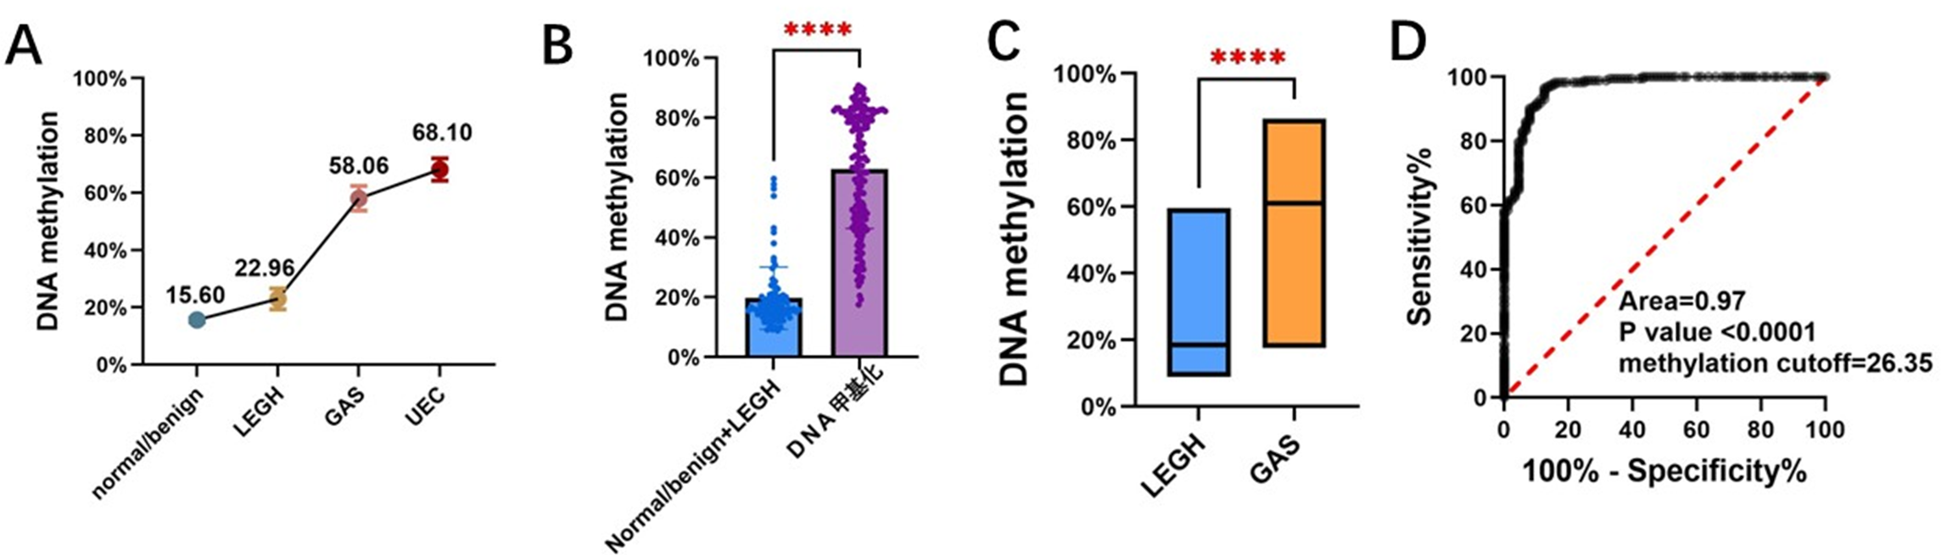
Results
Figure 1.
The average methylation level of PCDHGB7 DNA decreased in the following order UEC＞GAS ＞ LEGH/ALEGH ＞ benign/normal cases (Fig1A).
Methylation levels differed significantly among the four groups, as well as between the LEGH and GAS groups. (Fig1B, Fig1C, P<0.0001).
The ROC analysis yielded an area under the curve (AUC) value of 0.97 (Fig1D).

Slide 4
Table 1. The overall HPV positive rate and multiple infection rate
Diagnosis | Tested cases | HML cases | HML Ratio | Diagnosis | HML | HML Ratio
UEC | 83 | 83 | 100.00% | Carcinoma | 167 | 96.53%
GAS | 90 | 84 | 93.33%
LEGH/ALEGH | 49 | 11 | 22.45% | No-Carcinoma | 11 | 12.50%
Normal/Benign | 39 | 0 | 0.00%
HML, Hypermethylation
Table 2. Hypermethylated PCDHGB7 among different cervical lesions or benign cases
Diagnosis | Pathological Diagnosis
 | GAS vs UEC | Normal/Benign vs LEGH
Hyper-methylation | 167 | 11
Hypo-methylation | 6 | 77
The DNA methylation cutoff was 26.35 with the maximum Jorden index 0.8403
The performance of PCDHGB7 hypermethylation in distinguishing the endocervical adenocarcinomas from no carcinoma was well with a sensitivity 96.53% and specificity 87.50%

Slide 5
Conclusions
PCDHGB7 hypermethylation is a novel, sensitive and specific molecular marker, which can effectively distinguish GAS from LEGH/ALEGH.
However, further validation with larger sample sizes is required to confirm the optimal cut-off value for DNA methylation.

