Slide 1




HPV Viral Load: A Potential Biomarker for Diagnosis and Clinical Monitoring
Authors:
Fernanda Dahrouge Chiarot¹²*, Vanessa Regina da Silva², Julianne da Cunha Leite², Leticia Renaldi Pizzi²
Affiliations:
¹ Postgraduate Program in Oncology, Faculdade de Medicina, Universidade de São Paulo, São Paulo, Brazil
² Department of Molecular Biology, IPOG Lab – Gynecologic Oncology Research Institute, São Paulo, Brazil
* Presenting author
Contact:
fernanda.dahrouge@ipog.com.br
fernandachiarot@usp.br
Notes:
Hello everyone, thank you for being here. My name is Fernanda Chiarot, and today I will present our work on HPV viral load as a potential biomarker for diagnosis and clinical monitoring.

Slide 2
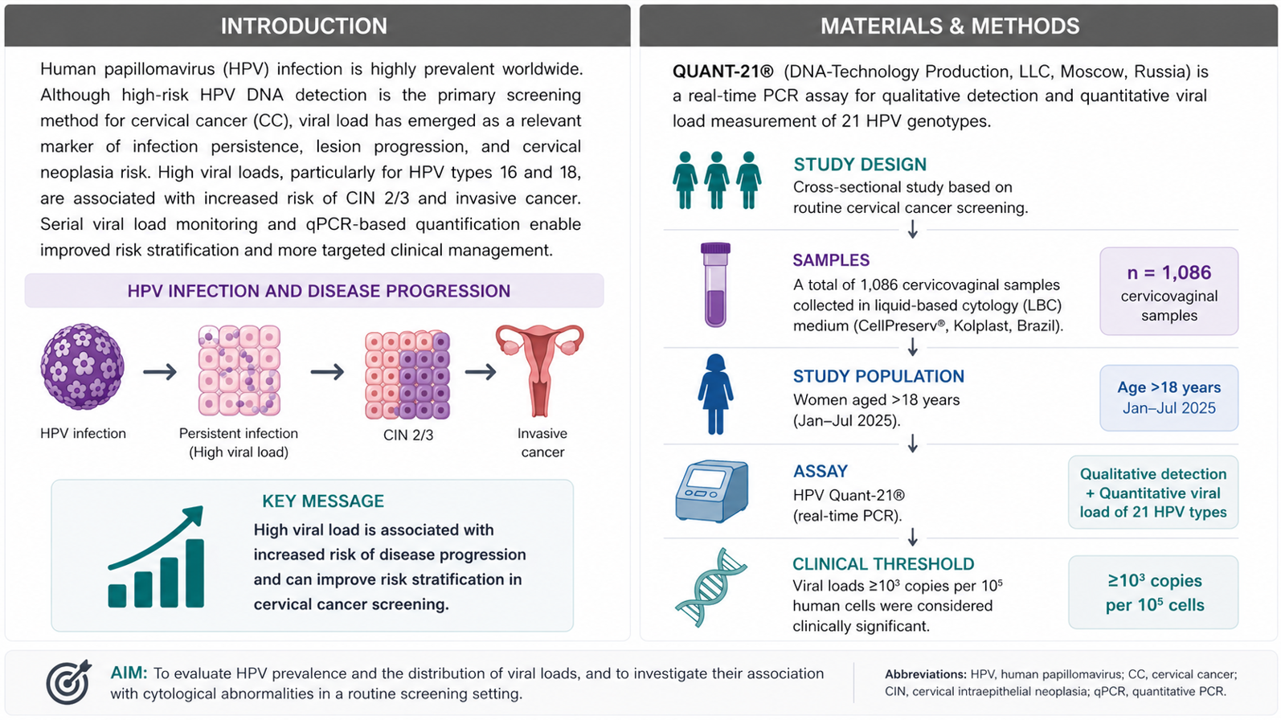

> 18 years
Notes:
HPV is one of the most prevalent sexually transmitted infections worldwide. While most infections are transient, persistent infection is a key factor in the development of cervical lesions and cervical cancer. In this context, HPV viral load has been suggested as a potential prognostic biomarker
Our study aimed to evaluate HPV prevalence and viral load distribution, and to assess whether higher HPV viral loads are associated with greater cytological severity, there by contributing to clinical risk stratification in routine screening.
We performed a cross-sectional study including women over eighteen years undergoing routine cervical screening. A total of one thousand and eighty-six cervicovaginal samples were collected in liquid-based cytology medium and analyzed using quantitative real-time PCR for twenty-one HPV genotypes. A clinical threshold of viral load greater than or equal to ten to the power of three copies per ten to the power of five cells was considered clinically significant.

Slide 3
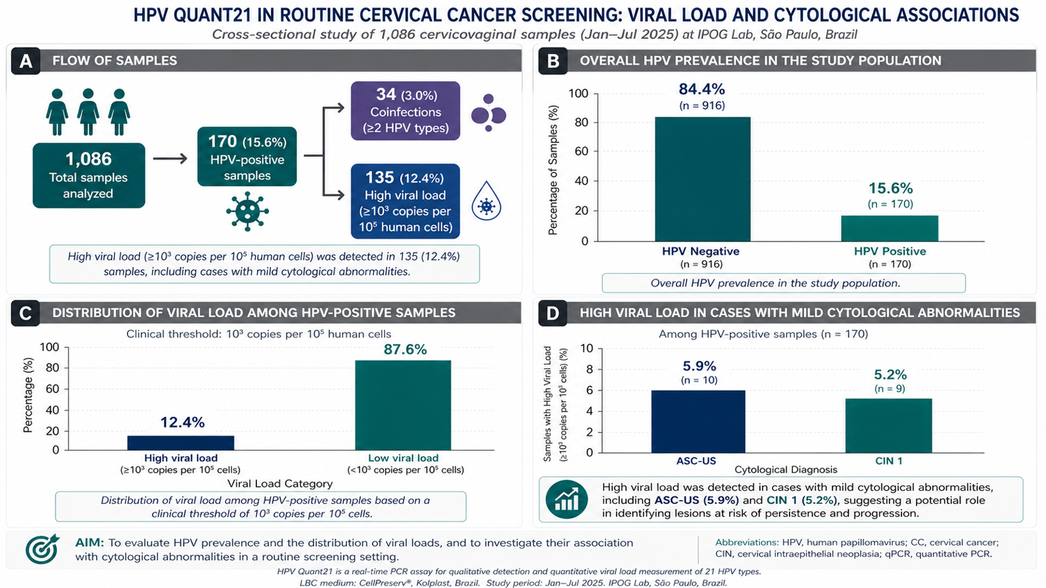

Notes:
Overall HPV prevalence was fifteen point six percent, corresponding to one hundred and seventy positive samples. High viral load was observed in twelve point four percent of cases, and motilpool HPV coinfections in three point zero percent. Higher viral load in mild cytological abnormalities suggests an association with early lesions and persistence.

Slide 4
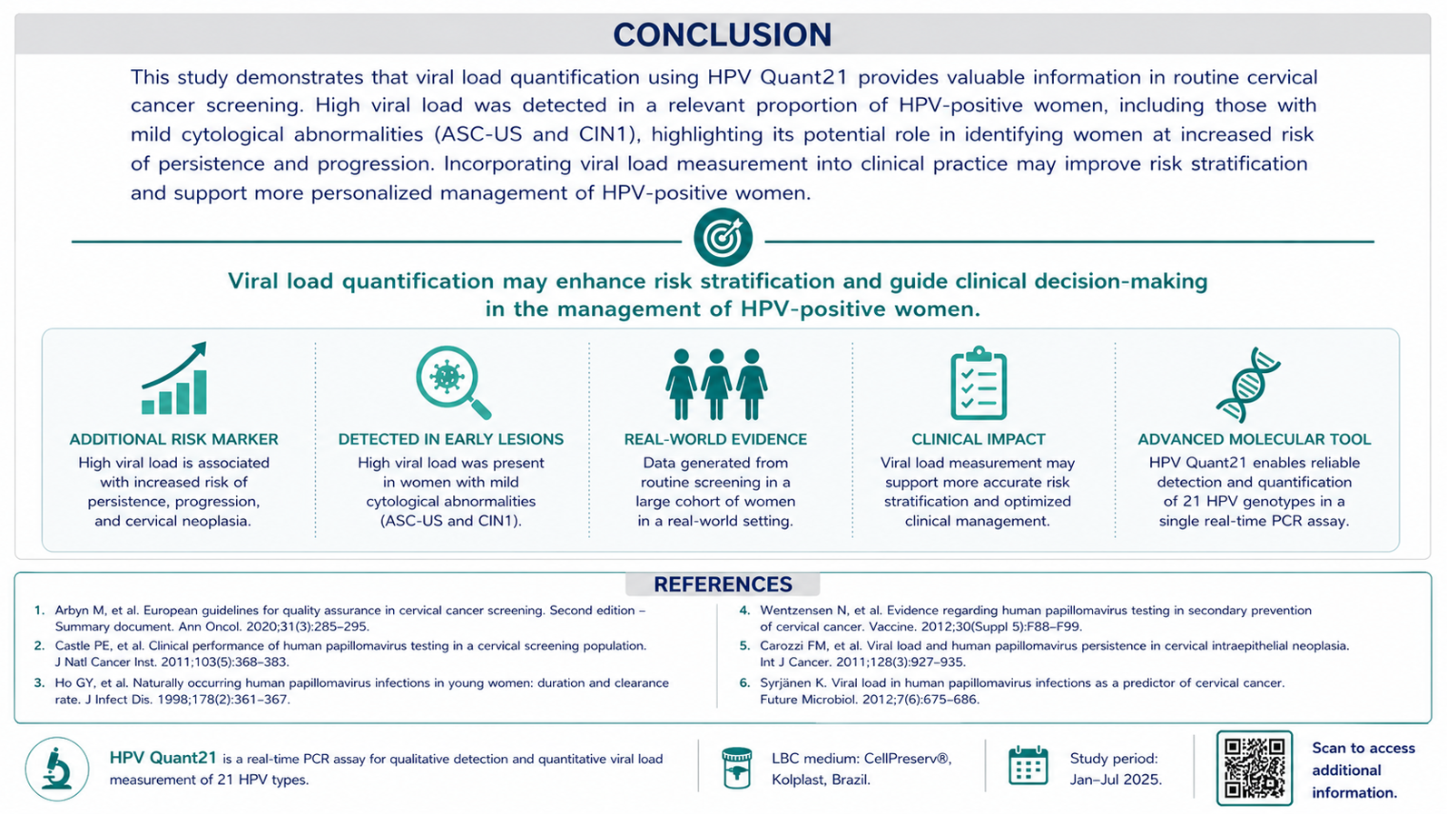


Notes:
In conclusion, our findings suggest that HPV viral load may have potential as a complementary biomarker to conventional HPV genotyping, possibly supporting risk stratification and longitudinal monitoring of HPV-positive patients.

Slide 5


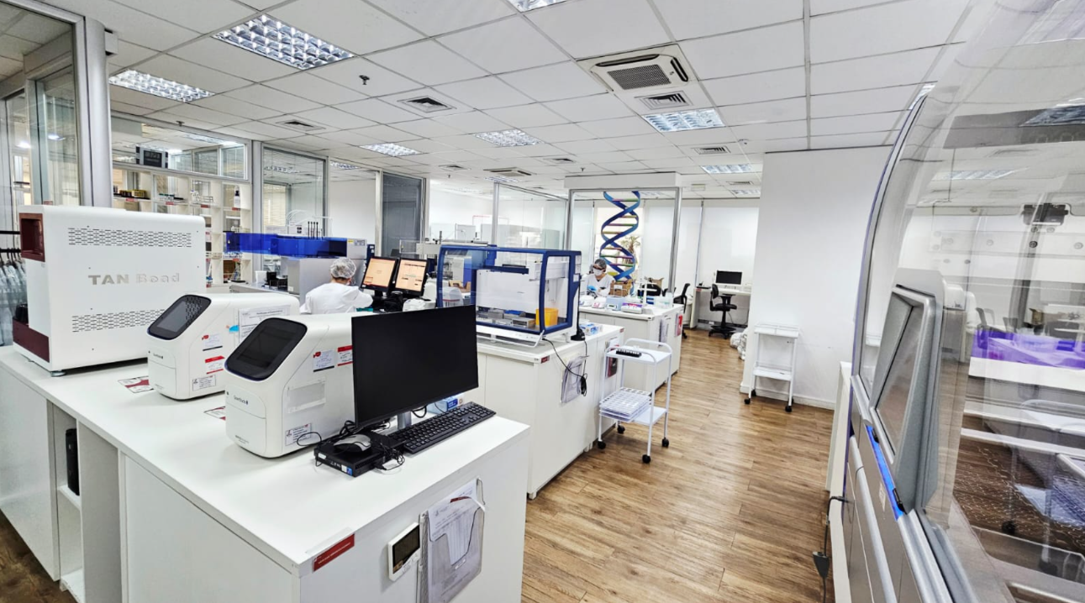


Acknowledgements
The authors gratefully acknowledge IPOG Lab and its management for their valuable support and contributions to this study. We also thank Biomédica Equipamentos Médicos and DNA-Technology for their sponsorship and support.
Disclosure
The authors declare no conflicts of interest. This study was supported by Biomédica Equipamentos Médicos and DNA-Technology.
The IPOG Lab team
IPOG Lab workspace
Contact:
fernanda.dahrouge@ipog.com.br
fernandachiarot@usp.br
Notes:
I would like to thank IPOG Lab, the study sponsors, and the entire team involved in this work. Thank you.

