Slide 1



Multiple Dimensions of Social Vulnerability and Cervical Cancer Screening
J. Haury, S. Crequit, G. Canlorbe, B. Renevier
Department of Gynecology and Obstetrics,
Intercommunal Hospital Center André Grégoire, Montreuil, France
Department of Surgery and Oncological Gynecology,
Pitié-Salpêtrière University Hospital, Paris, France

Slide 2
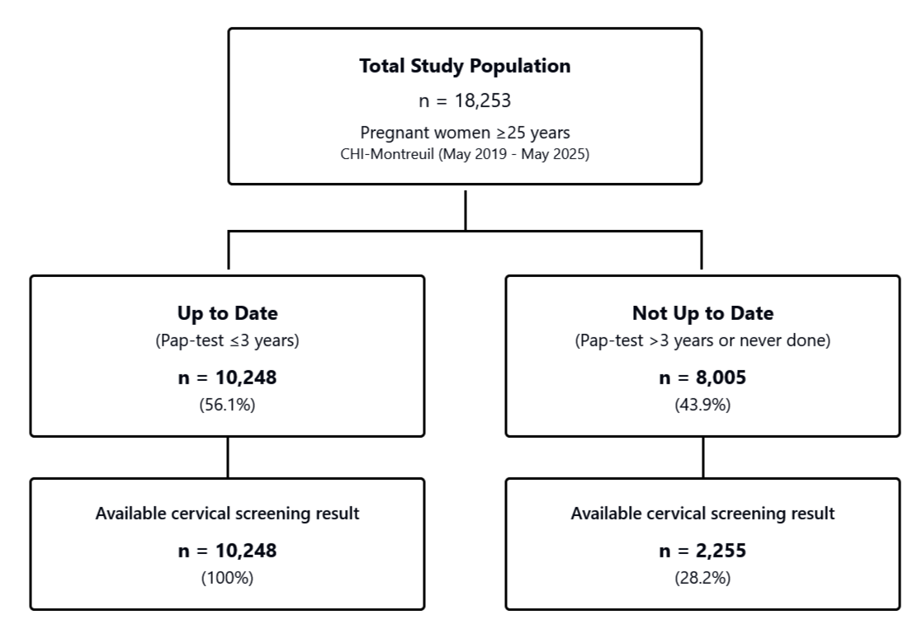
Main outcome
Identify distinct vulnerability profiles and their specific associations with cervical cancer screening
Single-center retrospective cohort study
Study population
Period : May 2019 - May 2025
Inclusion criteria: age ≥ 25 years old, delivery between May 2019 and May 2025 at Montreuil’s hospital
Methods
Multiple Component Analysis
Multiple logistic regression

Slide 3
Administrative and socioeconomic vulnerabilities
Living alone, poor or insecure housing, no work-related household income, no permanent healthcare insurance, recent immigration (<12 months), illiteracy, linguistic barrier, social isolation, severe dependency
Psychiatric disease, pychological distress, history of violence (physical, psychological, or sexual violence), violence during pregnancy, addiction before or during pregnancy
Profile 3 : Migrant/Linguistic
Recent immigration
Linguistic barrier / illiteracy
Social isolation
→ Cervical screening 37.1%
Identification of six vulnerability profiles
Profile 1 : Reference profil, low vulnerability
→ Cervical screening : 66.8%
Profile 4 : Psychological Violence
psychological violence exposure
→ Cervical screening 50.5%
Profile 2 : Psychological vulnerability and substance use
Addiction
Low administrative vulnerability
Psychological Vulnerability
→ Cervical screening 60.1%
Profile 5 : Sexual Violence
sexual violence history
→ Cervical screening 48.5%

Slide 4
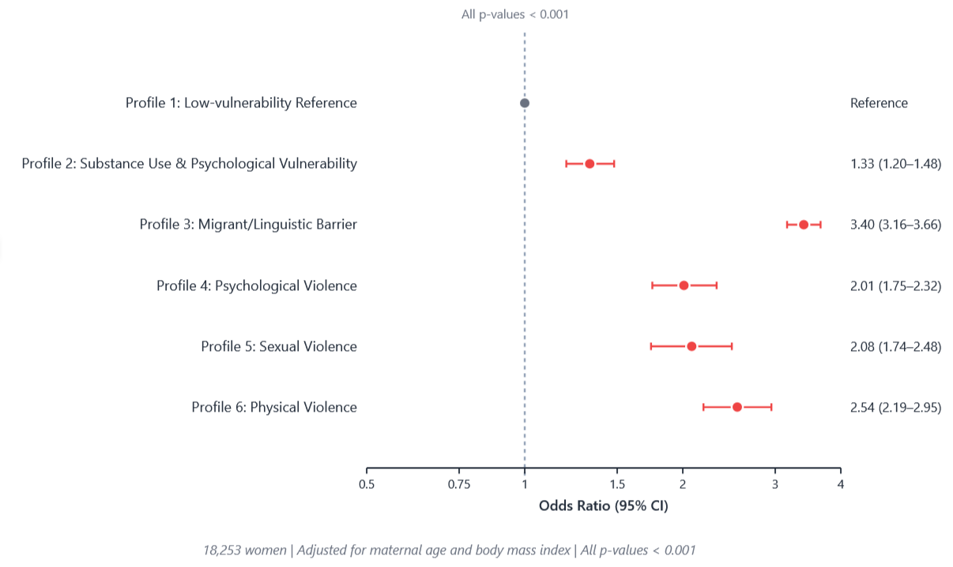
Association between screening inadequacy and vulnerability profiles

Slide 5
Conclusion
The least screened women correspond to the migrant profile
However, attention should also be paid to the ‘‘victims of violence’’ and ‘‘psychological disorders’’ profiles who are under-screened
→ cervical screening actions should ne targeted according to the profile
Information for healthcare providers :
  Identify vulnerable, patients, taking into account all types of vulnerability
  Promote screening among these patientes
  Strengthen the link between primary care and hospitals for sharing information about vulnerable patients
Information for patients :
  Raise awareness about screening (using a different approach than for other women)
  Explain the importance of regular follow-up

