Slide 1


19th Congress International Federation for Cancer Prevention and Colposcopy
Study Title: Determinants of Non-Participation in Cervical Cancer Screening by
Human Papilloma Virus (HPV) Self-Sampling among Urban Women in Mumbai, India
Presenting Author: Dr Devisowmiya Thiruvengadam, Fellow II,
Department of Preventive Oncology, Tata Memorial Hospital, Mumbai.
Corresponding Author: Dr Sharmila Pimple, Head of the Department of Preventive Oncology, Tata Memorial Hospital, Mumbai

Slide 2

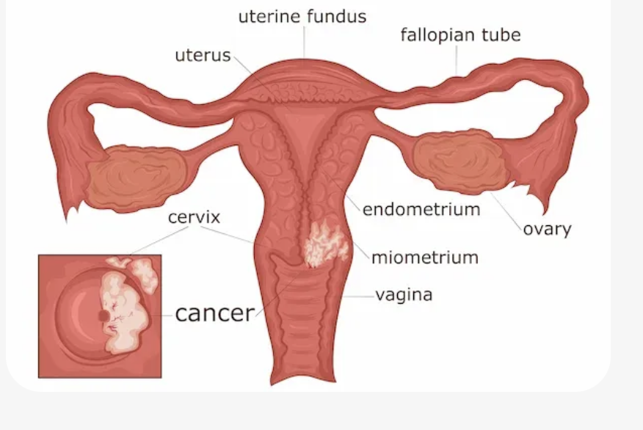
Introduction
Cervical cancer is the second leading cause of cancer deaths among Indian women.
In India, over 1,27,000 cases and 79,000 deaths annually. (1)
Low participation in screening significantly contributes to high mortality, with current uptake at just 1.2%, far below the WHO target. (2)
Over 90% of Cervical cancer cases are linked to High-risk HPV genotypes.
Barriers such as stigma, lack of awareness, and discomfort with clinician-led methods hinder participation - HPV self-sampling ensures an alternative strategy.
This study aims to identify the factors influencing acceptance and refusal of Cervical Cancer screening using HPV self-sampling (HPV-SS) and to explore the reasons for non-acceptance of HPV self-sampling among eligible women.

Slide 3
Methodology
A Cross-sectional analytical study, in Mumbai suburban area to assess Determinants of Acceptance and Refusal of HPV Self-Sampling (HPV-SS) for Cervical Cancer Screening among women aged 30–55 years.
A structured questionnaire was administered among
  Subsample of 115 women (out of 500 HPV-SS accepted) to assess factors influencing uptake
  Subsample of 61 women who refused screening to identify reasons for Non-acceptance.
Cross-Sectional Analytical Study
(Women - aged 30 to 55 years)
Mumbai - Suburban area -Household survey
Eligible women invited for Awareness Session
HPV-Self Sampling - done among
500 consenting women
Factors influencing uptake - among 115 women
Reason for refusal - among 61

Slide 4
Results
Reasons for Refusal
Among women who refused screening
  -50.8% were over 40 years, 63.9% belonged to joint (extended) families, and 86.9% were currently married.
The most common reasons for refusal were Embarrassment (28.0%) and Lack of family permission (28.0%).
Awareness of Cervical Cancer was Poor: 18.0% heard of Cervical Cancer, and knowledge of HPV was minimal (3.3%).
On Univariate analysis showed higher refusal among women from extended families, with lower education, lower income, and among women who were separated/widowed/divorced status.
On Logistic regression -Independent predictors of refusal.
  -Low household income (OR 79.92; 95% CI: 21.08–302.9)
  -Extended family structure (OR 4.98; 95% CI: 1.91–12.97)

Slide 5
Conclusion
Non-acceptance of HPV-SS was mainly influenced by
  Socioeconomic factors, family structure, embarrassment, and limited awareness. Highlighting the need for family-inclusive educational interventions to improve screening uptake.
References
Ferlay J, Ervik M, Lam F, Laversanne M, Colombet M, Mery L, Piñeros M, Znaor A, Soerjomataram I, Bray F (2024). Global Cancer Observatory: Cancer Today. Lyon, France: International Agency for Research on Cancer. Available from: https://gco.iarc.who.int/today.
International Institute for Population Sciences (IIPS) and ICF. 2021. National Family Health Survey (NFHS-5), 2019-21
Sultanov, M., Zeeuw, J.d., Koot, J. et al. Investigating feasibility of 2021 WHO protocol for cervical cancer screening in underscreened populations: PREvention and SCReening Innovation Project Toward Elimination of Cervical Cancer (PRESCRIP-TEC). BMC Public Health 22, 1356 (2022). https://doi.org/10.1186/s12889-022-13488-z

