Slide 1




Determining the Genetic Risk
for Cervical Cancer: Cervical Cancer Screening
The aim of this study was to develop a polygenic risk model for cervical cancer using genetic polymorphisms to improve the early detection of high-grade squamous intraepithelial lesions in HPV-infected women.
SNP Analysis
PCR Detection
Risk Stratification
AFFILIATIONS
Anastasia Minaeva ¹,
Mikhail Vinokurov ², Gulnara Leshkina ^{2,} Konstantin Mironov ², Anastasiia Efimova ¹
RESEARCH TEAM
¹ Medical Institute, Peoples' Friendship University Of Russia Named After Patrice Lumumba (RUDN University), Fomin Clinic - Moscow (Russian Federation);
² Central Research Institute For Epidemiology, Federal Service For Surveillance On Consumer Rights Protection And Human Wellbeing, Moscow, Russia - Moscow (Russian Federation)
Notes:
Determining the Genetic Risk for Cervical Cancer: Cervical Cancer Screening
The aim of this study was to develop a polygenic risk model for cervical cancer using genetic polymorphisms to improve the early detection of high-grade squamous intraepithelial lesions in HPV-infected women.

Slide 2
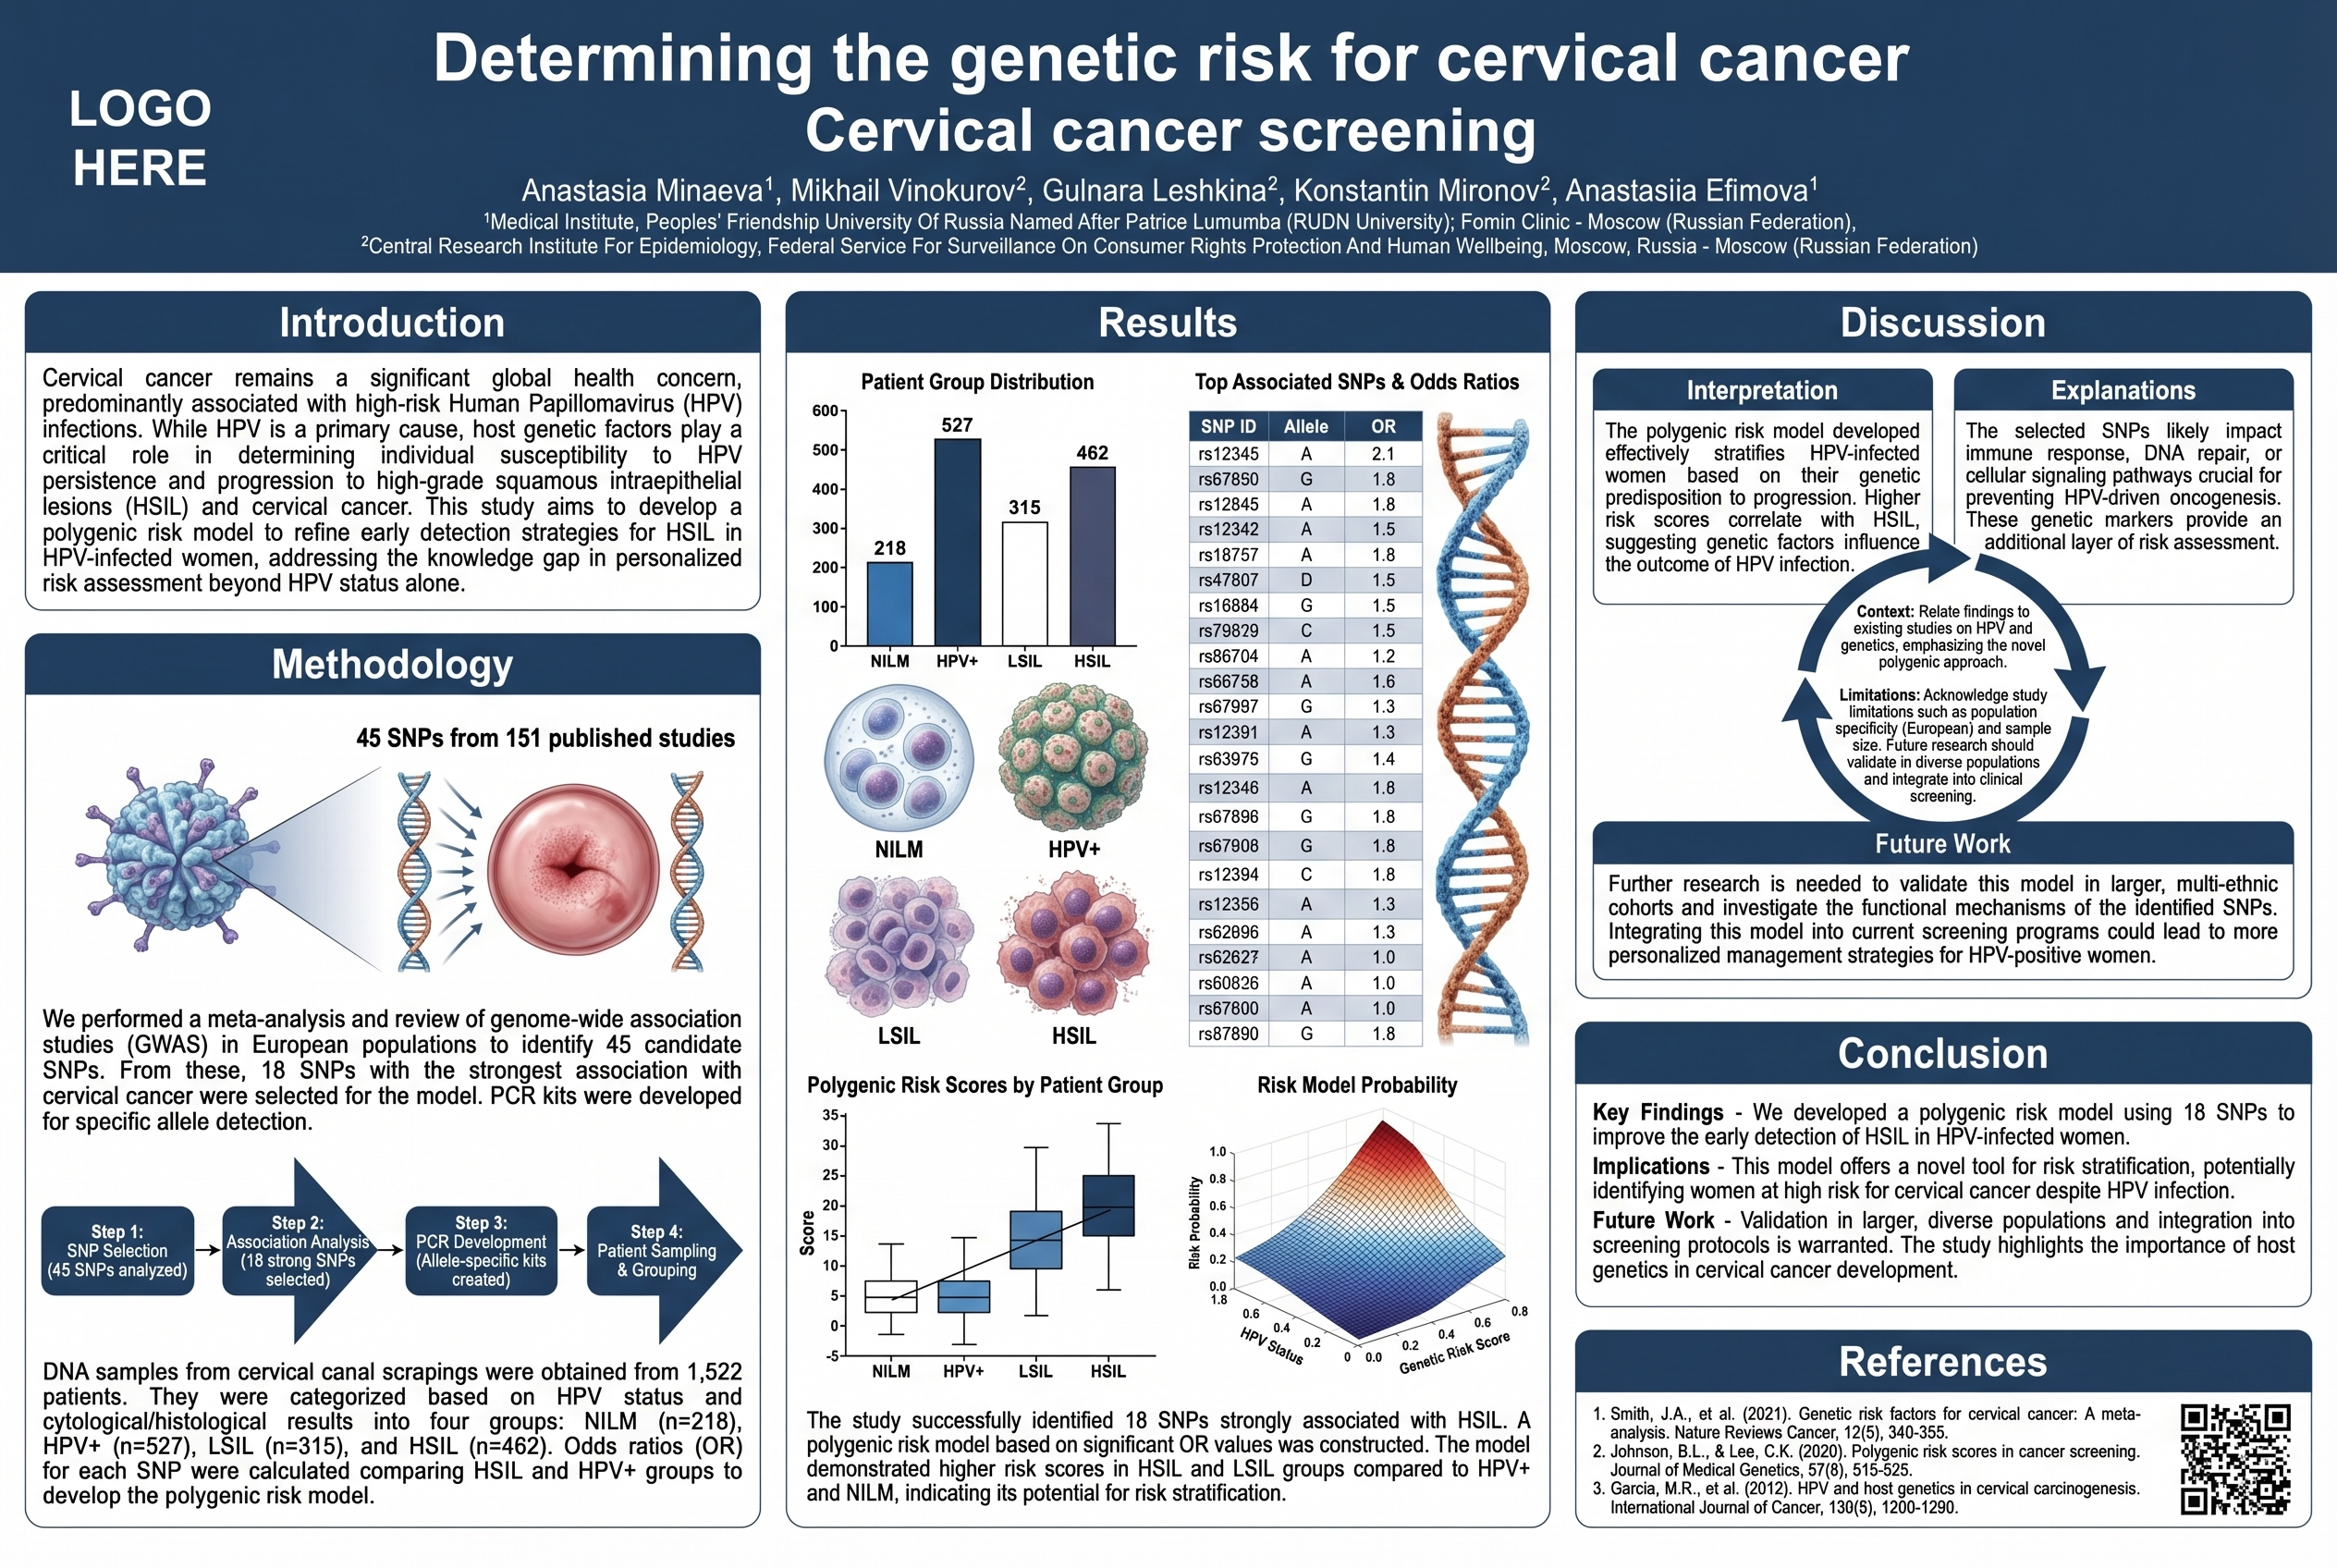
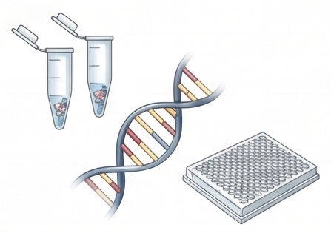
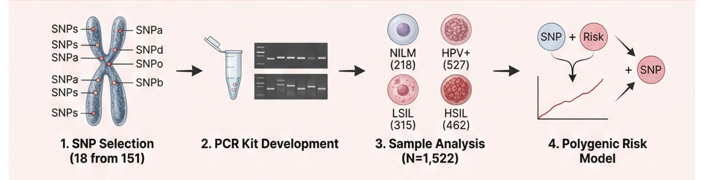
02
RESEARCH METHODOLOGY
Methodology & Study Design
n = 1,522 patients
SNP Selection Process
Patient Cohort
1
Literature Analysis
DNA samples from cervical canal scrapings grouped by HPV status and cytological/histological results:
Analyzed 45 SNPs from 151 published studies using meta-analysis and GWAS in European populations
2
Candidate Selection
n=218
n=527
Selected 18 SNPs with strongest association to cervical cancer
PCR Kit Development
NILM
HPV+
3
Developed PCR kits for SNP allele detection
n=315
n=462
LSIL
HSIL
Research Workflow
Total Sample Size
1,522
Notes:
Methods
We analyzed 45 single nucleotide polymorphisms (SNPs) from 151 published studies using meta-analysis and genome-wide association studies in European populations. We selected 18 SNPs with the strongest association with cervical cancer. PCR kits were developed to detect these SNP alleles. DNA samples from cervical canal samples from 1,522 patients were grouped based on HPV status, cytological and histological results: negative for intraepithelial lesion or malignancy (NILM, n=218), elimination of HPV without dysplasia (HPV+, n=527), low-grade squamous intraepithelial lesions (LSIL, n=315), and high-grade squamous intraepithelial lesions (HSIL, n=462). Odds ratios (OR) for each SNP were calculated by comparing the HSIL and HPV+ groups. A polygenic risk model was created based on significant OR values.

Slide 3
03
KEY FINDINGS
Results & Clinical Implications
Significant SNPs Associated with HSIL
9 SNPs
Key Achievement
SNP ID | Odds Ratio | 95% CI | p-value | Significance
rs55986091-G | 0.67 | 0.5–0.87 | <0.005
rs2516448-G | 0.52 | 0.4–0.68 | <0.001
rs9271898-G | 0.50 | 0.38–0.64 | <0.001
rs10175462-G | 1.15 | 1.02–1.30 | <0.05
rs4646903-A | 2.15 | 1.19–3.87 | <0.05
rs1801133-G | 1.60 | 0.99–2.58 | >0.05
rs73728618-T | 1.35 | 0.96–1.90 | >0.05
rs2069837-G | 1.45 | 0.98–2.14 | >0.05
rs187084-G | 1.70 | 0.96–2.98 | >0.05
HSIL Prediction Accuracy
82
%
When combining genetic data with HPV status
Significant improvement over HPV testing alone
Clinical Conclusions
SNP Detection: Algorithm enables precise SNP allele detection
Green highlighting indicates protective alleles (OR < 1); Red highlighting indicates risk alleles (OR > 1)
Risk Calculation: Accurate genetic risk stratification
Targeted Monitoring: Personalized patient surveillance
Risk Stratification Performance
Enhanced Screening: Early HSIL detection in HPV+ women
Low Risk
Medium Risk
High Risk
↓
→
↑
Risk-Stratified Preventive Care
Reduced HSIL probability
Moderate surveillance
Intensive monitoring
Personalized approach to cervical cancer prevention
Notes:
Nine SNPs showed a statistically significant association with HSIL.
The results of the study showed that there were significant differences in the genetic risk between patients with successful HPV elimination and those with high-grade squamous intraepithelial lesions (HSIL). The polygenic model was able to stratify patients into low-, medium-, and high-risk groups based on their genetic data. When combined with HPV data, the accuracy of HSIL prediction increased to 82%.
Conclusion
The developed algorithm allows for SNP allele detection, genetic risk calculation, and targeted patient monitoring. By integrating genetic testing into cervical cancer screening, early high-grade squamous intraepithelial lesion (HSIL) detection can be enhanced, particularly in women who are HPV-positive. This provides a risk-stratified approach to preventive care.

Slide 4




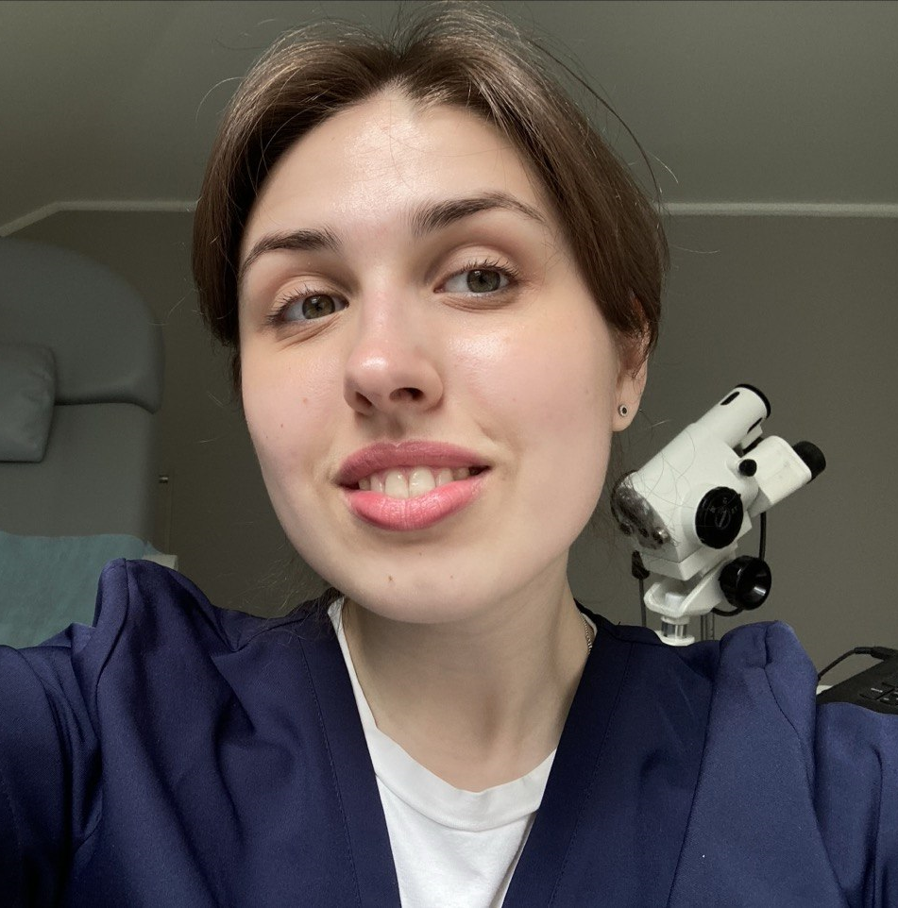
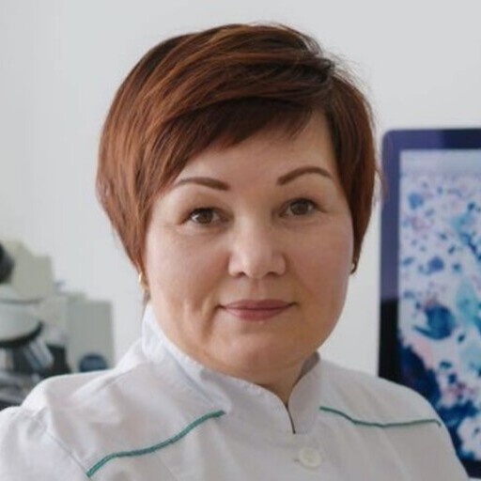

04
Research team
Mikhail Vinokurov
Subscribe @gynecologicum
2
3
4
1
2
Anastasia Minaeva
Mikhail Vinokurov
Gulnara Leshkina
Anastasiia Efimova

