Slide 1



Histological Yield of HR-HPV Positive, Cytology-Negative Referrals to Colposcopy in a Model 3 Hospital in Ireland
S.R. Nazir, S. Jaleel, H. Elves, E. McCole, K. Khan, M. Collins, M. Gardasanic
Department of Obstetrics & Gynaecology and Colposcopy
Letterkenny University Hospital, Ireland
Notes:
“Dear Audience, my name is Dr.Sofia Nazir and I am an SPR in OBGYN in Ireland. I’m presenting a retrospective audit from a Colposcopy unit in a Model 3 Hospital in Ireland , that looks into Histological Yield of HR-HPV Positive, Cytology-Negative Referrals to Colposcopy

Slide 2
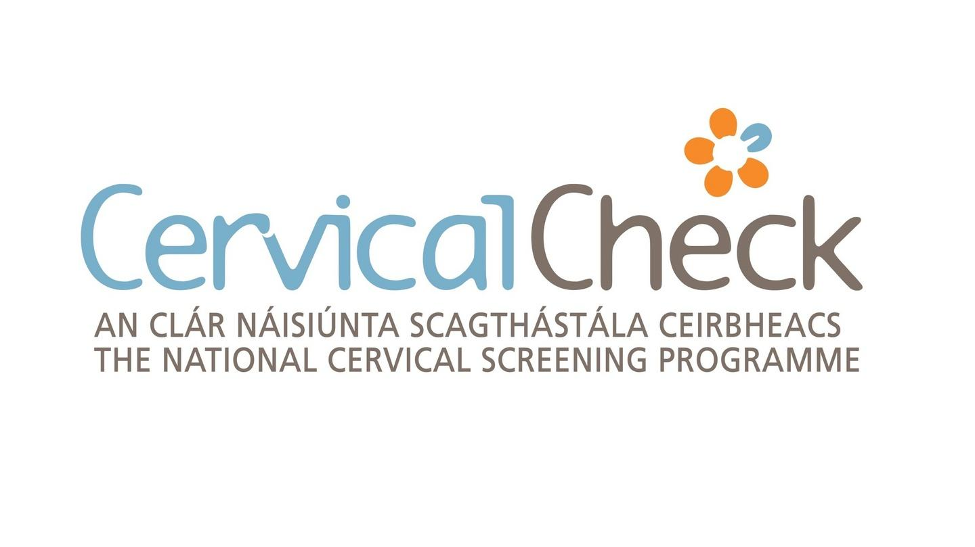
BACKGROUND
COHORT: HR-HPV Positive, Cytology-Negative
Rationale for audit: Persistent hrHPV infection is associated with a risk of CIN2+ despite negative cytology.
Health Service Executive (HSE). CervicalCheck: Cervical Screening Programme –Guidelines and Recommendations. Dublin: HSE.
HPV-Based Cervical Screening Pathway
Primary HPV Screening
↓
hrHPV Negative → Routine Recall
hrHPV Positive
↓
Cytology Triage
↓
Normal Cytology (NILM)
↓
Repeat HPV Test (12 months)
↓
Persistent hrHPV
↓
Colposcopy Referral
Notes:
Persistent hrHPV is recognised to carry a risk of high-grade cervical disease, including CIN2+, despite normal cytology.
In the CervicalCheck programme, these women undergo repeat HPV testing, and those with persistent HPV are referred to colposcopy. In Comparison BSCCP guidance prompts referral to colposcopy at 24 months.
This pathway reflects the clinical concern that cytology alone may not detect all clinically significant disease in this group.

Slide 3
AIM AND METHODS
Aim
To evaluate the histological yield of hrHPV-positive, cytology-negative referrals to colposcopy.
Methods
Retrospective audit using anonymised data from our colposcopy database, conducted in line with local audit governance processes.
Colposcopy Unit in a Model 3 Hospital in Ireland.
January–December 2025.
Data source: COMPUSCOPE (electronic colposcopy database).
Women referred following hrHPV-positive, cytology-negative screening results were identified and included.
Cases without documented histological outcomes were excluded (1.1%).
Notes:
We conducted a retrospective audit in the colposcopy unit at Model 3 hospital in Ireland, over a 12-month period, from January to December 2025.
Data were obtained from COMPUSCOPE, which is our electronic colposcopy database.
We identified women referred following hrHPV-positive, cytology-negative screening results.
We assessed biopsy rates and histological outcomes, categorised as no CIN, CIN1, CIN2, CIN3, or invasive disease.
The cases without documented histological outcomes were excluded from analysis.”

Slide 4
RESULTS
Histological Outcomes (n=57)
No CIN: 19.3%
CIN1: 63.2%
CIN2: 12.3%
CIN3: 1.8%
Invasive disease: 0
Cohort and Biopsy Rate
Total referrals: n=466
↓
hrHPV+/cytology–: n=90 (19.3%)
↓
Biopsied: n=57 (63.3%)
CIN2+ Detection
14.0% of biopsied women
8.9% of total cohort
Notes:
During the study period, there were 466 colposcopy referrals, of which19.3%, were in this hrHPV-positive, cytology-negative group.
Of these, 63.3%, underwent biopsy.
In terms of histological outcomes, 19.3% had no CIN, and the majority, 63.2%, had CIN1.
Importantly, CIN2 was identified in 12.3% and CIN3 in 1.8%, with no cases of invasive disease.
Overall, CIN2+ was identified in 14% of biopsied women, and 8.9% of the total cohort.”

Slide 5
CONCLUSION
hrHPV-positive, cytology-negative referrals accounted for 19.3% of colposcopy workload.
CIN2+ identified in 8.9% of women despite negative cytology.
The findings demonstrate the presence of clinically significant disease in this cohort and support colposcopy in persistent hrHPV despite negative cytology. This was a single-centre retrospective audit with a relatively small sample size.
References
1.Health Service Executive (HSE). CervicalCheck: Cervical Screening Programme – Guidelines and Recommendations. Dublin: HSE.
2.UK Health Security Agency (UKHSA). NHS Cervical Screening Programme: Colposcopy and Programme Management. London: UKHSA.
Notes:
In our unit, hrHPV-positive, cytology-negative referrals accounted for almost one-fifth of colposcopy workload.
A proportion of women in this group were found to have clinically significant disease, with CIN2+ identified in 8.9% despite negative cytology.
These findings demonstrate that high-grade disease can be present in this cohort.
This was a single-centre retrospective audit with a relatively small sample size.
Thank you for your attention

