Slide 1
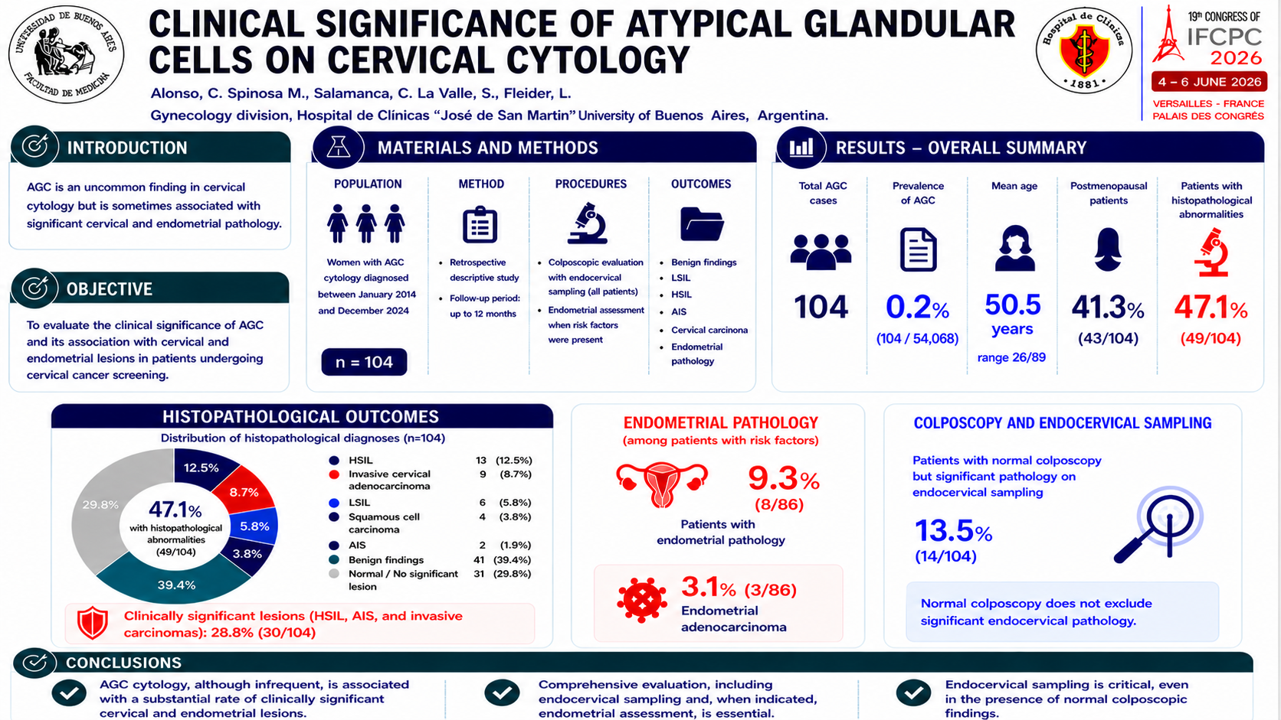

Notes:
Hello, my name is Carolina Alonso, and I will present our study on the clinical significance of atypical glandular cells in cervical cytology.
The obyectiv of this study was to describe the clinical significance of atypical glandular cells, or ei gi si, and their asousiéishon with cervical and endomítrial pathology in patients undergoing cervical cancer screening at a térshieri riféral hospital.
We condácted a rétrospektiv discríptiv study including patients dáiagnoust with ei gi si cytology at the Lower Genital Tract Unit of Hospital de Clínicas “José de San Martín” in Buenos Aires, Argentina, bitwíin January 2014 tu-tháusand for-tín and Dicember 2024 tu-tháusand tuénti for
Pregnant patients were excluded.
Clinical and demográphic data were collected, and follow-up was reconstructed for up to twelve months.
All patients underwent colposcópic evaluation with endocervical sampling, and endomitrial assessment was performed when risk factors were present.
Histopathological outcomes were classified as benign findings, low-grade and high-grade scuéimous intraepithelial lesions, adenocarcinoma in situ, cervical carcinoma, and endometrial pathology.
a tóutal ov wan-hándred and for patients with ei gi si cytology were analyzed, representing síro póint tu persént of all cervical cytology tests performed.
The mean age was fífti póint fáiv yíars, and fórti wan póint thrí persént of patients were postmenopausal.
Histopathological abnormalities were identified in fórti séven póint wan persént of cases.
The most frequent diagnosis was high-grade scuéimous intrapitéliol lesion, followed by invasive cervical adeno carcinouma, low-grade lesions, and scuéimous cell carcinouma.
Endomitrial pathology was detected in náin póint thrí persént of patients with risk factors, including thrí póint wan persént with endometrial adenocarcinoma.
impórtently, thirtín póint fáiv persént of patients with normal colpóscopi had significant pathology detected on endocervical sampling.
In conclusion, although ei-yi-sí cytology is infrequent, it is associated with a substantial rate of clinically significant cervical and endomitrial lesions.
Therefore, comprehénsiv evaluation is essential, including endocervical sampling and, when indicated, endomítrial asésment, even in the presence of normal colposcopic findings.
Thank you for your attention.

