Slide 1


Geographic inequalities from High-Grade Cervical Intraepithelial Lesions to Cervical Cancer in Isère, France
C. Balamou^{1,2}, C.M. Rodrigue¹, K. Zysman³, A. Seigneurin^{4,5}
¹CRCDC AuRA, Site de l’Ain - Bourg-en-Bresse (France). ²Translational Innovation in Medicine and Complexity / Recherche Translationnelle et Innovation en Médecine et Complexité, UMR 5525 – Laboratoire 1043049, Domaine de la Merci, 38706 La Tronche (France).
³CRCDC AuRA, Site de l’Isère - Meylan (France). ⁴Univ. Grenoble Alpes, CNRS, TIMC, CHU Grenoble Alpes, 38000 Grenoble (France). ⁵Registre du Cancer de l’Isère, Centre Hospitalier Universitaire de Grenoble, BP 217, Pavillon E, 38043 Grenoble Cedex 9, (France).
Contact: christian.balamou@depistagecanceraura.fr

Slide 2

Objective and Study design
Objective
This study identifies and describes geospatial clusters of high-grade cervical intraepithelial lesions (HSIL: including high-grade squamous intraepithelial lesions and adenocarcinoma in situ) and incident cervical cancer (ICC).
Methods
This population-based cross-sectional study used HSIL data from the french cervical cancer screening program in Isère, a french department and ICC data from the Isère Cancer Registry.
The analysis included women aged 25 to 65 years and diagnosed between 01/01/2010 and 12/31/2018. Cases were municipality-level geocoded.
A Poisson probability-based model using SaTScan purely spatial scan statistics was,,,,,, ,,,, performed to identify geographic clusters of higher (hot spots) or lower (cold spots) than,,,,,, ,,,, expected proportions of cases and adjusted for age and date of diagnosis.
Proportions were compared using the chi-square test and Fisher’s exact test, while,,,,,,,,,,,,,,,,,, medians were compared using the Wilcoxon-Mann-Whitney test. Statistical significance ,,,,, was defined as p≤ 0.05.

Slide 3
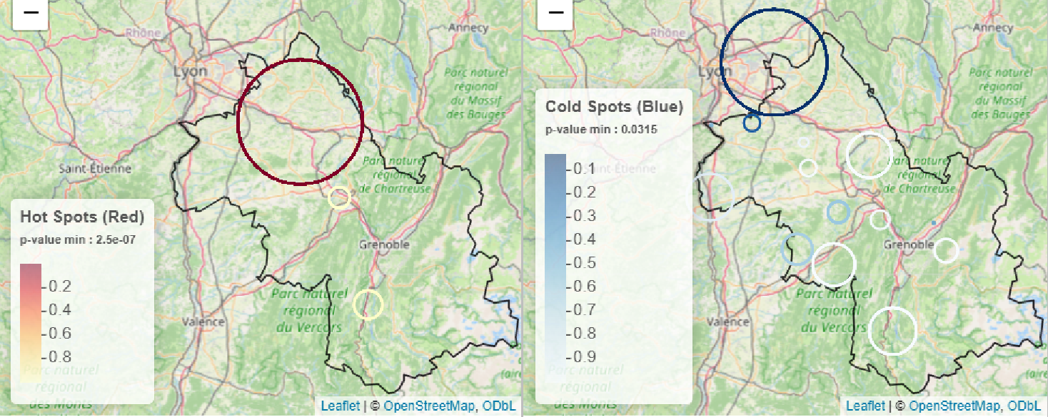
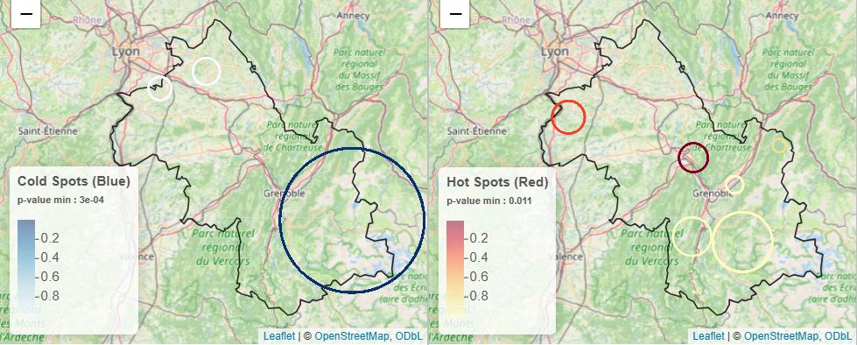
Clusters of HSIL and cervical cancer
Geographic Hot Spots of Cervical Cancer versus Cold Spots of HSIL
Among the 3,060 women with HSIL, spatial analysis identified two statistically significant clusters of HSIL: one hot spot in the West-centre (181 women (5.9%)) and one cold spot in the North (190 women (6.2%)).
Among the 287 women with ICC, two statistically significant clusters of ICC were identified: one hot spot in the North (120 women (41.8%)) and one cold spot in the Southeast (18 women (6.3%)).
ICC hot spot merges with the HSIL , cold spot.
Geographic Cold Spots of Cervical Cancer versus Hot Spots of HSIL

Slide 4
Characteristics of HSIL clusters
Variables | Hot spots N = 181 | Cold spots N = 190 | p-value Hot vs Cold
Age (median) | 38 (31 - 46) | 36 (30 - 42) | 0.04
Types of positive smears |  |  | < 0.001
HSIL cytology | 43,1% (78/181) | 23,7% (45/190)
ASC-H | 4,4% (8/181) | 21,6% (41/190)
ASC-US | 27,6% (50/181) | 24,2% (46/190)
LSIL | 23,2% (42/181) | 29,4% (56/190)
Atypical glandular cells – Adenocarcinoma in situ | 1,7% (3/181) | 1,1% (2/190)
Smear collectors |  |  | < 0.001
General physicians | 17,2% (31/180) | 29,3% (55/188)
Gynaecologists | 81,7% (147/180) | 64,9% (122/188)
Midwives | 1,1% (2/180) | 5,8% (11/188)
Missing | 1 | 2
French municipalities classification* |  |  | < 0.001
Municipalities generally favored in terms of accessibility to health care | 100% (181/181) | 88,4% (168/190)
Municipalities with poor accessibility to health care | - | 11,6% (22/190)
Municipalities limited access to specific types of health care professionals | - | -
French Deprivation Index** |  |  | < 0.001
Quintile-1 | 20,5% (37/181) | 12,1% (23/190)
Quintile-2 | 19,3% (35/181) | 21,6% (41/190)
Quintile-3 | 60,2% (109/181) | 20,5% (39/190)
Quintile-4 | - | 21,6% (41/190)
Quintile-5 | - | 24,2% (46/190)
*French municipalities classification was used to describe and analyze medical deserts in primary care (Bonal et al., 2024). **The French Deprivation Index (FDep) was developed to provide a geographic indicator of social disadvantage specifically tailored for population-based health studies in France (Rey et al., 2009). Quintile-1 representing the least deprived population and Quintile-5 representing the most deprived population.
Hot spots of HSIL are characterized by:
Municipalities generally favored in terms of accessibility to health care, though mitigated in some cases by high needs or a declining supply (100% of cases).
Easier access to gynecologists and specialists (81.7% of cases).
In contrast, cold spots are significantly (p < 0.001) more likely to include:
Municipalities with poor accessibility to healthcare.
The most socioeconomically disadvantaged quintiles ,,,,,,,,, (quintiles 4 and 5).

Slide 5
Take home message
Geographic-level comparisons reveal a high cancers screening disparity in Isère and that ICC hot spot merges with the HSIL cold spot.
Lower detection rates of HSIL seems to be linked to cancer detection in a specific area.
Our findings suggest that HSIL cold spot territory may be of specific attention as women still die from progressing HSIL that escape follow-up care.

