Slide 1


Clinical Utility of Point-of-Care E7 Oncoprotein Testing for Triage of HR-HPV Positive Women
Corresponding Author: Weidong ZHAO
E-mail: 18555582398@163.com
Institution: Department Of Obstetrics And Gynecology, The First Affiliated Hospital Of Anhui University Of Chinese Medicine

Slide 2
Cervical cancer remains a major global health burden
HR-HPV+
High sensitivity
but low specificity
Over-referral to colposcopy
Need effective triage
HR-HPV testing:
• High sensitivity
• Low specificity → excessive colposcopy referrals
Cytology (TCT) as a triage tool:
• Limited sensitivity
• Observer-dependent interpretation
→ An accurate triage tool is urgently needed

Slide 3
HR-HPV positive women (n=244)
E7 POCT + TCT
Colposcopy & biopsy
Histopathology HSIL+
Routine care:
Participants had undergone HR-HPV testing and TCT;
Sample collection:
Cervical samples collected prior to biopsy for E7 POCT;
Study design:
Paired comparison using histopathology HSIL+ as reference.

Slide 4
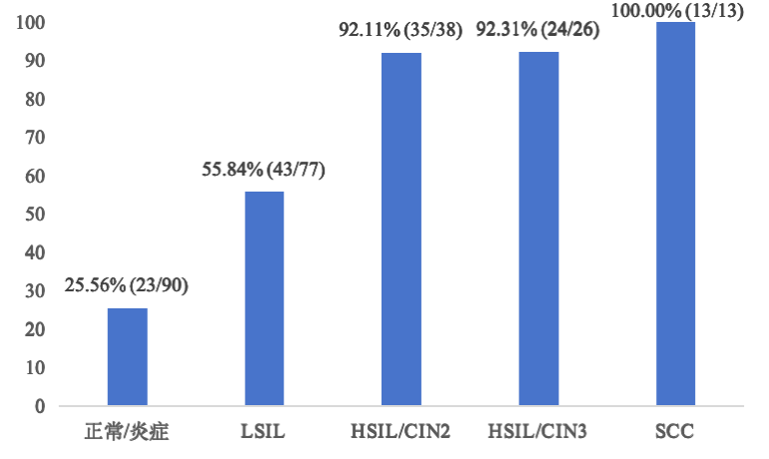
Indicator | E7 POCT | TCT | P-value
Sensitivity（%） | 93.51（72/77） | 76.62（59/77） | 0.006
Specificity（%） | 60.48（101/167） | 57.49（96/167） | 0.609
PPV（%） | 52.17（72/138） | 45.38（59/130） | —
NPV（%） | 95.28（101/106） | 84.21（96/114） | —
Normal
Table. Paired Comparison of the Diagnostic Accuracy of E7 POCT versus TCT for HSIL+
Figure. E7 POCT Positivity Increases with Disease Severity

Slide 5
E7 POCT shows higher sensitivity than TCT for detecting HSIL+
• Reduces unnecessary colposcopy
• Minimizes missed high-grade lesions
• Improves risk stratification
It reflects viral oncogenic activity rather than viral presence, could be a promising triage tool for HR-HPV positive women.

