Slide 1


Evaluation of testing efficacy and accuracy of urine samples in
HR-HPV cervical infection and optimization of sample collecting timing
Hanfei Niu, Bingbing Xiao
Department of Obstetrics and Gynecology
Peking University First Hospital

Slide 2

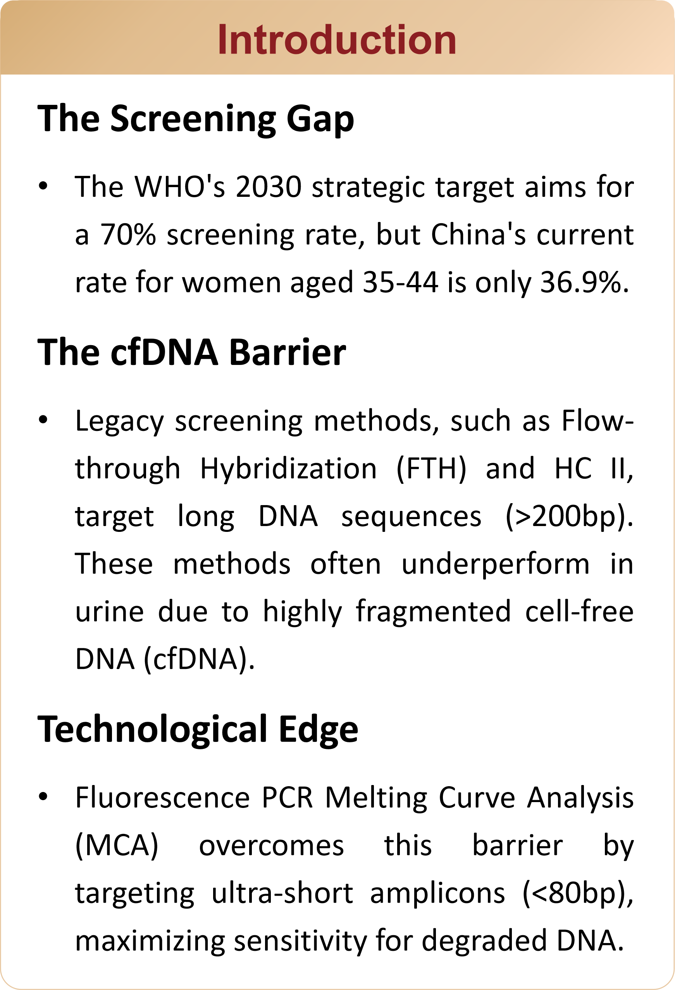
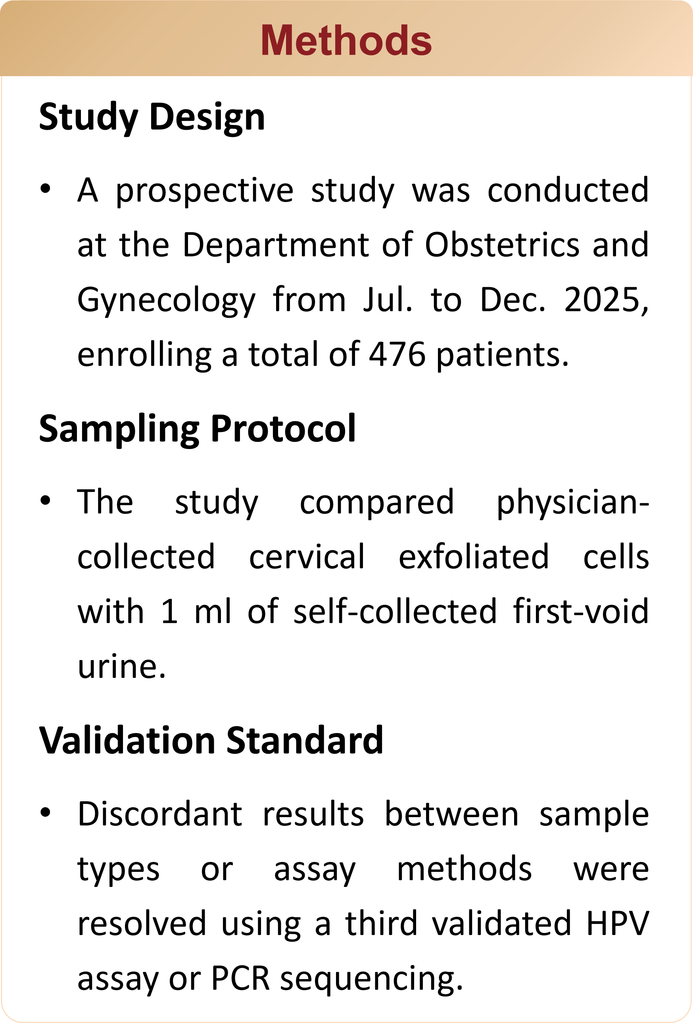
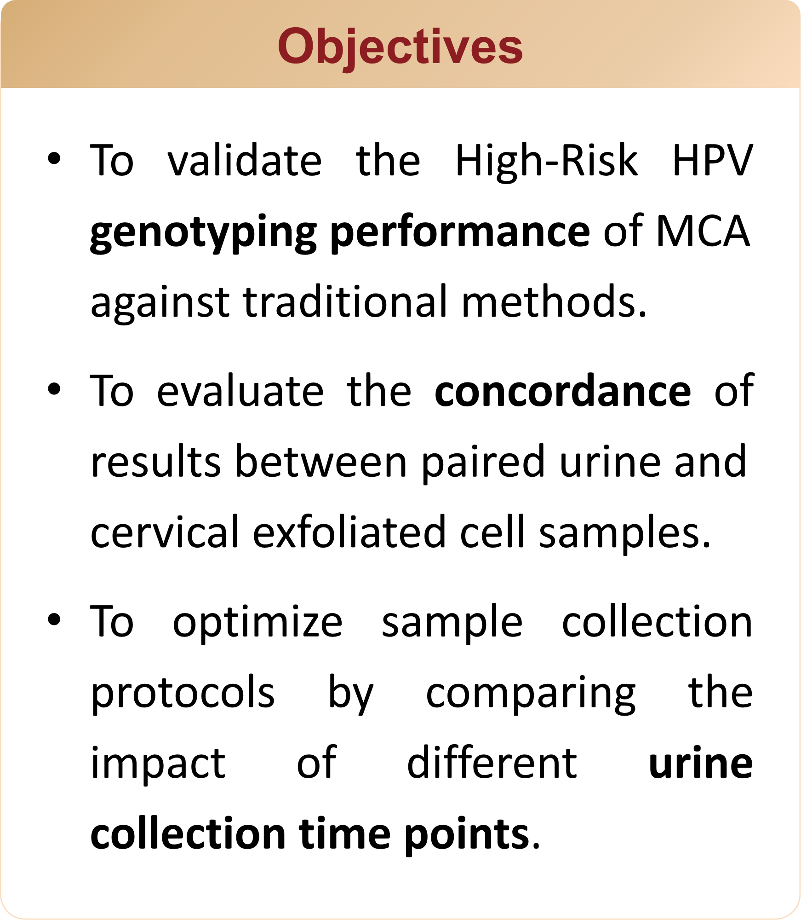
Contents
< >

Slide 3
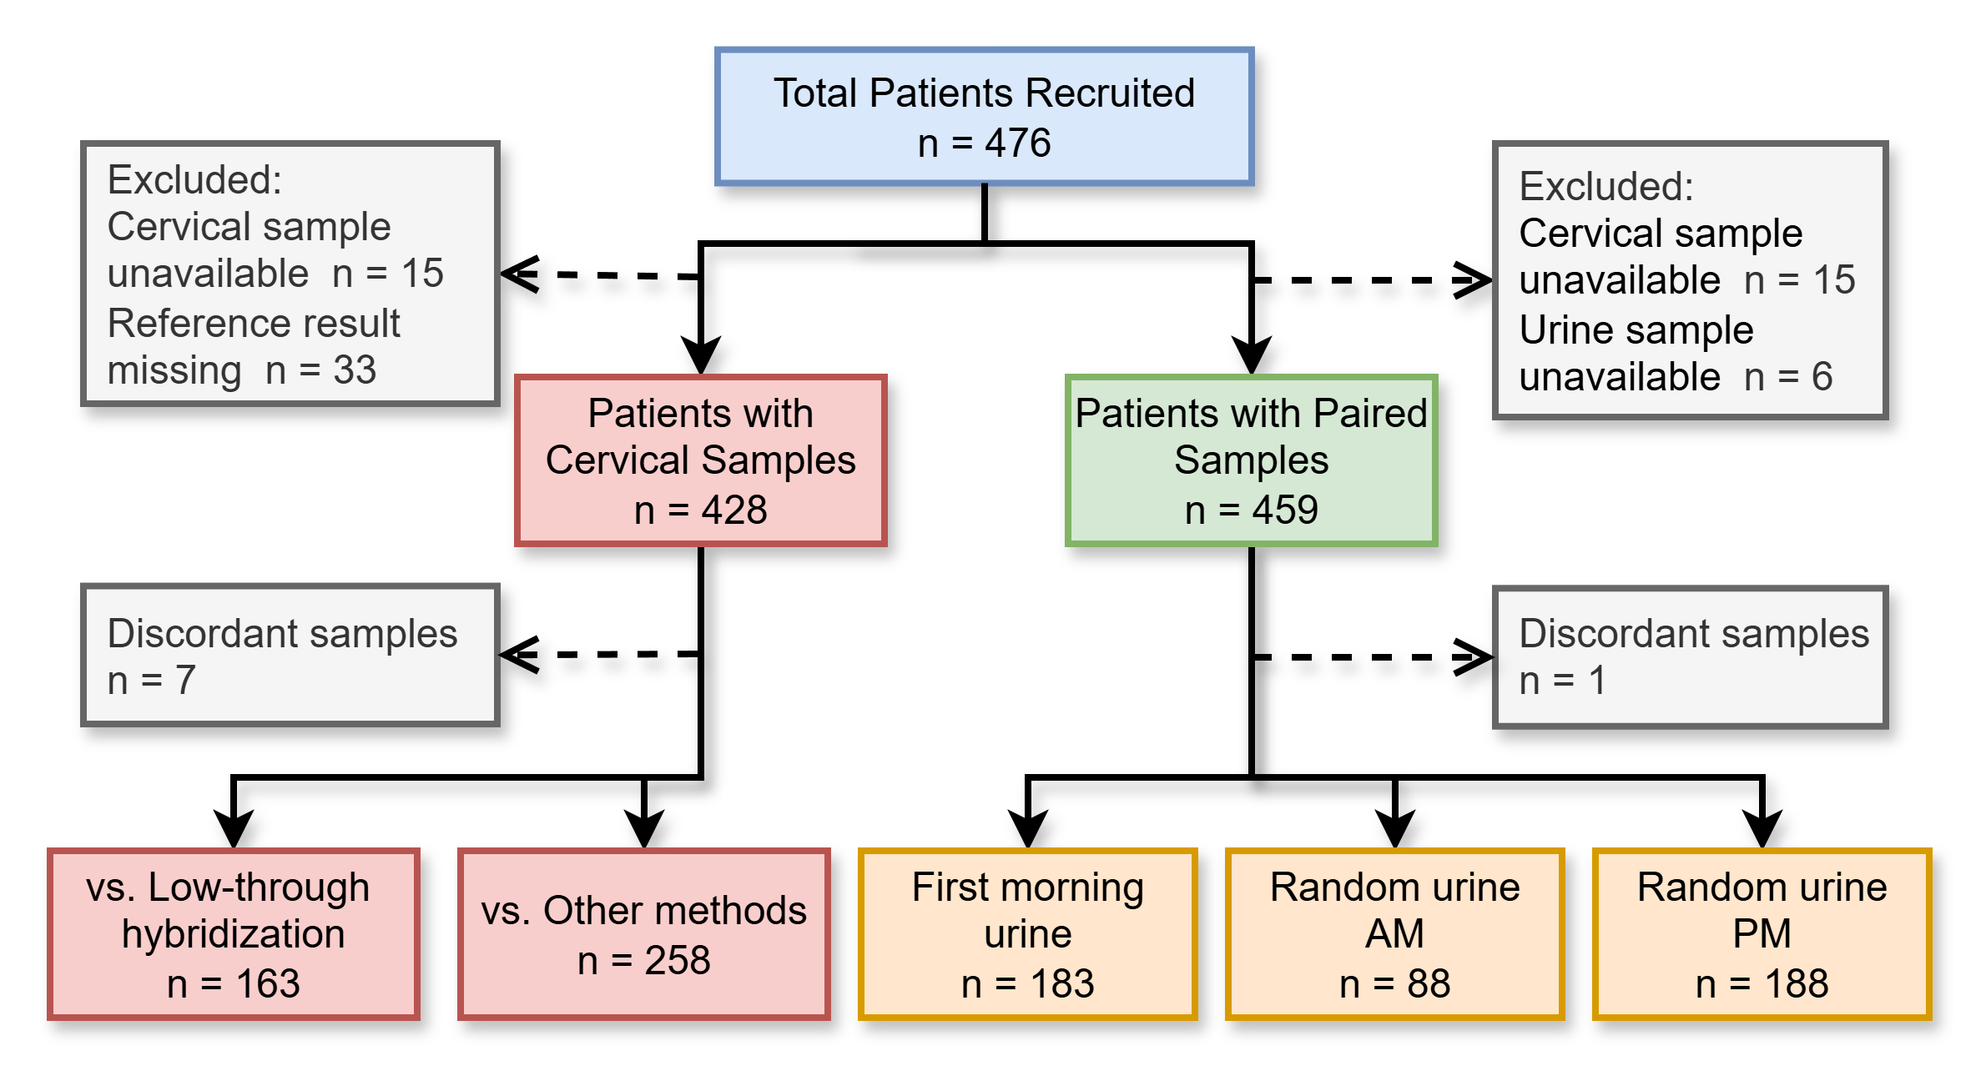
Results
< >

Slide 4
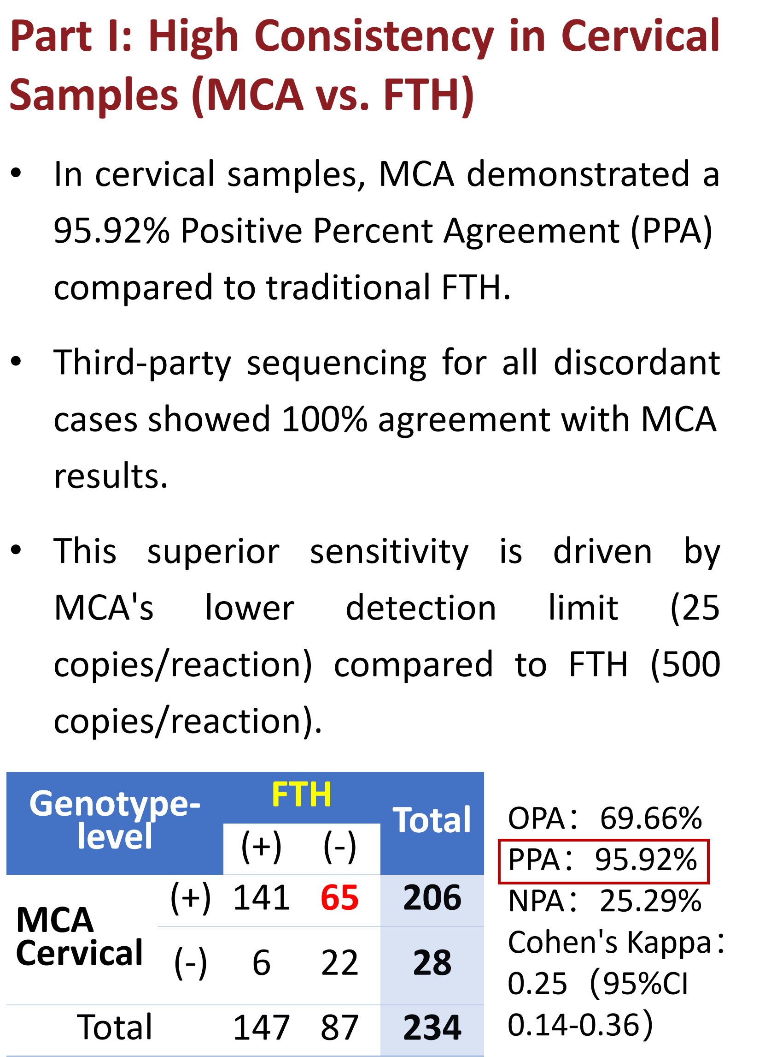
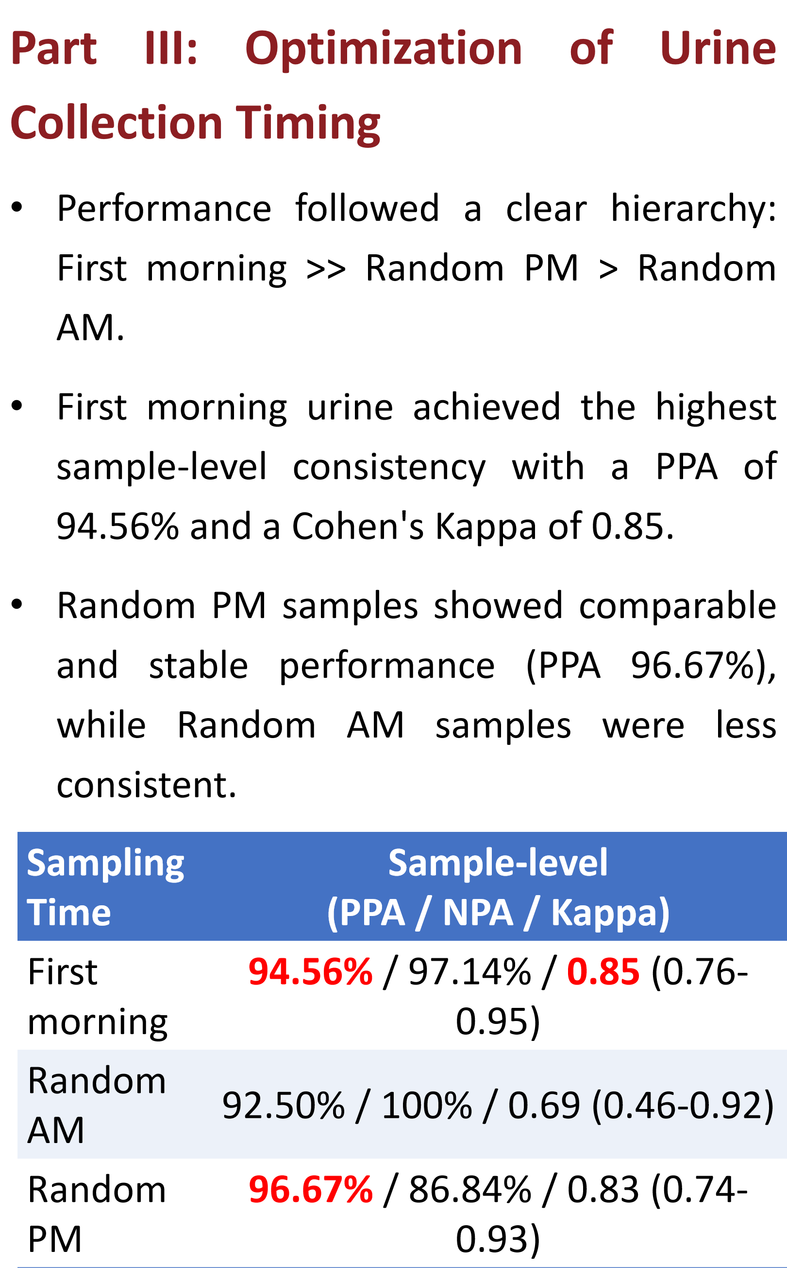
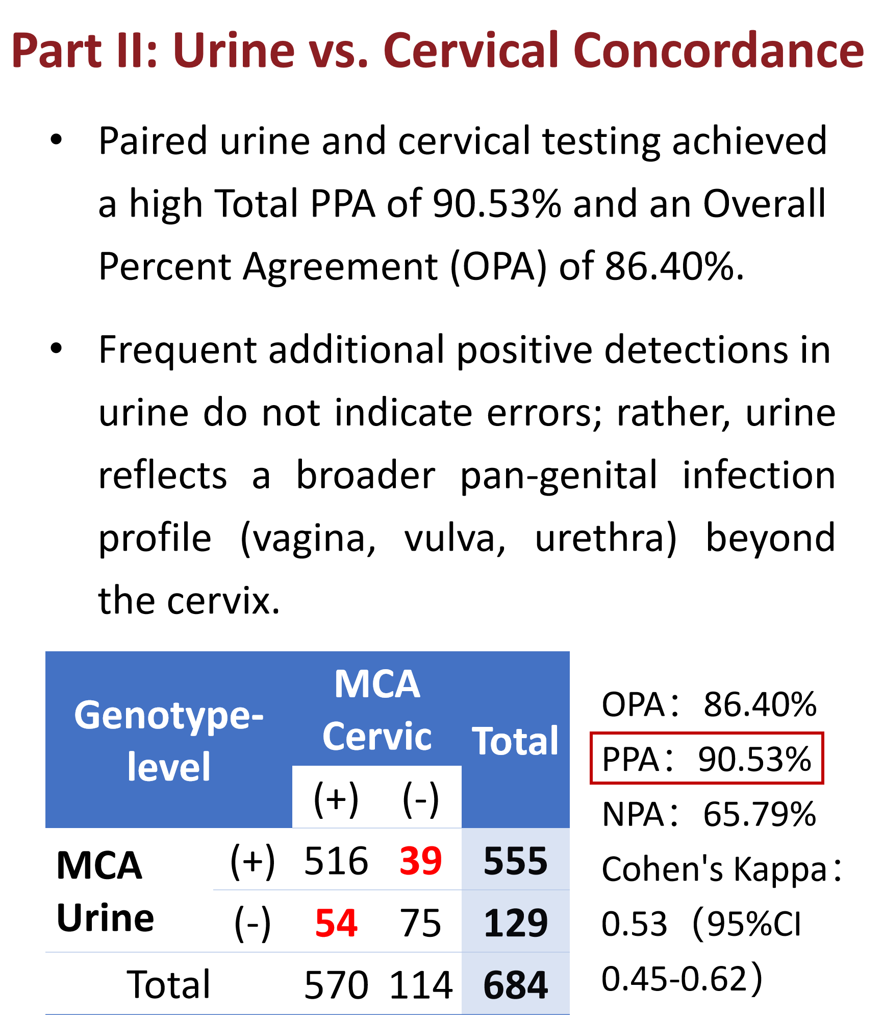
Results
< >

Slide 5
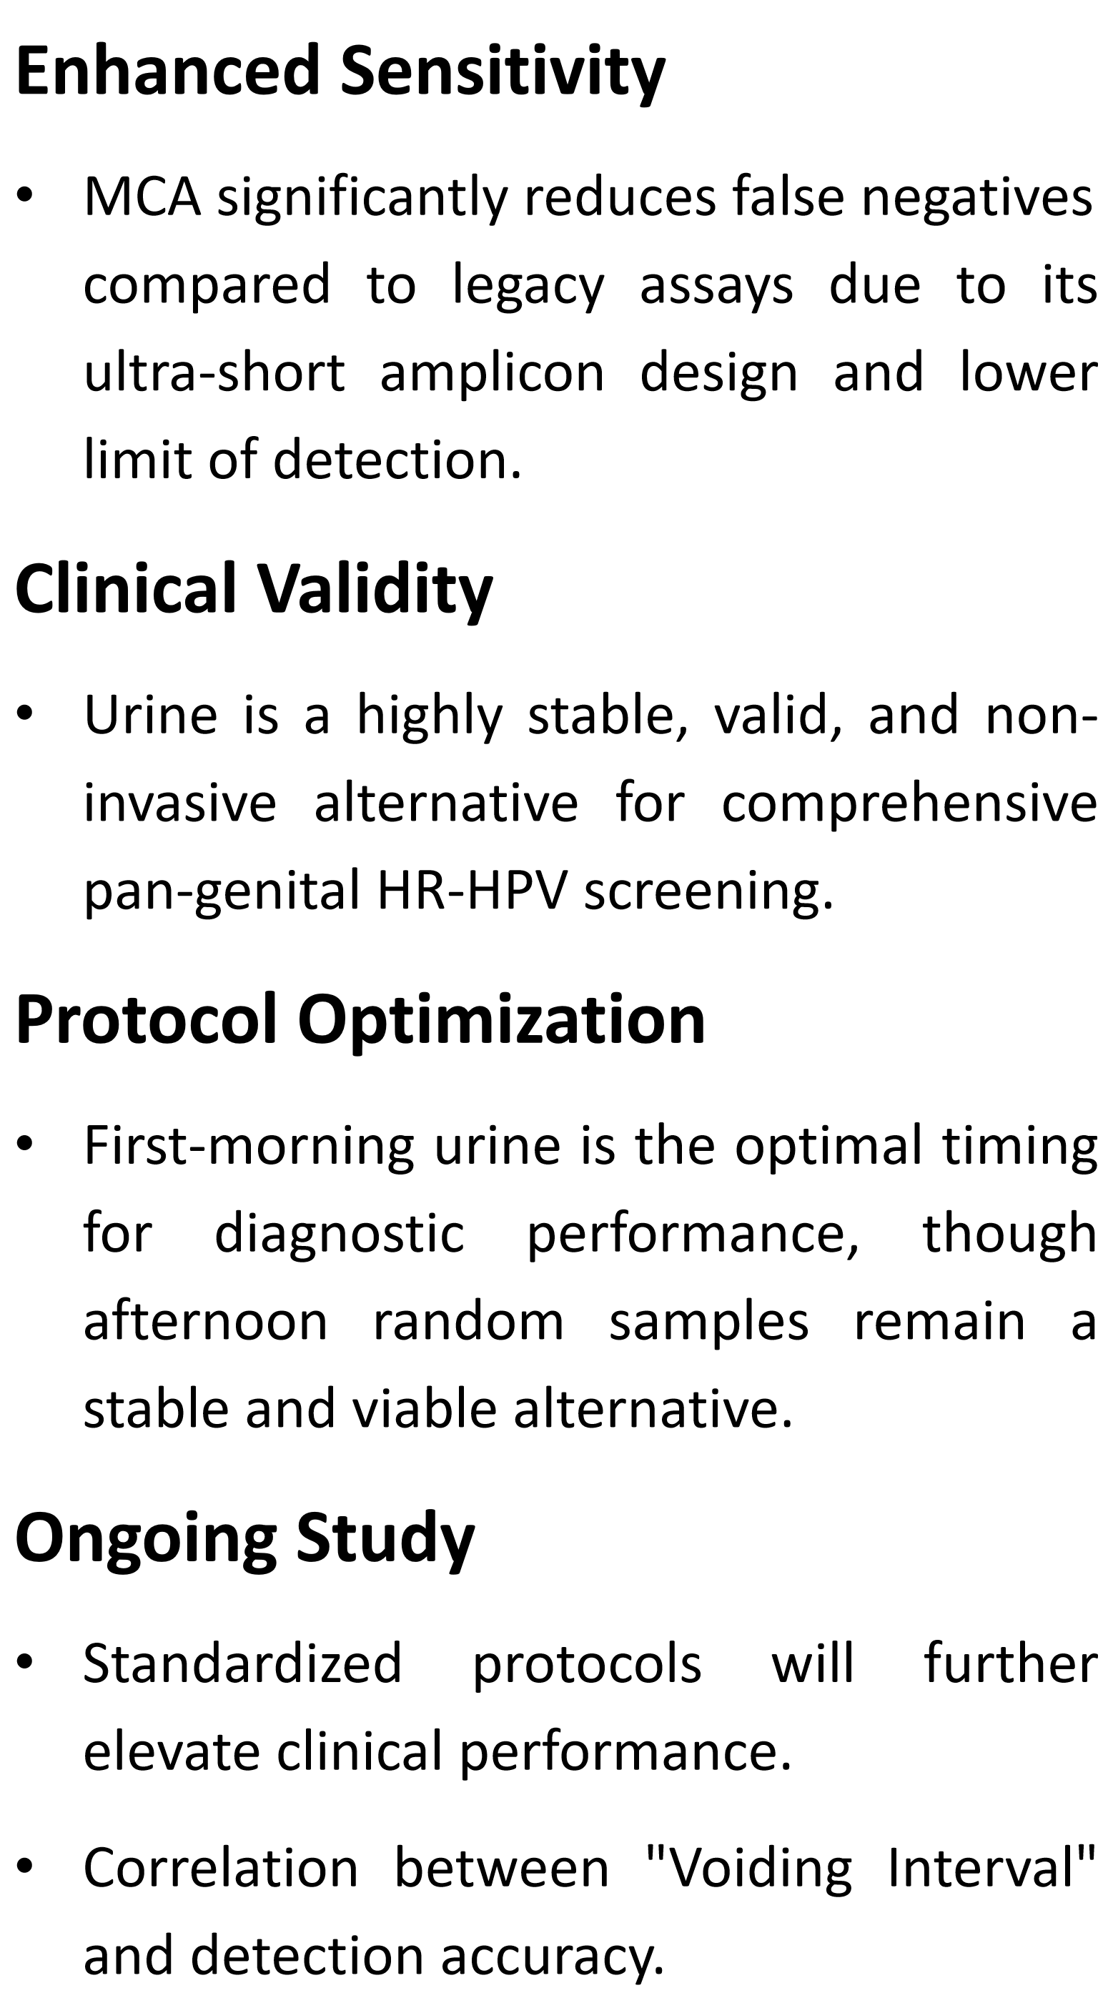
Conclusion
< >

