Slide 1






PC-001
Regional Distribution and
Genomic Mapping of
High-Risk HPV in Central
Mexico
A Population-Based Study Disrupting Global
Genotype Assumptions in Aguascalientes
Authors
Dr. Flota Diego, Dr. Camarillo Omar, Dr. Hernandez Laura, Dr. Sigala Keli, Dr. Sanchez Cesar
Speaker
Dr. Camarillo Contreras Omar
Hospital de la Mujer Aguascalientes (México)
Endofertyl (México)
Universidad Autónoma de Aguascalientes (México)
Institutes

Slide 2
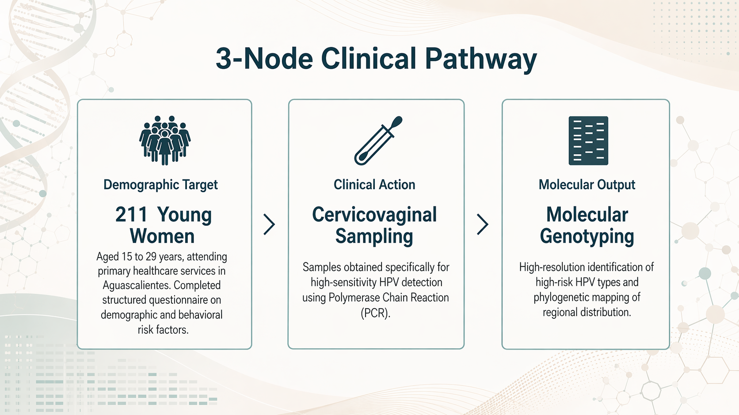

Slide 3
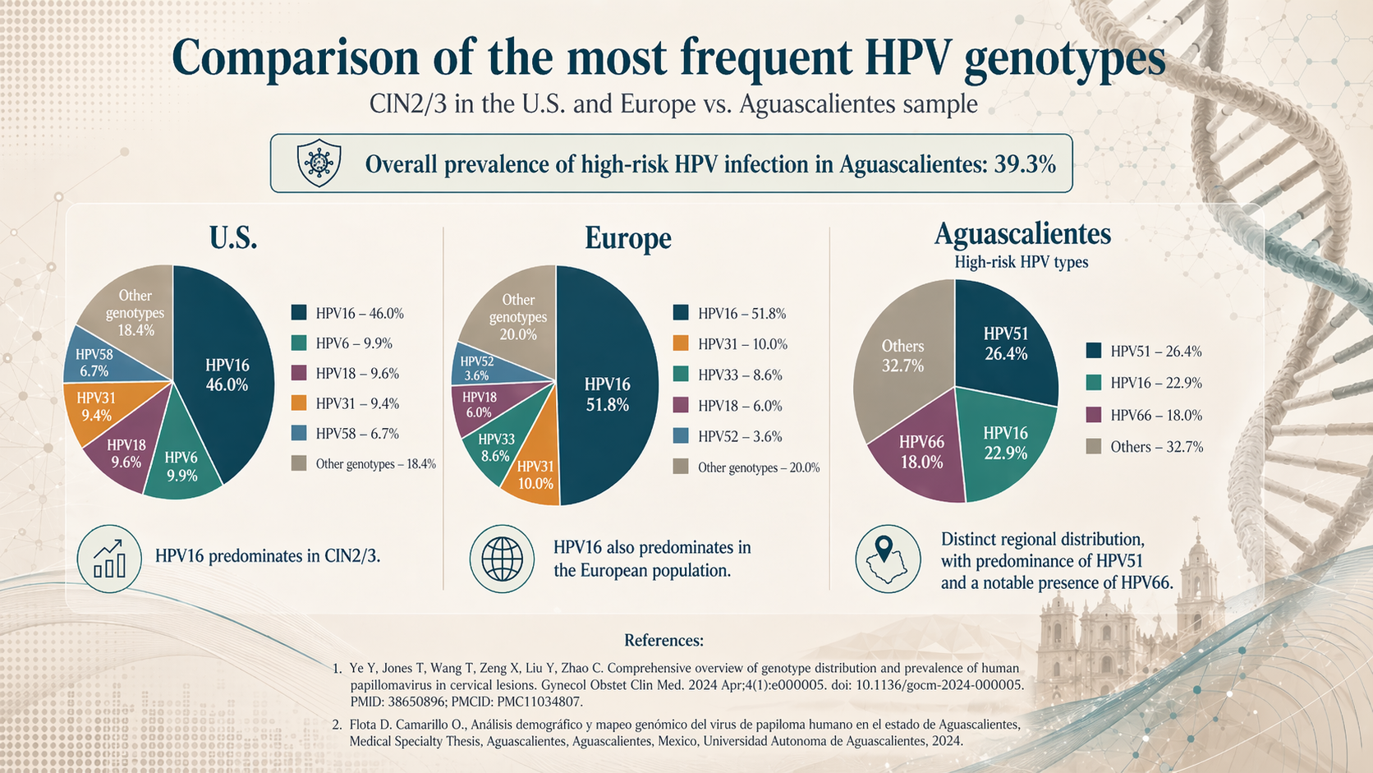

Slide 4
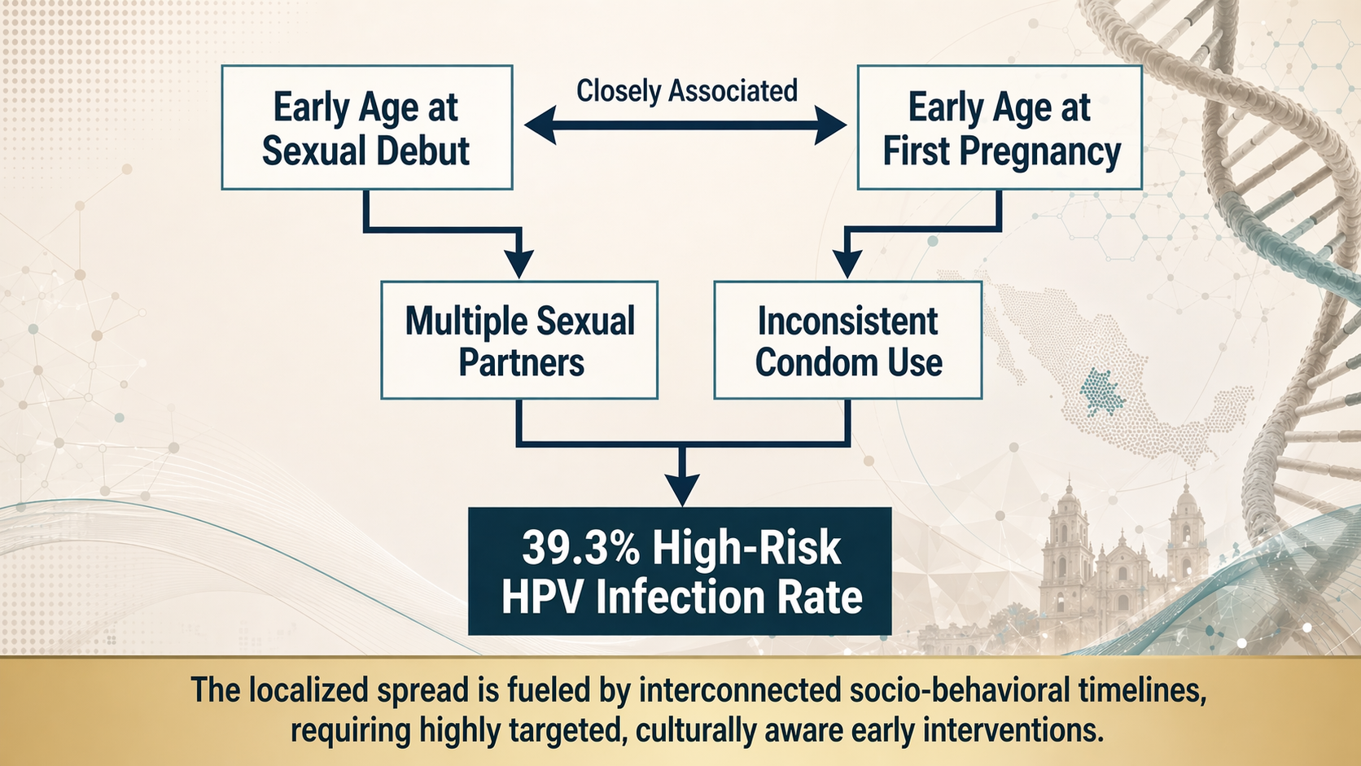

Slide 5
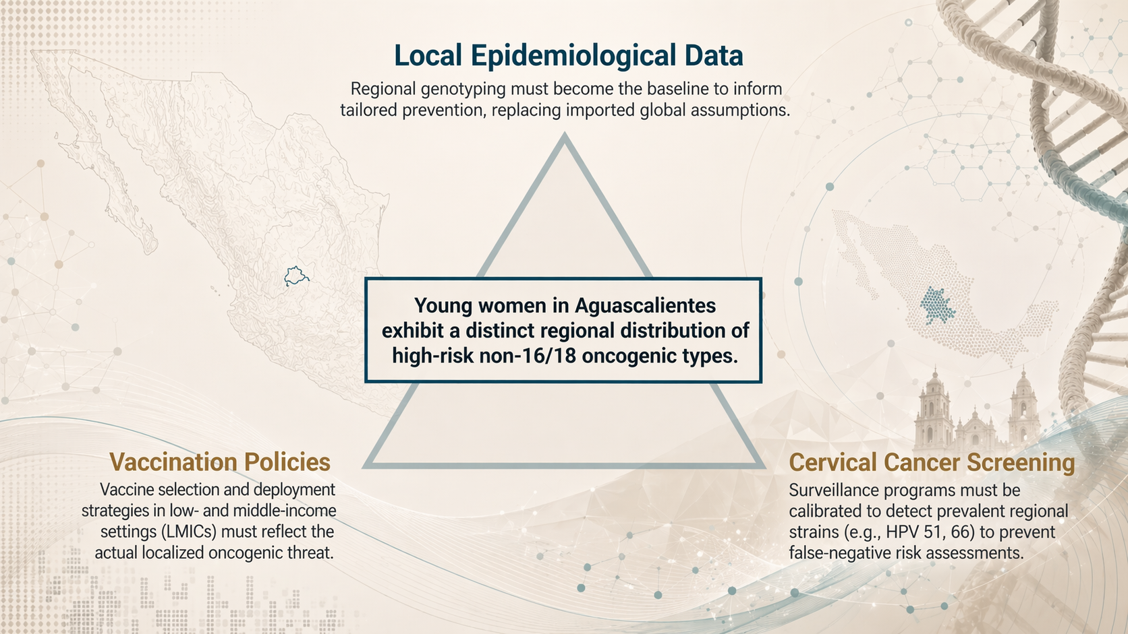

Slide 6


