Slide 1


VULVAR CARCINOMA CASE REPORT
DJELTI Sihem
Department of Obstetrics and Gynecology
EHSU Nouar Fadela, Oran, Algeria

Slide 2
INTRODUCTION - DEFINITION - OBJECTIVE
Rare malignancy (3–5% of gynecologic cancers)
90% squamous cell carcinoma
Predominantly affects older women
Symptoms often non specific (pruritus, pain, lesions)
Diagnostic delay is common
Hacker NF et al.Vulvar Cancer, International Journal of Gynecology & Obstetrics
Homes Ley HD.Management of vulvar cancer, Cancer

Slide 3
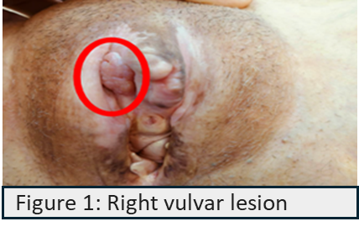
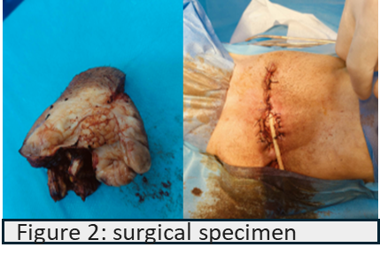
CASE REPORT
72-year-old woman
No significant past medical history
Chronic vulvar pruritus
Small lesion on right labium majus
No inguinal lymphadenopathy

Slide 4
DISCUSSION
Vulvar biopsy → malignant lesion (SCC)
Tumor stage: T1A
Likely non-HPV- related
Complete surgical excision performed
Clear margins, no lymph node dissection
Management of vulvar cancer, The Lancet Oncology
FIGO → Classification officielle du cancer vulvaire
National Comprehensive Cancer Network→ Recommandations détaillées sur la prise en charge
European Society of Gynaecological Oncology→ Guidelines européennes actualisées

Slide 5
CONCLUSION
Symptoms often underestimated → delayed diagnosis
Commonly associated with chronic dermatoses (e.g., lichen sclerosus)
Diagnosis relies on biopsy
Early-stage disease allows conservative Surgery
“Any persistent vulvar symptom in older women requires early biopsy.”

Slide 6
Thank you for your attention

