Slide 1


LAPAROSCOPIC PELVIC LYMPHADENECTOMY IN HIGH-RISK ENDOMETRIAL CANCER: CASE REPORT
DJELTI Sihem
Department of Obstetrics and Gynecology
EHSU Nouar Fadela, Oran, Algeria

Slide 2

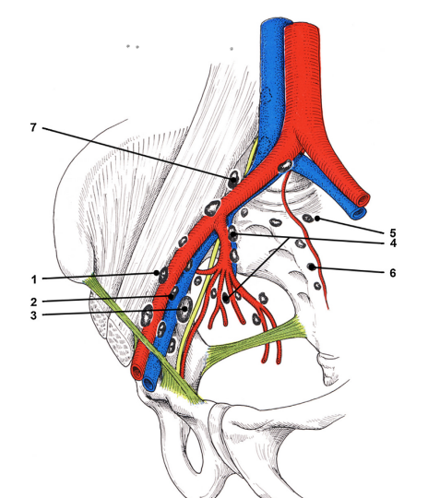
INTRODUCTION - DEFINITION - OBJECTIVE
Pelvic lymph nodes:
  External iliac
  Internal iliac
  Common iliac
Function: immune defense & cancer spread pathway
Indication: staging of gynecologic cancers
Iliopelvic lymph nodes
1: External iliac lymph nodes (lateral chain)
2: External iliac lymph nodes (intermediate chain)
3: External iliac lymph nodes (medial chain)
4: Internal iliac lymph nodes
5: Promontory lymph nodes
6: Sacral lymph node
7: Common iliac lymph node
. Papanikolaou ,F..Pelvis lymph nodule dissection eMedicine.Medscape.com web MDLLC;2013:
ht t p: / / em epic ine. m eds c ape. c om
. Andres a, kohan md et al, position émission tomography magnetic résonance Imaging in oncologic diseases of the mal and female pelvis , http//doi.org/10.1053/j.ro.2014.04.02

Slide 3
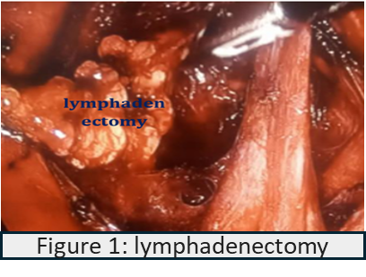
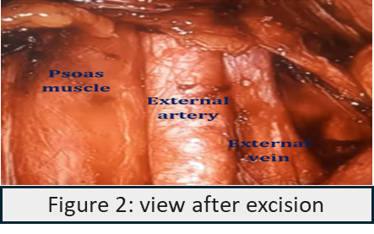
CASE REPORT
52- year- old postmenopausal woman
Symptom: postmenopausal bleeding
Imaging:
  Ultrasound: uterine mass
  MRI: intrauterine polyposis
Surgery:
Hysterectomy + bilateral salpingo-oophorectomy
Histology:
  Endometrial adenocarcinoma
  70% myometrial invasion

Slide 4
DISCUSSION
Indication: high- risk disease
Technique:
  Bilateral dissection
  remove a block of lymph nodes
  [located medial to the external iliac vein, anterior to the obturator nerve, and lateral to the umbilical artery]
Anatomical landmarks:
  External iliac vein
  Obturator nerve
  Umbilical artery
Benefits:
  Minimally invasive
  Accurate staging
-bulletin du cancer, volum 107, issu 6,2020,pp701-714 reste t il des indication de curage gonglionnaire dans les cancers epitheliaux de l’ovaire .

Slide 5
CONCLUSION
Recommended for most endometrial cancer stages
Exception: low-risk stage IA
Risks:
Vascular injury
  Nerve damage
  Lymphocele
  Infection
Requires surgical expertise

Slide 6
Thank you for your attention

