Slide 1


CERVICAL SARCOMA: A CASE REPORT
DJELTI Sihem
Department of Obstetrics and Gynecology
EHSU Nouar Fadela, Oran, Algeria

Slide 2

Introduction & Objective
Introduction
Uterine sarcomas are rare (<5% of uterine cancers)
Cervical sarcoma is extremely rare
Diagnosis is challenging
Objective
To highlight diagnosis and management

Slide 3
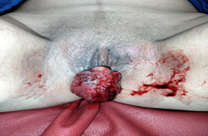
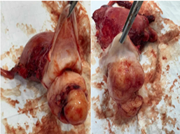
CASE REPORT
Case Report
52-year-old woman
Presented with abnormal bleeding
Cervical tumor (FIGO stage I) (Figure 1)
Treatment
Hysterectomy + radiotherapy (Figure 2)
Outcome
No recurrence after 1 year
Figure 1: tumor cervical
Figure 2: surgical specimen

Slide 4
DISCUSSION
Non-specific clinical presentation
Diagnosis requires histopathology
Multidisciplinary management is essential
Prognosis depends on stage and histology

Slide 5
CONCLUSION
Rare and aggressive tumor
Early diagnosis is crucial
Requires specialized management
Long- term follow-up is necessary

Slide 6
Thank you for your attention

