Slide 1

Reserved Cell Proliferative Pattern at Clear Margins of LEEP as a Marker of HPV Persistence and CIN2+ Recurrence
Muryzina I., Gargin V., Bilodid O., Alekseeva V., Lazurenko V.

Slide 2
Background & Hypothesis
Background
• CIN2+ → HPV-driven but heterogeneous
• Recurrence persists after LEEP
• Early detection remains limited
Rationale
• Reserved cells (RC) = potential HPV reservoir
• Proliferation may indicate persistence
Aim:
1. Assess RC at clear margins
2. Compare: HIV vs Refugees vs Controls
3. Link RC proliferation → CIN2+ recurrence

Slide 3
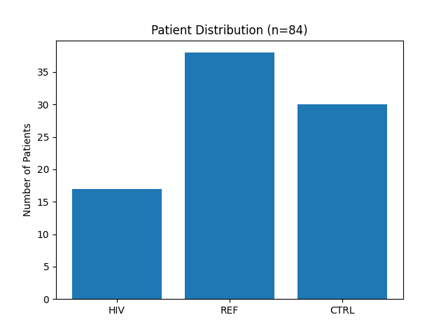
Material and Methods
Methods
1. Histology: Hematoxylin–eosin staining 2. Immunohistochemistry: CK7 → reserved cells identification CK19, p63, Ki67 → proliferative activity
Analysis
• Marker expression at clear margins
• Measurement uncertainty (95% CI, k=2)

Slide 4
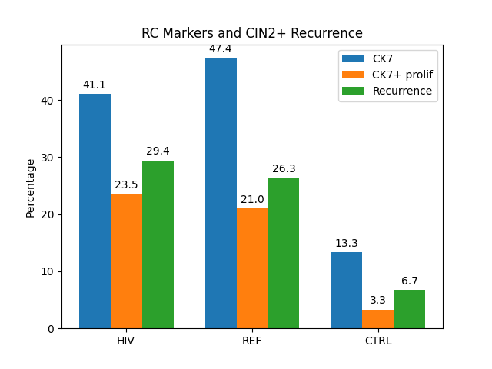
Results
HIV and refugee groups show comparable biological behavior
Chronic stress may act similarly to immunosuppression RC proliferation at margins likely represents
Latent HPV reservoir early step of recurrence development
• Higher in HIV & REF
• Similar pattern: HIV ≈ REF
• Recurrence only in CK7+

Slide 5
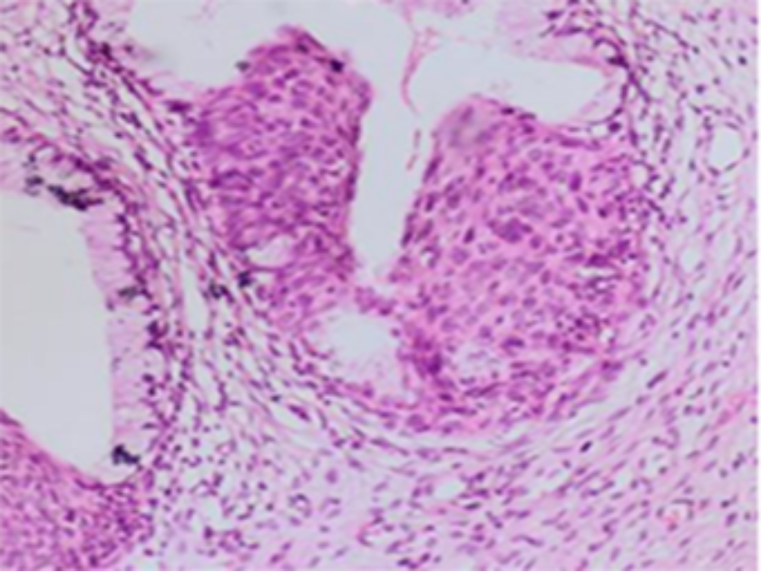
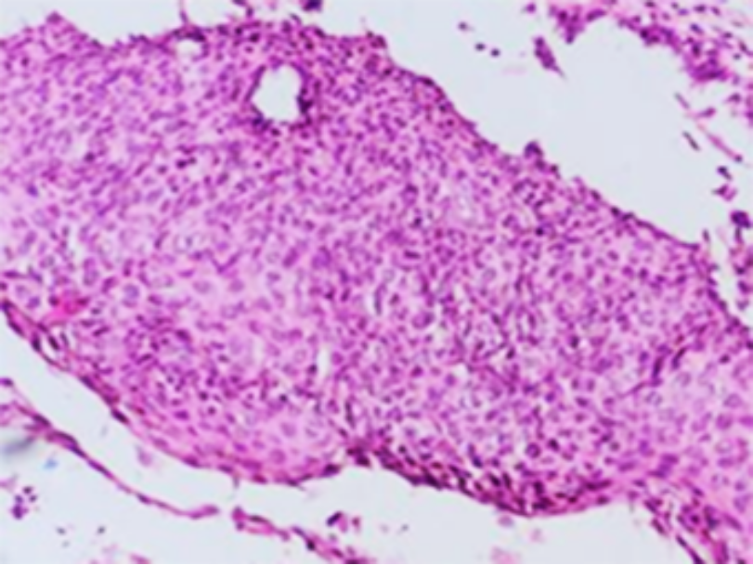
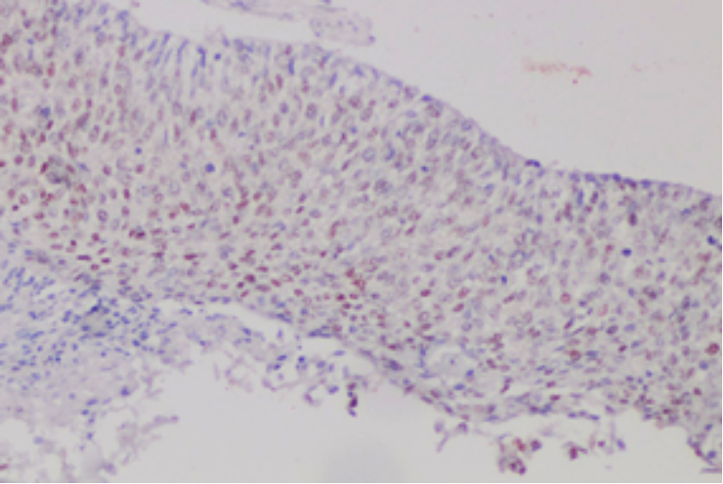
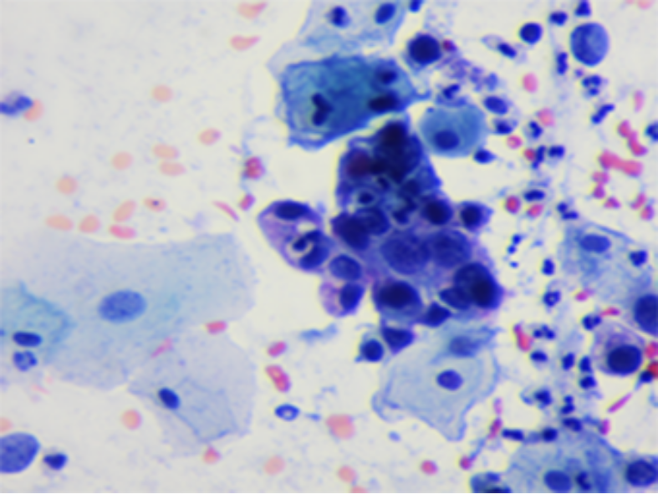
Thank you
for your
Attention !
CIN2, H&E, ×200
Ki-67, IHC, ×100
Pap test, moderate dysplasia, ×400

