Slide 1



EFFICACY OF THERMAL ABLATION IN HPV16,18 POSITIVE FEMALES
Dr. Anagha M. Diwan Mukta Colposcopy Center, Diwan Hospital, MS, India
Dr. Priya Ganeshkumar Sai Niwas Health Care, New Delhi

Slide 2

OBJECTIVE & FOCUS OF THE STUDY
To assess the clinical efficacy of thermal ablation in HPV 16 & 18 positive women
Target group: Females aged 30–45 years
Aim:
Clearance of HPV infection
Prevention of Invasive Cervical Disease
Emphasis on low-resource, practical treatment approach.

Slide 3
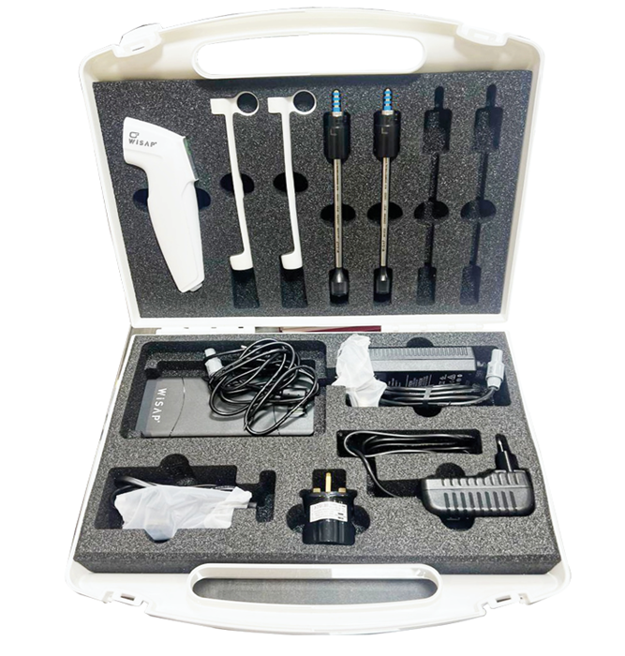
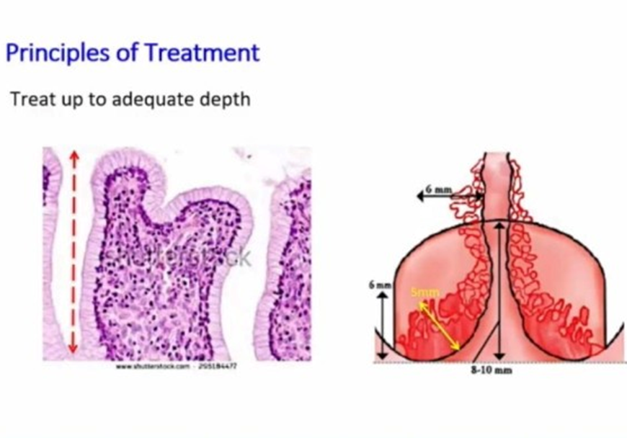
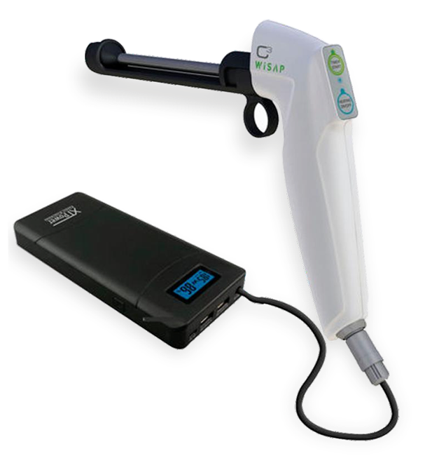
METHODOLOGY
Study sample: 110 HPV 16/18 positive women
Diagnosis confirmed using Cobas 4800 test
Selection Criteria:
Type 1 transformation zone
Lesions confined to one cervical quadrant
Exclusion:
Microinvasive disease
Glandular lesions
STIs / PID
Intervention:
Thermal ablation using thermocoagulator device
Follow-up schedule:
15 days (early healing)
2 months (short-term outcome)
1 year (Test of Cure – HPV status)

Slide 4
RESULT & KEY FINDING
Baseline Findings:
Majority (78) → Normal colposcopy
30 → Low-grade lesions
2 → High-grade lesions
Biopsy Results:
LSIL: 25
Chronic cervicitis: 5
HSIL: 2
Post-treatment Outcomes (1 year):
95.5% (105 women) → HPV negative
5 → Persistent HPV but no lesion progression
Clinical Outcomes:
No adverse post-procedure symptoms
Significant reduction in leucorrhoea
Good patient tolerance and safety profile

Slide 5
CONCLUSION & IMPLICATIONS
Thermal ablation is:
  Highly effective for HPV clearance
  Safe with minimal complications
  Cost-effective and feasible in low-resource settings
Success depends on:
  Proper case selection
  Full visibility of squamocolumnar junction
Clinical Implications:
Can be used as a primary treatment option
Reduces burden on advanced healthcare facilities
Must be combined with:
  HPV vaccination awareness
  Regular follow-up (Test of Cure)

