Slide 1


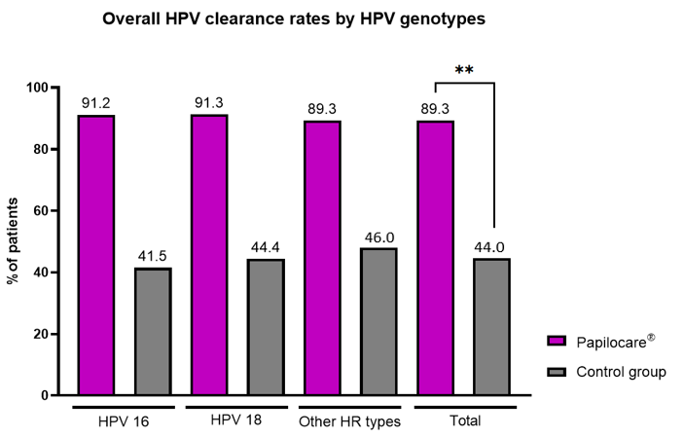
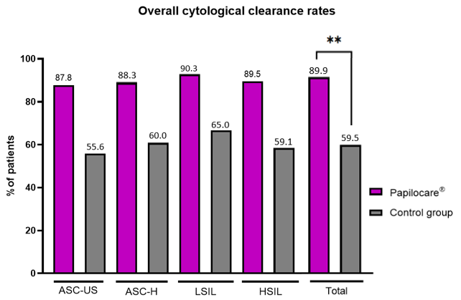
Effectiveness of a Coriolus versicolor–Based Vaginal Gel on High-Risk HPV Clearance and Cervical Cytology Outcomes: A Retrospective Cohort Study
H. TUNCER¹, U. AKGOR², D. BASARAN², Z.S. TUNCER², M. GULTEKIN²
1. Hacettepe University, Department of Obstetrics and Gynecology, Ankara, Turkey.
2. Hacettepe University, Department of Obstetrics and Gynecology,Division of Gynecologic Oncology, Ankara, Turkey.
OBJECTIVE
To evaluate the effectiveness of Papilocare®, a Coriolus versicolor–based vaginal gel on high-risk human papillomavirus (HR-HPV) clearance and cervical cytological outcomes in women undergoing conservative management.
Methods
This retrospective cohort study included 600 women with cervical HPV infection managed between January 2023 and August 2025. Three hundred women received Papilocare®, a Coriolus versicolor–based vaginal gel, while 300 were followed with standard clinical surveillance alone. HPV DNA testing and cervical cytology were performed at baseline and at six months. Clearance rates and associated factors were analyzed.
results
Baseline demographic characteristics, HPV genotype distribution, and cytological findings were comparable between groups. Overall HPV clearance was significantly higher in the treatment group compared with controls (89.3% vs. 44.0%, p<0.001). Clearance of high-risk HPV genotypes was markedly improved with treatment, including HPV 16 (91.2% vs. 41.5%, p<0.001) and HPV 18 (91.3% vs. 44.4%, p=0.001)(Figure-1).Cytological normalization occurred more frequently in the treatment group (89.9% vs. 59.5%, p<0.001) across all abnormal cytology categories (ASC-US, ASC-H, LSIL, HSIL)(Figure-2). Multivariable logistic regression identified use of the vaginal gel as the strongest independent predictor of HPV clearance (adjusted OR 8.45; 95% CI: 3.05–23.43; p<0.001).
Figure-1
Figure-2
p<0.001
p<0.001
conclusıon
Use of a Coriolus versicolor–based vaginal gel was associated with significantly higher rates of HR-HPV clearance and cervical cytological normalization compared with standard follow-up alone. This non-ablative local therapy may represent a clinically relevant adjunct to conservative management strategies for HPV-positive women, although prospective randomized trials are needed to confirm these findings.

