Slide 1
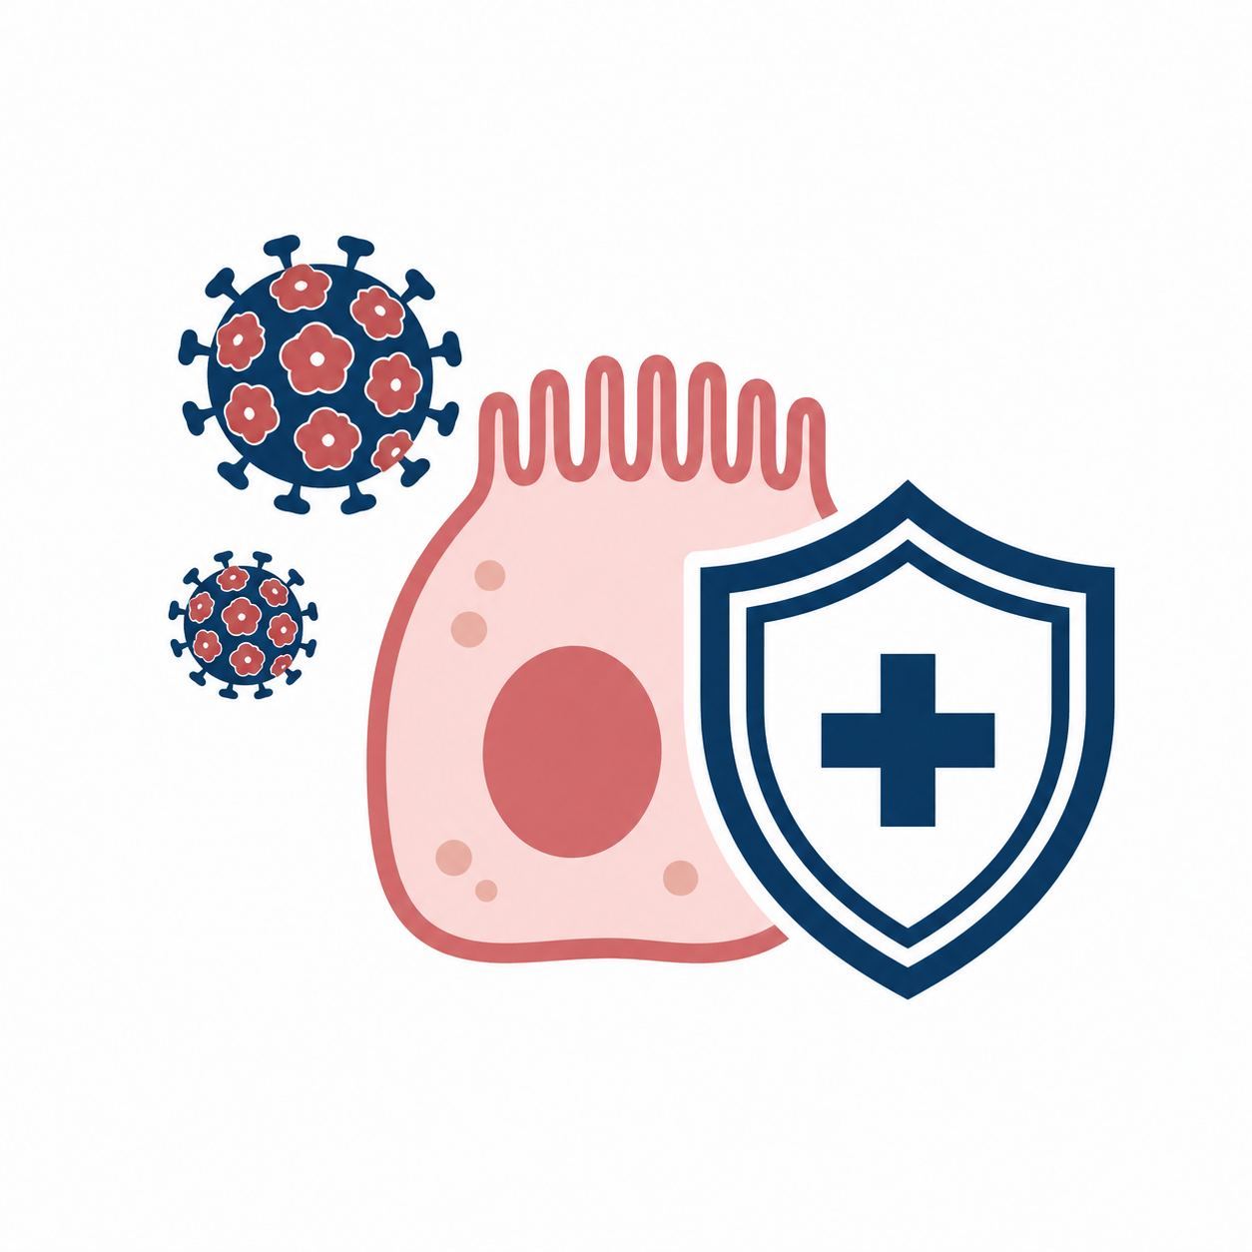



AWARENESS LEVEL OF MEDICAL STUDENTS REGARDING HPV AND GENDER DIFFERENCES IN UKRAINE
GENDER DIFFERENCES IN HPV AWARENESS AMONG UKRAINIAN MEDICAL STUDENTS
FEMALE STUDENTS SHOWED HIGHER HPV-RELATED KNOWLEDGE, BUT VACCINATION COVERAGE REMAINED LOW
CENTRAL FINDING:
GENDER-SPECIFIC KNOWLEDGE GAP IN HPV PREVENTION
136
114
13.2%
Medical students from years 1–6
Female students and 22 male students
Vaccination coverage among female students
A. Tvarkovska, M. Pershyn¹, O. Taran¹, I. Broda², T. Lobastova², S. Litvinov¹.
¹National Pirogov Memorial Medical University, Vinnytsya - Vinnytsya (Ukraine), ²Vinnytsia City Clinical Hospital No. 1, Clinical Maternity Department - Vinnytsya (Ukraine)
Notes:
Good morning. This e-poster presents HPV awareness among medical students in Ukraine, with a focus on gender differences. The main finding is that female students demonstrated higher HPV-related knowledge than male students, especially regarding vaccination and cervical cancer prevention. However, even in the better-informed group, actual vaccination coverage remained low.

Slide 2

BACKGROUND AND AIM
BACKGROUND
AIM
HPV vaccination is a key preventive tool in cervical cancer prevention.
Medical students will influence future patient counseling and vaccine acceptance.
Gender-specific differences in HPV awareness may require tailored educational strategies.
To assess knowledge of medical students about HPV with regard to gender differences.
GENDER-SPECIFIC
AWARENESS
TAILORED
EDUCATION
CORE QUESTION:
Which HPV-related knowledge domains differ by gender?
STUDY CONCEPT: FROM KNOWLEDGE GAP TO TARGETED HPV EDUCATION
KEYWORDS: HPV, CERVICAL CANCER PREVENTION, VACCINATION, MEDICAL EDUCATION, GENDER DIFFERENCES, UKRAINE
Notes:
HPV vaccination is one of the key tools for cervical cancer prevention. Medical students are future physicians, and their knowledge will influence patient counseling and vaccine acceptance. The aim of this study was to assess HPV-related knowledge among medical students and to determine whether awareness differs between male and female students.

Slide 3

MATERIALS AND METHODS
MATERIALS AND METHODS
QUESTIONNAIRE DOMAINS
STUDY DESIGN
PARTICIPANTS
136
19.27
22 M
114 F
Anonymous questionnaire-based survey developed by the authors
HPV awareness
Vaccine prevention of cervical cancer
Vaccination timing and safety
Number of adult doses
Vaccination status
medical students
years 1–6
mean age, years
gender groups
ANALYSIS
PARTICIPANTS WERE COMPARED AS MALE AND FEMALE STUDENTS.
Descriptive statistics
Mann–Whitney U test
Fisher’s exact test
p < 0.05
KEYWORDS: HPV, CERVICAL CANCER PREVENTION, VACCINATION, MEDICAL EDUCATION, GENDER DIFFERENCES, UKRAINE
KEYWORDS: HPV, CERVICAL CANCER PREVENTION, VACCINATION, MEDICAL EDUCATION, GENDER DIFFERENCES, UKRAINE
Notes:
We conducted an anonymous questionnaire-based survey developed by the authors. The study included 136 students from years one to six at Vinnytsia National Pirogov Memorial Medical University. The mean age was 19.27 years; 22 participants were male and 114 were female. Statistical analysis included descriptive statistics, the Mann-Whitney U test, and Fisher's exact test, with p below 0.05 considered significant.

Slide 4
RESULTS: FEMALE STUDENTS ANSWERED BETTER ON KEY HPV ITEMS
CORRECT ANSWERS BY GENDER
Know what HPV is
63.6%
85.1%
LARGEST GENDER GAPS
Vaccination prevents cervical cancer
54.5%
• Vaccination before sexual debut: 54.5% vs 87.7%
• Vaccine safety: 63.6% vs 90.4%
• Adult dose schedule: 22.7% vs 50.0%
80.7%
Most effective before sexual debut
54.5%
87.7%
HPV vaccine is safe
63.6%
90.4%
Know adult dose schedule
22.7%
50%
FEMALE STUDENTS SHOWED BETTER KNOWLEDGE, ESPECIALLY ABOUT HPV VACCINATION AND PREVENTION
Male
Female
SIGNIFICANT DIFFERENCES WERE OBSERVED IN VACCINATION-RELATED KNOWLEDGE DOMAINS
KEYWORDS: HPV, CERVICAL CANCER PREVENTION, VACCINATION, MEDICAL EDUCATION, GENDER DIFFERENCES, UKRAINE
KEYWORDS: HPV, CERVICAL CANCER PREVENTION, VACCINATION, MEDICAL EDUCATION, GENDER DIFFERENCES, UKRAINE
Notes:
Female students answered significantly better on several key items. They more often knew what HPV is, recognized that vaccination can prevent cervical cancer, and understood that vaccination is most effective before sexual debut. They also more frequently considered the HPV vaccine safe and correctly identified the number of vaccine doses required for adults.

Slide 5

RESULTS: KNOWLEDGE SCORE AND VACCINATION GAP
KNOWLEDGE LEVEL BY TOTAL SCORE
ACTUAL HPV VACCINATION COVERAGE
CONCLUSIONS
15 / 114
HPV awareness among medical students varied by gender.
Female students demonstrated significantly better knowledge, especially about vaccination.
Vaccination coverage remained low despite awareness.
Gender-sensitive education and motivation are needed.
Male
Female
53.5%
female students reported HPV vaccination
= 13.2%
50%
41.2%
27.3%
22.7%
5.3%
LOW
MEDIUM
HIGH
PRACTICAL IMPLICATION:
education should be combined with motivation, counseling, and access to HPV vaccination.
LOW KNOWLEDGE WAS MORE FREQUENT AMONG MALE STUDENTS; HIGH KNOWLEDGE WAS MORE FREQUENT AMONG FEMALE STUDENTS
KNOWLEDGE GAP IDENTIFIED
BUT VACCINATION REMAINED LOW
KEYWORDS: HPV, CERVICAL CANCER PREVENTION, VACCINATION, MEDICAL EDUCATION, GENDER DIFFERENCES, UKRAINE
Notes:
The total knowledge score also showed a gender difference. Low knowledge was more frequent among male students, while high knowledge was more common among female students. Nevertheless, vaccination coverage among female students was only 13.2 percent. Therefore, knowledge alone is not enough. These results support targeted education combined with motivation and better access to HPV vaccination.

