Slide 1


“Expression profile of immunological panel IL1β, IL10, IL18, TNF-α, TLR4, GATA3, CD68 on cervical samples with positive/negative hr-HPV DNA/E6 E7 mRNA status and cytological estimation.”
A. Kavrakova *1,2, B. Georgieva 1, K. Mesechkova 1,2 , M. Dochkova 2, V. Mitev 1 and А. Todorova1,2
1 Department of Medical Chemistry and Biochemistry, MU- Sofia, Bulgaria
2 Genetic and Medical-diagnostic laboratory „Genica“, Sofia, Bulgaria
* annita_25@abv.bg
Aim: To investigate IL1β, IL10, IL18, TNF-α, TLR4, GATA3, CD68 on hr-HPV DNA/hr-HPV E6 E7 mRNA positive/ negative cervical status and LBC estimation
Methods:
Clinical control group: (n=40) cervical samples with normal cytology (PAPI/II) and hr-HPV DNA positive status
Clinical group (n=50) with (ASCUS, LSIL, HSIL, CIS, CIN1, CIN2/3+ and more advanced findings) and hr-HPV DNA+.
DNA extraction, Real-time qPCR, PCR-based hybridization, cytological examination and photo-documentation techniques were applied.
The current study was supported by Grants:
D-117/29.05.2024; D-314/18.12.2024 - Medical University-Sofia, Bulgaria.

Slide 2

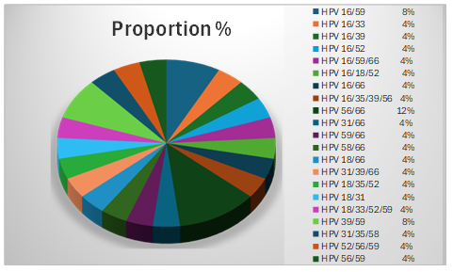
VIROLOGICAL RESULTS: hr HPV DNA (16, 18, 31, 35, 33, 45,51, 59, 39, 58, 56, 52, 66,68)
The present study was supported by Grants: D-117/29.05.2024; D-314/18.12.2024 - Medical University-Sofia, Bulgaria.
Type-specific hrHPV frequency in the clinical control group with normal cytology and hrHPV DNA +.
Distribution of co-infectious variants (25%) in the clinical control group with normal cytology, hrHPV DNA+
HPV 16 and HPV 66 were determined to be categorically dominant аs a rate of frequency of hrHPV, as well as dominant participants in co-infectious variants, followed by HPV 59, followed by 18 and 31, etc.
36% of co-infectious variants carry HPV 16
40% % carry HPV 66

Slide 3
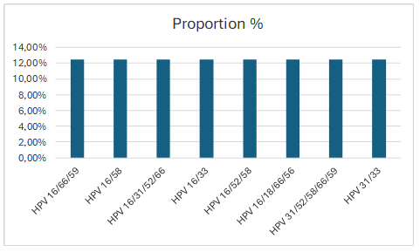
VIROLOGICAL RESULTS: hr HPV DNA (16, 18, 31, 35, 33, 45,51, 59, 39, 58, 56, 52, 66,68)
hrHPV frequency in the clinical group (ASCUS, LSIL, HSIL, CIS, CIN1, CIN2/3+) and hrHPV DNA +.
HPV 16 | HPV 18 | HPV 31 | HPV 33 | HPV 35 | HPV 39 | HPV 45 | HPV 51 | HPV 52 | HPV 56 | HPV 58 | HPV 59 | HPV 66 | HPV 68
66% | 6,66% | 20% | 13,33% | - | - | 6,66% | - | 20% | 6,66% | 20% | 6,66% | 33,3% | -
Distribution of co-infectious variants (53,33 %) in the clinical group with (ASCUS, LSIL, HSIL, CIS, CIN1, CIN2/3+) and
hrHPV DNA +.
equal shares of infectious variants detected of 12.5%.
HPV 16 was determined as dominant in the hrHPV co-infectious variants
75% of the co-infectious variants contain HPV 16.
50% of the co-infectious variants contain HPV 66.
37.5% of the co-infectious
variants contain HPV 58, 52 and 31

Slide 4
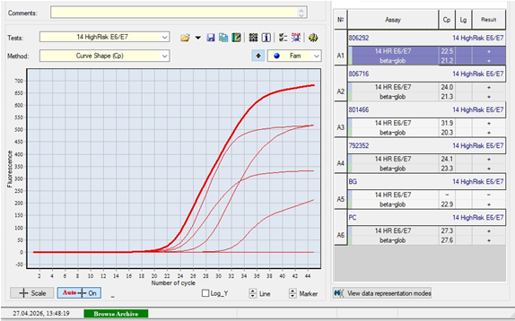
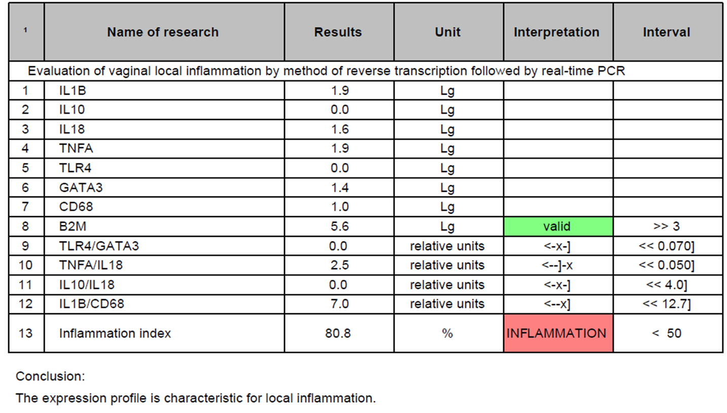
VIROLOGICAL RESULTS: hr HPV onco E6/E7 mRNA (16, 18, 31, 33, 35, 39, 45, 51, 52, 56, 58, 59, 66, 68)
- 100% of patients were hr-HPV E6/E7 mRNA positive in the clinical hrHPV DNA+ group (ASCUS, LSIL, HSIL, CIS, CIN1, CIN2/3+).
-58,9% of patients were hr-HPV E6/E7 mRNA positive in the control hrHPV DNA + group with normal cytology.
IMMUNOLOGICAL RESULTS (IL1β, IL10, IL18, TNF-α, TLR4, GATA3, CD68)
In hr-HPV DNA+ clinical group with abnormal cytology, elevated IFI > 95–100% was found in 95% without reactive cellular changes.
In hr-HPV DNA + control group /normal cytology, elevated inflammation index (IFI ≥ 50) was found in 77.2 % with reactive inflammatory changes and > 50% polymicrobial infection /dysbiosis/.
Real Time PCR results of positive/negative
Hr-HPV-E6/E7 mRNA status in Bulgarian patients.
Elevated IFI = 80.8 % in a studied patient

Slide 5
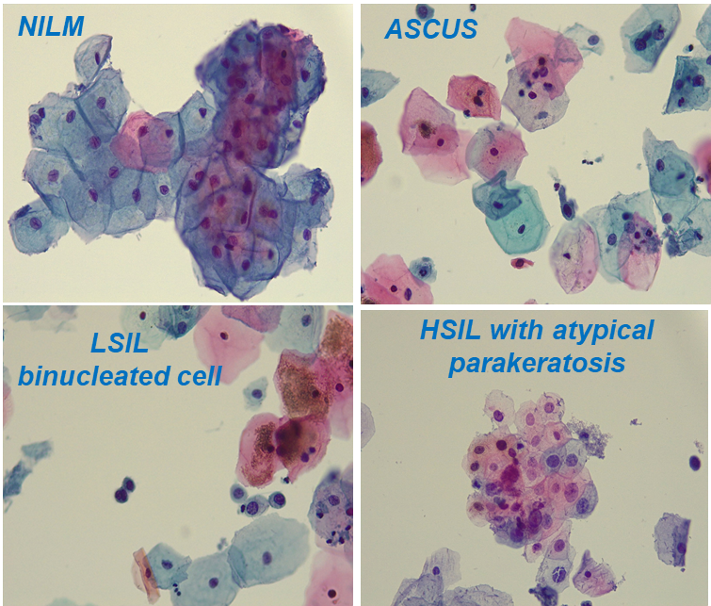

CONCLUSIONS
- IL-1β, IL-18, TNF-α, and CD68 expression was significantly increased in clinical/ clinical control groups, suggesting also their potential pro-tumor activity in addition to pro-inflammatory.
- In >50% of studied cases in control group was found predominantly an abundant superficial cervical layer. /10% was secondary established with more advanced cytological findings HSIL, CIN1, etc./
- 58.9% of hr-HPV E6/E7 mRNA positive patients in the control group with normal cytology are at a likely higher risk of cervical cancer, despite a normal cytology result- /subjective method with a lot of limitations/
- FAM19A4/miR124-2 methylation test on this 58, 9% hr-HPV E6/E7 mRNA +/normal cytology subgroup will be applied.
-The pilot unpublished data showed the need of powerful biomarkers for a reliable stratification of woman in a real higher risk of developing CC.
Find them even before they appear or when they are "invisible" !!!

