Slide 1




Spatial and Temporal Mapping of Cervical Lesions Using Cervical Cell Lift
; A Two-Year Longitudinal Observation
M. Miyazaki¹, N. Egawa¹, A. Shirz², A. Nishimura³, T. Motohara³,
K. Nagasaka⁴, R. Crawford², J. Doorbar¹.
¹Cambridge University - Cambridge (United Kingdom),
²Cambridge University Hospital - Cambridge (United Kingdom),
³Kumamoto University - Kumamoto (Japan),
⁴Teikyo University - Tokyo (Japan)
Notes:
Hello, My name is Mai Miyazaki from Cambridge University. I will present our two-year longitudinal observation using Cervical Cell Lift.

Slide 2
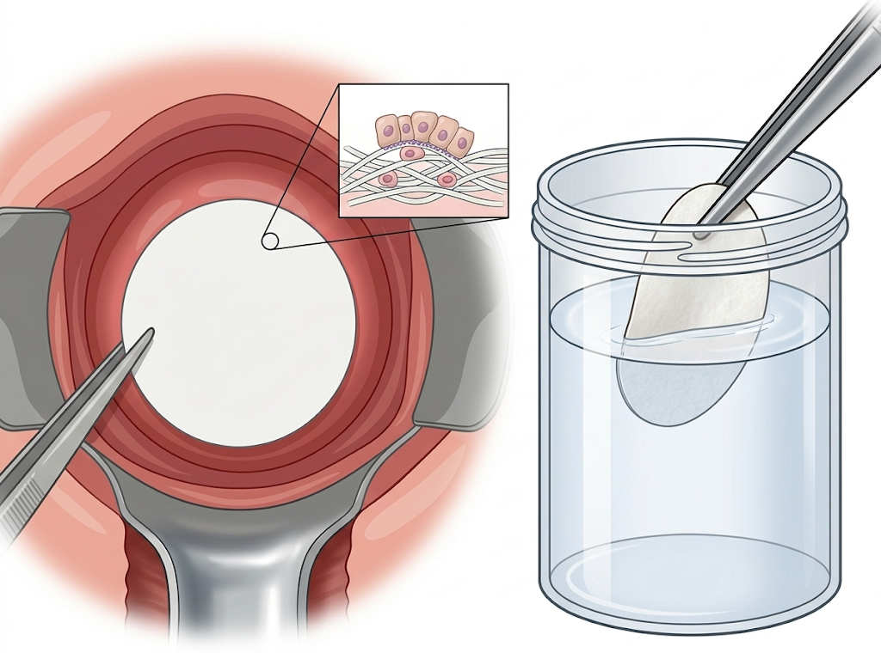
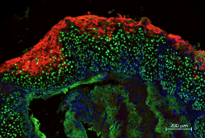
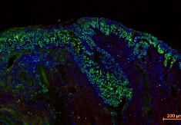
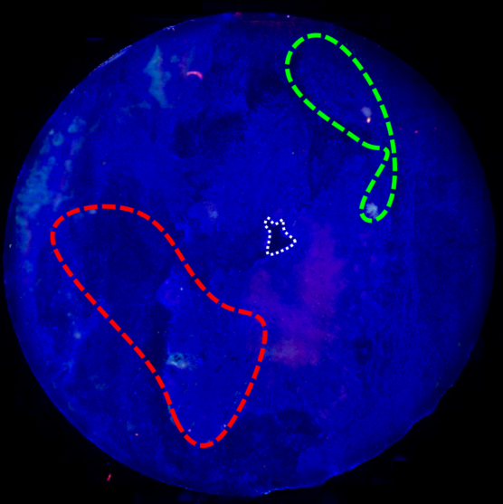
Principle of Cervical Cell Lift:
From Lesion Biology to Spatial Mapping
Cervical Cell Lift (CCL) = Non-invasive spatial mapping of cervical lesions while preserving epithelial topology
Enables grading & localization of lesions without biopsy
Capable of detecting HSIL
Methods
MCM/E4 patterns
in tissue lesions
Productive HPV+
Os
DAPI MCM E4
DAPI MCM E4
HSIL
CIN1(LSIL)
CIN2-3(HSIL)
MCM+ = Proliferating cells
E4+ = Productive HPV infection
DAPI E4 MCM
Apply nitrocellulose membrane to cervix for 15 sec
MCM / E4 staining and spatial mapping
Fixation
Aim
Can CCL track lesion changes over time and reduce the need for repeated biopsies?
Notes:
First, let me briefly explain Cervical Cell Lift, or CCL.
CCL is a non-invasive method for spatial mapping of cervical lesions while preserving epithelial topology.
The key concept is that LSIL and HSIL show different MCM and E4 patterns in tissue lesions.
MCM highlights proliferating cells and indicates an HSIL-like pattern when it extends upward.
E4 highlights productive HPV infection in superficial differentiated cells.
The procedure is simple: a nitrocellulose membrane is applied to the cervix for 15 seconds, then fixed and stained.
After scanning, these signals are converted into a spatial biomarker map.
Our aim was to assess whether CCL can track lesion changes over time without repeated biopsies.

Slide 3
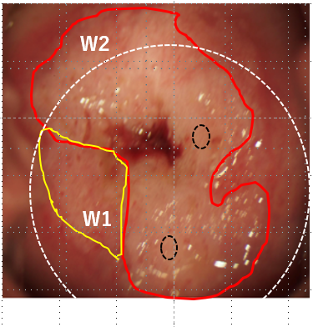
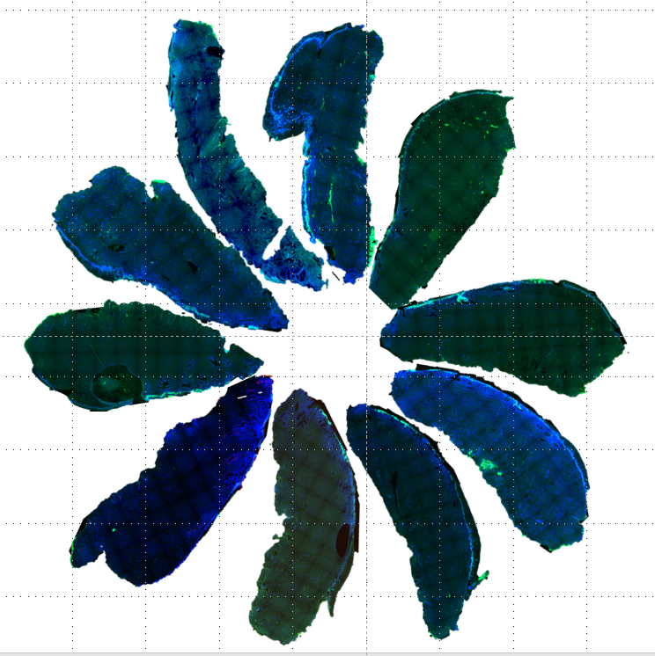
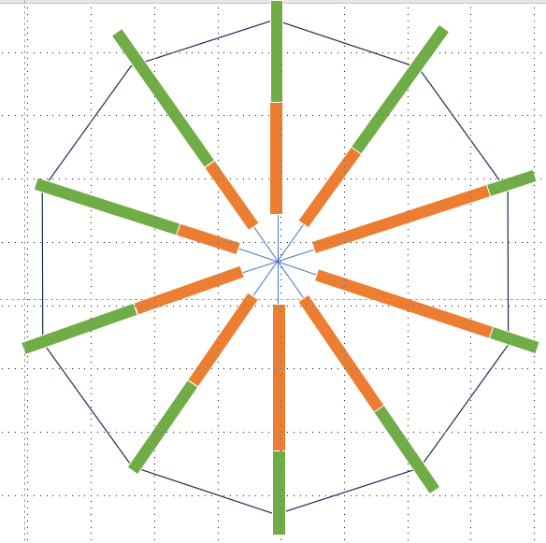
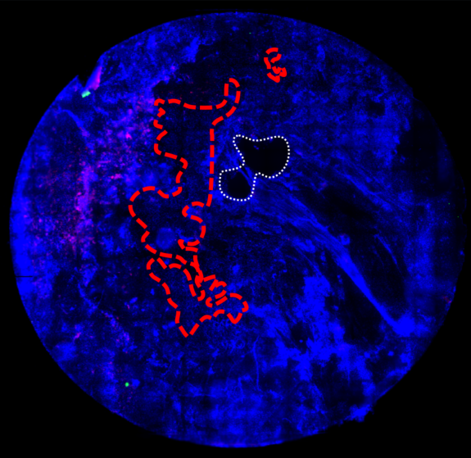
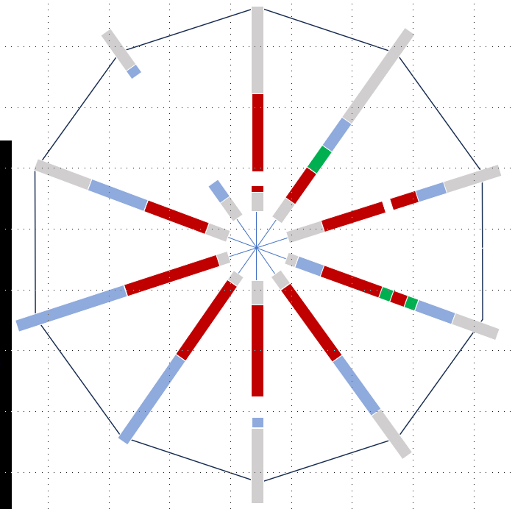
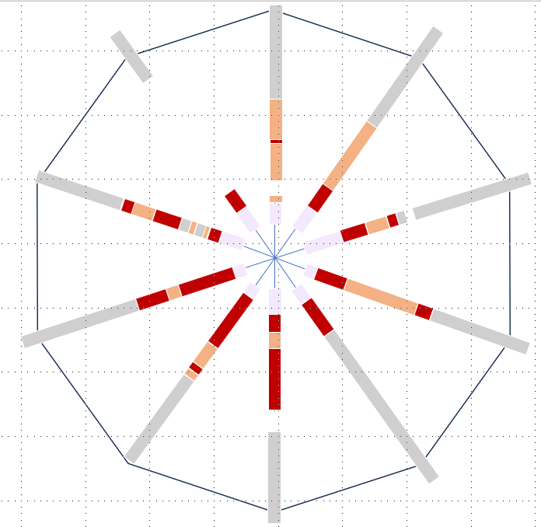
Patient Information and CCL–Cone Tissue Spatial Mapping
PI: Age：40, Cytology: HSIL, HPV67+
Spatial Mapping
CIN3
Conization
IF
(MCM, E4 , p16)
11-6’: MCM+
TZ
ECT
Final histology: CIN3,
negative margins
Os
DAPI E4 MCM
X-1M 1st Consultation
X
HSIL
LSIL
MCM>2/3
MCM>1/3
Normal
Metaplasia
Basal only
Columnar
Notes:
This is a 40-year-old woman with HSIL cytology and HPV67 positivity.
One month before conization, CCL showed MCM-positive areas from 11 to 6 o’clock.
Conization confirmed CIN3 with negative margins.
We then compared the preoperative CCL map with the conization tissue map.
On the right, the spatial maps show anatomical regions, histological lesion distribution, and upward MCM expression in the cone tissue.
The CCL map showed good spatial concordance with the conization tissue, suggesting that CCL can reflect regional lesion distribution on the cervix.

Slide 4
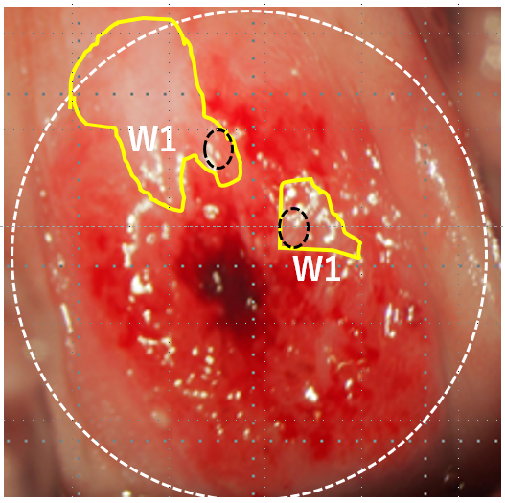
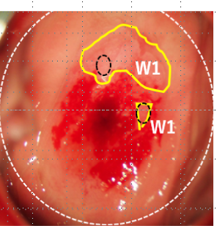
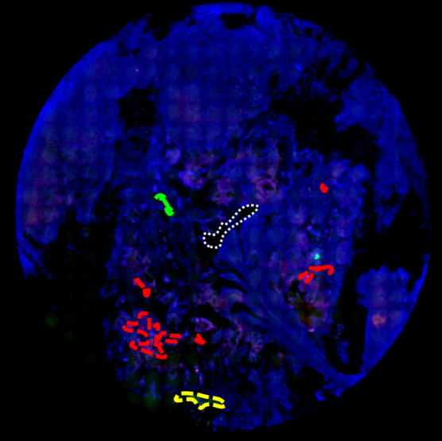
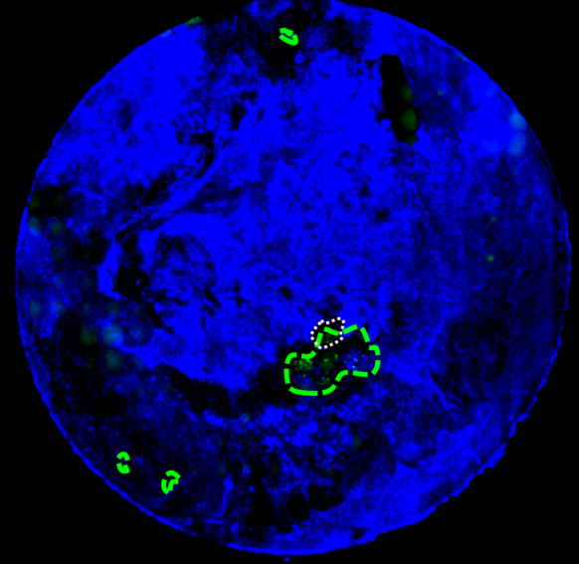
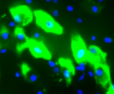
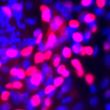
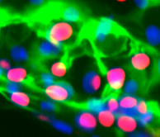
Two-Year Longitudinal Observation
CIN1
CIN1
CIN3
Conization
11-6’: MCM+
4-6’, 8-9’: MCM+
3’: E4+
6’: E4+, MCM+
0’, 5-6’: E4+
Final histology: CIN3,
negative margins
Os
Os
Os
DAPI E4 MCM
DAPI E4 MCM
DAPI E4 MCM
X-1M 1st Consultation
X
X+15M(LSIL)
X+30M(LSIL)
Notes:
We then followed the same patient over two years.
Before treatment, CCL showed a broad MCM-positive area, consistent with CIN3.
After conization, cytology initially became negative.
However, LSIL cytology was detected again 15 months after the operation.
At the same time point, repeat CCL showed focal MCM-positive areas and E4 positivity.
At 30 months, the dominant signal shifted toward E4-positive areas, suggesting productive HPV infection rather than a broad HSIL-like proliferative pattern.

Slide 5
Discussion ＆ Conclusion
Spatial Mapping
CCL could visualize biomarker distribution on the cervix non-invasively
Two-year follow-up showed spatial and temporal changes of the lesion
Concordance with Histology
CCL spatial mapping showed concordance with conization histology in this case
This suggests CCL can reflect regional lesion distribution
Non-invasive Follow-up
CCL may support non-invasive follow-up and help reduce repeated biopsies
Larger studies are needed to confirm clinical usefulness
Notes:
In conclusion, CCL visualized cervical biomarker distribution non-invasively.
In this case, it showed spatial concordance with conization histology and captured temporal changes over two years.
Larger studies are needed to confirm its clinical usefulness.
Thank you.

