Slide 1

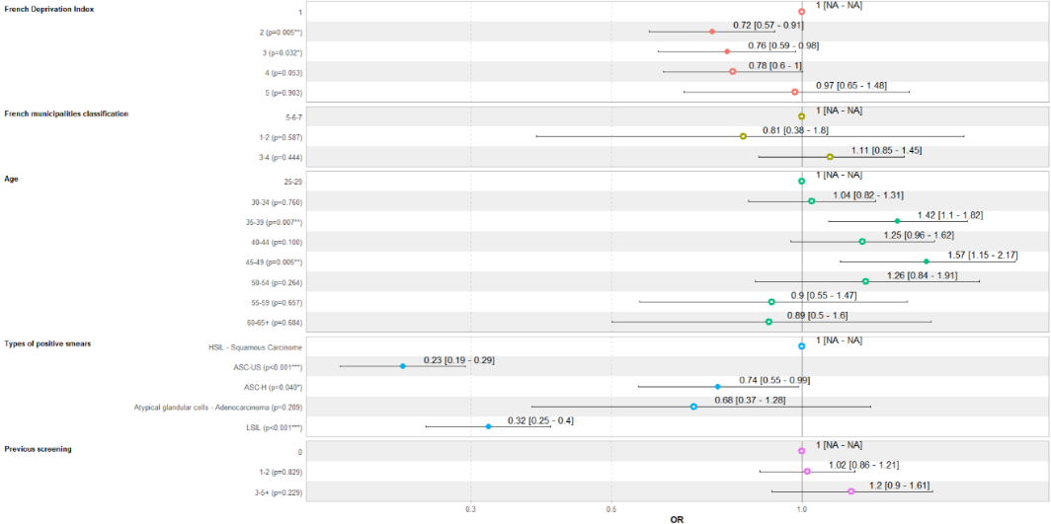

High-Grade Cervical Intraepithelial Lesions: Prevalence and impact of municipality-level social inequalities on the time to obtain a diagnosis and follow-up in the French Cervical Cancer Screening Program.
C. Balamou^{1,2}, K. Zysman³, C.M. Rodrigue¹, A. Seigneurin^{4,5}
Objective
This study analyzed high-grade cervical intraepithelial lesions (HSIL: including high-grade squamous intraepithelial lesions and adenocarcinoma in situ) detected within the french cervical cancer screening program and assessed the impact of municipality level social inequalities on the time to access diagnosis and initial treatment.
Methods
We conducted a retrospective cross-sectional study among 305,940 asymptomatic women, aged 25–65 years, living in Isère department, who underwent at least one Pap smear between 1/1/2010 and 12/31/2018. Women with abnormal screening results were referred for additional diagnostic procedures. HSIL diagnosis were compliant to the WHO classification of tumors of the uterine cervix. Social disparities were assessed at the municipal level using the French Deprivation Index.
Analysis of the relationship (logistic regression model) between HSIL and predictive factors
Characteristics | HSIL n (%) | Multivariable analysis
Overall | 3230 (100) | Adjusted OR (95% CI)
Age
25-29 | 804 (24.9) | Reference level
30-34 | 714 (22.1) | 0.96 (0.77-1.20)*
35-39 | 586 (18.1) | 1.14 (0.91-1.43)*
40-44 | 494 (15.3) | 1.56 (1.23-1.97)**
45-49 | 330 (10.2) | 1.77 (1.39-2.27)**
50-54 | 150 (4.6) | 2.37 (1.75-3.22)**
55-59 | 92 (2.9) | 2.28 (1.59-3.31)**
60 and older | 60 (1.9) | 3.07 (2.01-4.79)**
Types of positive smears
HSIL cytology | 878 (27.2) | Reference level
ASC-H | 480 (14.9) | 3.44 (2.66-4.46)**
ASC-US | 855 (26.5) | 8.19 (6.56-10.3)**
LSIL | 941 (29.1) | 10.4 (8.33-13.1)**
Atypical glandular cell | 65 (2.0) | 5.80 (3.79-9.02)**
Others | 11 (0.3) | -
* p-value not significant; **p-value estimation <0,001; n: Effectif.
Results
Mean age at diagnosis of HSIL was 36.8 (±9.0) years. The prevalence of HSIL in screened population was 0.4% (95% CI 0.4%-0.5%). According to the women age, the prevalence of HSIL decreased from 0.81% at 25-29 years to 0.09% at 60 years and older. In multivariable
analysis, HSIL detection increased significantly with age and types of positive smear. This risk was reduced by 37% for test completion times at 3 years ±6 months (OR 0.63 (95% CI 0.42-0.95)).
More than 50% of women with HSIL received their diagnosis (time from the screening test to diagnosis) within 58 days. This median time to diagnosis of HSIL was 46 days for HSIL and ASC-H, 56 days for AGC and 76 days for ASC-US and LSIL. The time to the first therapeutic proposal was available in 93.1% of cases, with a median of 50 days. In multivariable analysis, women from the most socioeconomically disadvantaged quintiles (quintiles 2 and 3) experienced significantly longer diagnostic delays for HSIL than women from more advantaged groups (quintile 1). Similarly, compared to HSIL cytology, ASC-H, ASC-US and LSIL results were associated with a longer time to diagnosis of HSIL.
Conclusion
- The prevalence of HSIL was higher among women under 35 years.
- Women from socioeconomically disadvantaged backgrounds and those with low-grade cytology experienced
significantly longer times for diagnostic procedures access.
- Given the potential progression to invasive cervical cancer, it may be advisable to allocate specific resources
to ensure appropriate follow-up for women with low-grade cytological lesions, particularly those residing in
socioeconomically disadvantaged municipalities.
Association between time to diagnosis (≤90 days, yes/no) and predictive factors: logistic regression model
French Deprivation Index (Quintiles)
French municipalities classification*
Age
CCU
Types of positive smears
Previous screening
Contact: christian.balamou@depistagecanceraura.fr * French municipalities classification was used to describe and analyze medical deserts in primary care (Bonal et al.,2024).
¹CRCDC AuRA, Site de l’Ain - Bourg-en-Bresse (France). ²Translational Innovation in Medicine and Complexity / Recherche Translationnelle et Innovation en Médecine et Complexité, UMR 5525 – Laboratoire 1043049, Domaine de la Merci, 38706 La Tronche (France). ³CRCDC AuRA, Site de l’Isère - Meylan (France).
⁴Univ. Grenoble Alpes, CNRS, TIMC, CHU Grenoble Alpes, 38000 Grenoble (France). ⁵Registre du Cancer de l’Isère, Centre Hospitalier Universitaire de Grenoble, BP 217, Pavillon E, 38043 Grenoble Cedex 9, (France).

