Slide 1


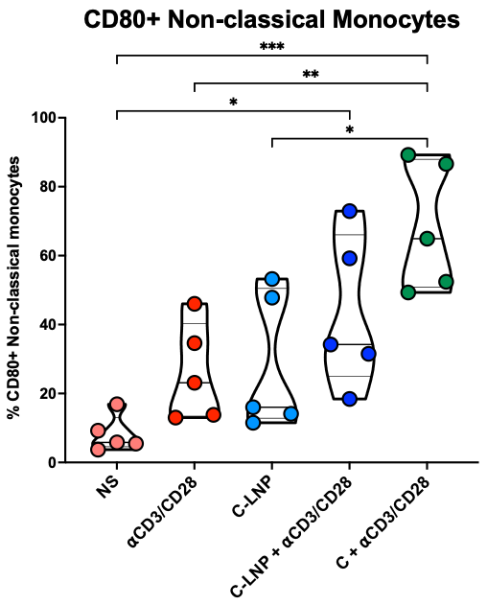
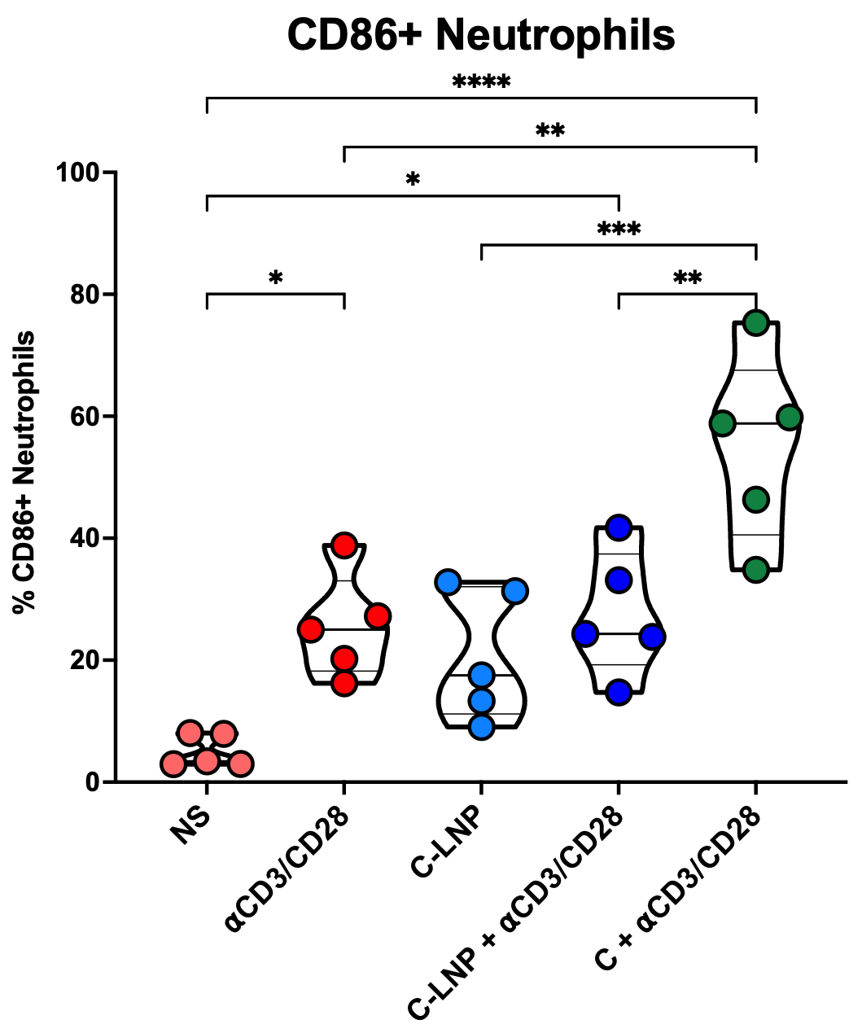
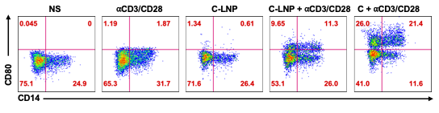
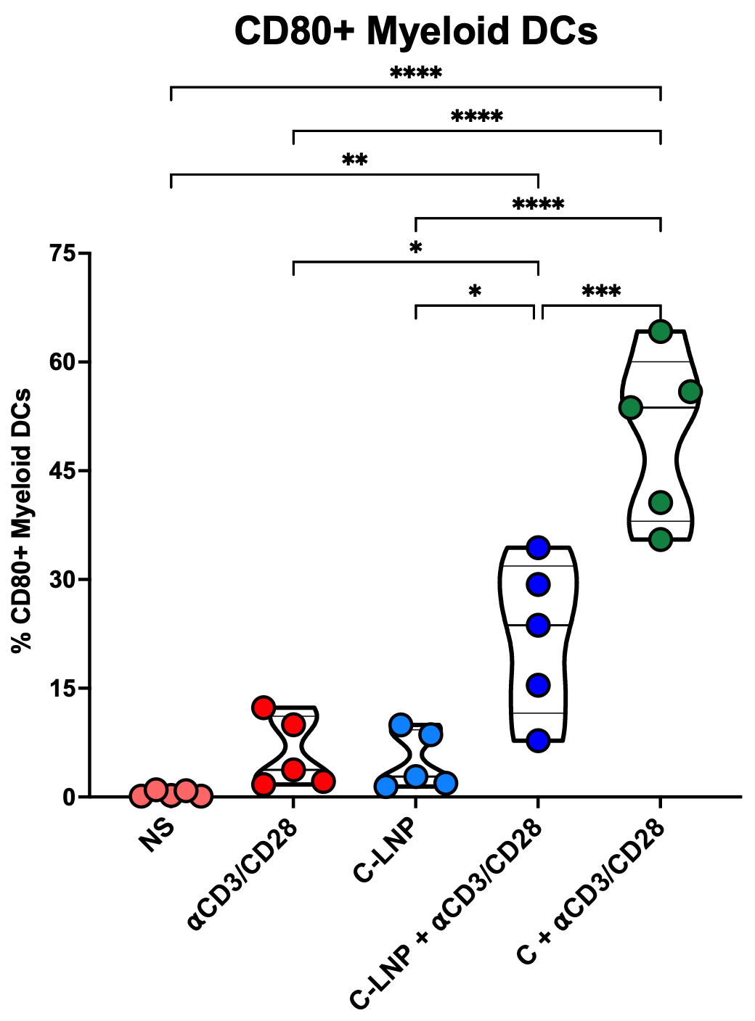
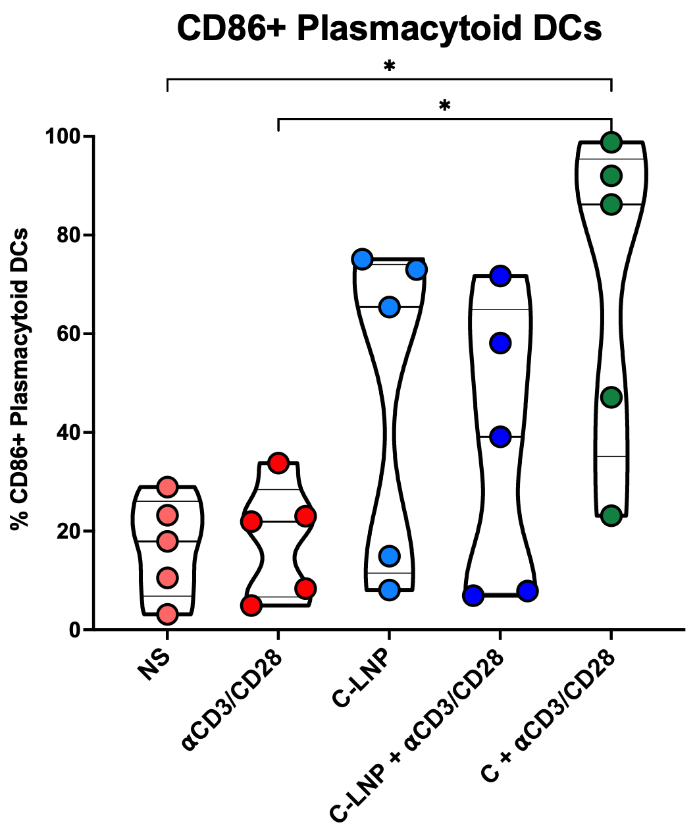
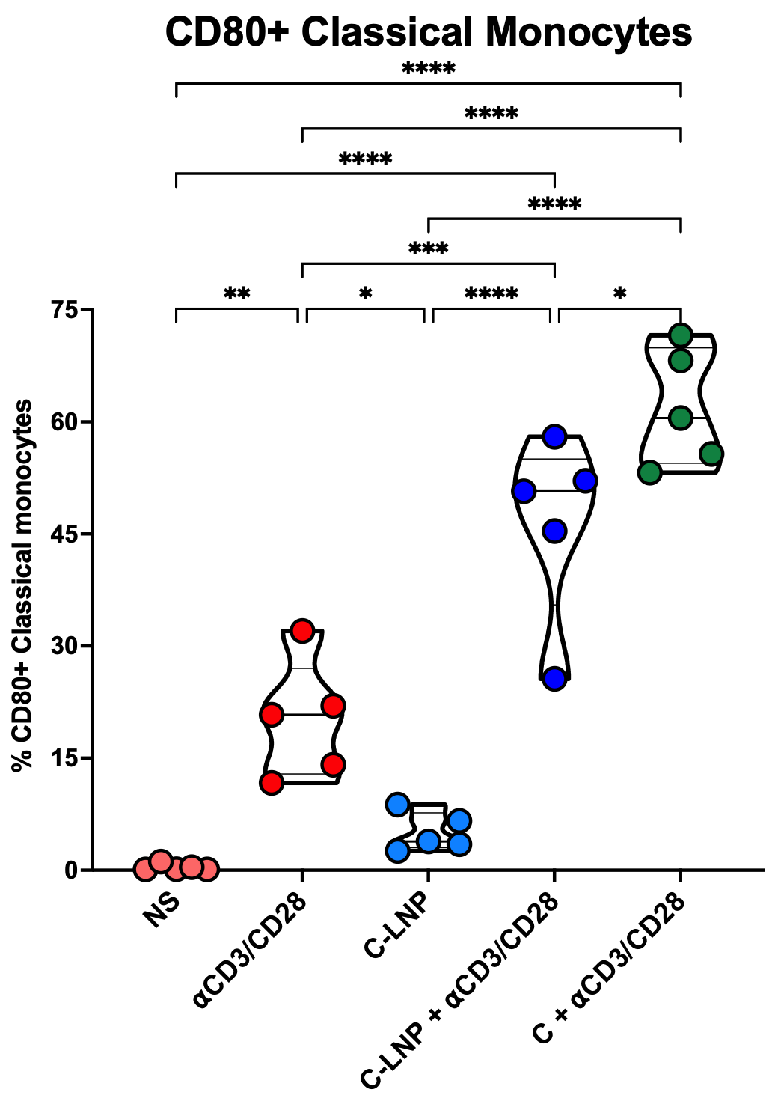
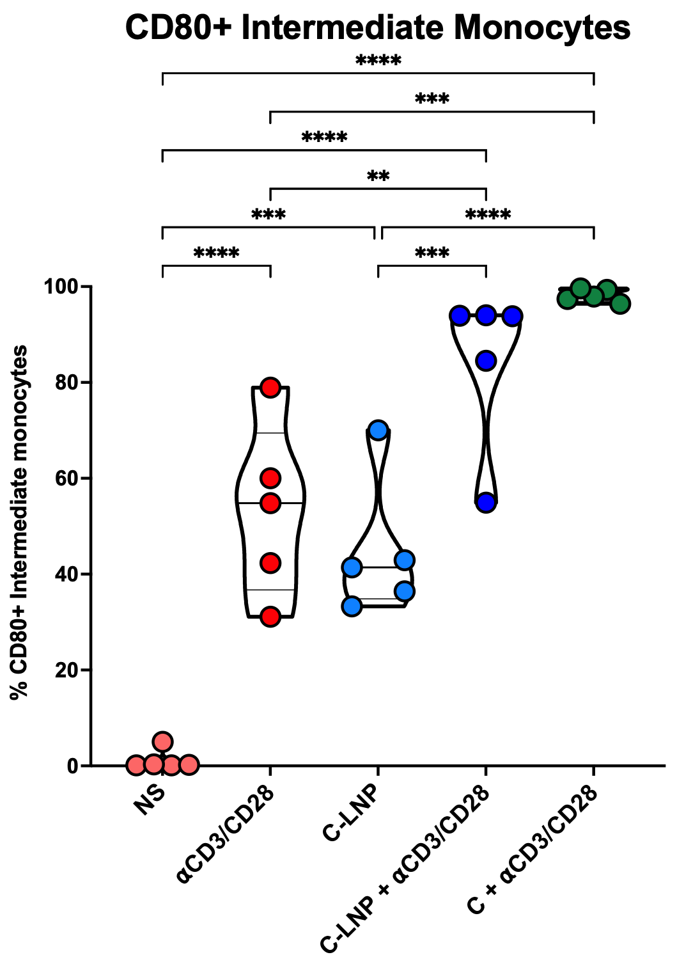
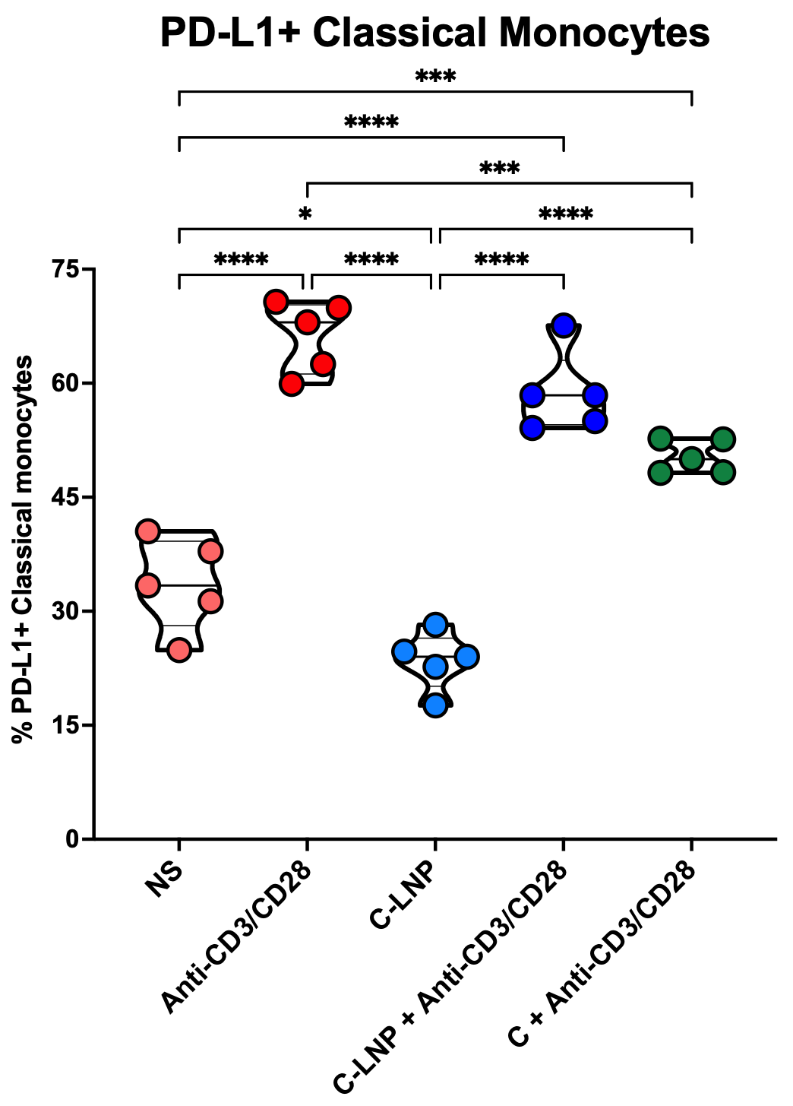
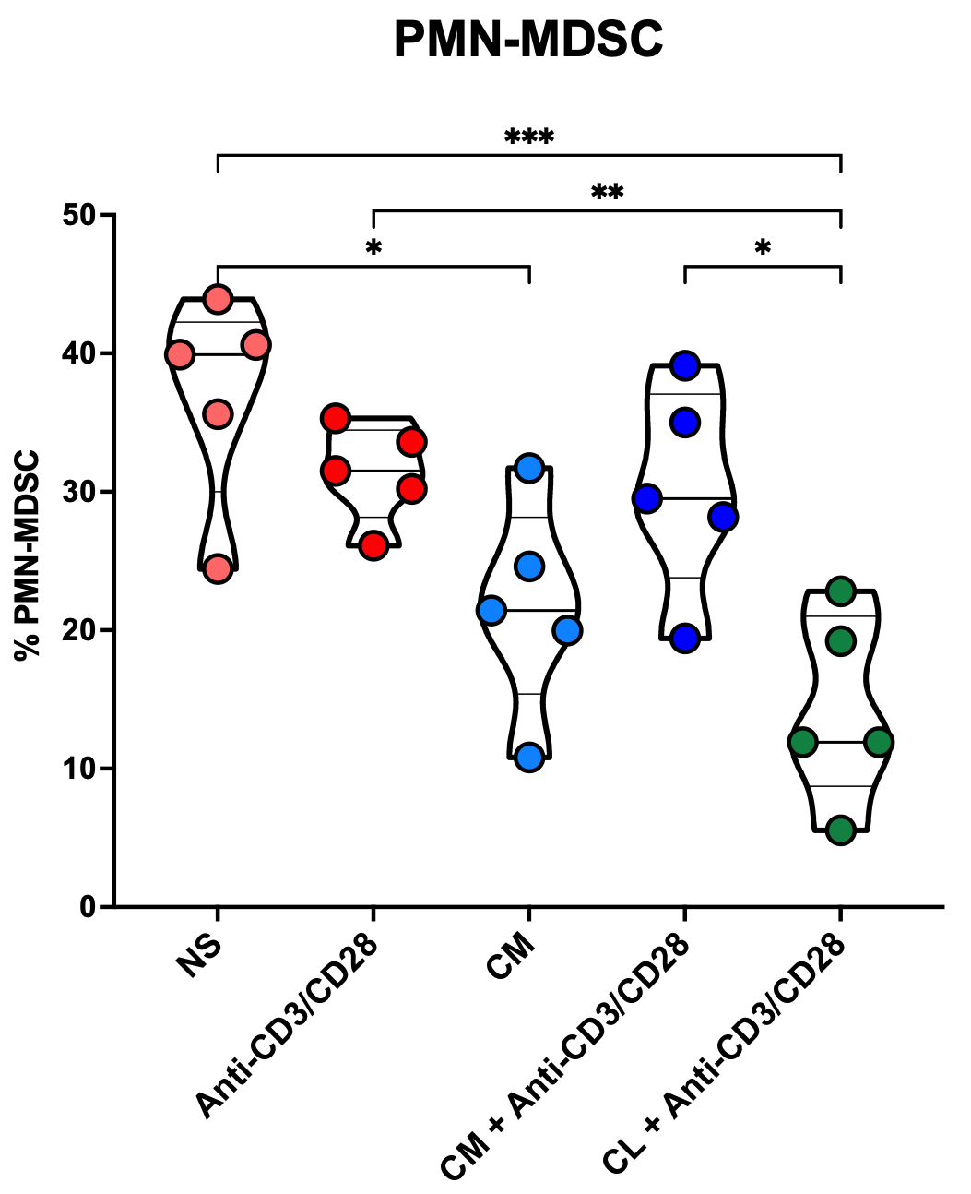
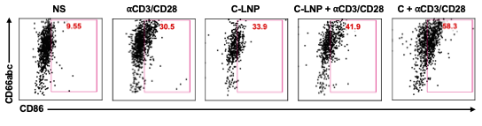
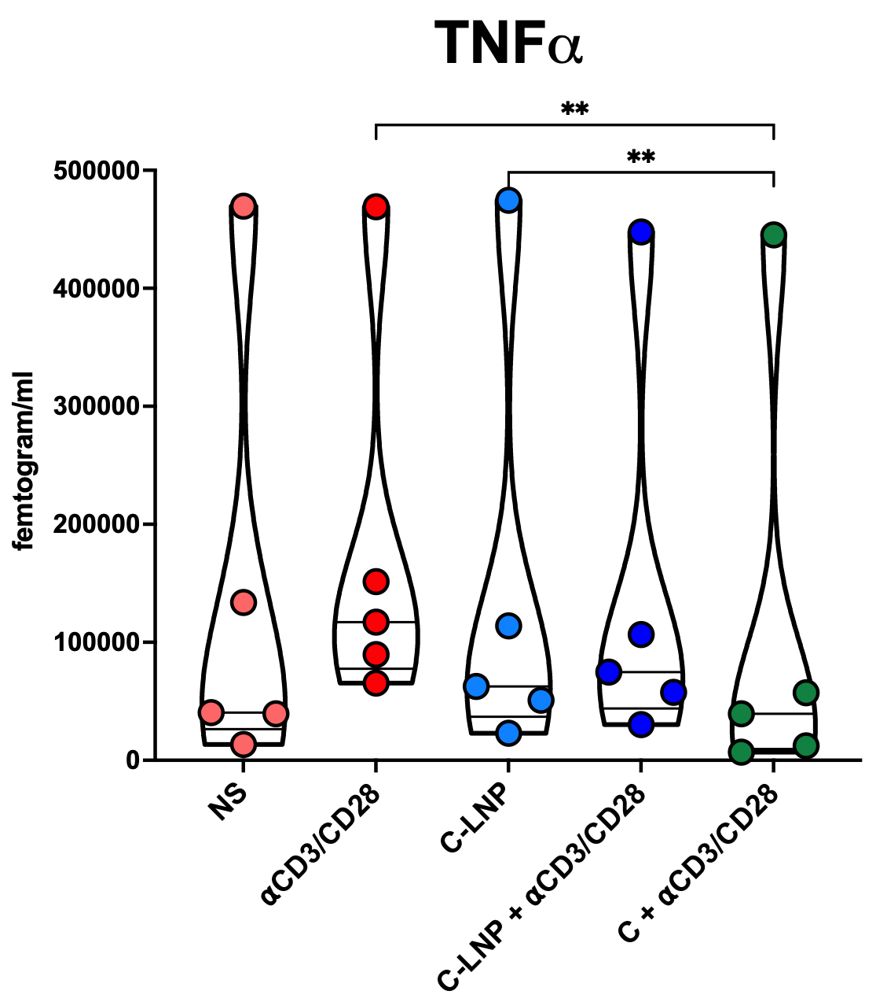
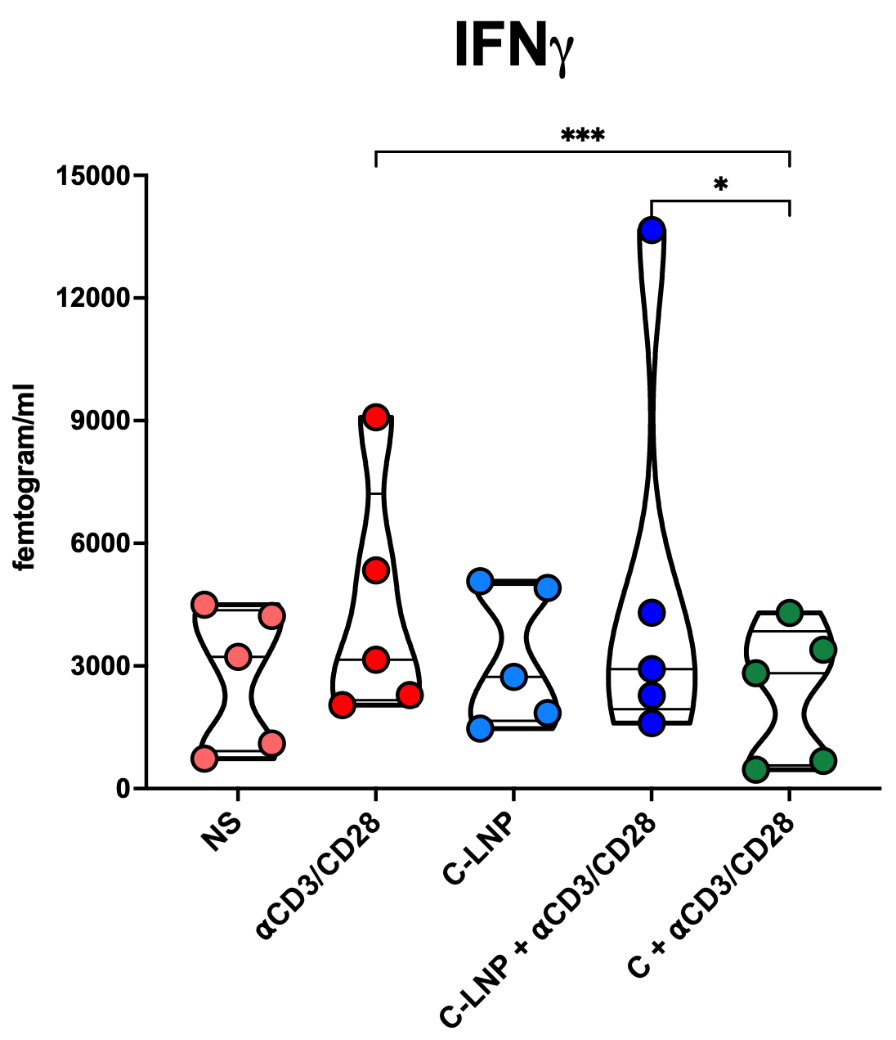
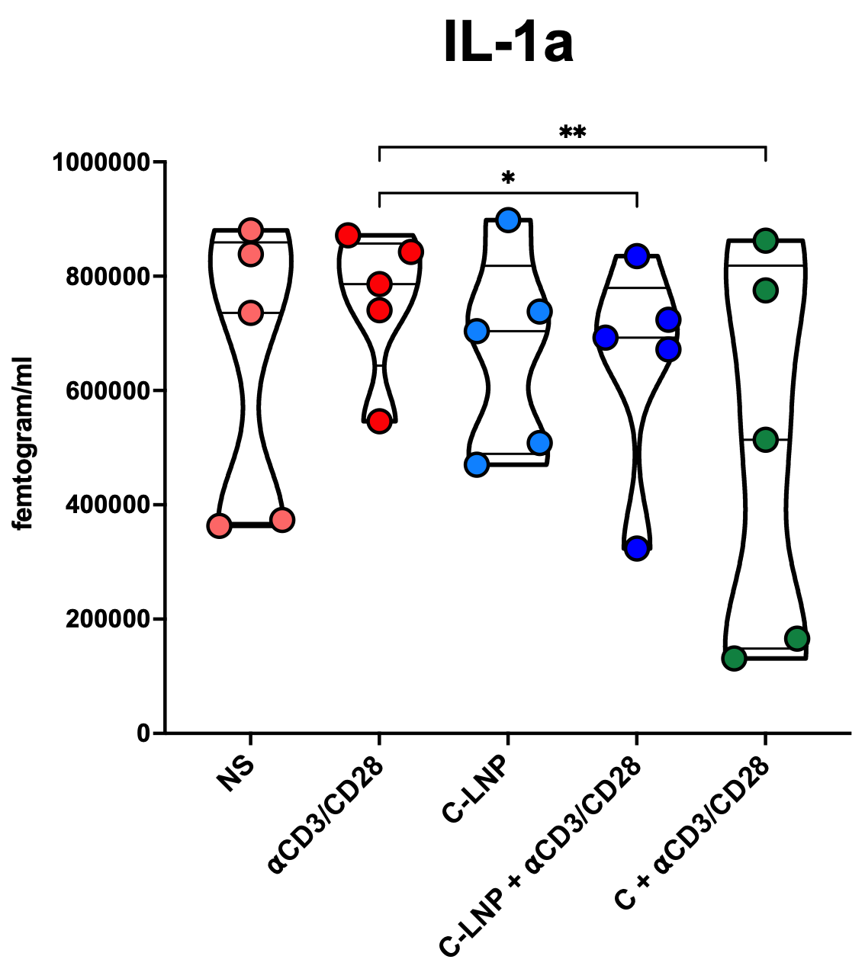
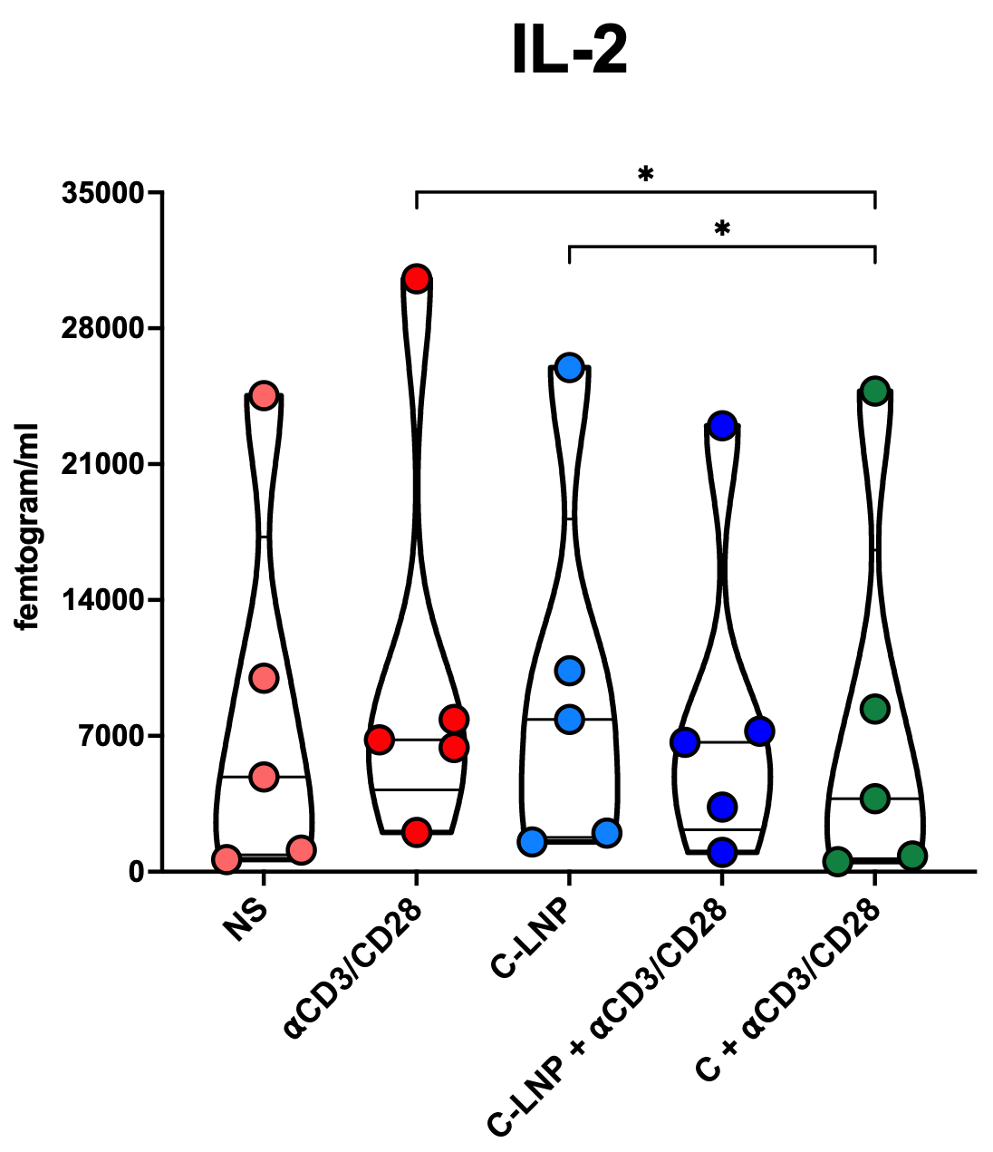
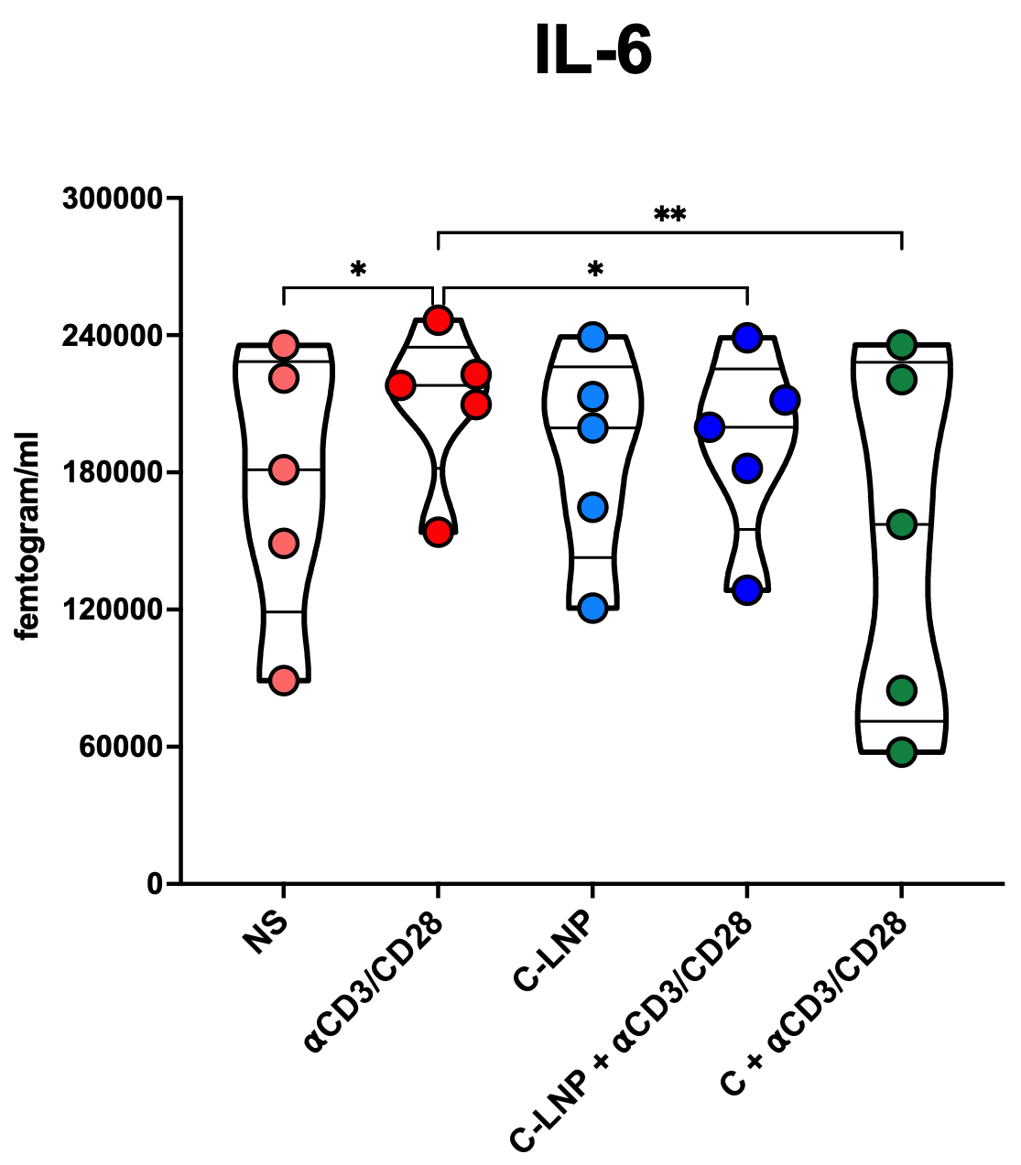
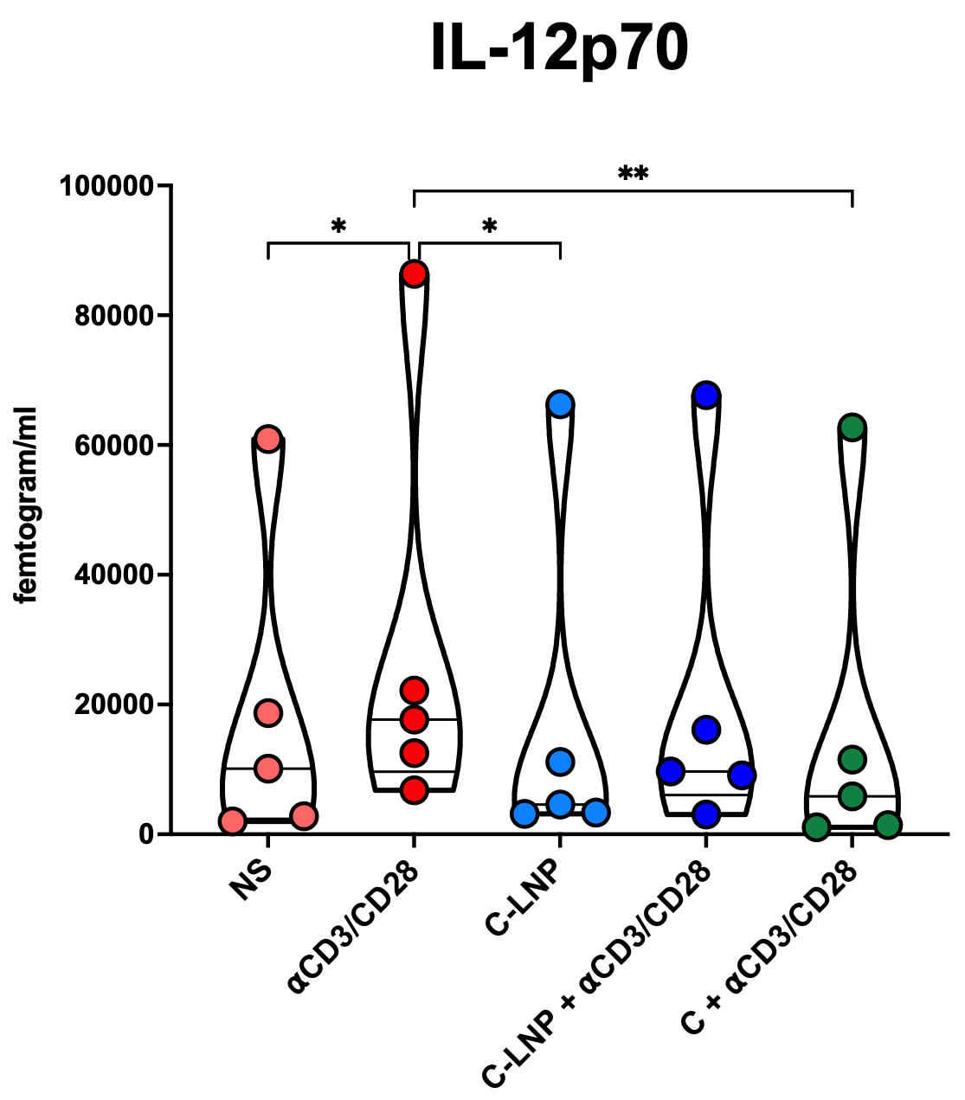
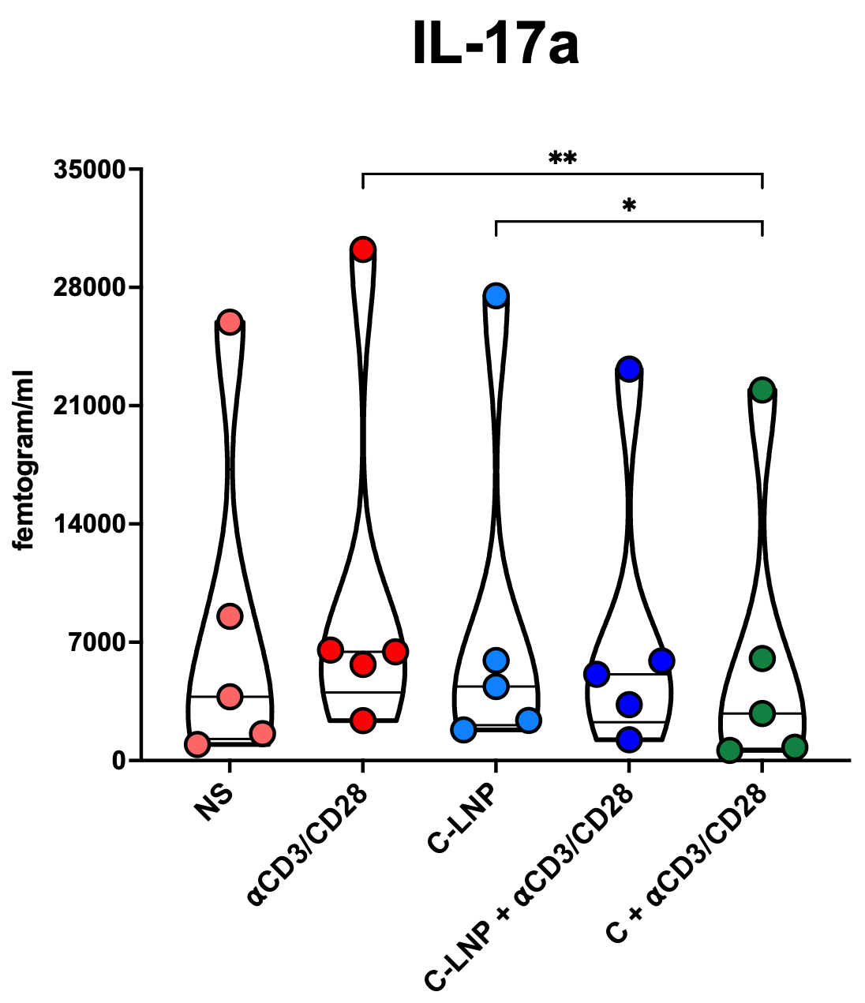
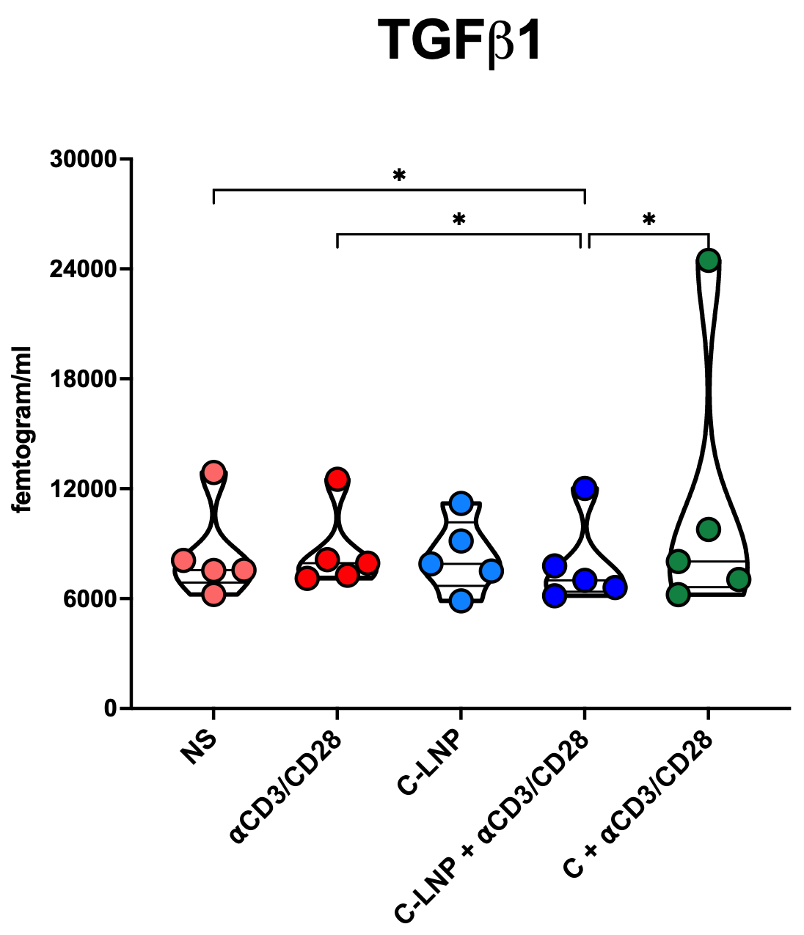
Curcumin Solid Lipid Nanoparticles and free Curcumin activate innate immune cells and reduces exhaustion markers and pro-inflammatory cytokines in humans
Sakthivel Govindaraj^{1,2}, Kadera Jana Lymon², Xiao Canhua³, Kaonga Nadi², Kamili Nourine², Martin D Souza⁴, Lisa Flowers*^{1,3} and Vijayakumar Velu*^{1,2}
¹Emory National Primate Research Center, ²Emory University School of Medicine, ³Winship Cancer Institute,
⁴Mercer University
EP_001
E
F
Objectives
Here we aimed to study the effects of curcumin formulations (Solid lipid nanoparticles (SLNPs) and free) on immune cells in humans.
Methods
Peripheral blood cells (PBMCs) were isolated from healthy donors and treated in vitro with curcumin-loaded solid lipid nanoparticles (SLNs) (10 µg/ml) or free curcumin (10 µg/ml) with and without TCR stimulations. Various innate and adaptive immune cells were monitored post-treatment using high-dimensional multi-color flow cytometry, and the cytokines of the supernatants were measured using the Mesoscale Discovery (MSD) platform.
A
Results
G
H
B
C
I
J
D
K
L
M
N
O
P
Q
R
Curcumin treatment significantly altered the immune cell function and cytokine levels in healthy individuals: (A) Representative plot for activation of classical monocytes. (B) A violin plot represents the frequency of activated classical monocytes. (C) Activated intermediate monocytes. (D) activation of neutrophils. (E) CD80+ Non-classical monocytes. (F) CD86+ Neutrophils. (G) CD80+ Myeloid DCs. (H) CD80+ Plasmacytoid DCs. (I) PD-L1+ Classical monocytes. (J) Frequency of PMN-MDSCs. (K) Concentration of TNF⍺; (L) IFN𝛄; (M) IL-1a; (N) IL-2; (O) IL-6; (P) IL-12p70; (Q) IL-17a; and (Q) TGFβ1 from culture supernatant (Mesoscale discovery).
Results & Conclusions
Curcumin increased activation of monocytes, neutrophils, and dendritic cells, while reducing PMN-MDSCs and PD-L1 expression
MSD analysis revealed reduced levels of pro-inflammatory cytokines (IFN-γ, TNF-α, IL-2, IL-17α, IL-1α, IL-12p70, and IL-6) with increased levels of anti-inflammatory cytokine TGF-β1, indicating heightened anti-inflammatory properties.
Overall, curcumin improves immune cell functions while mitigating anti-inflammatory properties, supporting its therapeutic potential.
Acknowledgements
Funding Disclosure/Acknowledgements: NIH/NIAD, R01CA285198, R01DE032243 U54CA302465, CFAR R03, Georgia CORE
Vijay Velu’s Lab, Lisa Flower’s Lab, Canhua Xiao’s Lab, & CFAR Flow Core.
Correspondence: Vijayakumar Velu- email @ vvelu@emory.edu and Lisa Flowers email @ lflowe2@emory.edu

